Slide 1
APRIL 2026
IBM
HORIZON BCBS
Horizon Operations
Talent Transformation Plan
Product-Aligned
AI-Assisted
AIOps-Driven
Product-Based Talent Strategy for AI-Led Operations
DevSecOps
Healthcare Domain
PORTAL ACCESS FOR REFERENCE
URL: https://horizon-payer.replit.app (CareOps360 Portal)
User: exec@horizon.com Pwd: Horizon&IBM2026
Path: Dashboard → Capability Uplift → Talent Plan
CONFIDENTIAL
IBM Confidential
Horizon Operations Talent Transformation Plan
1 / 8

Slide 2
EXECUTIVE SUMMARY
IBM's Talent Transformation Strategy
01
02
Shift to Product-Based Operations
Embed AI, AIOps, and Automation
Move from role-based application support to product-aligned teams with end-to-end ownership of business outcomes.
Bake GenAI, agentic workflows, AIOps and DevSecOps into the operating model — not as add-ons, but as defaults.
03
04
Upskill 391 Resources Across the Stack
Faster Delivery, Higher Resiliency, Lower Cost
Structured 6-month plan covering technology, healthcare domain depth, and AI-first ways of working.
Predictable releases, fewer incidents, automated remediation, and re-investable run savings — measured in business KPIs.
IBM Confidential
Horizon Operations Talent Transformation Plan
2 / 8

Slide 3
SLIDE 03 · CURRENT STATE
Current Workforce Composition
391
322
69
160
104
49
Total Resources
Offshore
Onshore
Developers
Ops Engineers
Tech Leads
Onshore vs Offshore
Role Distribution
IBM Confidential
Horizon Operations Talent Transformation Plan
3 / 8

Slide 4
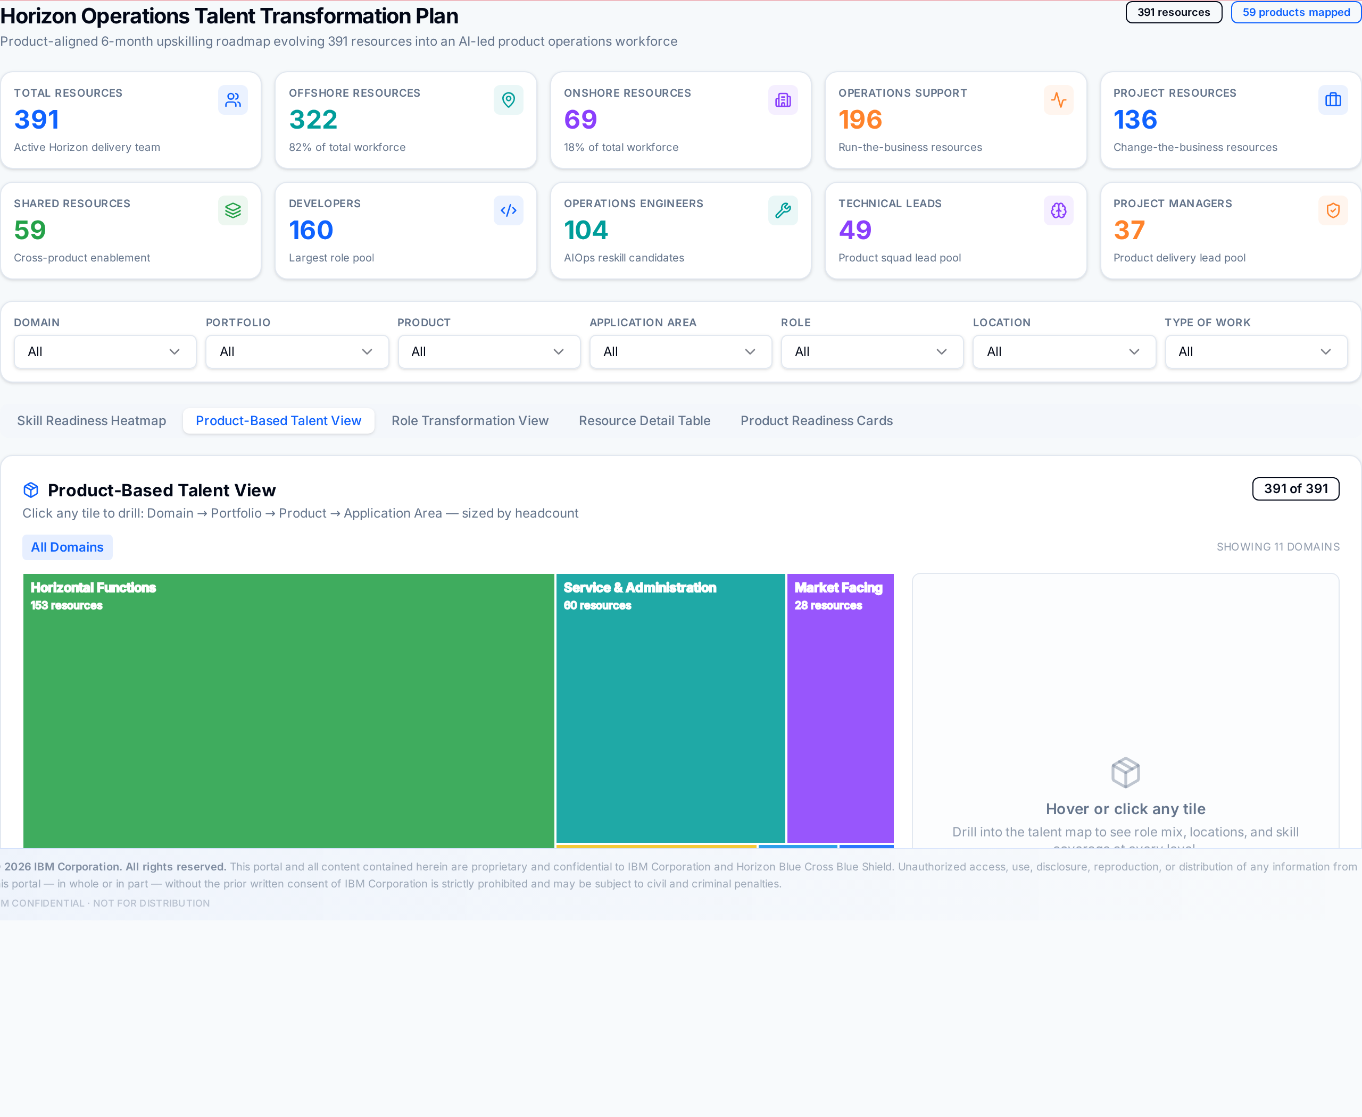
SLIDE 04 · ALIGNMENT
Shift to a Product-Centric Operating Model
Hierarchy of Ownership
DOMAIN
Top-level business areas (Health & Network, Service & Admin, Specialty, ...)
PORTFOLIO
Bundles of related products inside a domain.
PRODUCT
The unit of ownership — long-lived, business-aligned.
APPLICATION AREA
The technology surface a team operates and evolves.
Each resource is aligned to a product and application area to enable end-to-end ownership.
IBM Confidential
Horizon Operations Talent Transformation Plan
4 / 8

Slide 5
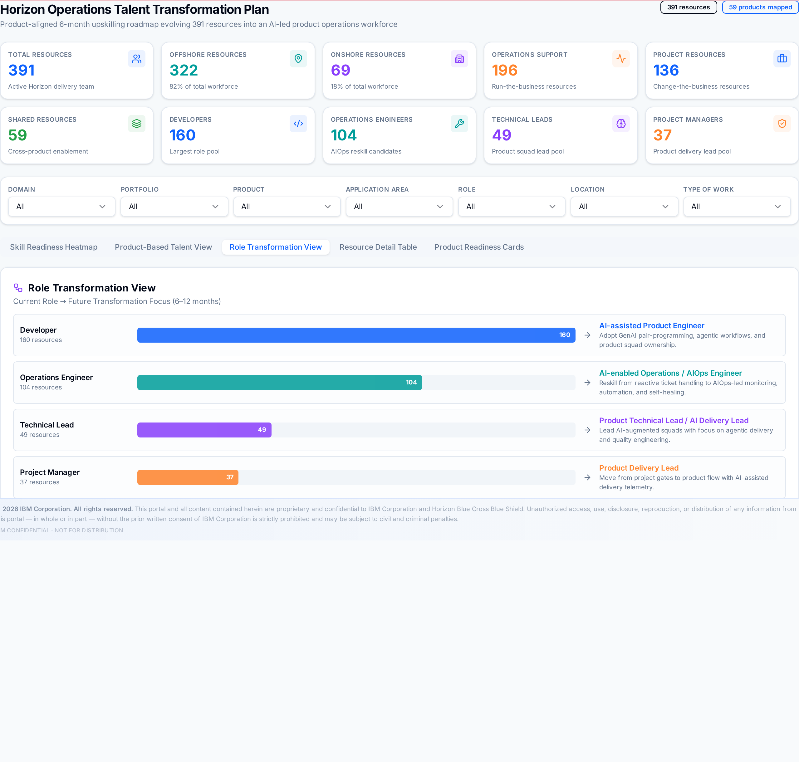
SLIDE 05 · ROLE TRANSFORMATION
Evolving Roles for AI-Led Operations
From → To Role Mapping
CURRENT
TARGET (AI-LED)
Operations Engineer
AIOps Engineer
CURRENT
TARGET (AI-LED)
Developer
AI-Assisted Product Engineer
CURRENT
TARGET (AI-LED)
Technical Lead
AI Delivery Lead
CURRENT
TARGET (AI-LED)
Project Manager
Product Delivery Lead
Plan covers all 391 resources, with role-specific upskilling and certification paths.
IBM Confidential
Horizon Operations Talent Transformation Plan
5 / 8

Slide 6
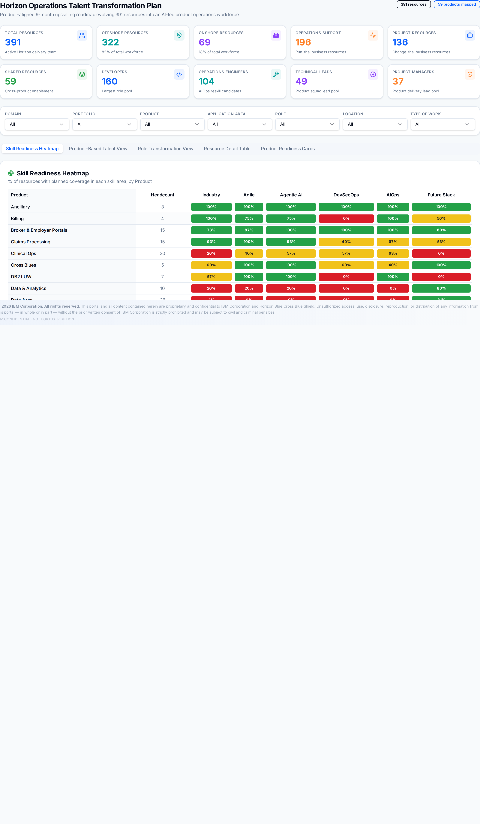
SLIDE 06 · SKILL READINESS
Current Skill Baseline and Gaps
Live view — Skill Readiness Heatmap
Where the gaps are
Agentic AI
Foundational — needs structured GenAI + Watsonx upskilling.
AIOps
Limited operational depth — required for zero-touch ops.
DevSecOps
Inconsistent across teams — bake into all engineering paths.
Healthcare Domain
Industry depth varies — universal Horizon onboarding.
Structured upskilling required to unlock AI-driven operations.
IBM Confidential
Horizon Operations Talent Transformation Plan
6 / 8

Slide 7
SLIDE 07 · ROADMAP
Structured 6-Month Upskilling Plan
Phase 1 · 0 — 2 Months
Phase 2 · 2 — 4 Months
Phase 3 · 4 — 6 Months
Healthcare Industry Jumpstart
GenAI + Watsonx fundamentals
AIOps implementation (observability, anomaly detection)
Agile foundations (CSM, Agile Explorer)
Prompt engineering & agentic workflows
Automation use cases (zero-touch run)
Product & domain familiarization
DevSecOps basics (CI/CD, security gates)
AI-enabled operations workflows in production
IBM Confidential
Horizon Operations Talent Transformation Plan
7 / 8

Slide 8
SLIDE 08 · FUTURE STATE
AI-Enabled Product Operations Model
01
02
03
04
05
Product-Aligned Teams
AI-Assisted Delivery
AIOps-Driven Operations
DevSecOps Automation
Healthcare Domain Depth
End-to-end ownership across business + tech.
GenAI co-pilots embedded in every engineering flow.
Predictive, self-healing run with zero-touch SLAs.
Secure-by-default pipelines, policy as code.
Industry fluency built into every team.
IBM's approach ensures Horizon's workforce is future-ready, scalable, and aligned to deliver measurable business outcomes in an AI-first operating model.
IBM Confidential
Horizon Operations Talent Transformation Plan
8 / 8

