Slide 1
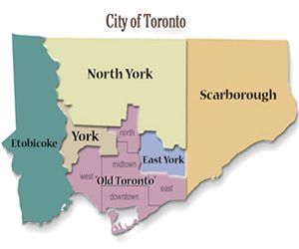
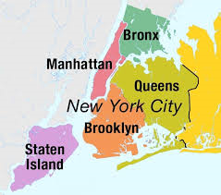
Capstone Project The Battle of Neighborhoods (Week 2)
To explore and analyze
The venues of neighborhoods of New York City and City of Toronto
Using Four Square Venue data
Lakshminarayana D
LNEPDS019@gmail.com

Slide 2
Table of Contents
Introduction & Background
Business Problem & Target Audience
Data Source
Methodology and Exploratory Data Analysis
Results and Discussion
Conclusion

Slide 3
1. Introduction
To explore and analyze, the venues of the neighborhoods of New York City and City of Toronto using Four Square Venue data to ensure the ease of decision making.
Background
At times when we are visiting or moving to a new city, it becomes very difficult to discover or to choose restaurants, stores and other local business venues at the neighborhoods from user perspective and to start up a venue from a business point of view. Decision making will be a huge task with lot of criteria in mind to select the venue based on distance, price tier, ratings and sometimes we often stuck at certain stages in deciding. In which the user contributions will also been an important element such as user likes of a venue, upload of venue photos by the user and user tips of a venue, which will be counted to the comparisons and the decision that we finally make out.
About the two cities
New York City is made up of five major areas or “boroughs” sitting where the Hudson River meets the Atlantic Ocean. some separated by rivers and connected via ferry or bridge. The five boroughs of New York are Manhattan, Brooklyn,
Queens, Staten Island and the Bronx.
Toronto is a city of neighborhoods. each with its own style, vibe and scene. One thing Toronto doesn’t have a shortage of is shopping, whether it be outlet shopping, thrift or on trend pieces, there’s a neighborhood for it. The neighborhoods are East York, Etobicoke, North York, Old City of Toronto, Scarborough and the York

Slide 4
2. Business Problem & Target Audience
Business Problem
To explore four-square venue data, to get new insights to recommend venue owners to start a new venue. To compare and conclude the better city on venues. To cluster & segment the venues to enhance user experience on selecting the
venues basis the below analysis.
•To compare and distinguish venue similarities of the two cities using frequency distribution all columns with percentile and by various methods, parameters.
•To analyze if there is any correlation exist between the user likes, rating, price tier, tips, photos and distance.
•To perform clustering and segmentation for the venues based on four square venue details.
Target Audience
Business personnel who wants to startup a new venue, this analysis will provide a detailed insight. Stakeholders to add new venues to the site in the respective locations having NIL venues in the categorical segment.
The analysis will give business owners an insight of the user behavior, patterns and trends, which will be useful to enhance their business or to revisit the existing business model. The stakeholders both internal and external will be benefited on the venue clustering and segmentation.

Slide 5
3. Data Source
To download the data from the below links to create the dataset
1. Wikipedia: To download cities neighborhood list. Links given below,
Link 1: New York City : https://en.wikipedia.org/wiki/Neighborhoods_in_New_York_City
Link 2: City of Toronto : https://en.wikipedia.org/wiki/Demographics_of_Toronto_neighbourhoods
2. Geopy Library: To download location coordinates, latitude & longitude.
3. FourSquare: To download places data & Augment basic venues details
a: Link 3 using Lat & Long: https://api.foursquare.com/v2/venues/explore?
b: Response details: Venue ID, name, category, id, address, distance, lat and lng.
c: Limit: 100
a: Link 4 using Venue ID: https://api.foursquare.com/v2/venues/{}?
b: Response details: likes.count, photos.count, rating, ratingSignals,
reasons.count, tips.count, verified and price.tier
c: Limit: 50

Slide 6
4. Methodology and Exploratory Data Analysis
Methodology
In line with the problem statement, the methods mentioned below are used to bring the insights as a resultant to our decision making.
• In the exploratory data analysis, we have used the frequency table for each city to analyze the neighborhood percentile, venue category location wise spread to analyze new venue opportunities and enhancements
• Data visualization methods applied such as seaborn bar plot, strip plot and regression plots to identify the strength and correlation between key entities.
• K-Means cluster algorithm used for venue segmentation, Elbow method used to identify number of clusters, k-means prediction algorithm used to generate the cluster labels for each record in the dataset. Scatter plot used for graphical visualization and python folium library utilized to generate visualization on maps using their respective venue location coordinates.

Slide 7
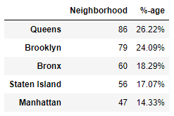
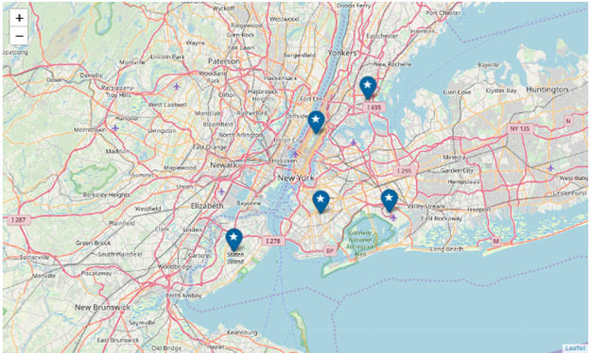
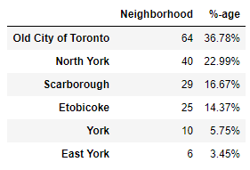
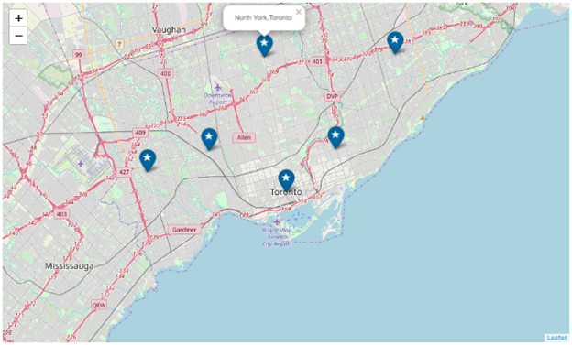
4.1 The Neighborhood Comparison.
New York City
Observations Toronto New York
No of boroughs 6 5
No of neighborhood 174 328
Average neighborhood/borough 29 67
Top 3 neighborhood count and % 133(76%) 225(67%)
*New York City neighborhood count is 47% higher
when compared to Toronto City
City of Toronto

Slide 8
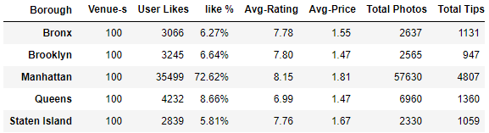
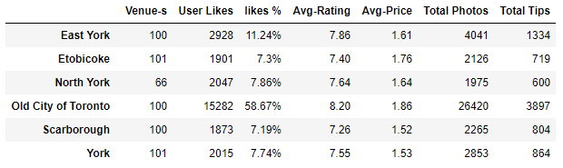
4.2 Venue Comparison
New York City
City of Toronto
Observation
New York City Venue user likes are higher by 47% compared to Toronto City
New York City Venue user photo count are higher by 45% and user tips are higher by 12% compared to Toronto.
Average rating of a venue is similar for both the cities, marginal difference found by 0.05.
Average price tier for both the cities are similar with marginal difference of 0.06.
Similarity: There is only 1 location for both the cities contributing more than 55% on user likes, photo count and user tips.
Old City of Toronto with 59% user likes and Manhattan with 73% user likes are the highlights of these two cities.

Slide 9
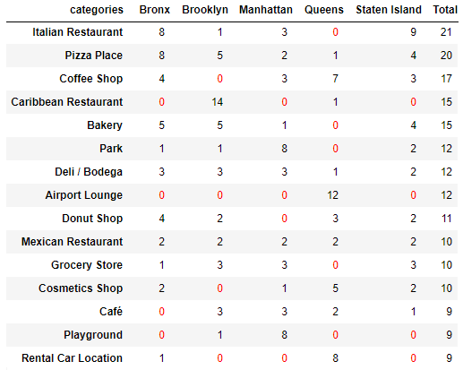
4.3 New York City - Top 15 Categories Venue count
Observation
Top 5 venue are under pizza place, coffee shop, Italian & Caribbean restaurant. Queens doesn’t have bakery, grocery, park & Italian restaurant venues.
Business Opportunities
We have observed zero venues at certain location and categories, business owners can start up new venues at these categories.

Slide 10
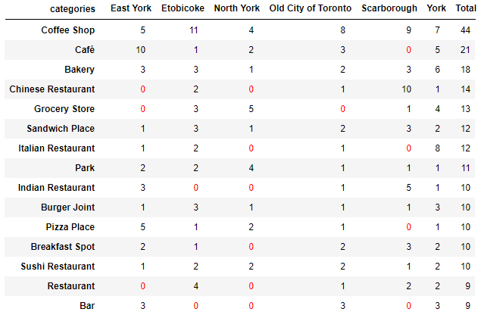
4.4 Toronto City - Top 15 Categories Venue count
Observation
1. Top 5 venue categories are coffee shop, bakery, Chinese restaurant and grocery stores.
2. Coffee shops, bakery, sandwich, park, sushi and burger joints are found across all locations.
3. Scarborough has the highest number of Chinese Restaurant and Coffee shops.
4. Grocery venue found only at North York and Etobicoke. New venues can be opened.
5. York location has the maximum no of Italian Restaurants and all venue categories are present.
Business Opportunities
We have observed zero venues at certain location and categories, business owners can review the same to start up new venues based on these categories

Slide 11
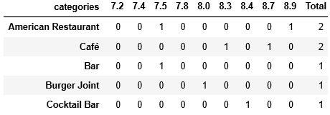
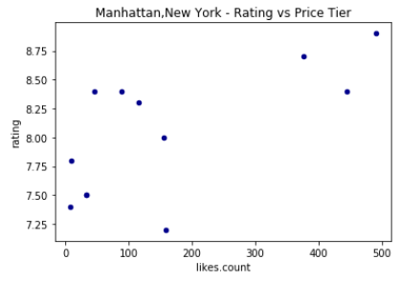
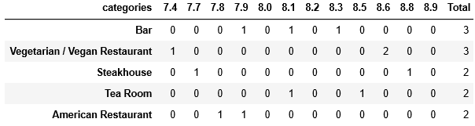
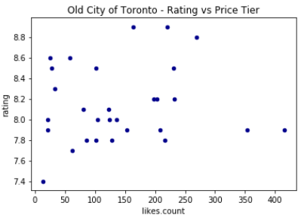
4.5 To analyze price tier 2: User likes vs Rating on venue categories of Manhattan and Old City of Toronto
Manhattan, New York City
Observation
At Manhattan location, American restaurant has the highest rating toping the list with two venues.
Burger Joint and Bars has lesser rating which is less than and equal to 8.0.
The scatter plot indicates as the user likes increases the ratings also increasing.
Old City of Toronto
Observation
In the old city of Toronto. Bar, vegetarian restaurant, steakhouse tops the list based on total venues.
The two American restaurants having less than 8.0 ratings when compared to the vegetarian restaurant having rating at 8.6. Scatter plot indicates higher the likes higher the ratings, barring the two outliers at 350 and 400

Slide 12
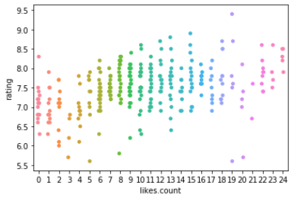
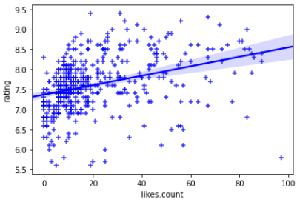
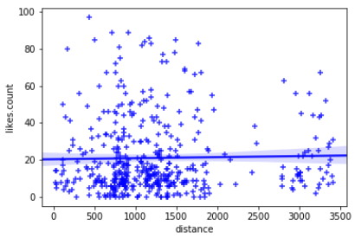
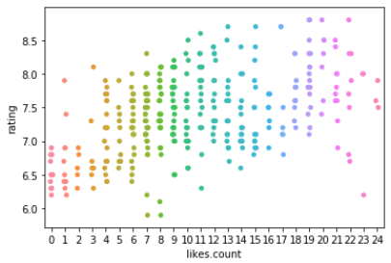
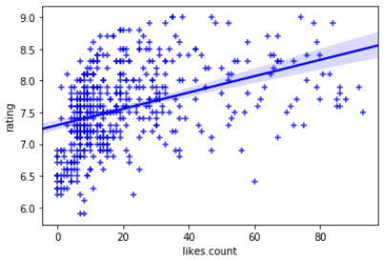
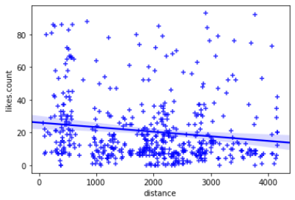
4.6 Correlation between Rating, User Like and Distance
New York City
City of Toronto
Observation:
The above regression plot indicates, there is a Positive relation between User Likes and Rating for both the cities and
there is Negative relation between Distance and User likes.

Slide 13
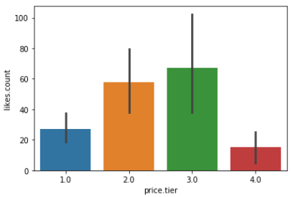
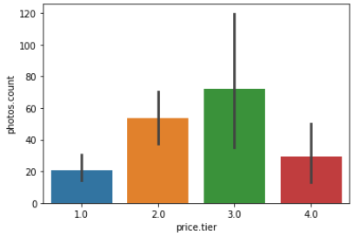
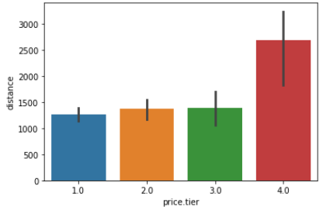
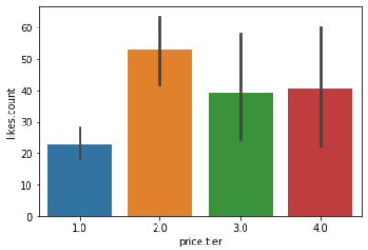
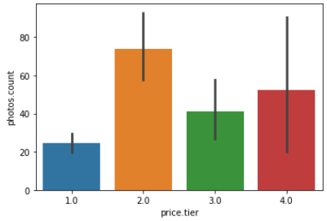
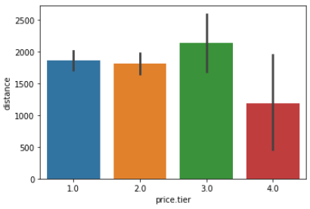
4.7 Bar Plot analysis on Price Tier vs User Like, Photos and Distance
New York City
City of Toronto
Observation on Price Tier vs User likes, Photo and Distance.
NYC user likes are higher for price tier 3.0. Toronto user likes are higher for price tier 3.0
NYC photo count are higher for price tier 3.0. Toronto user likes are higher for price tier 3.0
NYC distance are higher for price tier 4.0. Toronto distance are higher for 3.0

Slide 14
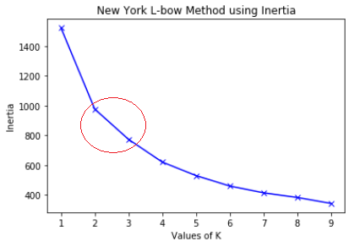
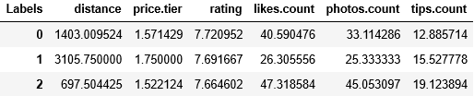

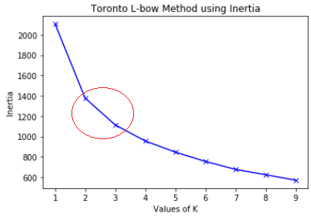
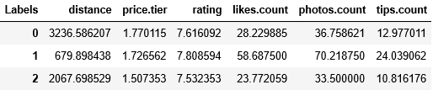

4.8 K-Means Clustering
New York
Summary of the Centroid(“Labels”) based on mean values of the clusters
Prediction Count
Toronto
Summary of the Centroid(“Labels”) based on mean values of the clusters
Prediction Count
Observation:
Number of Clusters are provided based on Elbow method, in the graph, cluster range indicates between 2 and 3
Venues are fitted into three clusters and each cluster are similar to each other in terms of the features included in the dataset.

Slide 15
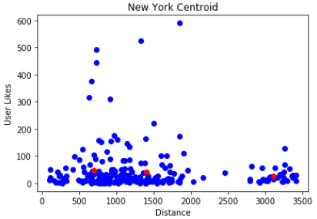
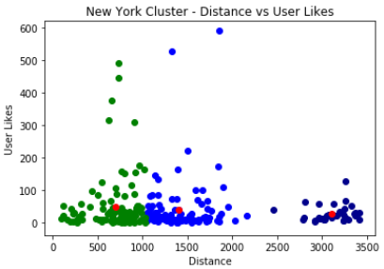
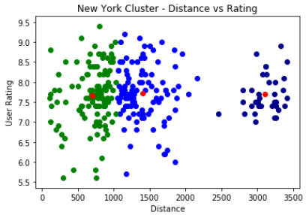
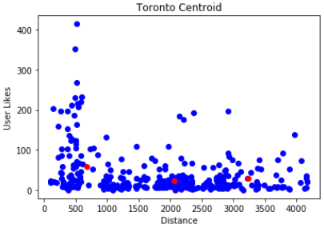
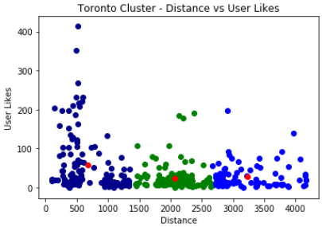
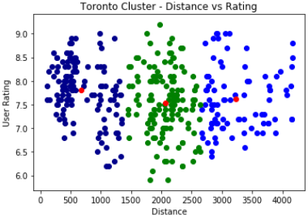
4.8 K-Means Clustering - continued
Observation:
User Likes: The maximum user likes spread lies between the range 0 to 200 for both the cities.
Rating: The maximum rating spread lies between the range 7.0 to 8.5 closer to the centroid for both the cities.

Slide 16
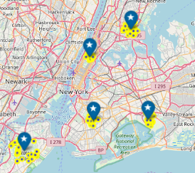
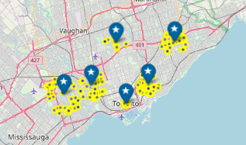
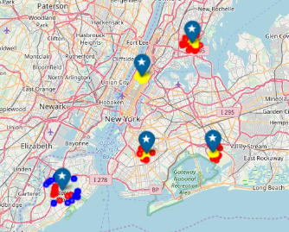
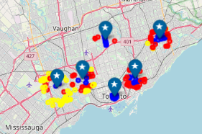
4.8 K-Means Clustering - continued
New York City
City of Toronto
<< Before Clustering
<< After Clustering

Slide 17
5. Result and Discussion
Results
The summary of the exploratory analysis of the two cities are plotted below
New York City has high neighborhoods which is 47% higher compared to Toronto City.
New York Venue has 48.8K user likes higher by 47% compared to Toronto 26K user likes.
The major contributors of user likes are Manhattan with 73% and old city of Toronto 59%.
Compared to Toronto, New York Venue User Tips higher by 12% and Photo count by 45%.
The average rating and price tier are Similar for both the cities with marginal difference.
Similarities for both the cities, where there is a positive correlation between venue user likes vs rating and negative correlation between distance vs user likes.
New York user likes and photo count are higher for price tier 3.0 and for Toronto its 2.0
Clustering of Venues created based on user likes, price tier, rating, distance, photo count, the number of clusters are 3 which is similar for both the cities using Elbow method.
The centroid mean value for price tier is similar for both cities with value 1.5 and 1.7 and the mean value for ratings are similar for both cities with the range 7.5 to 7.8
The clustering w.r.t user likes and distance, the maximum user likes found between the range 0 to 200 for both cities
Similarly, the clustering w.r.t rating and distance, the maximum rating found between the range 7.0 to 8.5 for both the cities.
Discussion
we have observed the significance of venue user likes, photo count and user tips. The descriptive analysis of the venue categories location wise shows, how the top categories of the venues distributed across locations and the findings provides a clear indicator to recommend business owners to startup new venues where there are no venues at certain locations and category for both the cities.
In comparing the venues of the two cities, Manhattan, New York city and Old City of Toronto, Toronto are the major stakeholders, Manhattan with 73% user likes and Old City of Toronto with 59% user likes and both the location with an average rating at 8.1 and average price tier at 1.86 will be the highlight to their respective cities. In the bar plot visualization, we have observed user likes and photo count are in higher side at the venues having price tier 3.0 at New York City and price tier 2.0 at City of Toronto.
And we have also observed similarities in our regression plots on user likes and ratings for both the cities. The visualization shows positive correlation, when the user likes increase’s the rating also is in increasing trend for both the cities and also visualized a negative correlation in terms of user likes and distance for both the cities. In clustering of venues, we have observed the maximum user likes found between the range 0 to 200 for both the cities w.r.t user likes and distance and also maximum rating found between range 7.0 to 8.5 w.r.t rating and distance for both the cities, which indicates the centroids of the cluster may change whenever there is a change in the user likes at the venues.

Slide 18
6. Conclusion
In this exploration, we have analyzed the effectiveness of venue user likes, photo count, user tips, distance and rating. We have compared the venues at both the cities and analysis revealed strong similarities on the venue user likes and ratings for the both the cities and dissimilarities when compared with distance and user likes.
Our descriptive analysis suggested the opportunities as how new business owner can startup new venues and the clustering of venues showed how users can choose venues of their preference to improve user experience at the venues.
The visualization of regression plots showed us a positive correlation with user likes and rating. The observation of various analysis showed the significance of user likes which is an important metric in rating the venues.
We have analyzed the venues of both the cities at various parameters, there are similarities and dissimilarities observed at both the cities. The venues of New York City when comparted to Toronto is higher at certain aspects of our analysis, basis the analysis we conclude New York City Venues are better than Toronto City.
The exploration and analysis have been performed based on Sample Venue data and regardless of the above results and conclusions, we recommend the future analyst to explore and analyze the entire population of the Venue data to get more insights, more positive outcomes and to bring significant improvements to the venue owners and as well as to the users.

Slide 19
Thank You

