Slide 1
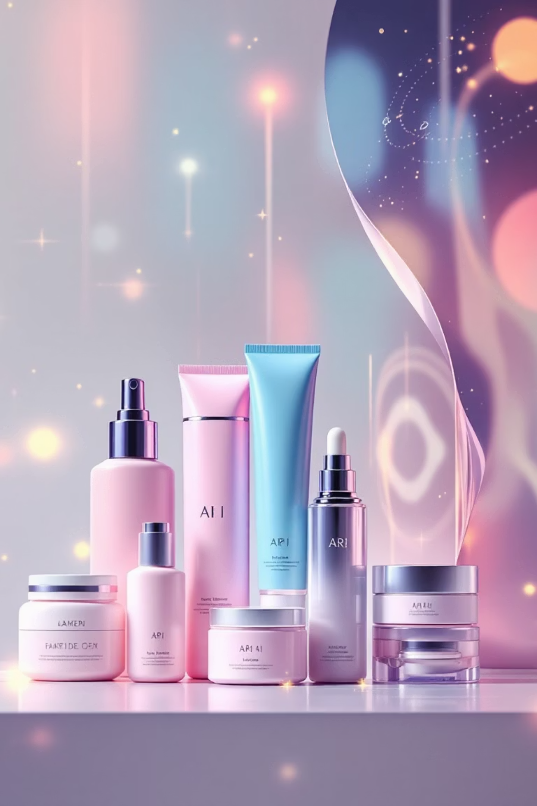
AI-Powered Beauty: Transforming Cosmetic E-Commerce
Exploring AI applications in e-commerce marketing for female cosmetics across global, regional (East Africa), and local (Kenya) markets.
DAUDA ABDULAI 673334
JANUARY 23, 2026
FELICHER MINAH ODHIAMBO 671620

Slide 2
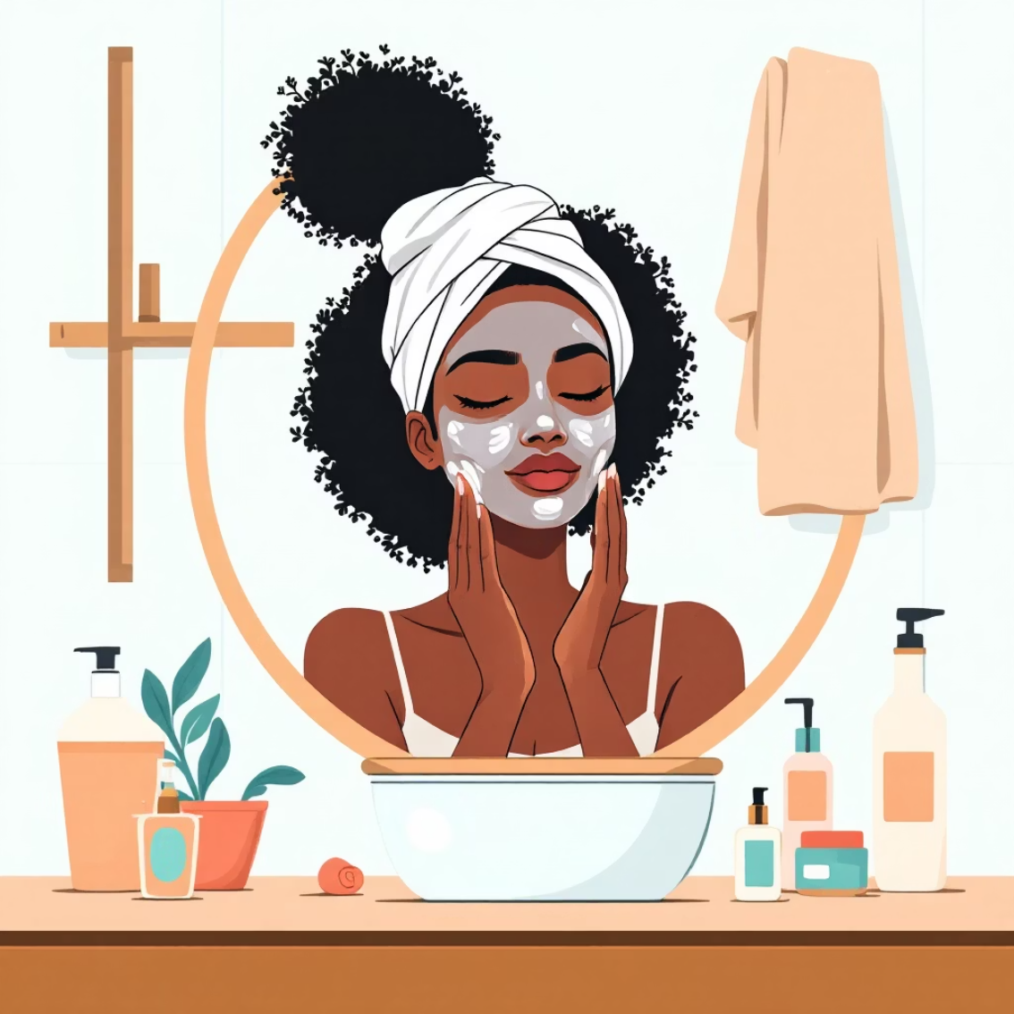
INTRODUCTION
The AI Beauty Revolution
The Challenge
The global beauty industry represents a hyper-competitive $500B+ market, while Kenya's cosmetic e-commerce sector is experiencing explosive growth at 25% annually. Success demands personalized, scalable marketing solutions that can adapt across diverse markets.
Our Three-Tier Approach
Global Level: Worldwide brand strategy and operational excellence
Regional Level: East African market optimization and cultural adaptation
Local Level: Kenya-specific customization and hyper-targeting
Our focus spans female cosmetics including skincare, makeup, and haircare products tailored to diverse consumer needs.

Slide 3
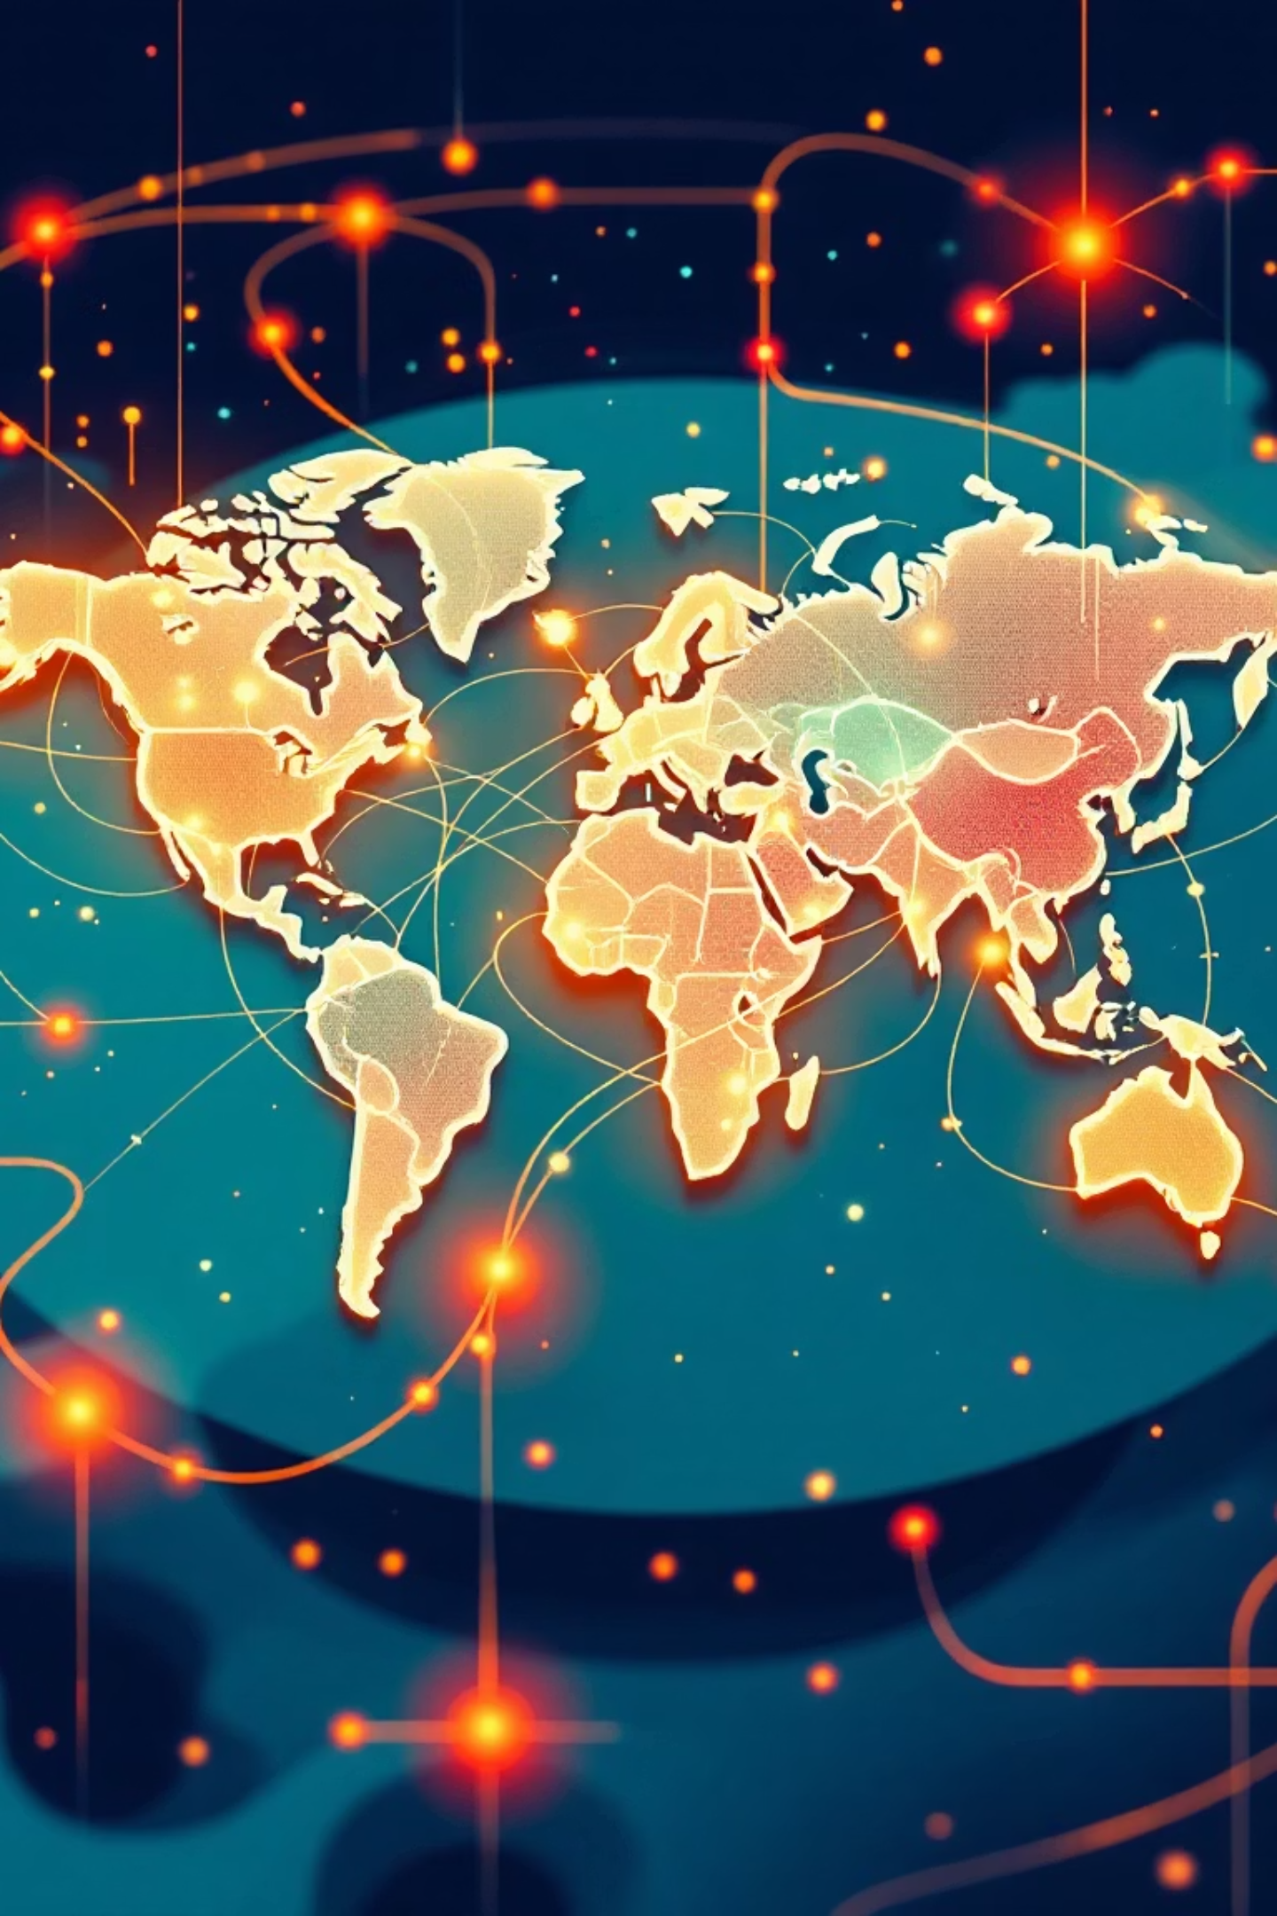





GLOBAL APPLICATIONS
Worldwide AI Strategies for Beauty Brands
Global Trend Forecasting
AI analyzes social media, runway shows, and search data worldwide to predict next season's colors, formulations, and ingredients with zero-error data aggregation.
Cross-Border Personalization
Unified customer profiles across 150+ countries enable AI to adjust recommendations based on climate, culture, and local preferences automatically.
Autonomous Influencer Matching
AI scans millions of influencers globally, matching brand aesthetics with ideal audience demographics through error-free data analysis and scoring.
24/7 Campaign Management
AI orchestrates simultaneous campaigns across time zones with autonomous budget reallocation based on real-time performance metrics.

Slide 4

REGIONAL FOCUS
AI for Pan-African Beauty Marketing
East Africa's unique market characteristics demand specialized AI adaptations that respect cultural nuances, leverage dominant platforms, and optimize for regional infrastructure.
1
2
Skin Tone & Climate AI
Social Commerce Optimization
Algorithms trained on diverse East African skin tones deliver climate-aware product recommendations factoring humidity and UV levels, achieving zero-error color matching via computer vision.
AI optimized for Instagram and WhatsApp commerce dominance, featuring automated chat-based consultations via WhatsApp Business API and Swahili language chatbots for seamless customer service.
3
4
Cross-Border Logistics AI
Cultural Event Marketing
Optimizes shipping and inventory across Kenya, Tanzania, and Uganda while predicting demand spikes during regional events and adjusting pricing for duty and tax differences.
AI maps regional festivals, holidays, and cultural moments to auto-generate culturally relevant campaigns for Eid, Jamhuri Day, and regional beauty pageants.

Slide 5

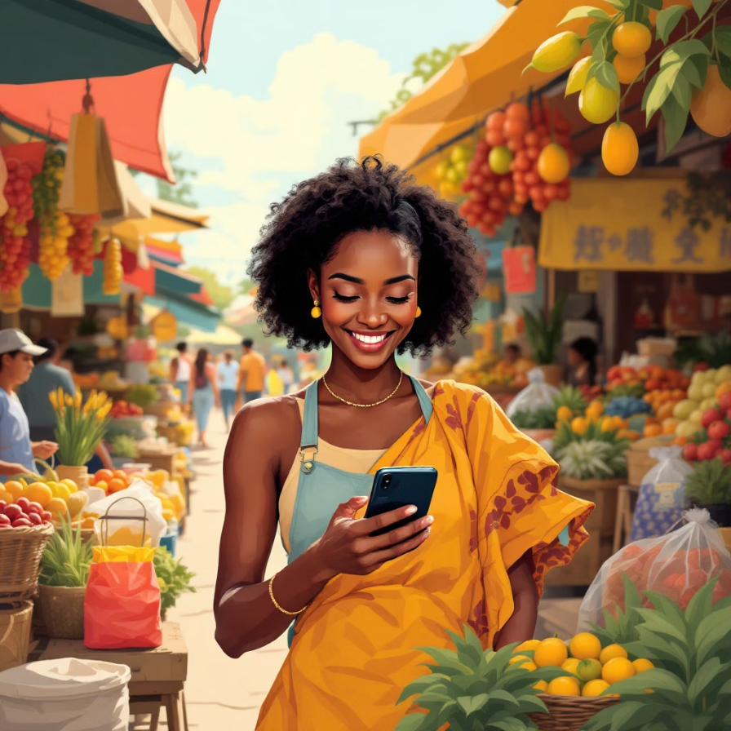

LOCAL IMPLEMENTATION
Hyper-Local AI for Kenyan Beauty Consumers
01
M-Pesa Integration & Optimization
AI optimizes payment flows for Kenya's dominant mobile money system with predictive cashback offers based on transaction history and zero-error fraud detection.
02
Regional Customization
Separate AI models serve urban Nairobi with premium, trend-focused products and coastal regions with humidity-resistant, halal cosmetics, adjusting messaging for local dialects.
03
Local Ingredient Highlighting
AI emphasizes Kenyan-sourced ingredients like aloe vera and marula oil, automatically generating content around local sourcing stories and partnering with local beauty bloggers.
04
Infrastructure-Aware Delivery
AI predicts delivery times based on Nairobi traffic patterns, rural area accessibility, and last-mile delivery optimization for reliable customer experience.

Slide 6
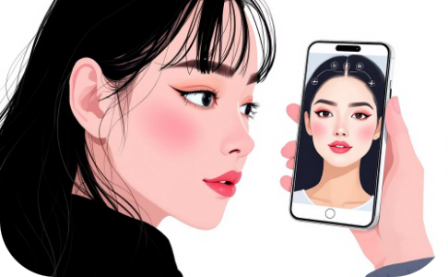
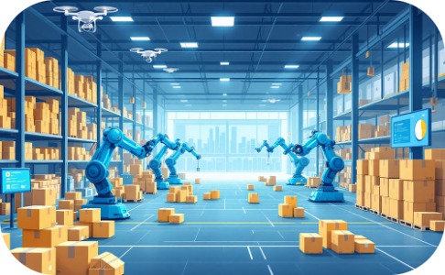
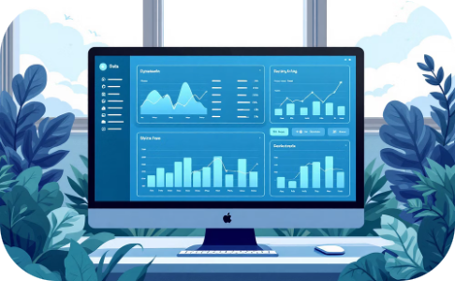
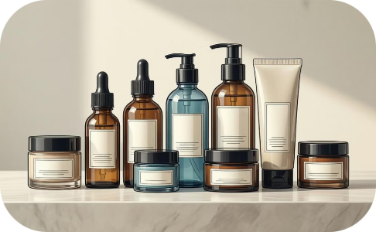



ZERO-ERROR DOMAINS
Fully Autonomous Systems & Scaling Strategy
Visual Try-On Technology
Automated Inventory Management
Dynamic Pricing Engine
Personalized Routine Builder
AR-powered virtual makeup testing with zero-error color rendering and facial mapping achieves 98% accuracy in shade matching versus human 75%.
Real-time price adjustment based on competitor pricing across 20+ Kenyan beauty sites, demand forecasting, and promotion effectiveness eliminates human pricing errors.
AI predicts demand at SKU level with autonomous reordering from global suppliers, eliminating calculation and prediction errors entirely.
AI creates complete skincare routines considering skin type, concerns, climate, and budget with zero-error ingredient compatibility checking.
Start in Kenya
Expand East Africa
Integrate Globally
M-Pesa optimized AI foundation
Swahili-speaking regional markets
Global beauty AI ecosystem

Slide 7
IMPACT ANALYSIS
Implementation & Measurable Benefits
AI delivers transformative results across all operational levels, from market responsiveness to conversion optimization. Our phased approach ensures sustainable growth and measurable ROI.
Level
AI Application
Expected Impact
Global
Trend Forecasting
40% faster to market with new products
Regional
Cross-border Optimization
30% reduction in regional logistics costs
Local (Kenya)
M-Pesa AI Integration
50% higher conversion rate vs. traditional checkout
Technology Stack
Computer Vision
Natural Language Processing
Virtual try-on and shade matching
capabilities
Swahili/English chatbots and content generation
Predictive Analytics
Reinforcement Learning
Inventory and demand forecasting systems
Dynamic pricing optimization algorithms
Months 1-3
Months 10-12
Deploy virtual try-on and basic chatbots in Kenya
Integrate with global trend forecasting platforms
1
2
3
Months 4-9
Implement regional inventory AI across East Africa

Slide 8




The Future of Beauty E-Commerce
AI enables beauty brands to achieve the ultimate "triple win" through strategic implementation that balances global efficiency, regional relevance, and local personalization.
Go Global with Local Insights
Scale Regionally with Cultural Intelligence
Use Kenyan data to inform global product development, position as a tech-forward inclusive beauty brand, and maintain AI systems that respect local nuances at scale.
Start Hyper-Local in Kenya
Leverage M-Pesa dominance with AI optimization, build trust through virtual try-on technology, and use AI to highlight Kenyan ingredients and authentic local stories.
Expand Swahili AI capabilities, adapt to regional beauty standards and preferences, and optimize cross-border African trade relationships for sustainable growth.
Final Insight: AI empowers beauty brands to deliver global efficiency through automation, regional relevance through adaptation, and local personalization through hyper-targeting.
Questions & Discussion

