Slide 1
IEEE International Conference on Communications
Towards Verified Security:
Formal Methods for LLM-Based Defenses
Daniel Daukševič
Prof. Dr. Roberto Magán-Carrión
Prof. Dr. Linas Laibinis Vilnius University
University of Granada
Glasgow
2026

Slide 2
Agenda
Problem & Motivation
Background & Contribution
System Architecture
Case Study
Results, Limitations & Future Work

Slide 3
Problem & Motivation
Cyberattack surface is constantly increasing
Human response is slow
LLMs can automate mitigation, but hallucinate
LLMs can propose solutions, a method of verifying their correctness is required
Notes:
particularly legacy medical and clinical device systems, patient safety and operational availability have traditionally been prioritized,
often at the expense of cybersecurity [5].
In recent years, due to the development of standards and regulations, cybersecurity has been increasingly recognized as an integral part of patient safety.
Security failures in healthcare are safety failures
blocked access to electronic medical records and patient management systems, was reportedly carried out via an external connection between the hospital and a third-party vendor.

Slide 4
Formal methods
Logic-based analysis
Automated property checking
Prove completeness
Notes:
The established principles of formal model-based development

Slide 5
Background
LLMs already used in intrusion detection & policy generation
Formal verification proven in avionics, automotive, security protocols
LLMs lack correctness guarantees; formal methods lack adaptability
Notes:
This motivates us to advance in the state-of-the-art workwith the following key contributions:1) A formal model of a computer network in TLA+, whichis used for verification of routing policies against thesecurity properties, is constructed and analysed;2) A methodology of verification of LLM-based suggesteddefenses preserving basic security services like availabil-ity is proposed;3) The practical application of the framework in a case studyhas been tested and validated as a proof of concept

Slide 6
Contribution
Formal model of a computer network
Methodology of verification of LLM-based suggested defenses
Practical application of the framework in case study
Notes:
This motivates us to advance in the state-of-the-art workwith the following key contributions:1) A formal model of a computer network in TLA+, whichis used for verification of routing policies against thesecurity properties, is constructed and analysed;2) A methodology of verification of LLM-based suggesteddefenses preserving basic security services like availabil-ity is proposed;3) The practical application of the framework in a case studyhas been tested and validated as a proof of concept

Slide 7
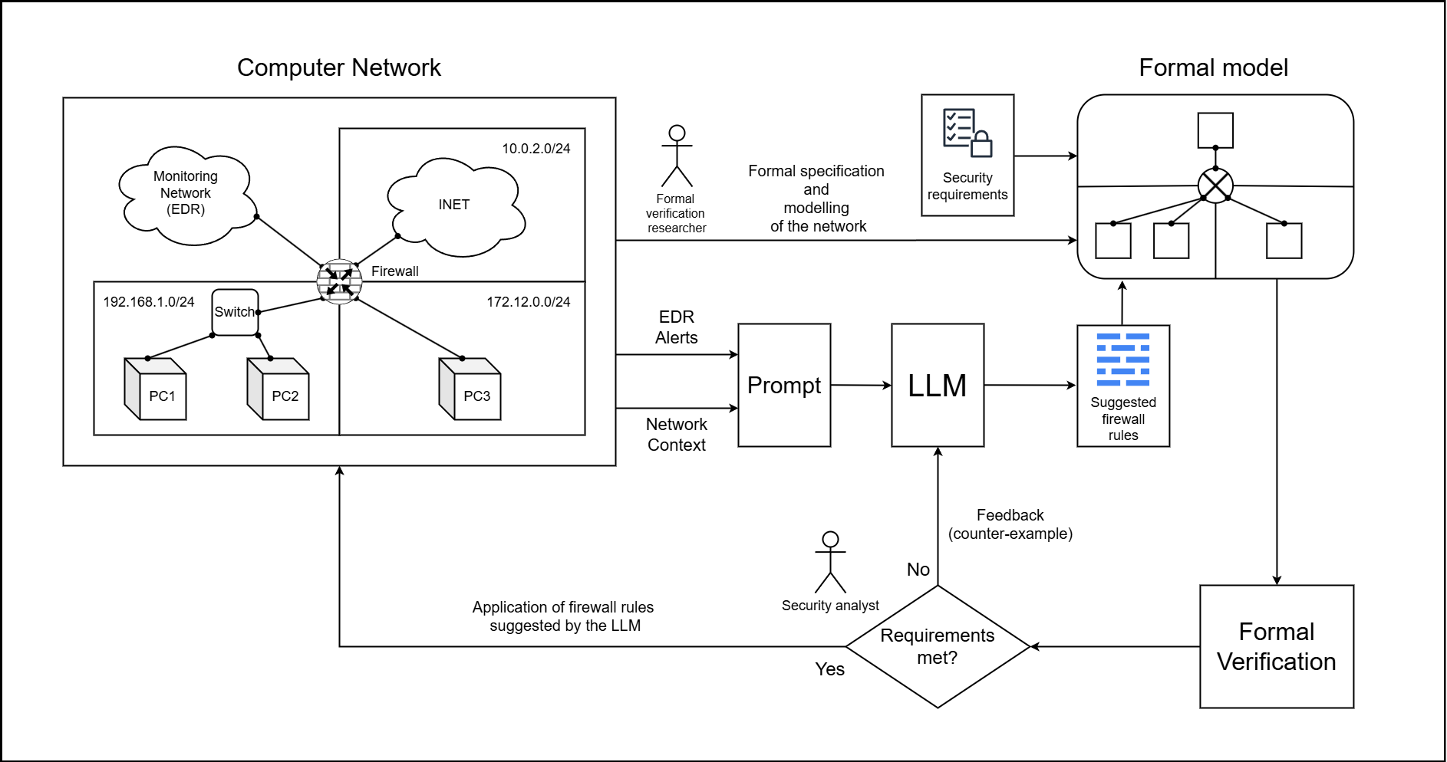
System architecture
Notes:
FV REVIEWER

Slide 8
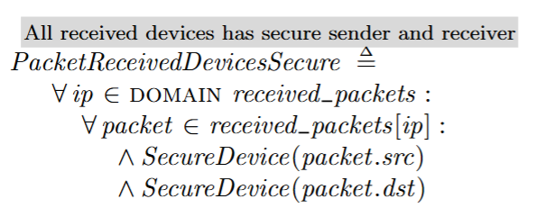
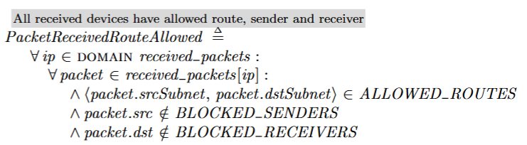
Security properties
Every data packet originating from or destined for the private network shall either be successfully routed to its intended destination (within the constraints of the firewall rules) or be explicitly dropped by the firewall based on the defined rules and default policy
Notes:
FV REVIEWER

Slide 9
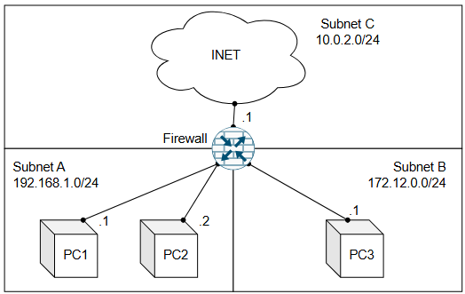
Case study
Notes:
FV REVIEWER

Slide 10

Case study
Notes:
FV REVIEWER

Slide 11
Case study
Notes:
FV REVIEWER

Slide 12
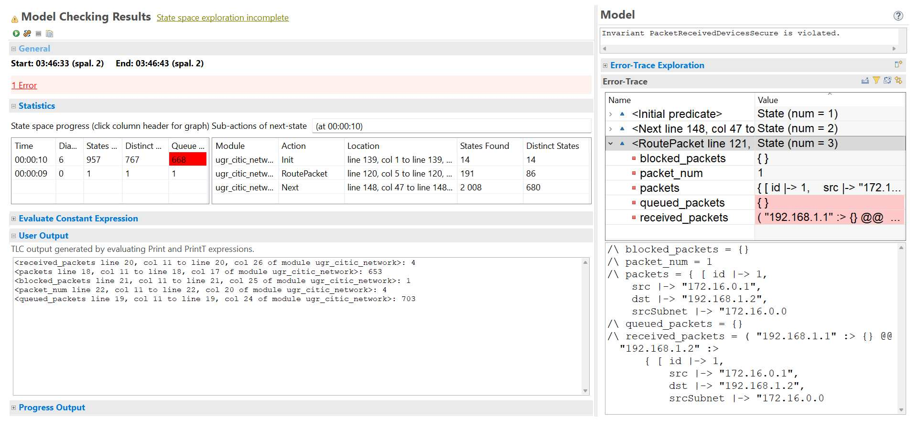
Case study
Notes:
FV REVIEWER

Slide 13
Case study
Notes:
FV REVIEWER

Slide 14

Case study
Notes:
FV REVIEWER

Slide 15
Case study
Notes:
FV REVIEWER

Slide 16
Results
Framework demonstrated end-to-end on a real case study
Formal verification closes the LLM correctness gap
Notes:
The established principles of formal model-based development

Slide 17
Limitations
Simplified, abstract model and generalized to larger-scale networks
Human interaction needed
Notes:
The established principles of formal model-based development

Slide 18
Future work
Larger topologies
Broader attack types
Formal model refinement
Increasing the automation level
Notes:
The formal verification focuses mainly on availability and reachability; other critical properties such as confidentiality, integrity, or policy conflicts are not evaluated.

