Slide 1
Username
username
password
Business
Business name
login

Slide 2

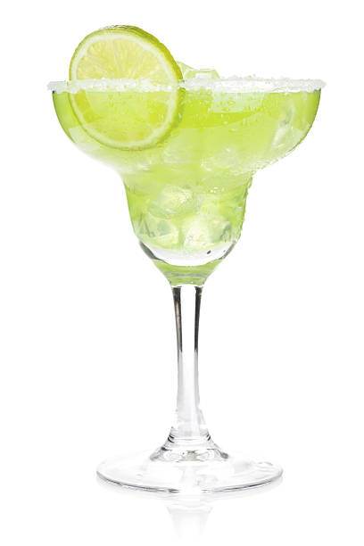
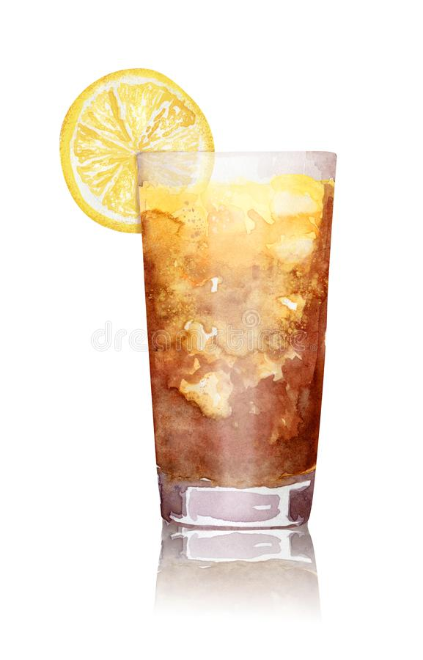
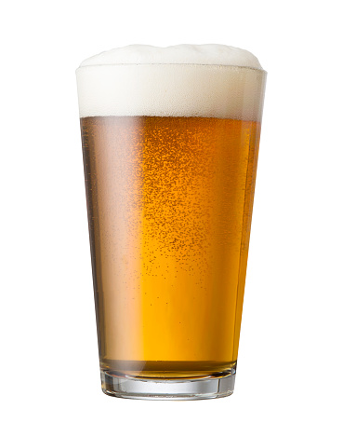
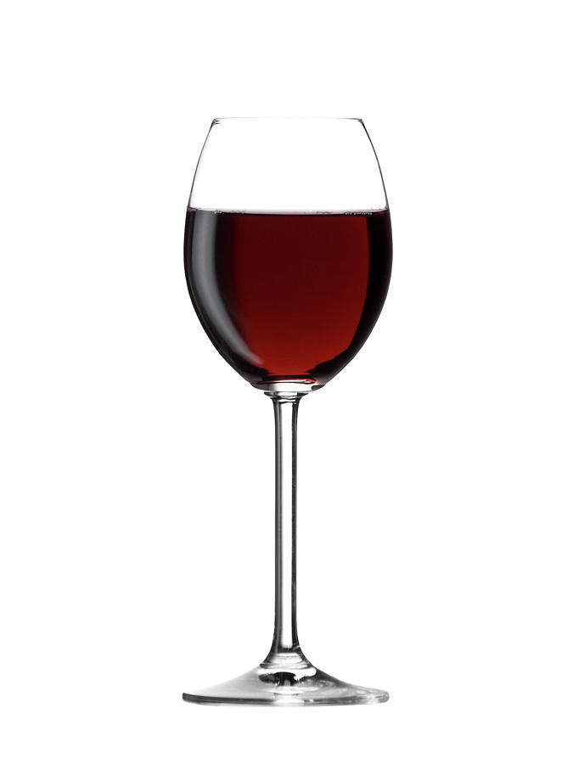
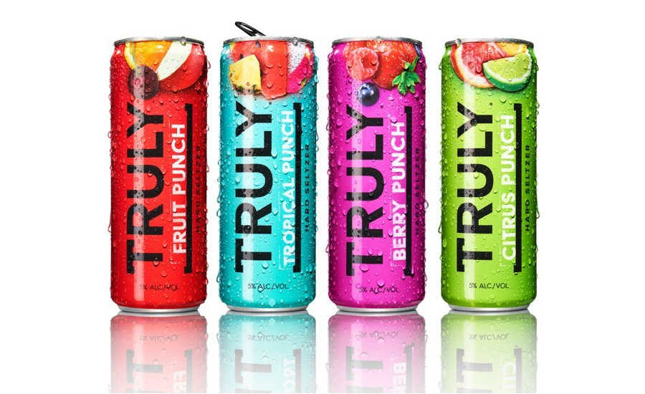
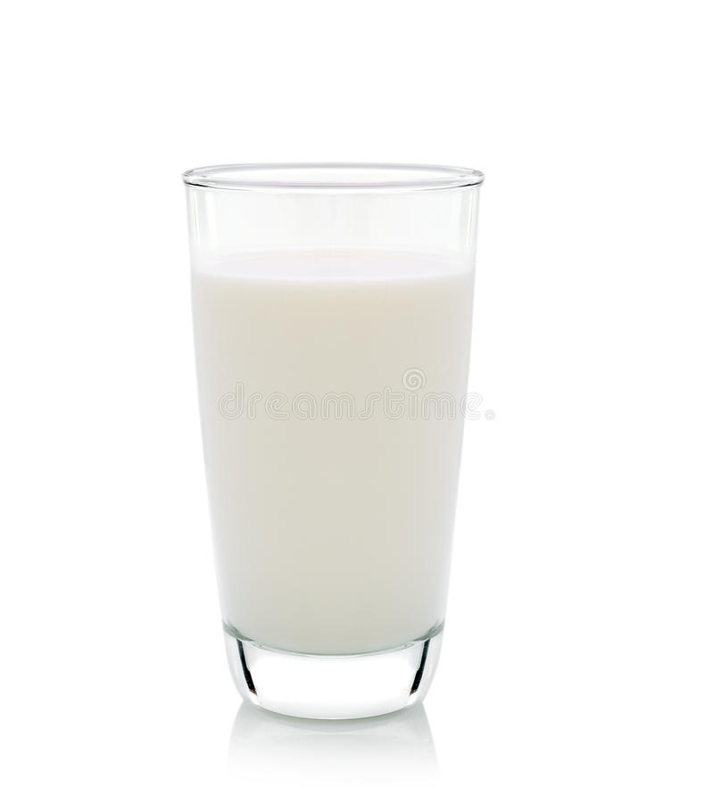
ÜBEER
ordering made easy
Dashboard
Manage Subscription
Financials
Logout
Hi Mx. Operarius,
Welcome to The Ebb.
There are 6 orders to complete,
and 15 notifications to be viewed and handled
Orders
Name | Time Since | Items | Total
Menu
Log
ID | Date | Desc. | Type
Margarita – $8.69
Long Island Iced Tea $8.69
Pint of PBR – $4.20
Glass of Red Wine – $8.69
Truly Variety– $12.99
Glass of milk - $0.25

Slide 3

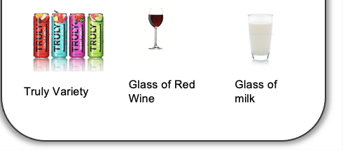
Pages
Pages
ÜBEER
ordering made easy
Orders
Hi Mx. Operarius,
Welcome to
The Ebb.
There are 6 orders to complete,
and 15 notifications to be viewed and handled
Name | Time Since | Items | Total
Log
Menu
ID | Date | Desc. | Type
Long Island Iced Tea
Margarita
Pint of PBR
Truly Variety
Glass of Red Wine
Glass of milk

