Slide 1

Drug Consumption Data Analysis
Data Boot Camp – Project 1
Group 2:
Daniel Usuga
Lisa Shimano
Rock David Adeline
Tammy Powell

Slide 2
Executive Summary
Project Outline
To investigate the patterns of drug consumption among individuals based on Country of Residence, Gender, Age and Education Level.
Research Questions
What percentage of people from each of the countries represented, uses illicit drugs?
The analysis uses a dataset containing a record of 1,855 participants recruited over a 12-month period, between March 2011 and March 2012.
Is there any difference between the drug consumption behavior for men and women?
Does illicit drug consumption reduce as people age?
Does level of education affect people’s level of drug intake particularly cannabis?

Slide 3
Data Source
The database was collected as part of a Research Proposal approved by the University of Leicester.
It contains records for 1,885 respondents (rows). For each respondent 12 attributes are known:
Demographic Information: age, gender, education, country, and ethnicity.
Personality Traits Information: five factor model, impulsiveness, and sensation seeking
Furthermore, each participant was questioned in the use of 18 different legal and illegal drugs.
An initial data cleaning procedure was used to remove personality traits attributes, responses related to legal drugs, and participants for which a country was not defined.
Final size of Data Frame contains the responses of 1,767 participants and usage information of 12 different drugs.
Source: https://www.kaggle.com/datasets/mexwell/drug-consumption-classification

Slide 4
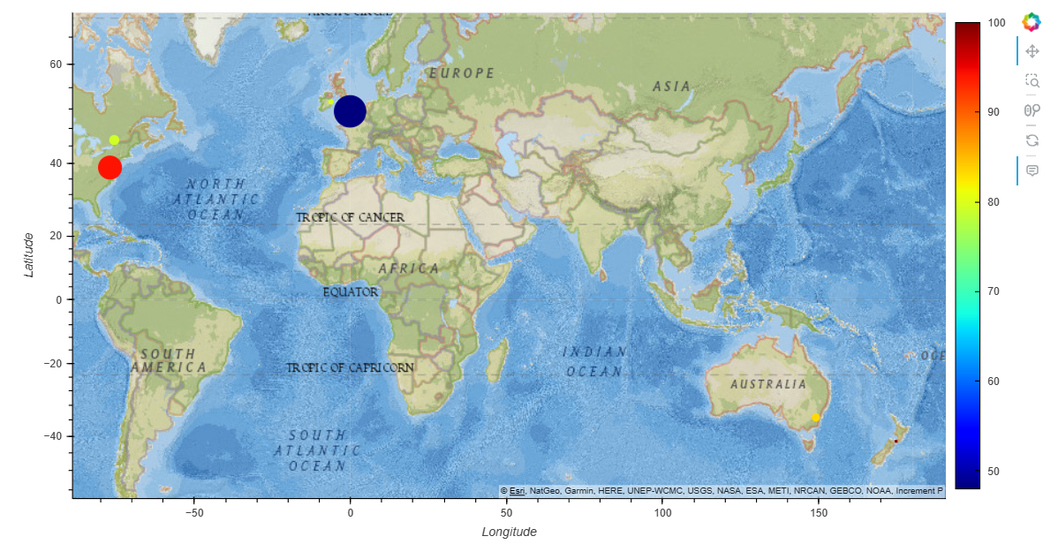
Drug Usage by Country Analysis Process
Country Info Python Library
Geocoding API from WeatherMaps
Cleaned Data
Find unique countries represented
Calculate number of people from each country
Calculate number of drug users from each country
Calculate % of drug users from each country
Get Capital & Latitude and Longitude from API
GeoViews
Map

Slide 5
Drug Usage by Country Analysis and Proportion by Country
Country | Capital | Latitude | Longitude | Number of people | Drug Users | % Drug users
Australia | Canberra | -35.297591 | 149.101268 | 54 | 45 | 83
Canada | Ottawa | 45.420878 | -75.690111 | 87 | 69 | 79
New Zealand | Wellington | -41.288795 | 174.777211 | 5 | 5 | 100
Republic of Ireland | Dublin | 53.349379 | -6.260559 | 20 | 16 | 80
United Kingdom | London | 51.507322 | -0.127647 | 1044 | 501 | 48
United States | Washington D.C. | 38.895037 | -77.036543 | 557 | 525 | 94

Slide 6
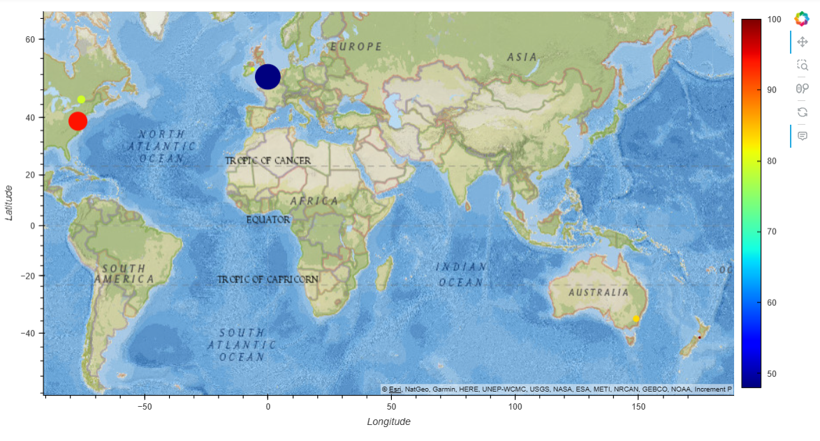

Slide 7
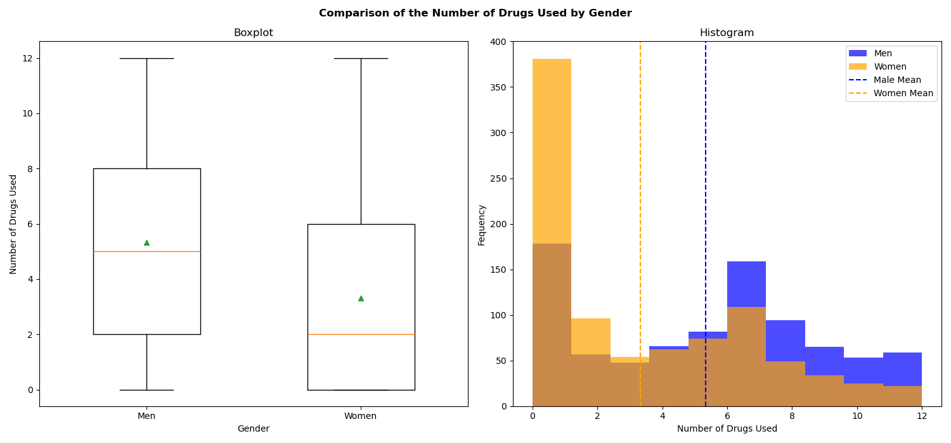
Drug Usage by Gender Number of Used Drug by Gender
Variable Definition:
Number of drugs that a person has used (out of the 12 different drugs).
Null Hypothesis: There is no difference in the average number of drugs consumed or tried between men and women.
Alternative Hypothesis: There is a significant difference in the average number of drugs consumed or tried between men and women.
t-statistic: 12.47
p-value: 3.04x10⁻³⁴
There is sufficient evidence to reject the null hypothesis and conclude that the average number of drugs consumed or tried differs between men and women.
Notes:
Our first approach is to analyze if Men have consumed/tried a wider variety of drugs than Women (in average). Visual representations in the form of a box plot and histogram have been utilized to compare the distributions of these two populations for any discernible discrepancies.
By looking at the figure, it can observe that, in average, women have consumed/tried a slightly less variety of drugs than men (with the average values being 3.32 and 5.33 respectively).
To assess whether a statistical discrepancy exists in drug consumption between men and women, a t-test has been conducted. The hypotheses are formulated as follows:
- Null Hypothesis: There is no difference in the average number of drugs consumed or tried between men and women.
- Alternative Hypothesis: There is a significant difference in the average number of drugs consumed or tried between men and women.
The resulting statistical analysis yields a p-value smaller than 0.01, indicating sufficient evidence to reject the null hypothesis. Consequently, we conclude that, statistically, the average number of drugs consumed or tried differs between men and women.

Slide 8
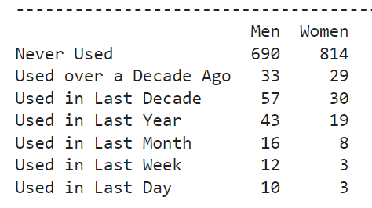
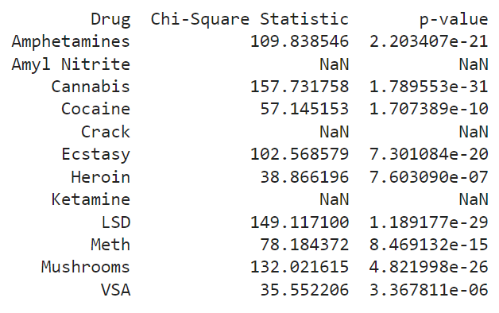
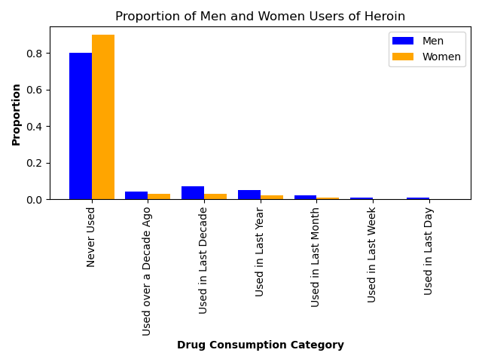
Drug Usage by Gender Usage Proportion by Drug
Variable Definition:
Number of people that have used the drug by Category and Gender.
Null Hypothesis: The proportions of drug usage by category are the same between men and women.
Alternative Hypothesis: The proportions of drug usage by category are different between men and women.
Variable example: Heroin
Notes:
Our second approach is to compare the if there is any difference in the consumption behavior of each Drug between men and women. Individuals are categorized in the below groups:
"Never Used"
"Used over a Decade Ago"
"Used in Last Decade"
"Used in Last Year"
"Used in Last Month"
"Used in Last Week"
"Used in Last Day“
Afterwards, the proportions of men and women on each category is computed for each type of Drug and a side-to-side comparison is presented on a Bar Chart.
The consumption behavior greatly varies between drugs. With crack or heroin showing lower proportions of usage in the last days, week, months, and years. While other drugs like Cannabis or Ecstasy presenting higher proportions of usage in more recent timeframes.
To assess if there is any significant statistical difference between the consumption patters of men and women, a Chi-Square Test is conducted for each Drug. The hypotheses are formulated as follows:
Null Hypothesis: The proportions of drug consumption by category are the same between men and women.
Alternative Hypothesis: The proportions of drug consumption by category are different between men and women.
The resulting statistical analysis yields p-value smaller than 0.01 for Amphetamines, Cannabis, Cocaine, Ecstasy, Heroin, LSD, Meth, Mushrooms, and VSA.
Due to the lack of sufficient observations in the Drug Consumption for Amyl Nitrite, Crack, and Ketamine, the Chi-Square cannot be computed for these drugs.
Based on the above results, there is sufficient evidence to conclude that the proportions of drug consumption by category are different between men and women for:
Amphetamines
Cannabis
Cocaine
Ecstasy
Heroin
LSD
Meth
Mushrooms
VSA

Slide 9
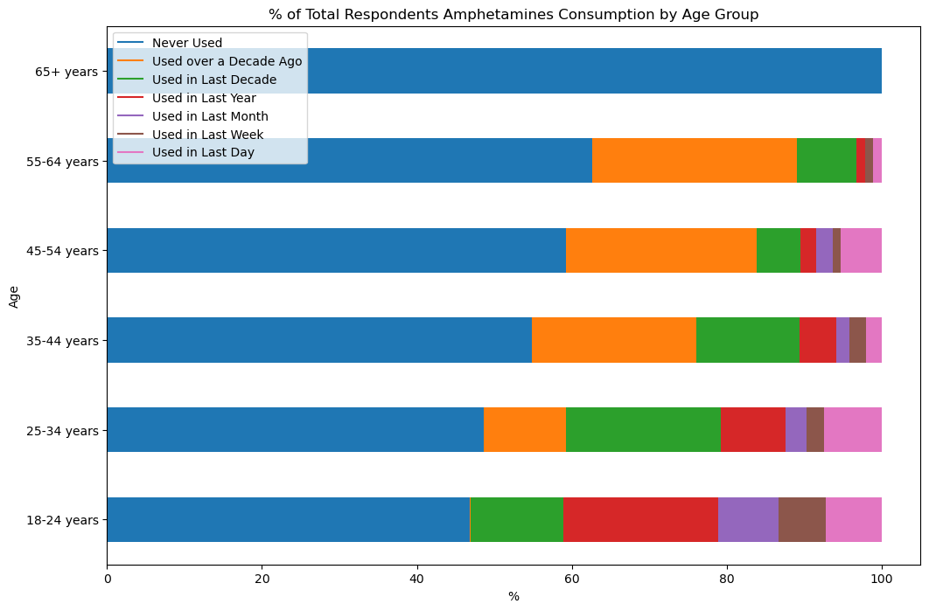
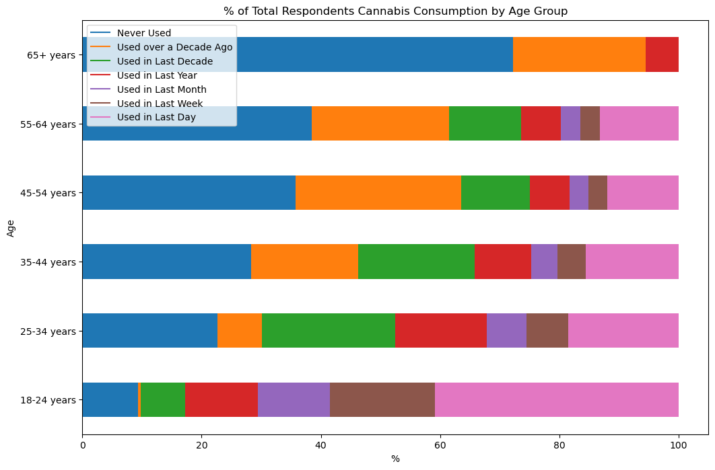
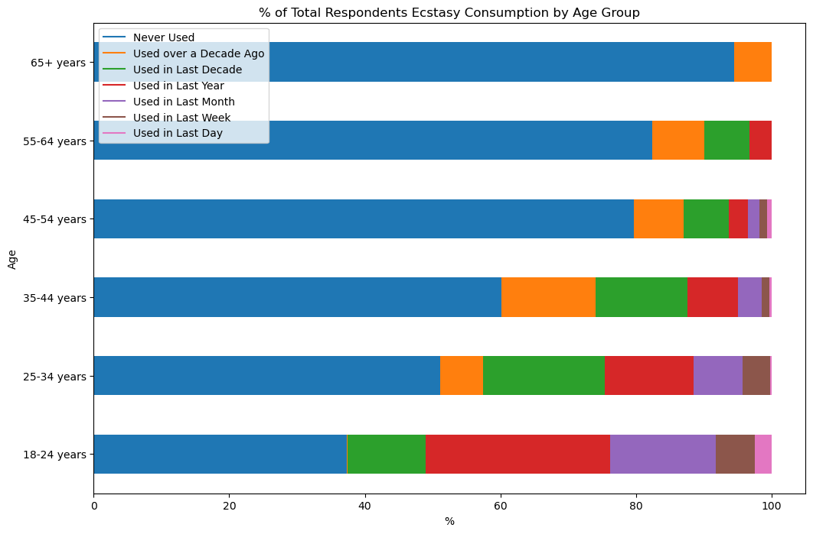
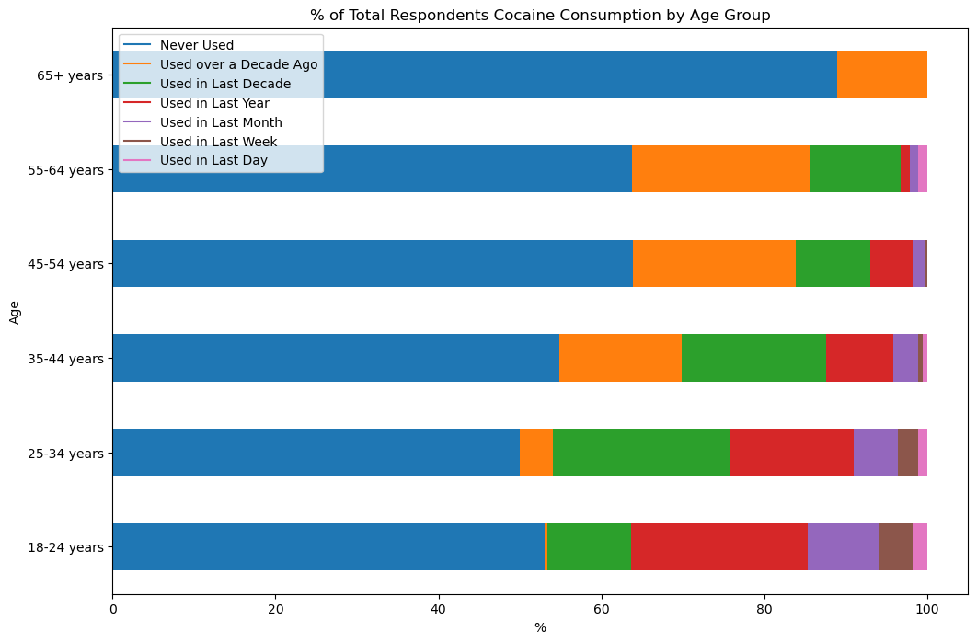
Drug Usage by Age Group % of Total Respondents Consumption by Age Group
Amphetamines
Cannabis
Ecstasy
Cocaine
Total Number of Respondents per Age Group
Sample Data
Total Number of Respondents = 1767
65+ years = 18
55 to 64 years = 91
45 to 54 years = 285
35 to 44 years = 339
25 to 34 years = 442
18 to 24 years = 592

Slide 10
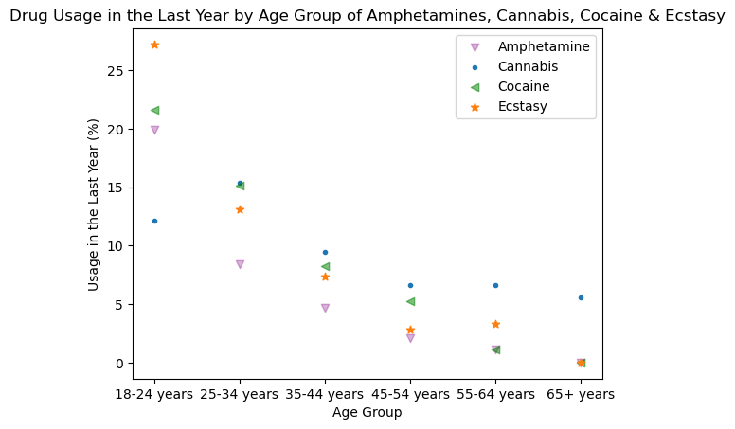
Drug Usage by Age Group
Drug use is most common among young adults and decreases as respondents age.

Slide 11
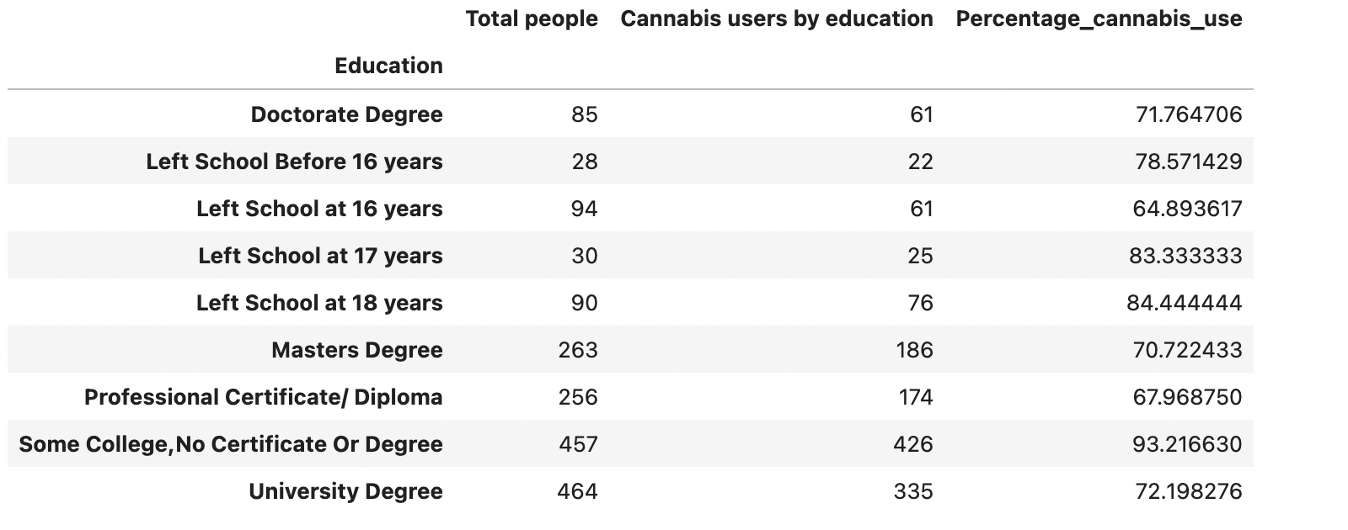
Drug Usage by Education Level
Research Question: Does level of education affect people’s level of drug intake particularly cannabis?
Hypothesis: having low level of education (people who have left school before 16 years) has a higher chance of cannabis intake level.
Null hypothesis: having low level of education (people who have left school before 16 years) has no effect on cannabis intake level.

Slide 12
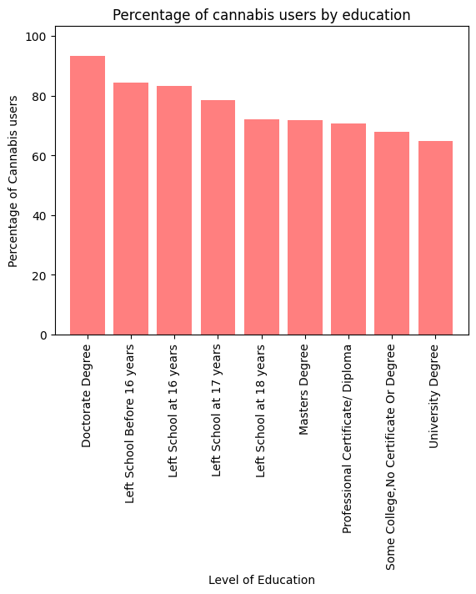
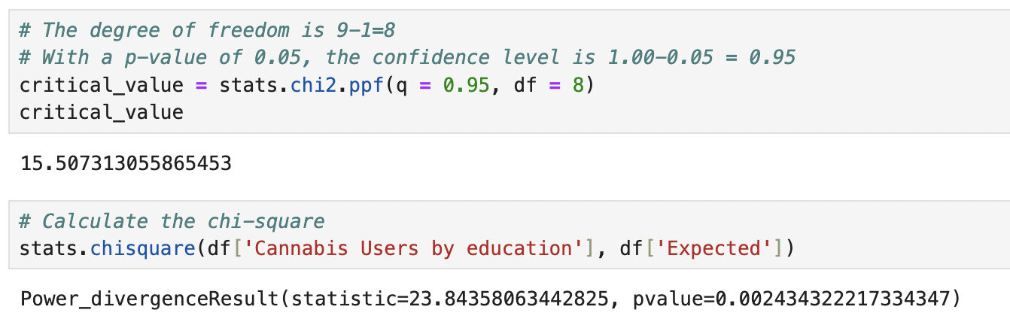
Drug Usage by Education Level

Slide 13
Limitations of the Study
The data set was mostly categorical which made it difficult for genuine statistical analysis.
Sample size was biased on many levels. The number of countries represented in the data was limited to developed countries with mostly white populations, with the city of residence not identified only the country. Age group representation was also biased to a younger demographic with the largest proportion of the sample aged between 18 and 34 years, so mostly young adults.
It was unclear if a respondent may have responded more than once if they used several drugs with differing consumption types.

Slide 14
Conclusions
The largest number of people represented is from the United Kingdom; however, its percentage of drug users is the lowest amount the countries within the sample.
The United States has the highest percentage of drug users
The drug consumption behaviour and patterns of consumption between Men and Women is different.
Potential next step: Investigate if there is a correlation between the GDP per capita of the countries in 2012 and the proportion of drug users.

