Slide 1
A Student Guide to Object- Orientated Development
Chapter 3 Use Cases

Slide 2
Use Cases
Use cases model the user’s view of the functionality of a system. Each use case represents a task or major chunk of functionality.

Slide 3
Use Cases
The use case model consists of:
a use case diagram
a set of scenarios
a set of uses case descriptions
actors and actor descriptions.

Slide 4
Use Case Diagram
The use case diagram models the problem domain graphically using 4 concepts:
the use case: Collection of all possible sequences of interactions between the system and actors related to a particular goal.
  the actor: All external entities that interact with a system
the relationship link and
the boundary.

Slide 5
Use Case Notation
Print invoice
We start each use case label with a verb making the point that the use case represents a major piece of functionality in the system e.g. Maintain customer, Create order, Print invoice.

Slide 6
Identifying use cases
A use case describes a cohesive piece of the system’s functionality as the user perceives it.
A use case should represent a complete process; one end to end pass through the system, a job that the user sits down at the computer to achieve at one go.
What we do when identifying use cases is to divide up the system’s functionality into chunks; the main areas of functionality. But what dictates the split is what the user sees as the separate jobs or processes that he will use the system to achieve.
The user may see a chunk of functionality as a task that he uses the system to achieve, one of the jobs that make up his daily workload, or it may produce a list or report he gets from the system.
Each use case must have a goal – something it achieves for the user.

Slide 7
An Actor
Receptionist
An actor represents any user or thing that interacts with the system.
An actor represents a role not a person.
Actors identified in the use case diagram represent users who interact with the system in some way, who use the system to achieve a particular task.
Each actor may represent several different people.

Slide 8
Actors
Use cases divide the world into two parts: the system and all entities external to the system.
The external entities are actors.

Slide 9
Kinds Of Actors
Users
  This includes all human users including targeted end-users, administrators, manager, and customers.
Applications
  This includes all systems and programs that interact with the system.
Devices
  Normally this does not include things like keyboards or mice, but deals with sensors and actuators.
External Events
  Periodic triggers such as a clock

Slide 10
A Sample Use Case Diagram: A University Course Registration System
Login
Registrar
Maintain Professor Information
View Report Card
Student
Register for Courses
Maintain Student Information
Close Registration
Billing System
Select Courses to Teach
Professor
Submit Grades
Notes:
Use case diagrams are used to show the existence of use cases and their relationships, both to each other and to actors. An actor is something external to the system that has an interface with the system, such as users. A use case models a dialogue between actors and the system. A use case is initiated by an actor to invoke a certain functionality in the system. For example, in the diagram above, one user of the system is a student who wishes to use the system to register for courses. Hence, Register for Courses is a use case.
The arrow (which is optional) indicates the direction of initiation of the interaction. For example, the Student actor initiates the Register for Courses use case. However, the Close Registration use case initiates interaction with the Billing System.
A use case is a complete and meaningful flow of events. The flow of events supplements the use case diagram and is usually provided in text format.
Taken together, all use cases constitute all possible ways of using the system.

Slide 11
Use Case Diagrams (Watch)
Package
SimpleWatch
Actor
ReadTime
WatchUser
SetTime
WatchRepairPerson
Use case
ChangeBattery
Use case diagrams represent the functionality of a system
from user’s point of view

Slide 12
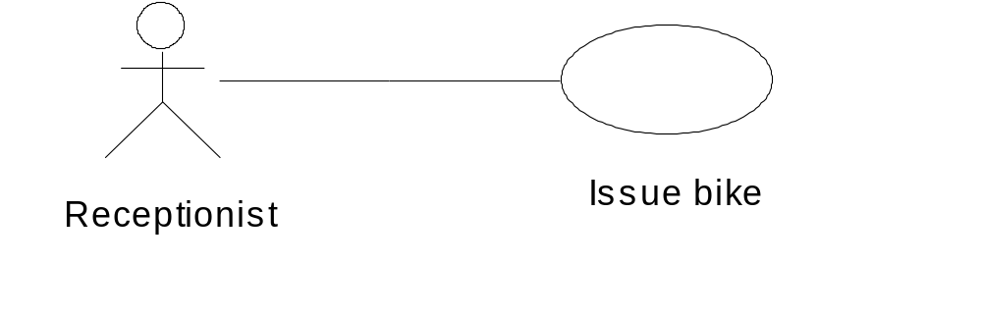
Use Case Relationship
This relationship is known as a
communication relationship

Slide 13
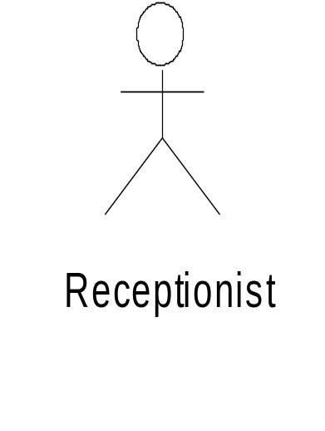
Boundary – separates use cases from actors
Issue bike

Slide 14
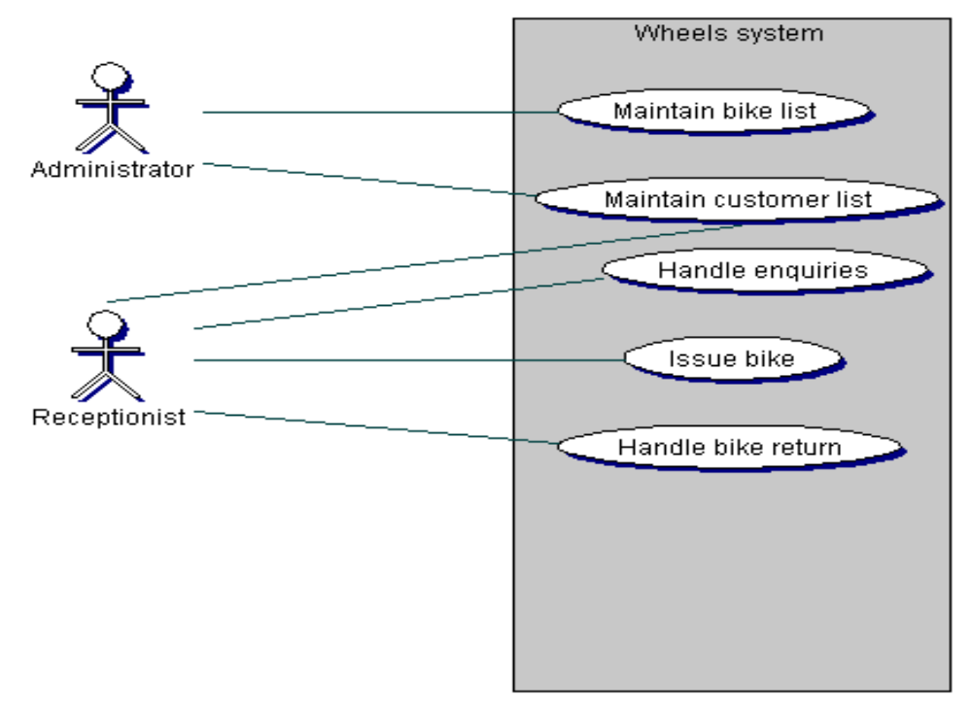
Wheels use case diagram

Slide 15
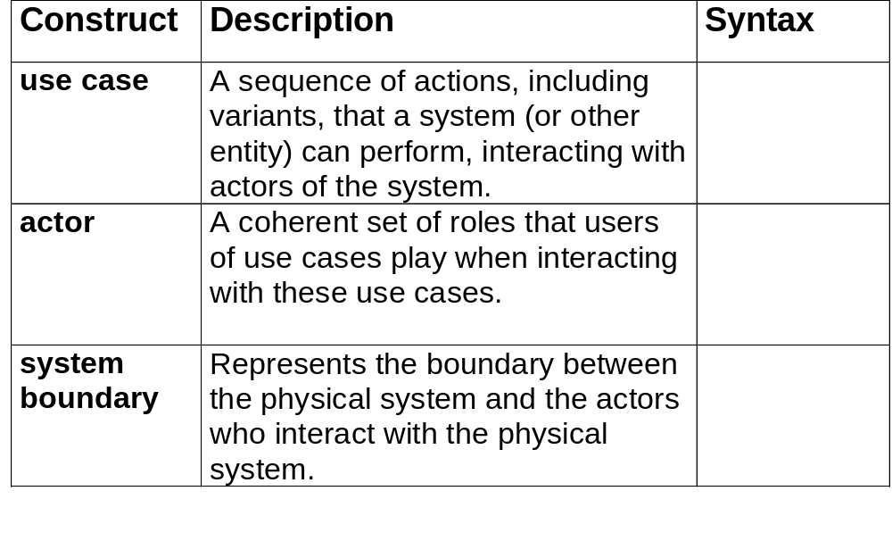
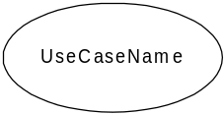
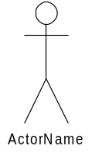

Use Case Modeling: Core Elements

Slide 16
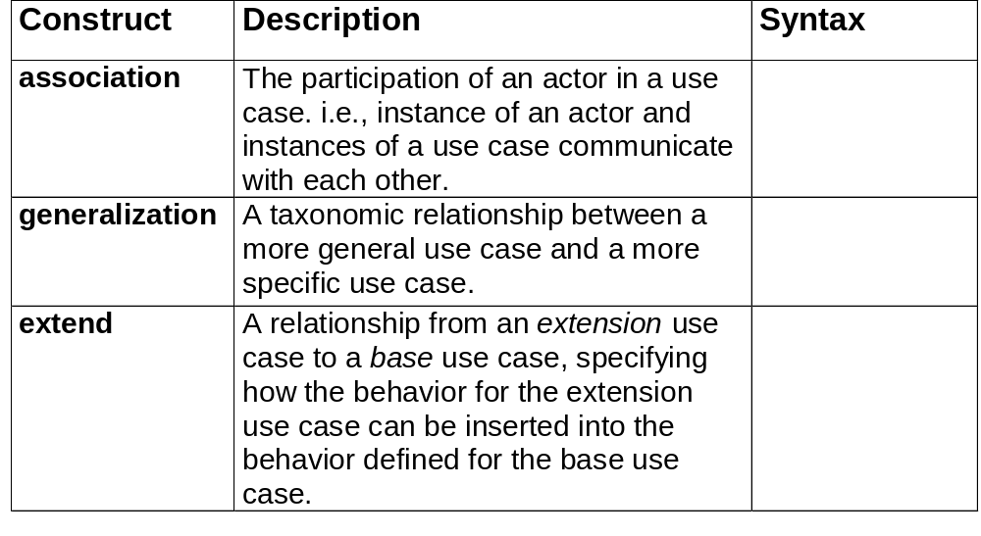



Use Case Modeling: Core Relationships
<<extend>>

Slide 17
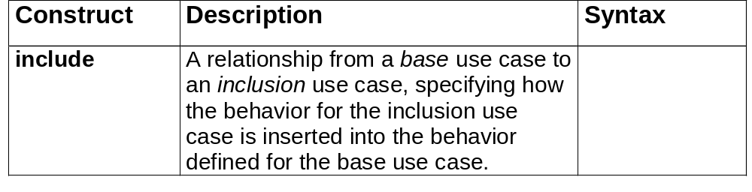
Use Case Modeling: Core Relationships (cont’d)
<<include>>

Slide 18
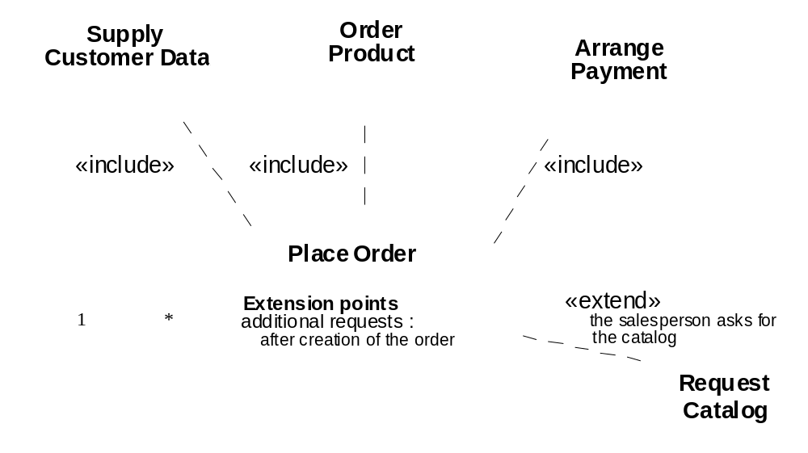
Example: Use Case Relationships
UML and C++ A Practical Guide To Object-Oriented Development
UML Notation Guide

Slide 19
Use Case Relationships - Include
<<include>>
Order goods
Check customer credit
An include relationship between uses cases indicates where one use case always includes the behavior of another, the use case ‘Order goods’ always incorporates a credit check

Slide 20
Use Case Relationships - extend
<<extend>>
Chase payment
Issue warning letter
An extend relationship between two use case indicates alternative behaviour; the use case ‘Chase payment’ sometimes calls the issue warning letter use case but not always.

Slide 21
Scenarios
A sequence of interactions between the user and the system.
To achieve a specified goal
Each use case represents a group of scenarios
Each scenario describes a different sequence of events involved in achieving the goal

Slide 22
Successful scenario – Wheels
    Stephanie chooses a mountain bike
    Annie sees that its number is 468
    Annie enters this number into the system
    The system confirms that this is a woman’s mountain bike and displays the daily rate (£2) and the deposit (£60)
    Stephanie wants to hire the bike for a week
    Annie enters this and the system displays the cost
    Stephanie agrees this
    Annie enters Stephanie’s details
    Stephanie pays the £74
    Annie records this and the system prints out a receipt

Slide 23
Scenarios
A successful scenario, one that achieves the use case goal, is sometimes referred to as
a ‘happy day’ scenario or
the ‘primary path’.

Slide 24
Scenarios
Scenario for the situation where the use case goal is not achieved
Michael arrives at the shop at 12.00 on Friday
He selects a man’s racer
Annie see the number is 658
She enters this number into the system
The system confirms that it is a man’s racer and displays the daily rate (£2) and the deposit (£55)
Michael says this is too much and leaves the shop without hiring the bike.

Slide 25
The scenarios should document:
a typical sequence of events leading to the achievement of the use case goal – e.g. a customer hires a bike
obvious variations on the norm, e.g. a customer hires several bikes
sequences of events where the use case goal is not achieved e.g. the customer cannot find the bike he wants

Slide 26
A Sequence Diagram
Ch 10
registration
schedule
available
John :
form
form
courses
Student
1: enter id
2: validate id
3: enter current semester
4: create new schedule
5: display
6: get courses

Slide 27
Use Case Descriptions
The use case description is a narrative document that describes in general terms the required functionality of the use case. The description is generic and should encompass every sequence of events, every scenario relating to the use case.

Slide 28
Use Case Descriptions – High Level Descriptions
Use case: Issue bike
Actors: Receptionist
Goal: To hire out a bike
Description:
When a customer comes into the shop they choose a bike to hire. The Receptionist looks up the bike on the system and tells the customer how much it will cost to hire for a specified period. The customer pays, is issued with a receipt, then leaves with the bike.

Slide 29
Expanded Use Case Description
More detailed and structured than the high level description and should document:
  what happens to initiate the use case
  which actors are involved
  what data has to be input
  the use case output
  what stored data is needed by the use case
  what happens to signal the completion of the use case
  minor variations in the sequences of events.

Slide 30
  Use case : Issue bike
  Actors: Receptionist
  Goal: To hire out a bike
  Overview:
  When a customer comes into the shop they choose a bike to hire. The receptionist looks up the bike on the system and tells the customer how much it will cost to hire the bike for a specified period. The customer pays, is issued with a receipt, then leaves with the bike.
  Cross reference R3, R4, R5, R6,R7, R8, R9, R10
  Typical course of events
  Actor action System response
  1. The customer chooses a bike
  2. The Receptionist keys in the bike number 3. Displays the bike details 4. Customer specifies length of hire
  5. Receptionist keys this in 6. Displays total hire cost
  7. Customer agrees the price
  8. Receptionist keys in the customer details 9. Displays customer details
  10. Customer pays the total cost
  11. Receptionist records amount paid 12. Prints a receipt
  Alternative courses
  Steps 8 and 9. The customer details are already in the system so the Receptionist needs only to key in an identifier and the system will display the customer details.
  Steps 7 – 12. The customer may not be happy with the price and may terminate the transaction.

Slide 31
Actor descriptions
An actor represents one particular way of using the system; an actor represents the role someone plays in the use case – e.g. the Receptionist issues the bike. It may be that several people can play this role.

Slide 32
Actor Descriptions - Examples from Wheels
The Receptionist uses the system to answer queries about bike availability and cost, to issue a bike for hire and to register a bike return. The Receptionist can be the Shop Manager (Annie), any of the mechanics or the owner (Mike).
The Administrator uses the system to maintain lists of customers and bikes. The administrator can be the head mechanic, shop manager or shop owner.

Slide 33
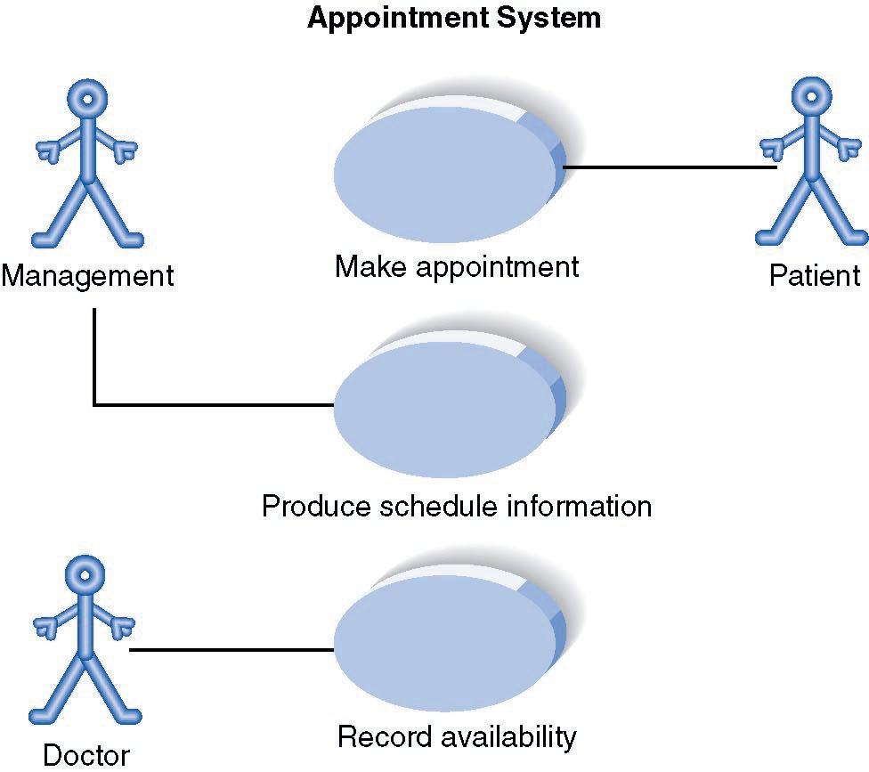
Use Case Diagram for Appointment System (Level of Information)

Slide 34
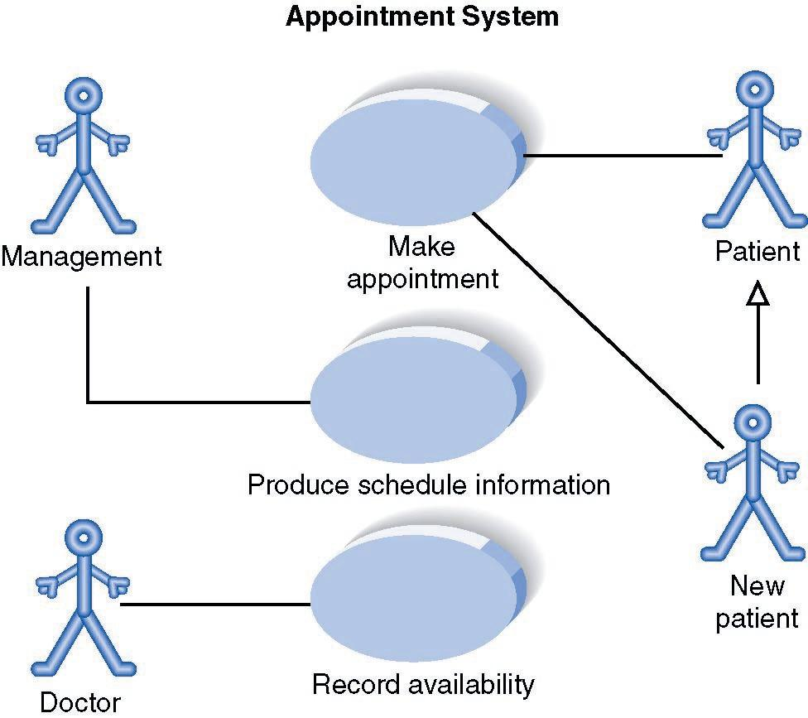
Use Case Diagram for Appointment System (Level of Information)

Slide 35
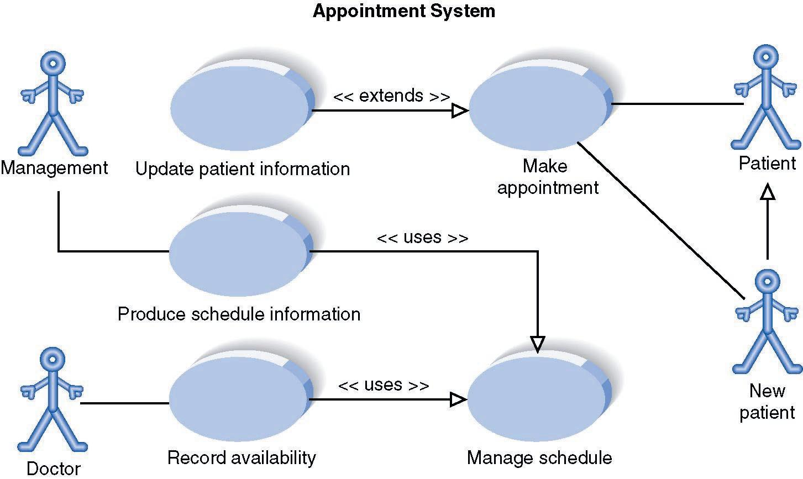
Extends or Uses Associations

Slide 36
Actor Relationships
UML an Actor (even it is an external system).
Bank Employee
UML Uses A Triangle To Represent The Generalization Relationship
Bank Teller
Bank Manager
This figure illustrates that a Bank Teller and a Bank Manager are both Bank Employees

Slide 37
Further Reading
Bennett, S., McRobb, S. and Farmer, R. Object-Oriented Systems Analysis and Design Using UML, 2nd Ed, London: McGraw-Hill, 2002.
Brown, D. Object-Oriented Analysis: objects in plain English, New York: John Wiley, 1997.
Fowler, M. UML Distilled: a brief guide to the standard object modeling language, 2nd Ed, Reading Massachusetts: Addison-Wesley, 2000.
Larman, C. Applying UML and patterns: an introduction to object-oriented analysis and design, New Jersey: Prentice Hall, 1998.
Lunn, K. Software Development with UML, Hampshire: Palgrave Macmillan, 2003
Stevens, P., with Pooley, R. Using UML. Software Engineering with Objects and Components Updated edition, Harlow: Addison-Wesley, 2000.

