Slide 1
Software Process and Quality Management
Nguyen Quang Vu

Slide 2
What is Software?
What is a Process?
What is Quality?
What is Management?

Slide 3
Software is the instructions that tell the computer what to do.
Process is the set of steps (procedure) to accomplish a goal.
What is a goal?
What are the steps?
Quality is meeting the goal, satisfy the requirements, delivering what the customer needs or wants.
Management is planning, organizing, and controlling. Management applies to resources. Leadership goes beyond management and deals with motivating people. Leadership applies to people.
So a starting definition would be:
“Software Process and Quality Management is leading people in planning, organizing, and controlling a set of steps to produce instructions for the computer that achieves a goal of satisfying a customer’s needs.”
We will start here and analyze more and build on this.

Slide 4
Software is used to automate business processes as in Business Process Analysis (BPA). Is this the same process?
While we study Business Processes that we wish to automate in order to understand them and simplify them before we automate them, our business is quality software development so our processes of focus for this class are the processes that deal with automating the steps to produce software that in turn automates the business processes.

Slide 5
Some questions for discussion:
Must Quality be built in, or can it be inspected in?
Is it a good idea to exceed customer’s expectations?
Does paying more increase Quality?
Does Quality cost extra?
Is Quality a measure of the cost or the value of something?

Slide 6
The fundamental premise of Quality Management is:
“The quality of the process determines the quality of the product produced by that process.”

Slide 7
In this course we will study the following:
Why SPQM is important?
What several leading Quality methods, techniques, and tools are?
Observe: There will be overlap. There is no single, universal Software Quality Methodology that satisfies all.
What are the five phases to follow to develop quality software?

Slide 8
Some models include:
CMMi
ITIL
CoBit
ISO
Six Sigma

Slide 9
Process Improvement Phases (5 steps)
• Organize and Priorities
“If you don’t know where you are going then any direction is fine.” Watts Humphrey
• Design the process
• Assess
“If you don’t know where you are, a map won’t help.”
Watts Humphrey
• Develop Improvement Plans
• Measure Progress ---- Repeat as needed
© 2010 CMU-ISR
10

Slide 10
Improved definition:
“SPQM is the study and practice of the actions to plan, organize, and control the compliance with the steps of the software development process according to a given standard in order to achieve the required quality of the software product as determined by the customer. “

Slide 11
To develop software we often follow an SDLC.
What is an SDLC?
SDLC includes:
  a Methodology (HOW?/WHO?)
  a Model
  Measurements and Metrics
Why measure?

Slide 12
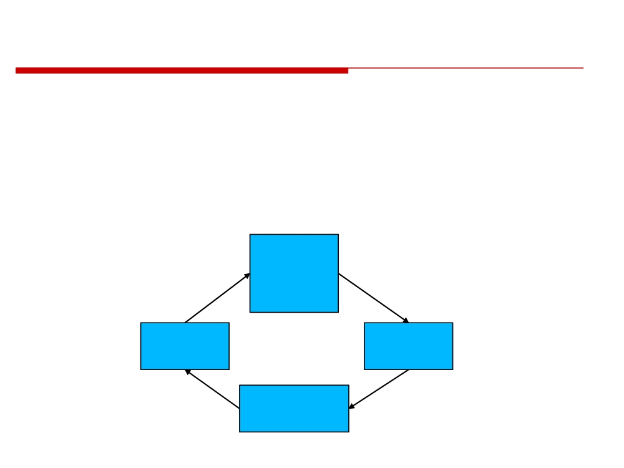
Why do we talk about Process and Quality together?
Because the best way of improving Quality is through changes to the Processes.
Software
Products and
Implement
Measure
Services
Software
Measured
Processes
by Quality
Change
Quality
Assess
Management
14

Slide 13
Observation:
The principles and concepts studied in this class and applied to the software development processes can be applied to improve any process by maturing the practice of the process to eliminate non-value-added variation.
LEAN - the identification and elimination of waste.
Waste - spending resources for which the customer does not perceive value.

Slide 14
Student Learning Objectives
Upon completion of this class, the student will be able to:
Understand and apply the steps in the processes to produce quality software and how to improve them.
Measure the processes to determine if the improvements are meeting the goals.
Develop a process improvement plan as necessary.

Slide 15
Day 1 Work (1):
Work in group (3 students), investigate and answer the followings question:
1. What is a software process?
2. What is software process improvement?
3. What are the benefits of software process improvement?
4. Describe the 2 models available for software process improvement.
5. Describe how a process improvement initiative may be run for one of two above-mentioned models.
6. Draw the process map for the process of development your private website.
7. What are the main barriers to successful software process improvement
initiatives and how can they be overcome?

Slide 16
Day 1 Work (2):
All answers must be put into one (NameOfGroup_ClassName).pdf file.
E.g., NamLongHoang_SCIS.pdf
- Send the file to lecturer email: nquangvu@gmail.com before 21:00 29/06/2020.
Let the following information included at the beginning of the file:
Class Name:
Group members:
Answer for:
Question 1: …
Question 2: …
Question 3: …
…
Full Name | Student ID | Question(s) done | Mark
Nguyễn Viết Cường (Group leader) | IS10701 | 1,2,3
Trần Xuân Bình | IS10701 | 3,4
Phạm Hoàng Chung | IS10701 | 5
…

