Slide 1
Value of Process Improvement

Slide 2
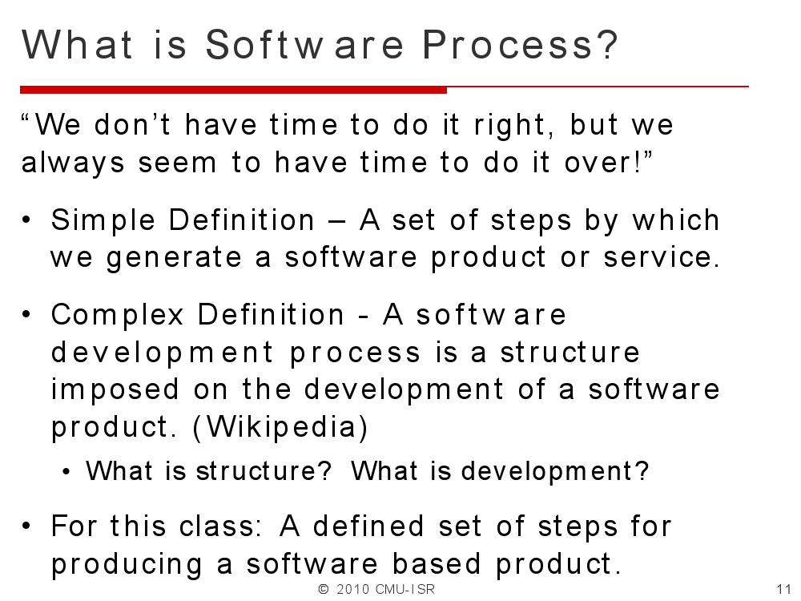

Slide 3
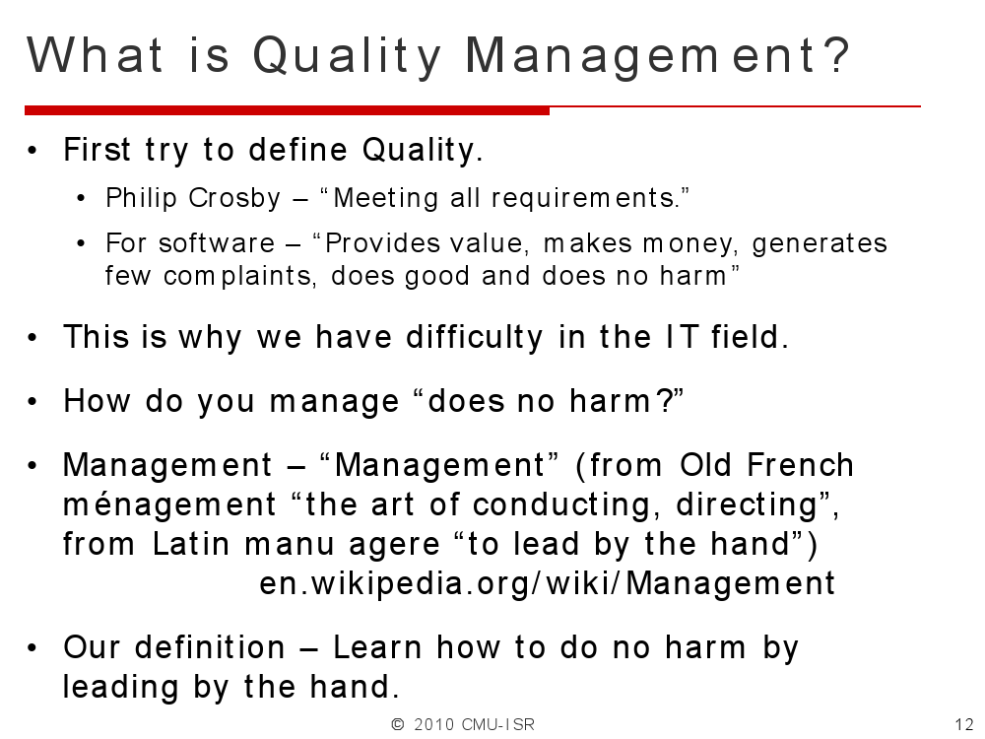

Slide 4
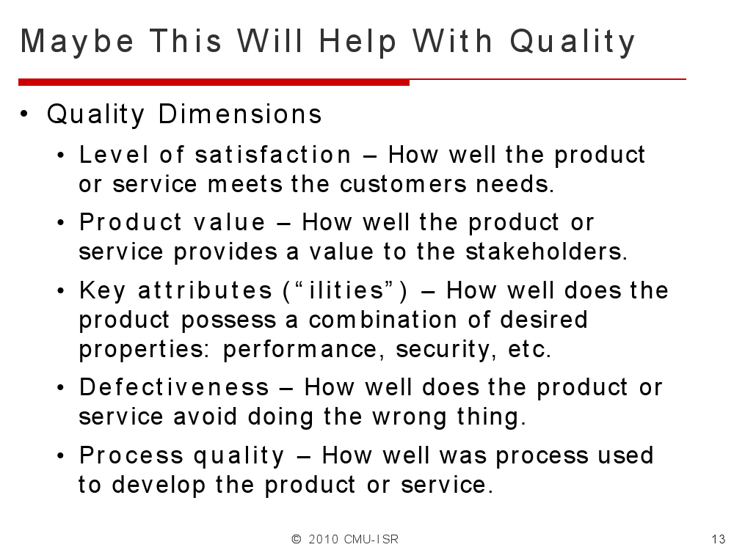

Slide 5
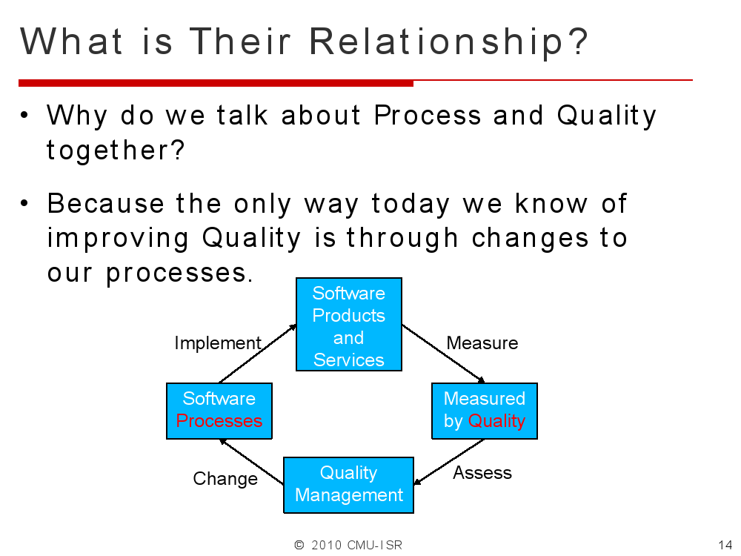

Slide 6
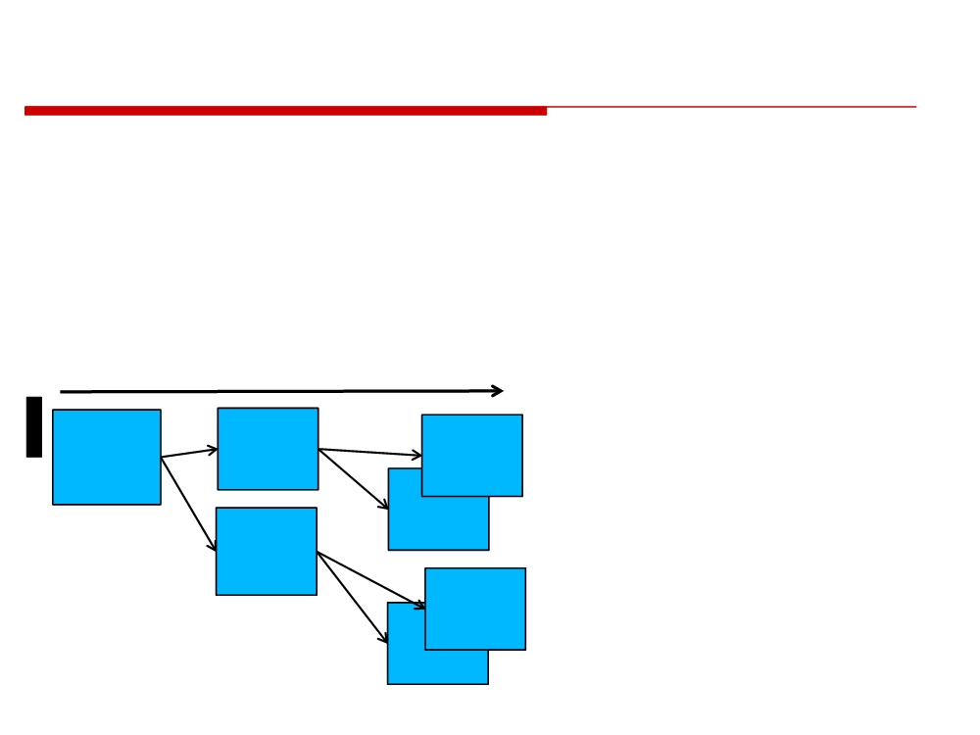
10 to 1 - Cost of No-Quality
▪ It has been shown that the defects cost more to remove the later we find them in our development process.
▪ There are many reasons for this, but the easiest way to see this is the idea of defect propagation.
Time
Defect
Defect
Defect
@
Point B
Point C
Design
Each defect leads to
Point A
D
DD #1
more defects, the
Defect
Point C
DD #2
…
increasing number
Point B
means higher cost to
Docu.
Defect
remove.
De
Point C
Po
Doc 2
Doc 3
© 2014 CMU-ISR
4

Slide 7

Costs Before/After Development
Requirements -
1 to 1
Design -
3-6 to 1
Coding -
10 to 1
Development Test -
15-40 to 1
System Test -
30-70 to 1
Release / Maintenance -
40-1000 to 1
Pay now or pay later… Much more
© 2014 CMU-ISR
5

Slide 8
Change Advocate
• To sell senior management, you need to appeal to their reason.
• Typically you have to build an economic case for process improvement.
• How much have similar process improvement efforts cost in similar organizations?
• What is the return on investment?
• Ask for goals and meaningful measures.
© 2014 CMU-ISR
11

Slide 9
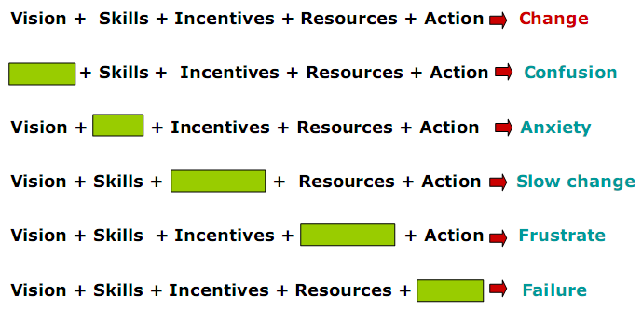
Effects of Missing Elements
Notes:
Khích lệ, thúc đẩy, động lực

Slide 10
Key Concepts In Change
Focusing on high value activities
Establishing core competencies
Standardizing & simplifying internal processes
Training & retraining
Outsourcing “commodity” activities
Improving workflow efficiency
Strengthening customer relationship
Managing by facts & data
Integrating Commercial Off The Shelf

Slide 11
Conditions for Change
D = dissatisfaction with the status quo
occurs in chaotic organizations
V = vision of a future state
visionaries see a way to do “it” better F = first steps towards the vision
the bold ones act on the vision R = resistance to change
many are afraid of change and resist it and will quit before they will change
© 2014 CMU-ISR
12

Slide 12
Conditions for Change
if D
* V * F
> R
then
“change will occur”
Where:
D = dissatisfaction with the status quo V = vision of a future state
F = first steps towards the vision R = resistance to change
V,F,R typically requires management commitment
© 2014 CMU-ISR
13

Slide 13
Deming -
The Father of Quality Improvement
• Plan -> Do -> Check -> Act (Repeat)
• Plan - Decide what you want to Do, i.e. the change you want to make.
• Do - Make the change happen, take some actions.
• Check - Verify that the actions created the result planned.
• Act - Do what is needed to make the plan successful, repeat with Plan again.
© 2014 CMU-ISR
16

Slide 14
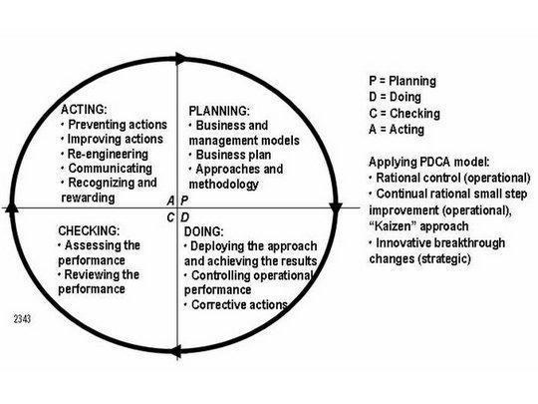

Slide 15
Plan Also Evaluation
• Collect data.
• Evaluate current position and issues.
• Plan some changes that you want to make happen.
• Also plan the measures you will use to know if change is occurring.
© 2014 CMU-ISR
19

Slide 16
Do - Action
• Perform the plan. • Famous saying
•
“Plan the work and work the plan.”
• Collect data to see if change is happening.
© 2014 CMU-ISR
20

Slide 17
Check (Ck)
• See what has happened.
• If the proper change is occurring, then continue…
• If the proper effect is not occurring, then take prepare new actions.
• Verify that the change meets expectations.
© 2014 CMU-ISR
21

Slide 18
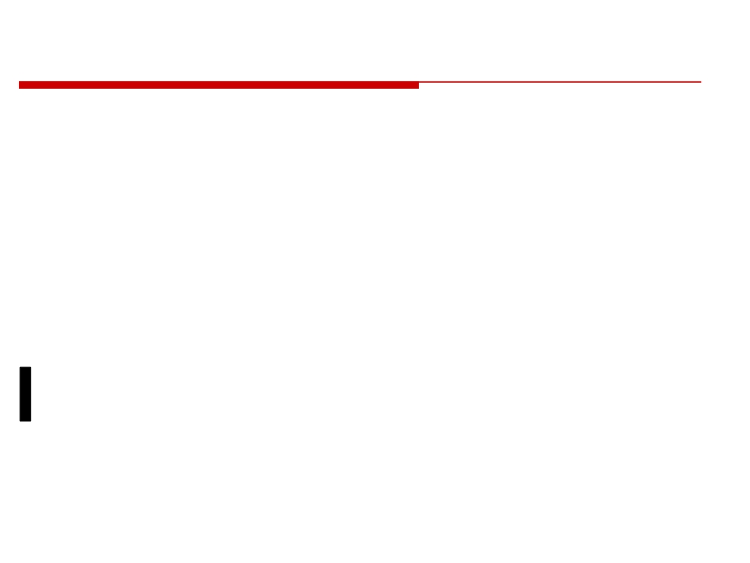
Act
• Change expectations
• Change what we are looking for • Change measures
• Change how we are measuring • Do it again…back to Plan
© 2014 CMU-ISR
22

Slide 19
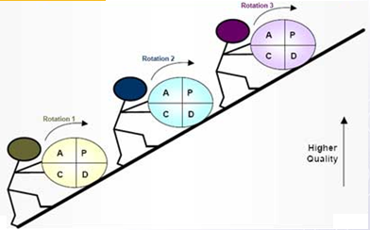

Slide 20
Software Process & Quality Management
Mel Rosso-Llopart © 2014
Why Is This Stuff Important?
Mel Rosso-Llopart
Senior Lecturer, Executive Education Program Institute for Software Research
Carnegie Mellon University

Slide 21
Technology Turnover
• Technology turnover is about 12-18 months.
• Technology turnover among people is 5 to 7 percent a year.
• What does this mean to an organization?
© 2014 CMU-ISR
4

Slide 22
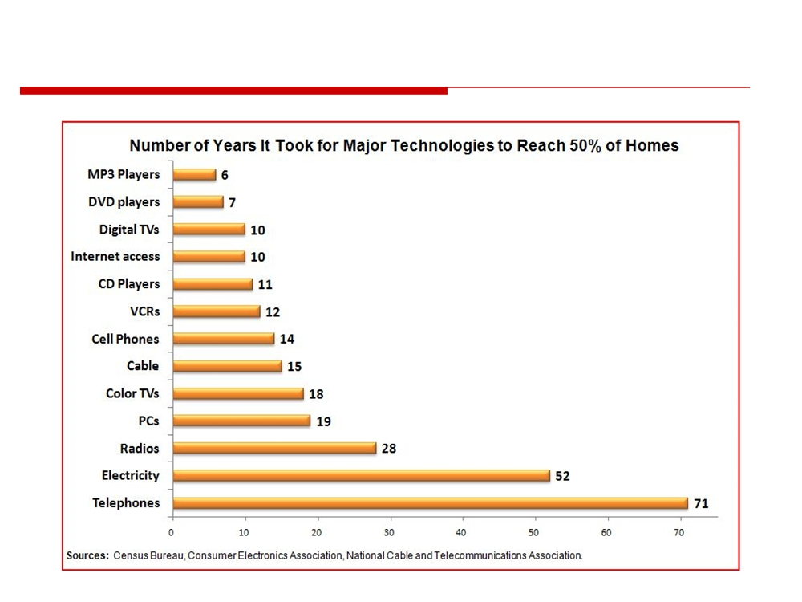
The Only Constant is CHANGE
© 2014 CMU-ISR
5

Slide 23
We Need to Build Improvement Into What We Do
• We need quantitative measures rather than qualitative feelings:
• I know this is better because of…
• Rather than I think this is better…
• This is part of management and the processes we use.
© 2014 CMU-ISR
7

Slide 24
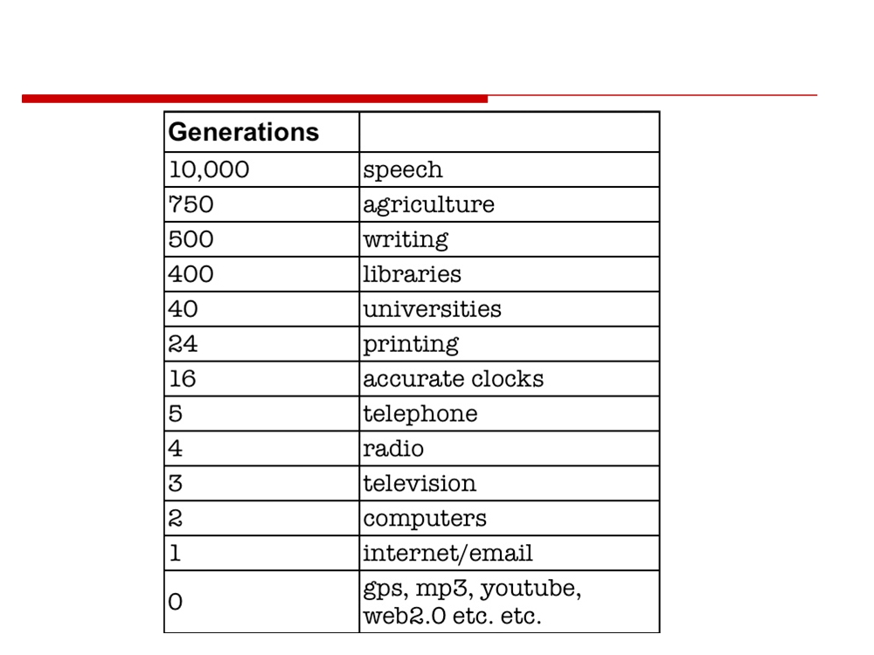
Another Way to Look at Change
© 2014 CMU-ISR
8

Slide 25
Survey Found Online
• The rate of change of technology increases the importance of:
1. Outsourcing the IS function.
2. Implementing and enforcing good processes.
3. Hiring personnel willing to make a career within the organization.
4. Meeting user requirements.
© 2014 CMU-ISR
9

Slide 26
The Implications are Obvious
• IT projects must get better at what they do!
• More requirements
• More people doing the job
• New ideas and ways of looking at old information • New information and trends
• From days → hours → minutes → ????
© 2014 CMU-ISR
13

Slide 27
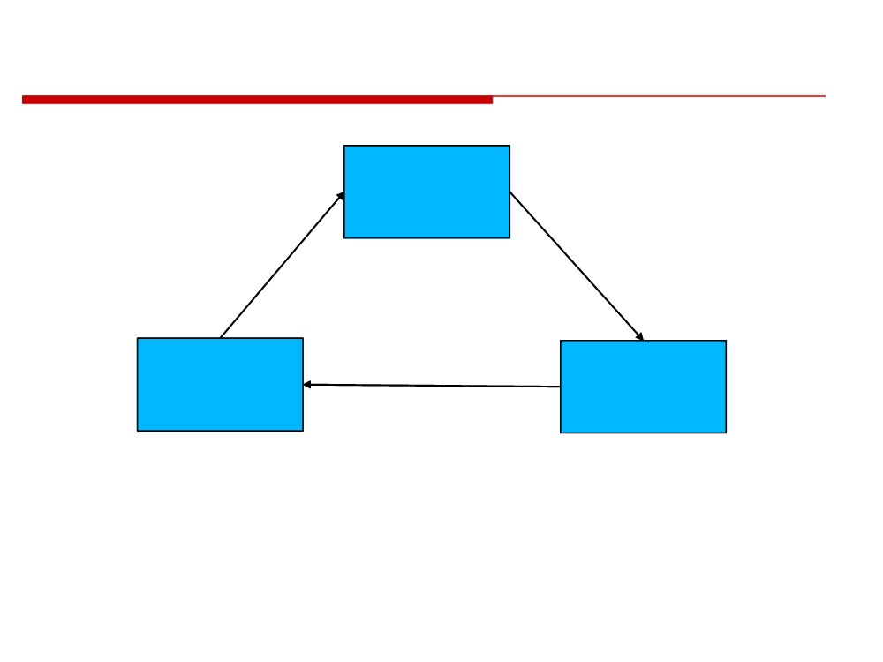
Technology Change Cycle
Standard
Functions
used everyday
This cycle is becoming faster
New
Changes in
capabilities
technology
new Functions
Can you think of some examples of this?
© 2014 CMU-ISR
14

Slide 28
Re-Technology Change Cycle
Provide clear IT
Put quality IT so we
Standard
management of the
don’t have to spend
Functions
technology so
all the time fixing the
used everyday
we influence how it is
old functions.
brought into an
organization.
New
Changes in
capabilities
technology
new Functions
Provide the IT services that give new functions rather than be function integrators.
© 2014 CMU-ISR
18

Slide 29
Homework Assignment
Investigate:
Process Improvement
Process Quality

