Slide 1
Software Process & Quality Management
Mel Rosso-Llopart © 2010
Estimating ROI
Mel Rosso-Llopart
Senior Lecturer, Executive Education Program Institute for Software Research
Carnegie Mellon University

Slide 2

Agenda
▪ Total Cost of Quality (COQ) ▪ Four areas of quality:
• Internal Failure
• External Failure
• Appraisal Costs
• Prevention Costs
The cost iceberg
© 2014 CMU-ISR
2

Slide 3
Cost of Quality
• Concept originated in the 1960’s
• Deming, Juran and Crosby “Quality is free” • Primarily applied to manufacturing
• Heavily adopted by the Japanese
• Now being applied to Software and therefore IT
© 2014 CMU-ISR
3

Slide 4
Process to Calculate ROI for IT Process Improvement
• Steps
Identify opportunities where process improvement can be measured and quantified.
Devise a coherent plausible formula for calculating a cost savings for each process improvement opportunity.
3. Reduce those calculations to a number that becomes the ROI for the improvement effort over time.
• Time frame for typical process improvement effort 18 to 36 months.
© 2014 CMU-ISR
4

Slide 5
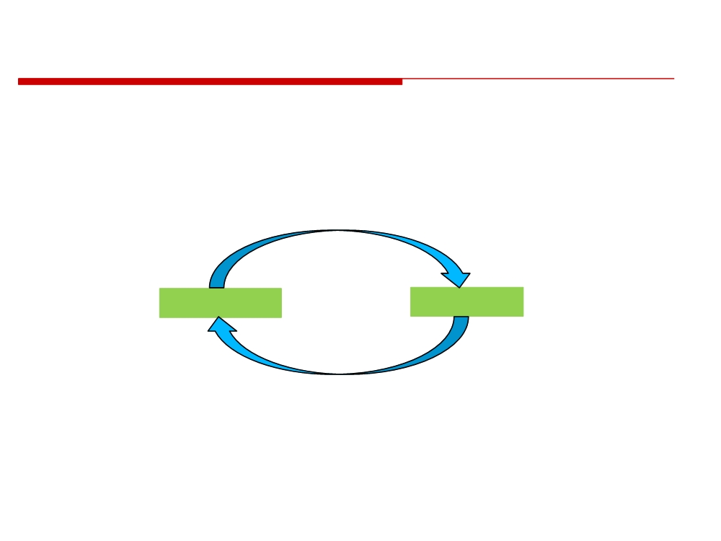
A Framework for Thinking About Trends in IT
• Process-oriented management
• Rapid and continuous change
• Decentralization and globalization
• ERP Applications
• Groupware
• Cheaper networking
• Workflow
• Powerful PC
•Intranets
• Universal standards
•Knowledge mgmt
(TCP/IP, Web)
Enables
•Organization CAD tools
Infrastructure
Applications
Requires
• Middleware
• Component software
• Technologies for enterprise integration
• New network technologies
• IT infrastructure to support agile bus. Proc.
• Better, Faster, Cheaper networks and UI’s
* Michael A. Cusumano
© 2014 CMU-ISR
6

Slide 6
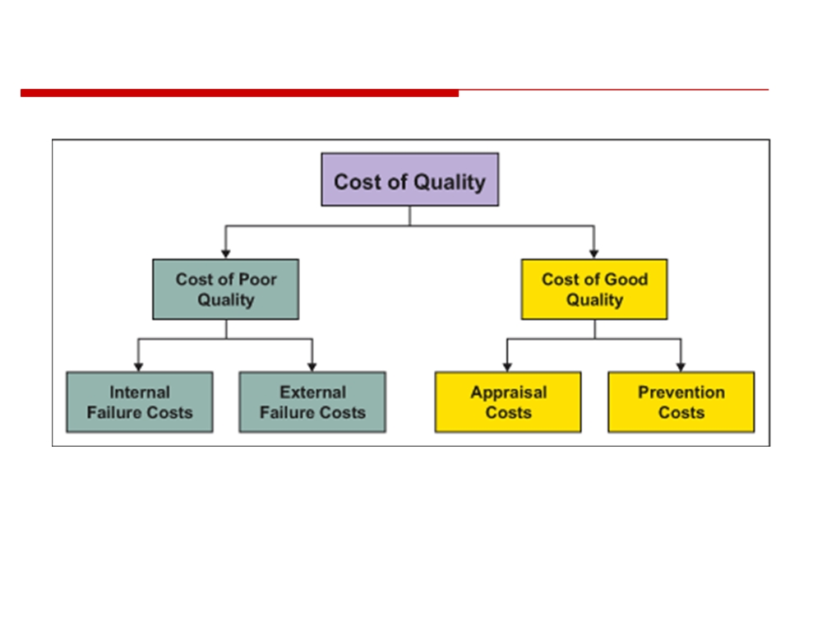
Value of Improvement or The Cost of Quality
Philip Crosby
© 2014 CMU-ISR
7

Slide 7
Internal Failure
•Rework
•Re-testing
•Delays
•Downgrading
•Re-designing
•Downtime
•Shortages
•Lack of flexibility
and adaptability
•Failure analysis
Can you think of others that directly
influence the company internally?
© 2014 CMU-ISR
8

Slide 8
External Failure
• Complaints
• Repairing goods and redoing services • Warranties
• Customers’ bad will
• Losses due to sales reductions • Environmental costs
© 2014 CMU-ISR
9

Slide 9
Prevention Costs
• Quality planning
• Supplier evaluation • New product review • Error proofing
• Capability evaluations
• Quality improvement team meetings • Quality improvement projects
• Quality education and training
© 2014 CMU-ISR
11

Slide 10
So These Are Some of the Sources for Estimating ROI
• The cost of doing business
• Prevention and checking what’s happening • The cost of failing to do it right
• Internal and external failures in quality • Therefore
The Cost of Poor Quality - the Cost of Good quality = The cost of Quality
© 2014 CMU-ISR
12

Slide 11
Other Things to Consider
• The business of quality.
• The impact of decisions and choices we make on the business we do.
• It is not that we have to fix what didn’t do right which is paying twice for the job.
•
…but the impact on our customer and the
market of bad quality.
© 2014 CMU-ISR
13

Slide 12
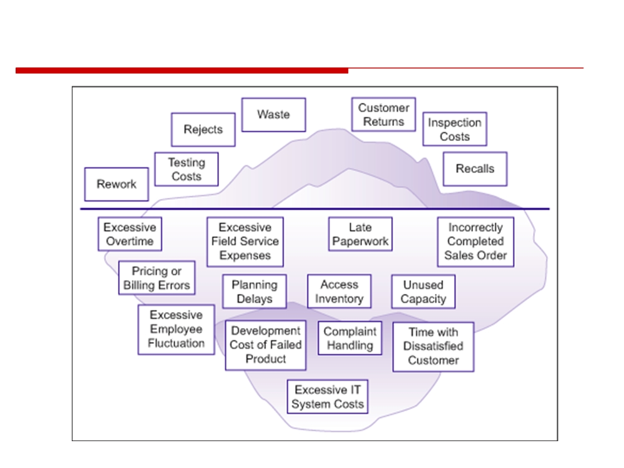
The Iceberg Model of Cost of Quality
© 2014 CMU-ISR
14

Slide 13
Homework Assignment
Investigate Cost of Quality

