Slide 1
Software Process & Quality Management
Mel Rosso-Llopart © 2014
Process Improvement - CMMI
Mel Rosso-Llopart
Senior Lecturer, Executive Education Program Institute for Software Research
Carnegie Mellon University

Slide 2

Agenda
• To explain the principles of software process improvement
• To explain how software process factors influence software quality and productivity
• To explain how to develop simple models of software processes
• To explain the notion of process capability and the CMMI process improvement model
© 2014 CMU-ISR
2

Slide 3

Process Attributes
Process
Description
characteristic
Understandability To what extent is the process explicitly defined and how easy is it to understand the process definition?
Visibility
Do the process activities culminate in clear results so that the
progress of the process is externally visible?
Supportability
To what extent can CASE tools be used to support the process
activities?
Acceptability
Is the defined process acceptable to and usable by the engineers
responsible for producing the software product?
Reliability
Is the process designed in such a way that process errors are
avoided or trapped before they result in product errors?
Robustness
Can the process continue in spite of unexpected problems?
Maintainability
Can the process evolve to reflect changing organisational
requirements or identified process improvements?
Rapidity
How fast can the process of delivering a system from a given
specification be completed?
© 2014 CMU-ISR
5

Slide 4
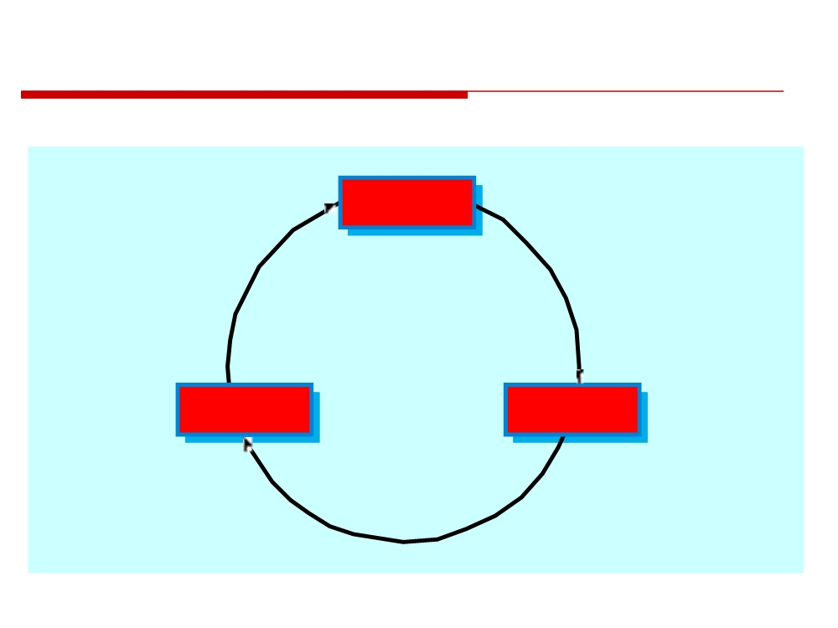
The Process Improvement Cycle
Measure
Change
Analyse
ODA - Observe Decide Act
© 2014 CMU-ISR
6

Slide 5
Process Improvement Stages
• Process Measurement
• Attributes of the current process are measured. These are a baseline for assessing improvements.
• Process Analysis
• The current process is assessed and bottlenecks and weaknesses are identified.
• Process Change
• Changes to the process that have been identified during the analysis are introduced.
© 2014 CMU-ISR
7

Slide 6
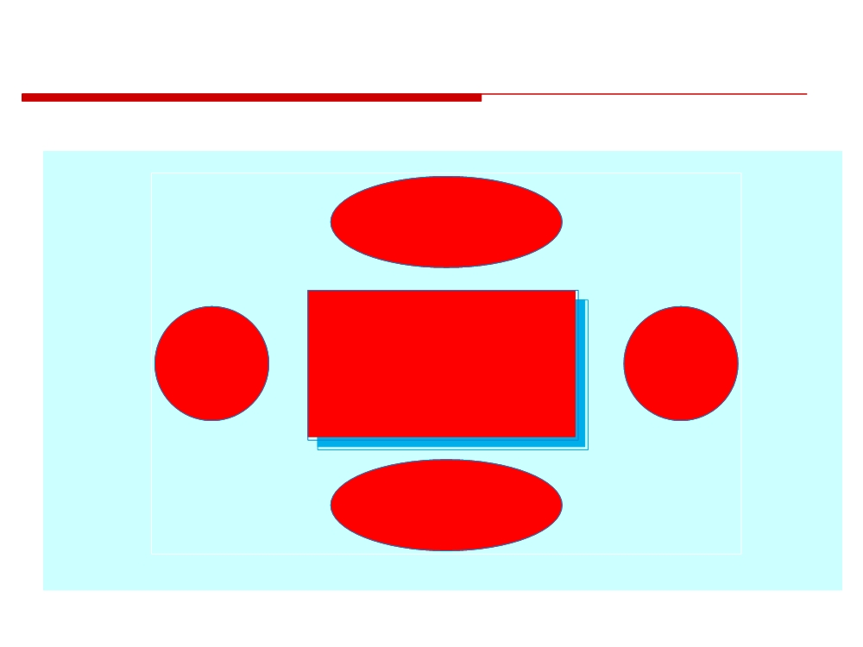
Principal Product Quality Factors
Development
technology
Process
Product
People
Quality
Quality
Quality
Cost, time and
schedule
© 2014 CMU-ISR
9

Slide 7
Process Classification
• Informal
• No detailed process model. Development team chose their own way of working.
• Managed
• Defined process model which drives the development process.
• Methodical
• Processes supported by some development method such as the RUP.
• Supported
• Processes supported by automated CASE tools.
© 2014 CMU-ISR
11

Slide 8
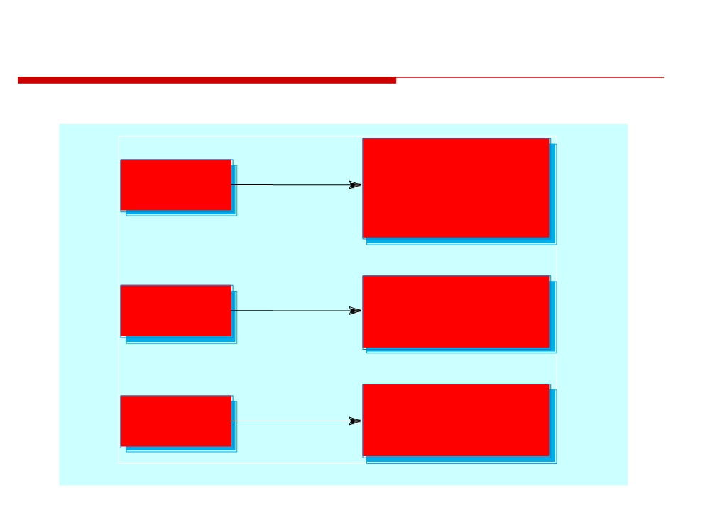
Process Applicability
Prototypes
Informal
Short-lifetime systems
process
4GL business systems
Small/medium-sized
systems
Managed
Large Systems
process
Long-lifetime products
Methodical
Well Understood
process
Application domain
Re-engineered systems
© 2014 CMU-ISR
12

Slide 9
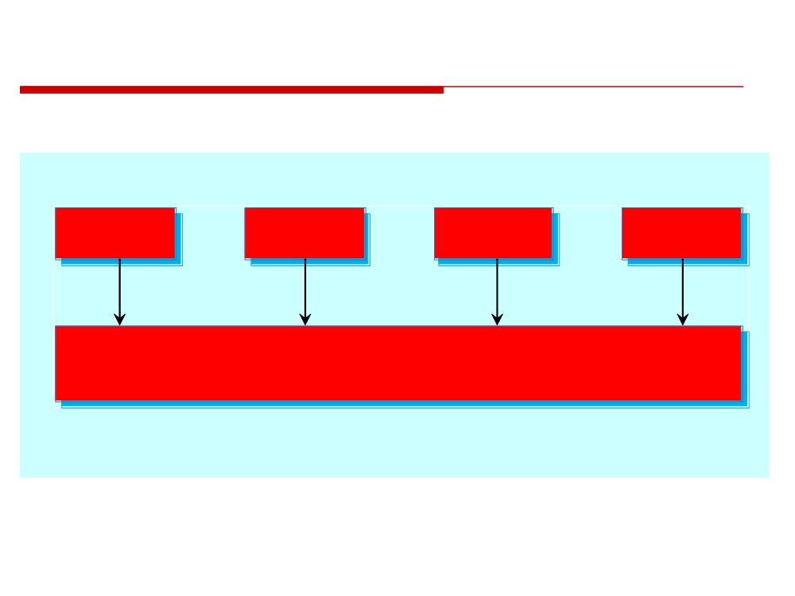
Process Tool Support
Informal
Managed
Methodical
Improving
process
process
process
process
Generic
Configuration
Project
Analysis and
Specialised
tools
management
management
design
tools
tools
tools
workbenches
© 2014 CMU-ISR
14

Slide 10
Process Measurement
• Wherever possible, quantitative process data should be collected
• However, where organisations do not have clearly defined process standards this is very difficult as you don’t know what to measure. A process may have to be defined before any measurement is possible.
• Process measurements should be used to assess process improvements
• But this does not mean that measurements should drive the improvements. The improvement driver should be the organizational objectives.
© 2014 CMU-ISR
15

Slide 11
Classes of Process Measurement
• Time taken for process activities to be completed
• E.g. Calendar time or effort to complete an activity or process
• Resources required for processes or activities
• E.g. Total effort in person-days
• Number of occurrences of a particular event
• E.g. Number of defects discovered
© 2014 CMU-ISR
16

Slide 12
Goal-Question-Metric Paradigm
• Goals
• What is the organisation trying to achieve? The objective of process improvement is to satisfy these goals.
• Questions
• Questions about areas of uncertainty related to the goals. You need process knowledge to derive these.
• Metrics
• Measurements to be collected to answer the questions.
© 2014 CMU-ISR
17

Slide 13
Process Analysis and Modelling
• Process analysis
• The study of existing processes to understand the relationships between parts of the process and to compare them with other processes.
• Process modelling
• The documentation of a process which records the tasks, the roles and the entities used;
• Process models may be presented from different perspectives.
© 2014 CMU-ISR
18

Slide 14

Process Model Elements 1
Activity
An activity has a clearly defined objective, entry and exit
(shown as a round-edged
conditions. Examples of activities are preparing a set of test data to
rectangle with no drop
test a module, coding a function or a module, proof-reading a
shadow)
document, etc. Generally, an activity is atomic i.e. it is the
responsibility of one person or group. It is not decomposed into
sub-activities.
Process
A process is a set of activities which have some coherence and
(shown as a round-edged
whose objective is generally agreed within an organisation.
rectangle with drop shadow)
Examples of processes are requirements analysis, architectural
design, test planning, etc.
Deliverable
A deliverable is a tangible output of an activity that is predicted in
(shown as a rectangle with
a project plan.
drop shadow)
Condition
A condition is either a pre-condition that must hold before a
(shown as a parallelogram )
process or activity can start or a post-condition that holds after a
process or activity has finished.
© 2014 CMU-ISR
21

Slide 15

Process Model Elements 2
Role
A role is a bounded area of responsibility. Examples of roles might
(shown as a circle with
be configuration manager, test engineer, software designer, etc. One
drop shadow)
person may have several different roles and a single role may be
associated with several different people.
Exception
An exception is a description of how to modify the process if some
(not shown in examples
anticipated or unanticipated event occurs. Exceptions are often
here but may be
undefined and it is left to the ingenuity (the quality of being clever, original, and inventive.) of the project managers and
represented as a double
edged box)
engineers to handle the exception.
Communication
An interchange of information between people or between people
(shown as an arrow)
and supporting computer systems. Communications may be
informal or formal. Formal communications might be the approval of a deliverable by a project manager; informal communications might be the interchange of electronic mail to resolve ambiguities in a document.
© 2014 CMU-ISR
22

Slide 16
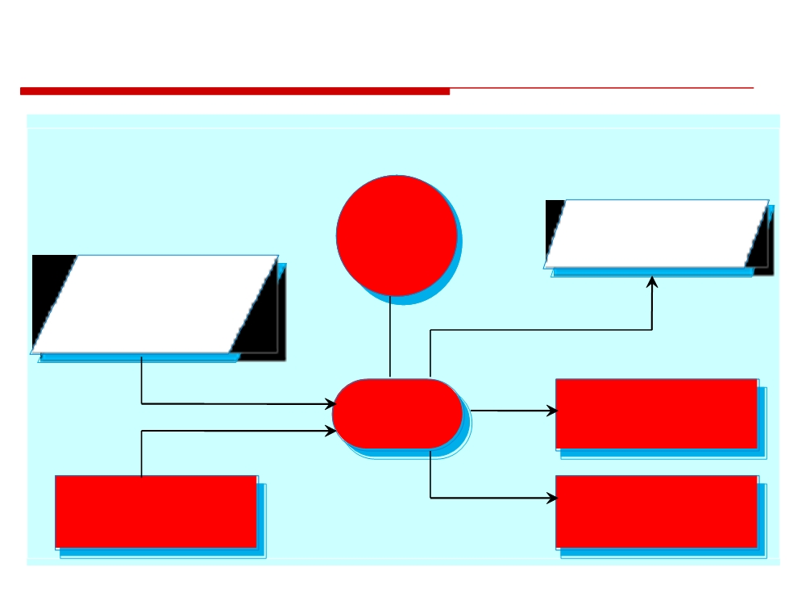
The Module Testing Activity
Role
Pre-condition
Post-condition
Test
All defined tests
Engineer
run on module
Module compiles
without syntax
errors
Responsible
for
Outputs
Test
Signed-off Test
Input
Record
Module
Process
Module
Module Test
Specification
data
© 2014 CMU-ISR
23

Slide 17
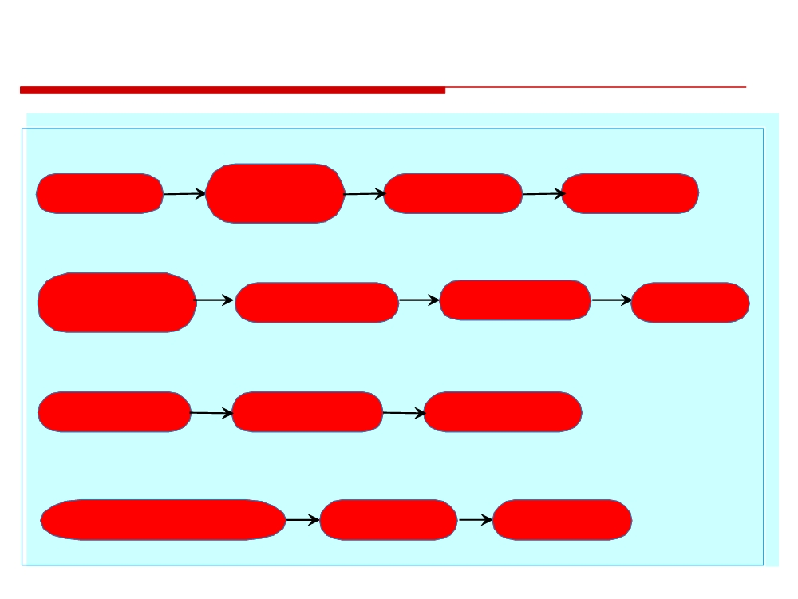
Activities in Module Testing
TEST DATA PREPARATION
Read module
Prepare test data
Submit test data
specification
According to
for review
Review test data
specification
MODULE TEST HARNESS PREPARATION
Check out module
Read and understand
Compile test
from Configuration
module interface
Prepare test harness
harness
Management system
for module
TEST EXECUTION
Incorporate module
Run approved tests
Record test results
with test harness
on module
for regression tests
TEST REPORTING
Write report on module testing including
Submit report
Submit test
details of discovered problems
For approval
Results to CM
© 2014 CMU-ISR
24

Slide 18
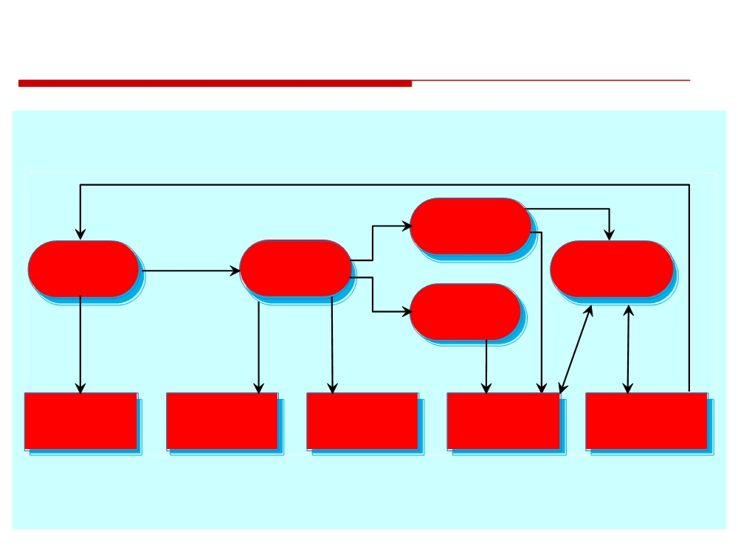
The Process Change Process
Introduce
Process change
Identify
Prioritize
Tune Process
Improvements
Improvements
Changes
Train
Engineers
Process
Process
Training
Feedback on
Revised Process
Model
Change Plan
Plan
Improvement
Model
© 2014 CMU-ISR
27

Slide 19
Process Change Stages
Improvement identification
Improvement prioritization
Process change introduction
Process change training
Change tuning
• Can you say ODA…
© 2014 CMU-ISR
28

Slide 20
Discussion
Compare to
Waterfall vs Agile
Based on Process model Elements

Slide 21

The CMMI Framework
• The CMMI framework is the current stage of work on process assessment and improvement that started at the Software Engineering Institute in the 1980s.
• The SEI’s mission is to promote software technology transfer particularly to US defence contractors.
• It has had a profound influence on process improvement
• Capability Maturity Model introduced in the early 1990s. • Revised maturity framework (CMMI) introduced in 2001.
© 2014 CMU-ISR
29

Slide 22
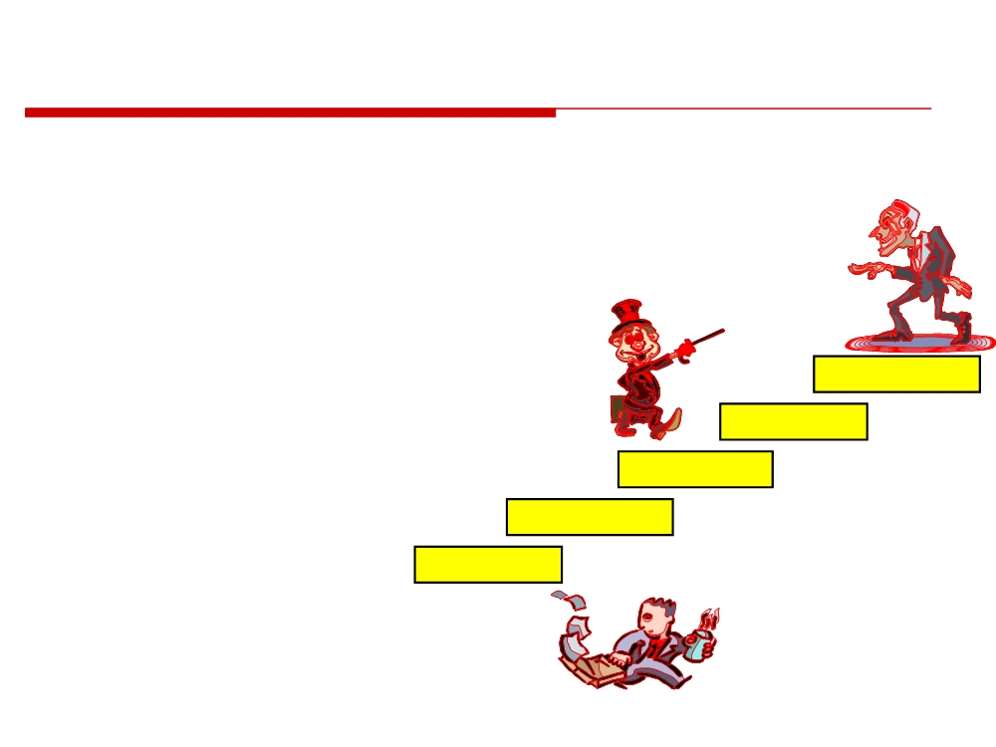
The SEI Capability Maturity Model
1. Initial
• Essentially uncontrolled 2. Repeatable
• Product management procedures defined and used
3. Defined
5- Optimizing
• Process management procedures
and strategies defined and used
4- Managed
4. Managed
3- Defined
• Quality management strategies defined
2- Repeatable
and used
1- Initial
5. Optimising
• Process improvement strategies defined and used
© 2014 CMU-ISR
31

Slide 23
The CMMI Model
• An integrated capability model that includes software and systems engineering capability assessment.
• The model has two instantiations
• Staged where the model is expressed in terms of capability levels;
• Continuous where a capability rating is computed.
© 2014 CMU-ISR
33

Slide 24
CMMI Model Components
• Process areas
•24 process areas that are relevant to process capability and improvement are identified. These are organized into 4 groups.
• Goals
• Goals are descriptions of desirable organizational states. Each process area has associated goals.
• Practices
• Practices are ways of achieving a goal - however, they are advisory and other approaches to achieve the goal may be used.
© 2014 CMU-ISR
34

Slide 25
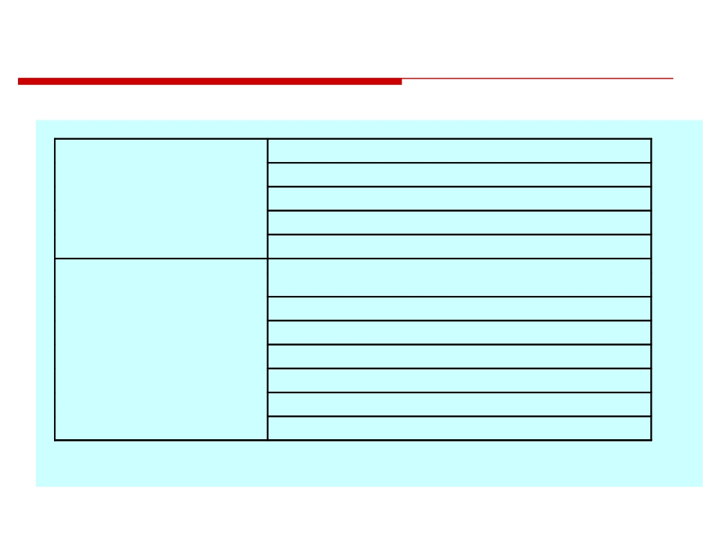
CMMI Process Areas 1
Organisational process definition
Organisational process focus
Process management
Organisational training
Organisational process performance Organisational innovation and deployment
Project planning
Project monitoring and control
Supplier agreement management
Project management
Integrated project management
Risk management
Integrated teaming
Quantitative project management
© 2014 CMU-ISR
35

Slide 26
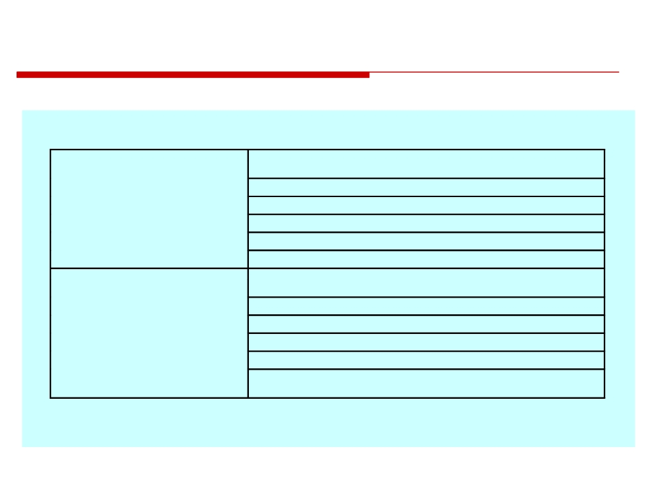
CMMI Process Areas 2
Requirements management
Requirements development
Engineering
Technical solution
Product integration Verification
Validation
Configuration management
Process and product quality management Measurement and analysis
Support
Decision analysis and resolution Organisational environment for integration Causal analysis and resolution
© 2014 CMU-ISR
36

Slide 27
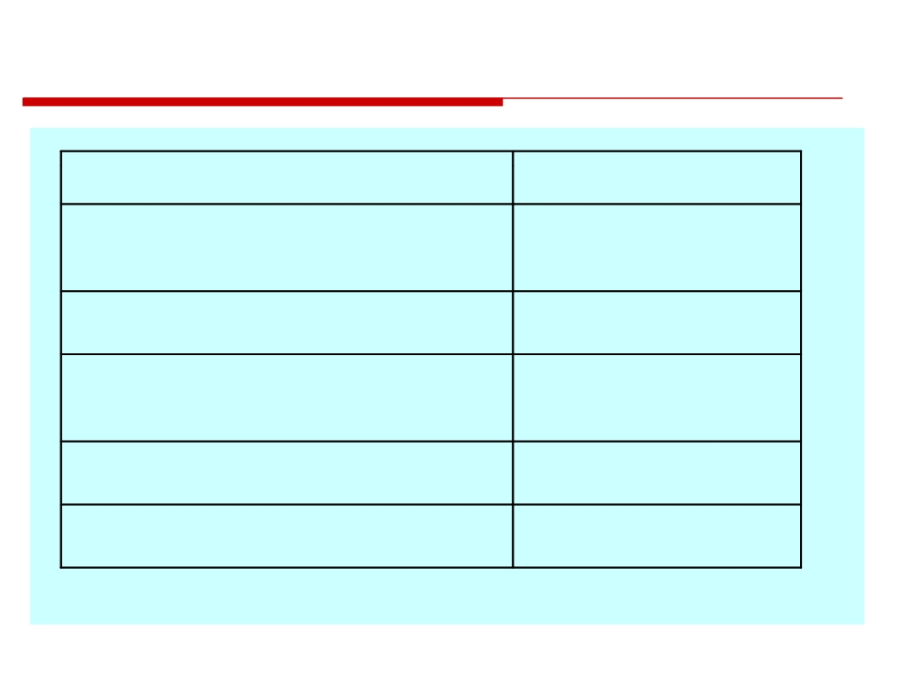
CMMI Goals
Goal
Process area
Corrective actions are managed to closure
Specific goal in Project
when the project’s performance or results
Monitoring and Control
deviate significantly from the plan.
Actual performance and progress of the
Specific goal in project
project is monitored against the project plan.
monitoring and control
The requirements are analysed and validated
Specific goal in
and a definition of the required functionality
requirements development.
is developed.
Root causes of defects and other problems
Specific goal in causal
are systematically determined.
analysis and resolution.
The process is institutionalised as a defined
Generic goal
process.
© 2014 CMU-ISR
37

Slide 28
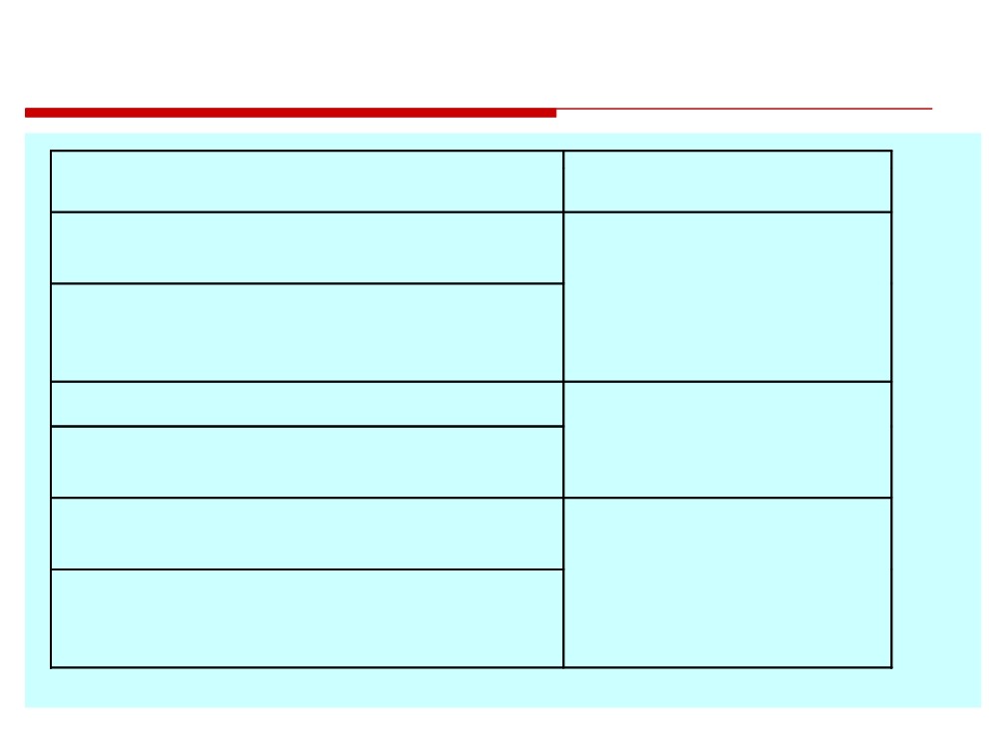
CMMI Practices
Practice
Associated goal
Analyse derived requirements to ensure that they are
The requirements are analysed and
necessary and sufficient
validated and a definition of the
required functionality is developed.
Validate requirements to ensure that the resulting product will perform as intended in the user’s environment using multiple techniques as appropriate.
Select the defects and other problems for analysis.
Root causes of defects and other
problems are systematically
Perform causal analysis of selected defects and other
determined.
problems and propose actions to address them.
Establish and maintain an organisational policy for planning
and performing the requirements development process.
The process is institutionalised as a
defined process.
Assign responsibility and authority for performing the
process, developing the work products and providing the
services of the requirements development process.
© 2014 CMU-ISR
38

Slide 29
CMMI Assessment
• Examines the processes used in an organization and assesses their maturity in each process area.
• Based on a 6-point scale:
0. Not performed
1. Performed 2. Managed 3. Defined
4. Quantitatively managed 5. Optimizing
© 2014 CMU-ISR
39

Slide 30
The Staged CMMI Model
• Comparable with the software CMM.
• Each maturity level has process areas and goals. For example, the process area associated with the managed level include:
• Requirements management;
• Project planning;
• Project monitoring and control;
• Supplier agreement management; • Measurement and analysis;
• Process and product quality assurance.
© 2014 CMU-ISR
40

Slide 31
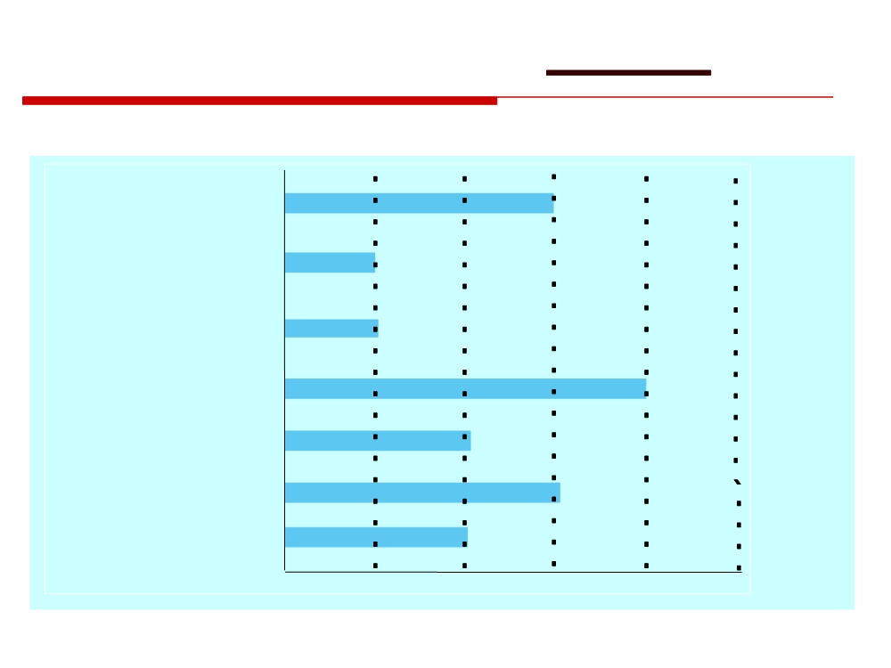
A Process Capability Profile
Project monitoring
and control
Supplier agreement Management
Risk
Management
Configuration Management
Requirements Management
Verification Validation
0
1
2
3
4
5
© 2014 CMU-ISR
44

Slide 32

Key Points
• Process improvement involves process analysis, standardisation, measurement and change.
• Processes can be classified as informal, managed, methodical and improving. This classification can be used to identify process tool support.
• The process improvement cycle involves process measurement, process analysis and process change.
• Process measurement should be used to answer specific process questions, based on organisational improvement goals.
© 2014 CMU-ISR
45

Slide 33
Key Points - 2
• The three types of process metrics used in the measurement process are time metrics, resource utilisation metrics and event metrics.
• Process models include descriptions of tasks, activities, roles, exceptions, communications, deliverables and other processes.
• The CMMI process maturity model integrates software and systems engineering process improvement.
• Process improvement in the CMMI model is based on reaching a set of goals related to good software engineering practice.
© 2014 CMU-ISR
46

Slide 34
Homework Assignment
Compare Waterfall vs. Agile Models/ or other process model
Deadline: before next class

Slide 35
http://www.sdlc.ws/agile-vs-waterfall/
http://www.completeitprofessional.com/agile-vs-waterfall/

