Slide 1
Software Process & Quality Management
Mel Rosso-Llopart © 2014
ITIL - Information Technology Infrastructure Library
Mel Rosso-Llopart
Senior Lecturer, Executive Education Program Institute for Software Research
Carnegie Mellon University

Slide 2

Introduction
• I.T.I.L. - Information Technology Infrastructure Library
• Originated from the UK
• UK government was not satisfied with quality of service from internal and external IT companies
• CCTA (Central Computer and Telecomm Agency) was instructed to develop a standard approach for efficient and effective delivery of IT Services
• Collection of “best practices”
© 2014 CMU-ISR
3

Slide 3
Benefits and Risks
• Benefits include:
• Provision of IT services becomes more customer-focused • Services are described better
• Better management of quality
• Improved communication within IT organization • Risks include:
• Can take a long time and require significant effort to use
• Over-engineered procedures can be seen as bureaucratic obstacles
• No real benefit if there is a fundamental lack of understanding about what the relevant processes should provide
© 2014 CMU-ISR
4
Notes:
Provision sự chuẩn bị, dự phòng

Slide 4
Definitions
• Service: means of delivering value to customers by facilitating outcomes the customers want to achieve without the ownership of specific costs or risks
• Function: subdivision of an organization that is specialized in fulfilling a specified type of work, and is responsible for specific end results.
© 2014 CMU-ISR
5

Slide 5
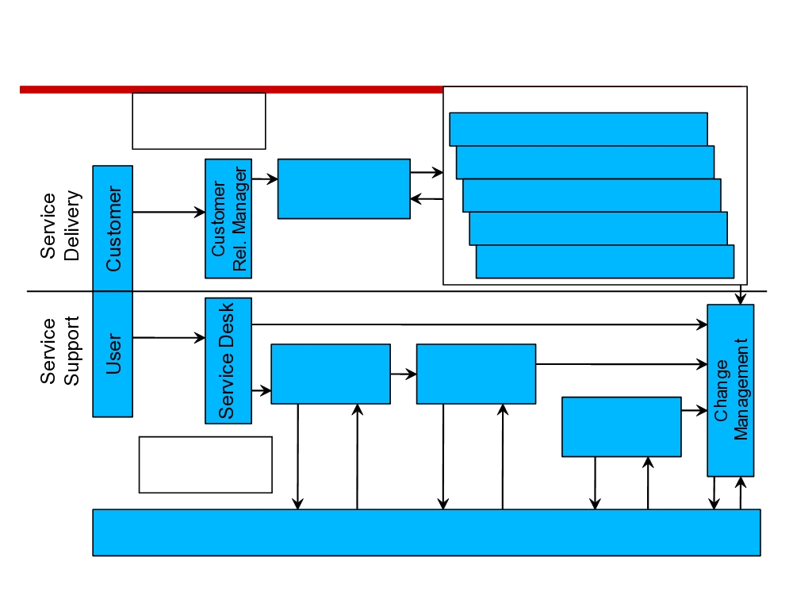
ITIL Process Overview
Demand
Performance Management
Management
Capacity Management
Availability Management
SLA
Management
Financial Management IT
Service
IT Svc Continuity
Entry
Point
Security Management
Incident
Problem
Service
Management
Management
Entry Point
Release
Management
Expectation Management
Configuration Management
© 2014 CMU-ISR
7
Notes:
Continuity liên tục
Incident điều bất ngờ

Slide 6
Service Support
Widely Used Process of IT
• Configuration Management
• Provide a logical model of the IT Infrastructure by identifying, controlling, maintaining and verifying the versions of all Configuration items
• Service Desk
• Central point of contact between users and the IT service Organization
• Incident Management
• Restore normal operations as quickly as possible
• Problem Management
• Prevent and minimize adverse effect on the business of errors in the IT Infrastructure
© 2014 CMU-ISR
8
Notes:
adverse tác dụng phụ, bất lợi

Slide 7
Service Support
Widely Used Process of IT - 2
• Change Management
• Ensure standardized methods and procedures are used for efficient prompt and authorized handling of all changes in the IT Infrastructure.
• Release Management
• Ensure that all technical and non-technical aspects of a release are dealt with in a coordinated approach
© 2014 CMU-ISR
9

Slide 8
Service Delivery
• Service Level Agreement (SLA) Management
• Maintain and improve IT service quality through a constant cycle of agreeing, monitoring, reporting and reviewing IT service achievements.
• Capacity Management
• Ensure that capacity and performance aspects of the business requirement are provided timely and cost effective.
• Availability Management
• Optimize the capability of the IT Infrastructure and supporting organization to deliver a cost effective and sustained level of availability to satisfy business objectives.
© 2014 CMU-ISR
10
Notes:
sustained duy trì, sự chịu đựng

Slide 9
Service Delivery - 2
• Financial Management for IT Services
• Provide Cost effective stewardship of IT assets and resources used in providing IT services.
• IT Service Continuity Management
• Ensuring that the required IT technical and service facilities can be recovered within the time scales required by Business Continuity Management.
• Security Management
• Managing a defined level of security for information and IT Services.
© 2014 CMU-ISR
11
Notes:
stewardship quản lý, quản gia

Slide 10
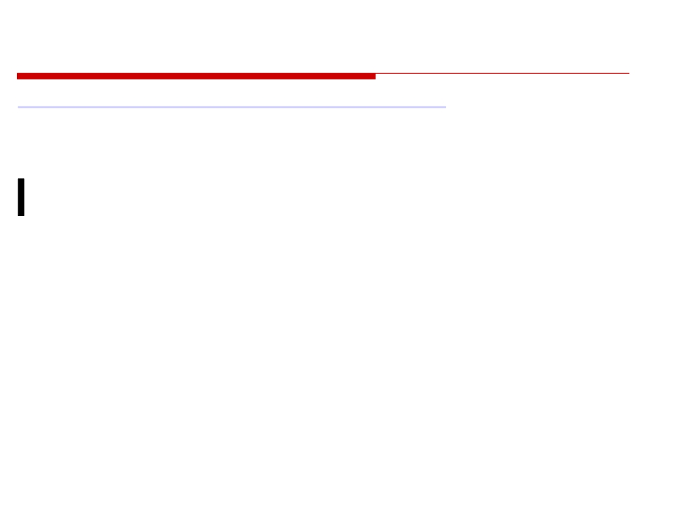
VIDEO
http://www.youtube.com/watch?v=w_3cDbo90aQ
• A Vlog by a person who took a 2 day ITIL course
• How others perceive ITIL.
© 2014 CMU-ISR
12
Notes:
perceive nhận thức

Slide 11

ITIL V3
Service Lifecycle (5 Phases)
• Service Strategy - designing, developing and implementing service management as a strategic resource
• Service Design - developing appropriate IT services, including architecture, processes, policy and documents; the design goal is to meet the current and future business requirements
• Service Transition - developing and improving capabilities for the transition of new and modified services to production
• Service Operation - achieving effectiveness and efficiency in providing and supporting services in order to ensure value for the customer and service provider
• Continual Service Improvement - creating and maintaining the value for the customer by design improvement, and service introduction and operation
© 2014 CMU-ISR
13

Slide 12
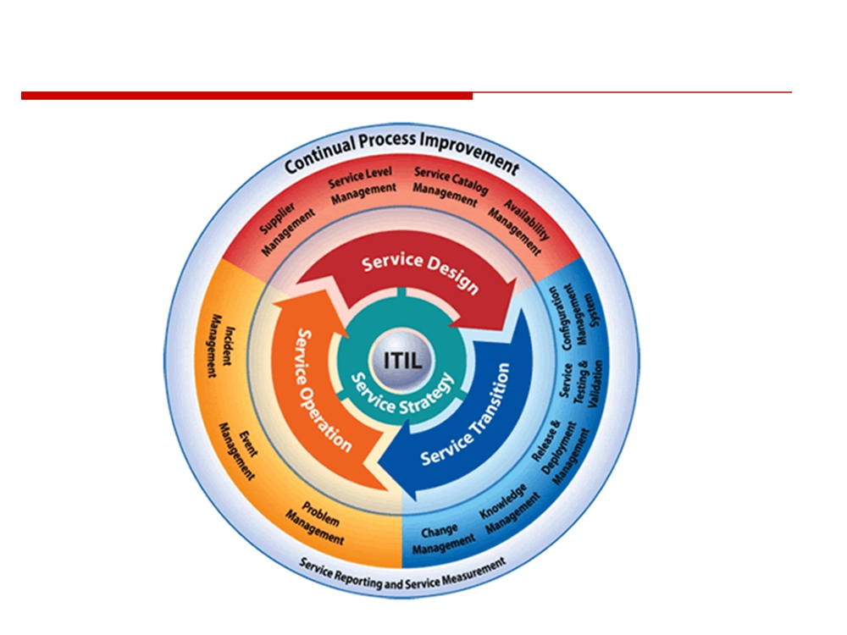
Service Lifecycle
© 2014 CMU-ISR
14

Slide 13
1. Service Strategy
•“Hub” of ITIL v3 core itself
• A view which aligns information technology and the business
• Helps in identifying, selecting and prioritizing opportunities
© 2014 CMU-ISR
15

Slide 14
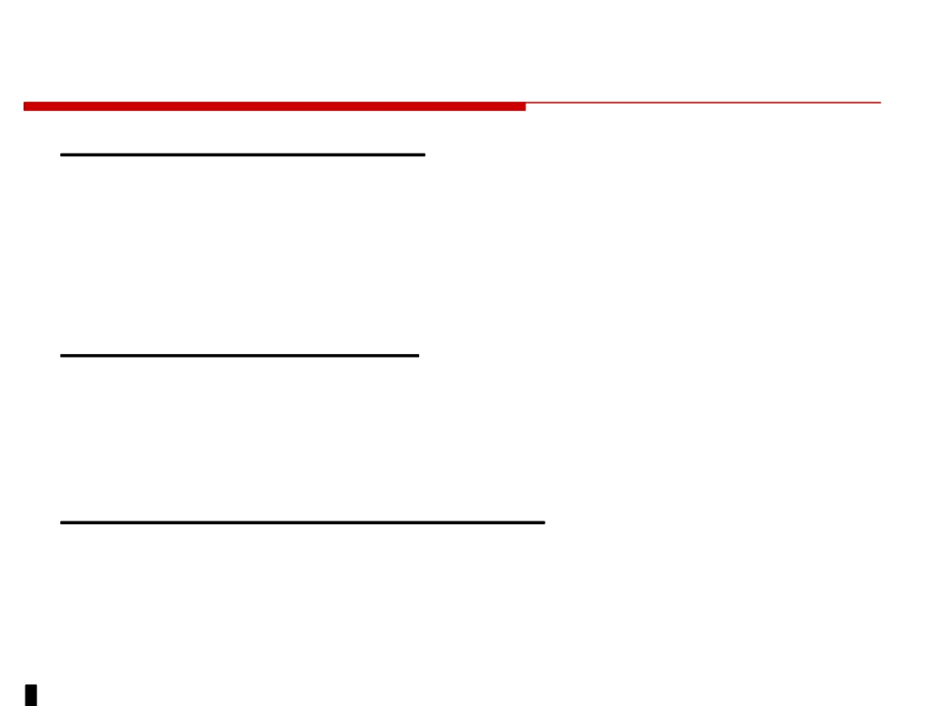
3 Processes at the Strategic Level
• Financial Management - anticipates the essential management information that is required for the guarantee of efficient and cost-effective service delivery
(Cost effectiveness)
• Demand Management - predict as accurately as possible the purchase of products, and if possible, to regulate it
(Meeting Demand)
• Service Portfolio Management - achieve maximum value creation while at the same time managing the risks and costs.
(Maximizing value)
© 2014 CMU-ISR
16

Slide 15
2. SERVICE DESIGN - 2
• Most important objective of Service Design:
•“The design of new or modified services for introduction into a production environment”
• Objectives include:
• To contribute to business objectives • Save time and money
• Minimize & prevent risks
• To contribute to satisfying current and future needs
• Delivery options: in sourcing, outsourcing, co- sourcing, multi sourcing,….
© 2014 CMU-ISR
17

Slide 16

3. SERVICE TRANSITION
• Service Transition: includes the management and co-ordination of the processes, systems and functions required for the building, testing and deployment of a ‘release’ into production, and establish the service specified in the customer and stakeholder requirements
Goals:
• supporting the change process of the business (client)
• reducing variations in the performance and known errors of the new/changed service
• ensuring the service meets the requirements of the service specifications.
© 2014 CMU-ISR
18

Slide 17
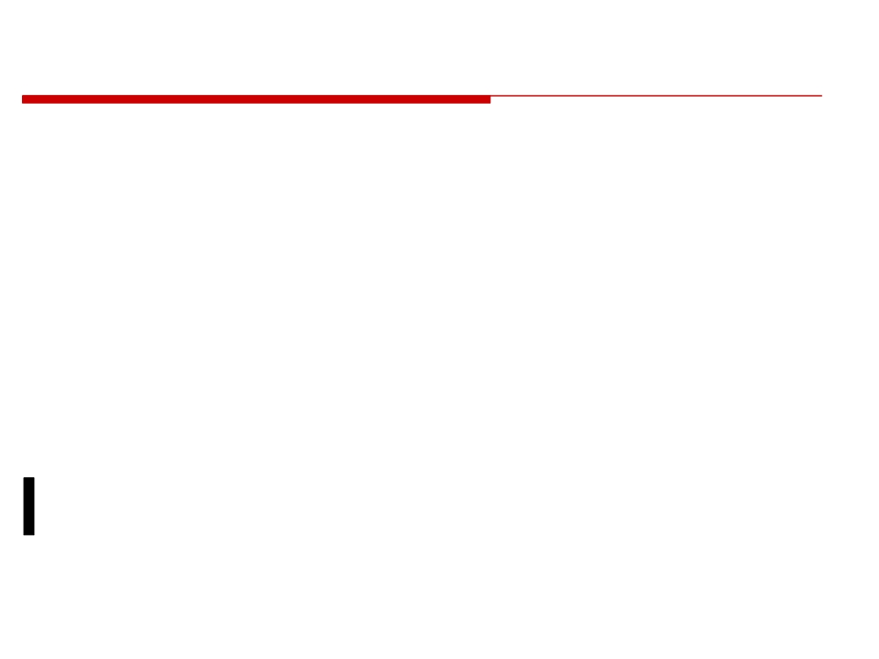
3. SERVICE TRANSITION - 2
Objectives:
• Necessary means to realize, plan and manage the new service
• Ensuring the minimum impact for the services which are already in production
• Improving customer satisfaction and stimulate the proper use of the service and mutual technology
© 2014 CMU-ISR
19

Slide 18

4. SERVICE OPERATION
• Service Operation: co-ordinate and fulfill activities and processes required to provide and manage services for business users and customers with a specified agreed level
Providing support for: • The services
• The service management processes • The technology
• The people
© 2014 CMU-ISR
20

Slide 19

4. SERVICE OPERATION - 2
• Processes within Service Operation • Event management
• Incident management
• Problem management
• Request fulfillment
• Access Management
• Monitoring and Control • IT operations
© 2014 CMU-ISR
21

Slide 20
5. CONTINUAL SERVICE IMPROVEMENT
• Goal: continual improvement of the effectiveness and efficiency of IT services, allowing them to meet the business requirements better
• Continual Service Improvement(CSI):
• Process compliance - following process or using tools
• Quality - are process activities meeting their goals
• Performance - measuring process efficiency/elapsed times
• Business Value of a process - makes a difference/ effectiveness
© 2014 CMU-ISR
22
Notes:
compliance tuân thủ, làm cho đúng

Slide 21
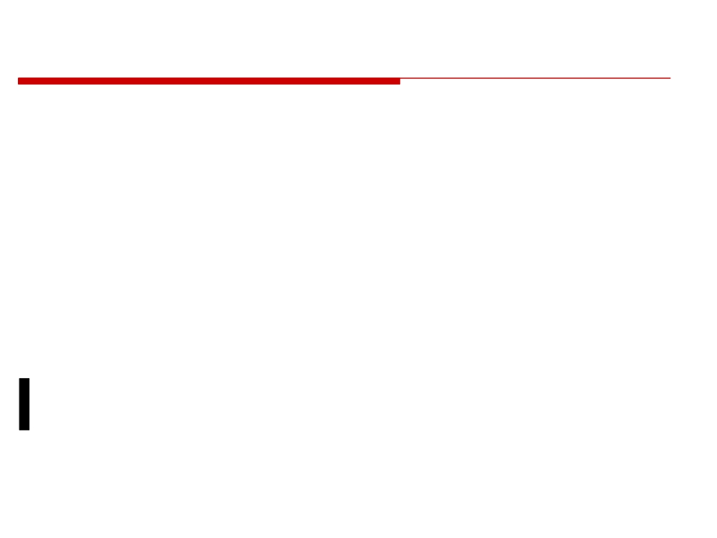
ITIL and Day-to-Day Work
• Resolving incidents and problems • Creating change requests
• Software development
• Software releases
• Hardware and Software research
• From start to finish of the IT daily operations.
© 2014 CMU-ISR
23

Slide 22
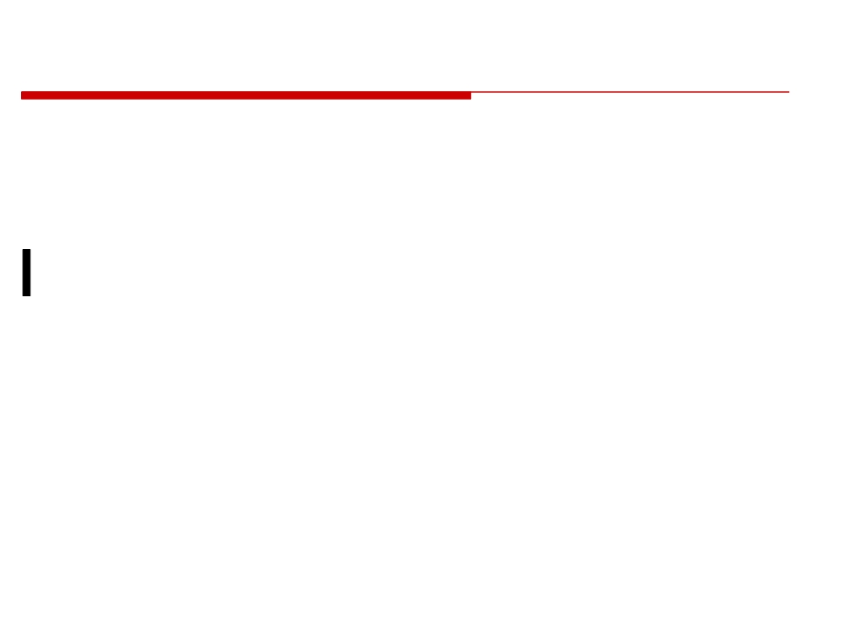
References
•
“Foundations of IT Service Management Based on ITIL V3” (itSMF
International)
• http://en.wikipedia.org/wiki/ITIL
© 2014 CMU-ISR
26

Slide 23
Homework Assignment
Investigate ITIL
Reading: ISO lecture, summary and questions for next class.

