Slide 1
Software Process & Quality Management
Mel Rosso-Llopart © 2014
CoBit - Control Objectives for Information and Related Technology
Mel Rosso-Llopart
Senior Lecturer, Executive Education Program Institute for Software Research
Carnegie Mellon University

Slide 2

History of CoBit
•1996 - CoBit was developed by ISACF (Information Systems Audit and Control Foundation)
•1998 - Founding of the ITGI (IT Governance Institute)
•1998 - ITGI begins an initiative for better IT Governance, focused around CoBit.
• http://www.isaca.org
http://www.itgi.org
© 2014 CMU-ISR
3

Slide 3
CoBiT là một chuẩn quốc tế về quản lý CNTT gồm những khuôn mẫu(framework) về các thực hành tốt nhất về quản lý CNTT do ISACA và ITGI xây dựng năm 1996. CoBiT cung cấp cho các nhà quản lý, những người kiểm tra và những người sử dụng IT một loạt các cách đo lường, dụng cụ đo, các quy trình và các hướng dẫn thực hành tốt nhất để giúp tăng tối đa lợi nhuận thông qua việc sử dụng công nghệ thông tin; giúp quản lý và kiểm soát IT trong tổ chức, doanh nghiệp.
Mục đích của COBIT là “nghiên cứu, phát triển, quảng bá và xúc tiến các mục tiêu của kiểm soát CNTT dành cho các nhà quản lý doanh nghiệp và những người kiểm tra áp dụng vào trong các hoạt động công việc”

Slide 4
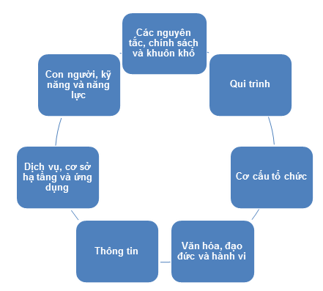

Slide 5
COBIT® được thiết kế với hơn 200 mục tiêu kiểm soát, phục vụ cho 34 quy trình CNTT chính yếu tổ chức theo bốn lĩnh vực quan trọng là:
Lập kế hoạch & Tổ chức (Plan & Organize),
Xây dựng & Triển Khai (Acquire & Implement),
Bàn giao & Hỗ trợ (Deliver & Support),
Giám sát & Đánh giá (Monitor & Evalute).
Tất cả những tiêu thức trên được thiết kế để đảm bảo 5 yêu cầu chính của tổ chức, doanh nghiệp đối với CNTT bao gồm:
Liên kết chiến lược (Strategic Alignment),
Hiện thực hoá giá trị cam kết (Value Delivery),
Quản lý nguồn lực (Resource Management),
Quản lý rủi ro (Risk Management) và
Quản lý thực hiện (Performance Measurement).

Slide 6

What is COBIT?
• COBIT (Control Objectives for Information and Related Technology) is globally accepted as being the most comprehensive work for IT governance, organization, as well as IT process and risk management.
• COBIT provides good practices for the management of IT processes in a manageable and logical structure, meeting the multiple needs of enterprise management by bridging the gaps between business risks, technical issues, control needs and performance measurement requirements.
• The COBIT mission is to research, develop, publicize and promote an authoritative, up-to-date, international set of generally accepted information technology control objectives for day-to-day use by business managers and auditors.
© 2014 CMU-ISR
4

Slide 7

More History - Deming Cycle
• Deming Cycle - continuous improvement process
• CoBit uses - Plan-Do-Check-Act Cycle • CoBit reflects
• Information need - Corporate view
• Information technology - IT Governance
© 2014 CMU-ISR
5

Slide 8
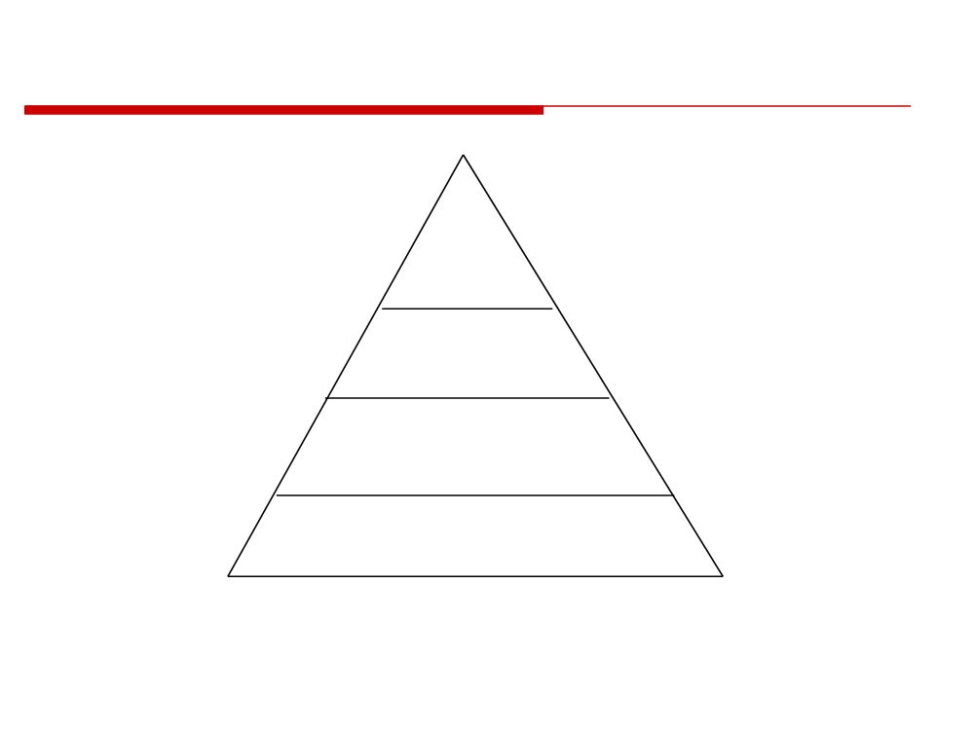
CoBit’s Hierarchy
CoBit’s Top Down Approach
• Plan and Organize (PO)
• Acquire and Implement (AI)
• Deliver and Support (DS)
4
Domains
• Monitor and Evaluation (M)
34
Processes
318
Control Objectives
1,547
Control Practices
© 2014 CMU-ISR
6

Slide 9
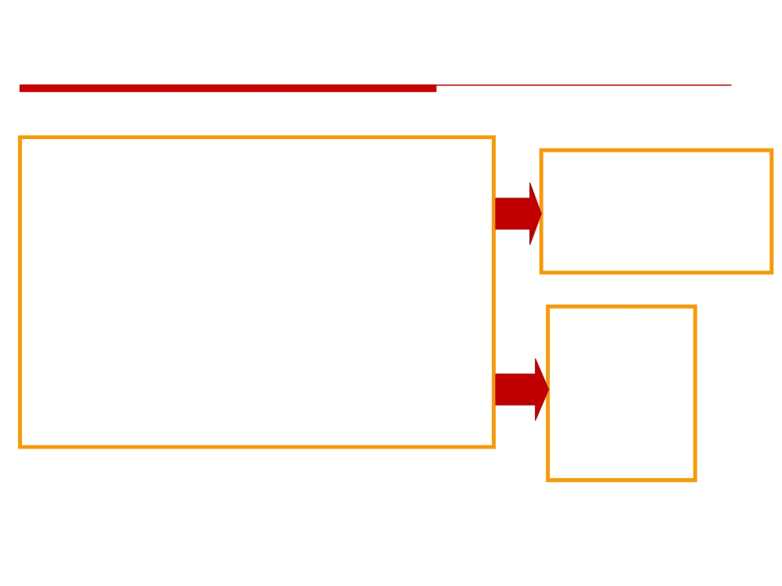
Point of View for CoBit
• Starts from the premise that IT needs to deliver the
1.
Planning
information that the enterprise needs to achieve its
objectives.
2.Acquiring & Implementing
• Promotes process focus and process ownership
3.
Delivery & Support
• Divides IT into 34 processes belonging to four domains
4.
Monitoring
and provides a high level control objective for each
• Looks at fiduciary, quality and security needs of
1.
Effectiveness
enterprises, providing seven information criteria that can
2.
Efficiency
be used to generically define what the business requires
3.
Availability
from IT
4.
Integrity
• Is supported by a set of 318 detailed control objectives
5.
Confidentiality
6.
Reliability
7.
Compliance
© 2014 CMU-ISR
7

Slide 10
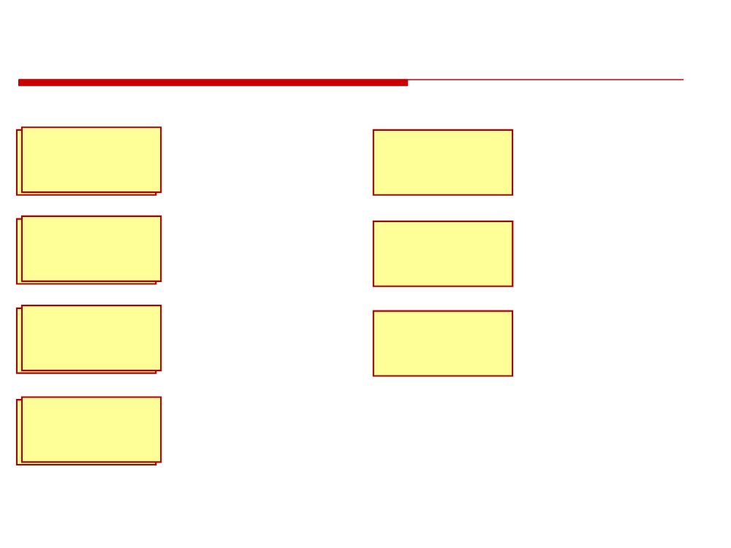
CoBit Definitions - 7 Information Criteria
Deals with information being
relevant and pertinent to the
Relates to the information
EFFECTIVENESS
business process as well as
AVAILABILITY
being available when required
being delivered in a timely,
by the business process now
correct, consistent and
and in the future
usable manner
Concerns the provision of the
Deals with complying with
EFFICIENCY
information through the
COMPLIANCE
laws, regulations and
optimal use of resources
contractual arrangements.
Concerns the protection of
RELIABILITY OF
Relates to the provision of
CONFIDENTIALITY
sensitive information from
appropriate information for
unauthorized disclosure
INFORMATION
the workforce of the
organization
Relates to the accuracy and completeness of information
INTEGRITY
as well as to its validity in accordance with business values and expectations
© 2014 CMU-ISR
8

Slide 11
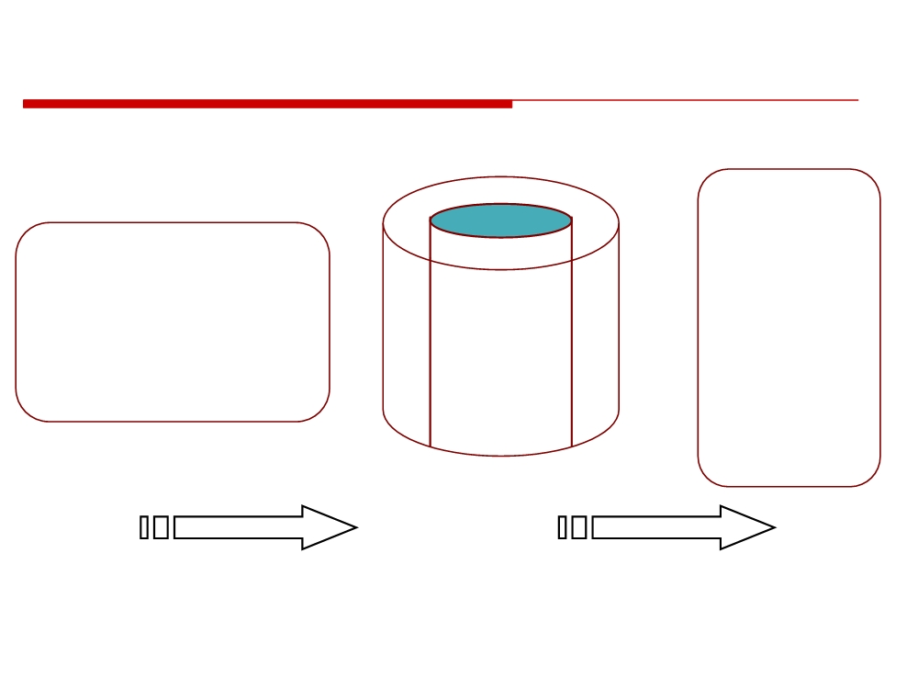
General Information Risk Criteria
Events can be defined in terms of the processes, technology (systems) and organization (people) that compose them
RISK
DATA
CRITERIA
EVENTS
Effectiveness
Business Operations
Efficiency
Business Opportunities
PROCESS
Confidentiality
External Requirements
TECHNOLOGY
Integrity
Regulations
ORGANIZATION
Availability
Compliance Reliability
MESSAGE INPUT
SERVICE OUTPUT
© 2014 CMU-ISR
9

Slide 12

The 4 COBIT Domains
Planning & Organization
Acquisition & Implementation
Delivery & Support
4. Monitoring & Evaluation
© 2014 CMU-ISR
10

Slide 13

Planning and Organization
• This domain covers strategy and tactics, and concerns the identification of the way IT can best contribute to the achievement of the business objectives.
• Furthermore, the realization of the strategic vision needs to be planned, communicated and managed for different perspectives.
• Finally, a proper organization as well as technological infrastructure must be put in place.
© 2014 CMU-ISR
11

Slide 14

Acquisition and Implementation
• To realize the IT strategy, IT solutions need to be identified, developed or acquired, as well as implemented and integrated into the business process.
• In addition, changes in and maintenance of existing systems are covered by this domain to make sure that the life cycle is continued for these systems.
© 2014 CMU-ISR
12

Slide 15
Delivery and Support
• This domain is concerned with the actual delivery of required services, which range from traditional operations over security and continuity aspects to training.
• In order to deliver services, the necessary support processes must be set up.
• This domain includes the actual processing of data by application systems, often classified under application controls.
© 2014 CMU-ISR
13

Slide 16

Monitoring & Evaluation
• All IT processes need to be regularly assessed over time for their quality and compliance with control requirements.
• This domain thus addresses management’s oversight of the organization's control process and independent assurance provided by internal and external audit or obtained from alternative sources.
• The assessment if the values are as expected and meet with organizational expectations.
© 2014 CMU-ISR
14

Slide 17
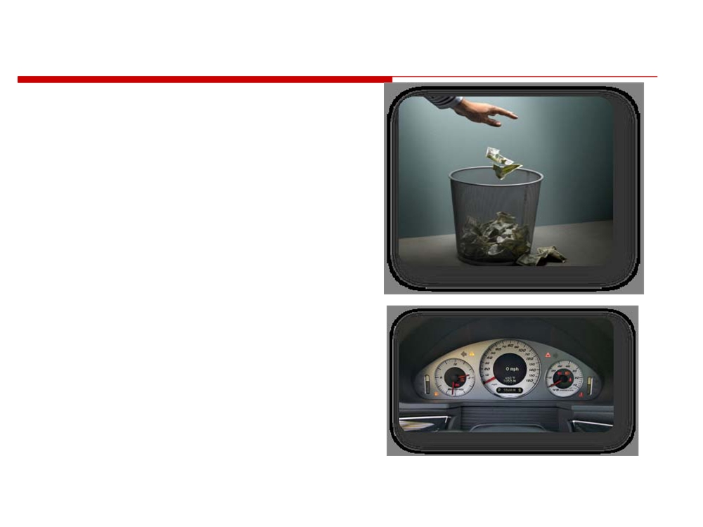
IT Governance is the Key Issue
• Enterprises are sacrificing
money, productivity and competitive advantage by not implementing effective IT governance
• Executives need a better way to:
- Direct IT for optimal advantage
- Measure the value provided by IT
- Manage IT-related risks
 2009 ISACA All Rights reserved. 15
© 2014 CMU-ISR
15

Slide 18
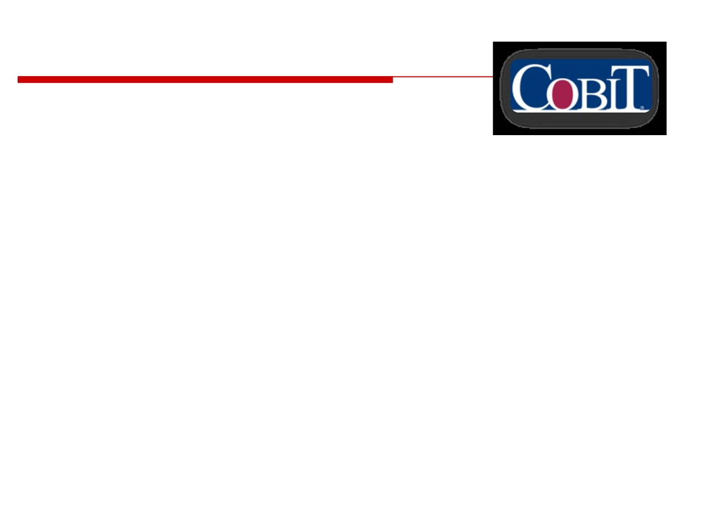
COBIT® is a Road Map to Good IT Governance
• Accepted globally as a set of tools that ens effectively
• Functions as an overarching framework
• Provides common language to communicate goals, objectives and expected results to all stakeholders
• Based on, and integrates, industry standards and good practices in:
- Strategic alignment of IT with business goals - Value delivery of services and new projects - Risk management
- Resource management - Performance measurement
 2009 ISACA All Rights reserved. 16
© 2014 CMU-ISR
16

Slide 19
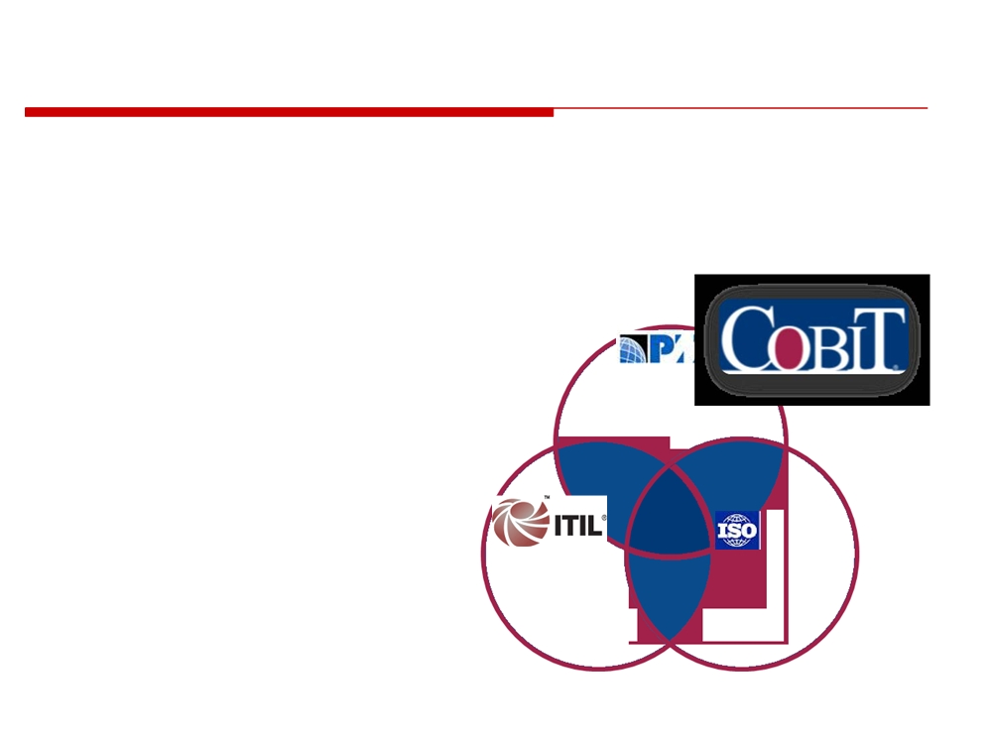
COBIT® Harmonises with other Standards
• COBIT is often used at the highest level of IT governance
• It harmonizes practices and standards such as ITIL, ISO 27001 and 27002, and PMBOK
- Improves their alignment
to business needs
- Covers full spectrum of IT-related activities
27001/2
 2009 ISACA All Rights reserved. 17
© 2014 CMU-ISR
17

Slide 20

Why and How is COBIT Used?
COBIT as a response to the needs
➢ Incorporates major international
standards
➢ Has become the de facto standard for overall control over IT
COBIT
➢ Starts from business requirements
➢ Is process-oriented
best practices
repository for
IT Processes
IT Management Processes IT Governance Processes
© 2014 CMU-ISR
18

Slide 21
COBIT
PO1 Define a strategic IT plan
Framework
PO2 Define the information architecture PO3 Determine the technological direction
Criteria
PO4 Define the IT organisation and relationships
• Effectiveness
PO5 Manage the IT investment
• Efficiency
• Confidenciality
PO6 Communicate management aims and direction
• Integrity
PO7 Manage human resources
• Availability
PO8 Ensure compliance with external requirements
• Compliance
PO9 Assess risks
• Reliability
PO10 Manage projects
IT
PO11 Manage quality
M1 Monitor the process
RESOURCES
M2 Assess internal control adequacy
M3 Obtain independent assurance
• Data
M4 Provide for independent audit
• Applicatio
• Technology
• Facilities
• People
PLAN AND
ORGANISE
MONITOR AND EVALUATE
ACQUIRE AND IMPLEMENT
DS1 Define service levels DS2 Manage third-party services DS3 Manage peformance and capac DS4 Ensure continuous service
DS5 Ensure systems security
DELIVER AND
DS6 Identify and attribute costs
SUPPORT
DS7 Educate and train users
AI1 Identify automated solutions
DS8 Assist and advise IT customers
AI2 Acquire and mantain application software
DS9 Manage the configuration
AI3 Acquire and maintain technology infrastructure
DS10 Manage problems and incidents
AI4 Develop and maintain IT procedures
DS11 Manage data
AI5 Install and accredit systems
DS12 Manage facilities
AI6 Manage changes
DS13 Manage operations
© 2014 CMU-ISR
19

Slide 22
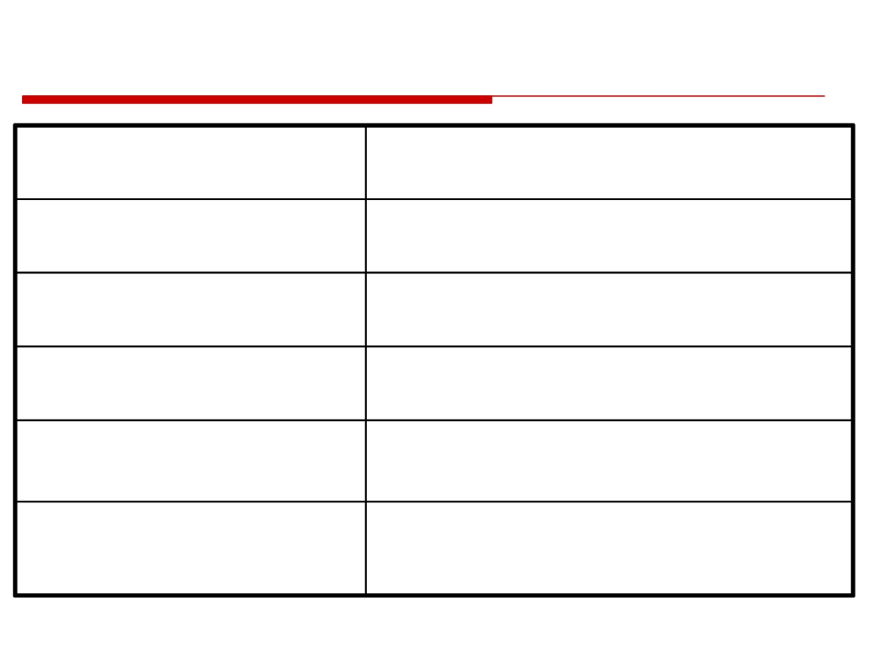
Basic CoBit Documentation Support
Executive Summary
There is a method…
Framework
The method is…
Control Objectives
Minimum controls are…
Audit Guidelines
Here is how you audit…
Implementation Toolset
Here is how you implement…
Management Guidelines
Here is how you measure…
© 2014 CMU-ISR
20

Slide 23
References
http://ecci.com.vn/tu-van/dich-vu/trien-khai-cobit
http://quantri-cntt.blogspot.com/2013/06/gioi-thieu-ve-cobit.html
http://www.isaca.org/COBIT/Documents/Recognition-table.pdf
http://www.isaca.org/Knowledge-Center/cobit/Pages/COBIT-Case-Studies.aspx
http://www.isaca.org/Knowledge-Center/COBIT/Pages/Overview.aspx

Slide 24
Homework
Prepare - Case study 2 (FibreNet Project)

