Slide 1
Software Process & Quality Management
Mel Rosso-Llopart © 2014
ISO 9000
What You Need to Know
Mel Rosso-Llopart
Senior Lecturer, Executive Education Program Institute for Software Research
Carnegie Mellon University

Slide 2

What are ISO 9000 Standards?
• ISO 9000 Standards
• Define the required elements of an effective quality management system
• Can be applied to any company
• Adopted by the United States as the ANSI/ASQC Q90 series.
• Revised 2000 - wider applicability
© 2014 CMU-ISR
3

Slide 3
Quality Management
• ISO 9001 is for quality management.
• Quality refers to all those features of a product (or service) which are required by the customer.
• Quality management means what the organization does to
• ensure that its products or services satisfy the customer's quality requirements and
• comply with any regulations applicable to those products or services.
© 2014 CMU-ISR
4

Slide 4
Quality Management (cont.)
• Quality management also means what the organization does to
• enhance customer satisfaction, and
• achieve continual improvement of its performance.
© 2014 CMU-ISR
5

Slide 5

Processes, Not Products
• ISO 9001 is concerned about the way an organization goes about its work.
• It is not product standards. • It is not service standards. • It is process standards.
• And it can be used by product manufacturers and service providers.
© 2014 CMU-ISR
6

Slide 6
Processes, Not Products (cont.)
• Processes affect final products or services.
• ISO 9001 gives the requirements for what the organization must do to manage processes affecting quality of its products and services.
© 2014 CMU-ISR
7

Slide 7
Certification is a Business Decision
• Certification is a decision to be taken for business reasons:
• if it is a contractual, regulatory, or market requirement,
• if it meets customer preferences
• if it is part of a risk management program, or
• if it will motivate staff by setting a clear goal.
© 2014 CMU-ISR
8

Slide 8
ISO Does Not Certify
• ISO does not carry out ISO 9001 certification.
• ISO does not issue certificates.
• ISO does not accredit, approve or control the certification bodies.
• ISO does develop standards and guides to encourage good practice in
accreditation and certification.
© 2014 CMU-ISR
9

Slide 9
The ISO 9000 Family
• ISO 9001 is the standard that gives the requirements for a quality management system.
• ISO 9001:2000* is the latest, improved version. • It is the only standard in the ISO 9000 family that can be used for certification.
• There are 14 other standards in the family that can help an organization on specific aspects such as: performance improvements, quality plans, projects, configuration management, measurement
processes and measuring equipment, system documentation, realizing financial and economic benefits, training, the selection and use of consultants, quality and/or environmental management systems auditing, complaints handling, codes of conduct for
customer satisfaction, and dispute resolution.
* The year may change.
© 2014 CMU-ISR
10

Slide 10
Who Created the Standards?
• International Organization for Standardization - Geneva
• ISO tech committee - TC 176 started in 1979
• Standards created in 1987
• To eliminate country to country differences • To eliminate terminology confusion
• To increase quality awareness
© 2014 CMU-ISR
11

Slide 11
How Did ISO Get Started?
•
1906 - International Electro-Technical
Commission
•1926 - International Federation of the National Standardizing Associations (ISA)
•1946 London - delegates from 25 countries decided to create a new international organization "the object of which would be to facilitate the international coordination and unification of industrial standards
•
1947 - ISO began to officially function
•
1951 - The first ISO standard was published
•
"Standard reference temperature for industrial length
measurement".
© 2014 CMU-ISR
12

Slide 12
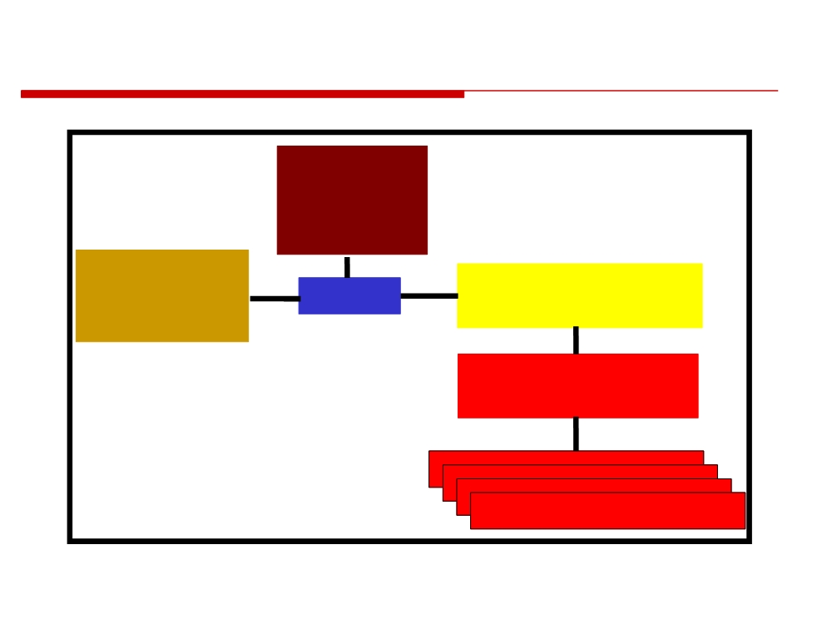
ISO Organization
General
Assembly
Policy
Technical
Development
Council
Management Board
Committees
Technical Advisory
Groups
Technical Committees
© 2014 CMU-ISR
13

Slide 13
What Has ISO Accomplished?
• ISO film speed code
• Standard format for telephone and banking cards
• ISO 9000 which provides a framework for quality management and quality assurance
• ISO 14000 series provides a similar framework for environmental management
• Internationally standardized freight containers • Standardized paper sizes.
• Automobile control symbols
• ISO international codes for country names, currencies and languages
© 2014 CMU-ISR
14

Slide 14

ISO 9000:2000 Consists of 3 Areas
• ISO 9000:2000 Quality Management Systems: fundamentals and vocabulary
• ISO 9001:2000 Quality Management Systems - Requirements (required for certification)
• Management responsibility
• Resource management
• Product/service realization
• Measurement, analysis, improvement
• ISO 9004-2000 Quality Management Systems - Guidelines for performance improvement
© 2014 CMU-ISR
15

Slide 15
What are the Elements of the Standards?
Management
Process Control
Responsibility
•Inspection and Testing
•Resource Management
•Inspection, Measuring
•Quality System
and Test Equipment
•Contract Review
•Inspection and Test
Status
•Design Control
•Control of Non-
•Document Control
conforming product
•Purchasing
•Corrective Action
•Purchaser-Supplied
•Quality Records
Product
•Internal Quality Audit
•Product Identification and Traceability
•Training
•Servicing
•Statistical Techniques
© 2014 CMU-ISR
16

Slide 16
Element Standard:
Management Responsibility
• Management must have a written policy statement of their commitment to quality. This policy must be communicated to and understood by all employees.
• Management must clearly define quality- related organizational responsibilities and interrelationships.
• A management representative must be assigned to oversee the implementation and continuous improvement of the quality system.
• Senior management must continually review the system.
© 2014 CMU-ISR
17

Slide 17
Element Standard: Process Control
• The company must identify all processes that directly affect the quality of the product or service and ensure that these processes are carried out under controlled conditions, including:
• Formal approval of process design and equipment.
• Documented work instructions.
• Development of quality plans describing how the process is to be monitored.
• A suitable working environment. • Documented quality criteria.
© 2014 CMU-ISR
18

Slide 18

Why is ISO 9000 Important?
• European Union directive
• ISO 9000 certification required by suppliers of “Regulated Products”
• health, safety, and the environment
• EC has strict corporate liability legislation protecting consumers
• Globalization impact
© 2014 CMU-ISR
19

Slide 19
Why Adopt ISO 9000?
• To comply with customers who require ISO 9000
• To sell in the European Union market • To compete in domestic markets
• To improve the quality system
• To minimize repetitive auditing by similar and different customers
• To improve subcontractors’ performance
© 2014 CMU-ISR
20

Slide 20
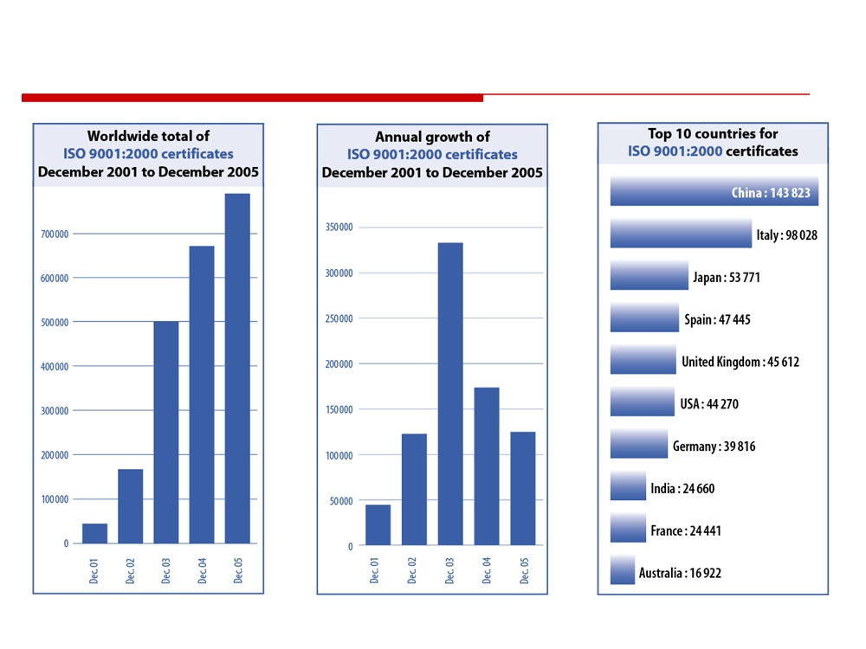
The ISO Survey
© 2014 CMU-ISR
21

Slide 21
The ISO Survey (cont.)
• The worldwide total of certificates to ISO 9001:2000 at the end of 2005 was 776,608.
• This was increase of 18 % over 2004 when the total was 660,132 certificates.
• Certificates had been issued in 161 countries compared to 154 the previous year.
© 2014 CMU-ISR
22

Slide 22
Homework Assignment
Investigate ISO 9000
Tóm tắt bài số 10

