Slide 1
Software Process & Quality Management
Mel Rosso-Llopart © 2010
Six Sigma
Mel Rosso-Llopart
Senior Lecturer, Executive Education Program Institute for Software Research
Carnegie Mellon University

Slide 2

Agenda
• Understand the Basics of the Six Sigma Program
• Ability to Define a Strategy and Roadmap for Success
• Cost of Quality
• Understand How Six Sigma Relates to Lean, TOC, TQM
•
(Theory Of Constraints; Total Quality
Management)
© 2010 CMU-ISR
2

Slide 3

About Six Sigma
• Six Sigma was Developed at Motorola in the 1980’s as a Method to Improve Process Quality.
• It was First Used to Improve Manufacturing Process Capability and Then Migrated to Business Processes Capability
• Companies That Have Deployed Six Sigma: Bank of America, Motorola, GE, IBM, Kodak and Many More.
• The Basic Premise is, All Processes Have Variation. Variation is the Enemy.
© 2010 CMU-ISR
3

Slide 4
Define
• Is it a Goal, a Measure, a Process or a Tool?
● Yes
© 2010 CMU-ISR
4

Slide 5

Define
Six Sigma
• Is a Management Methodology
• Customer focused
• Data driven decisions
• Breakthrough performance gains • Validated bottom line results
© 2010 CMU-ISR
5

Slide 6
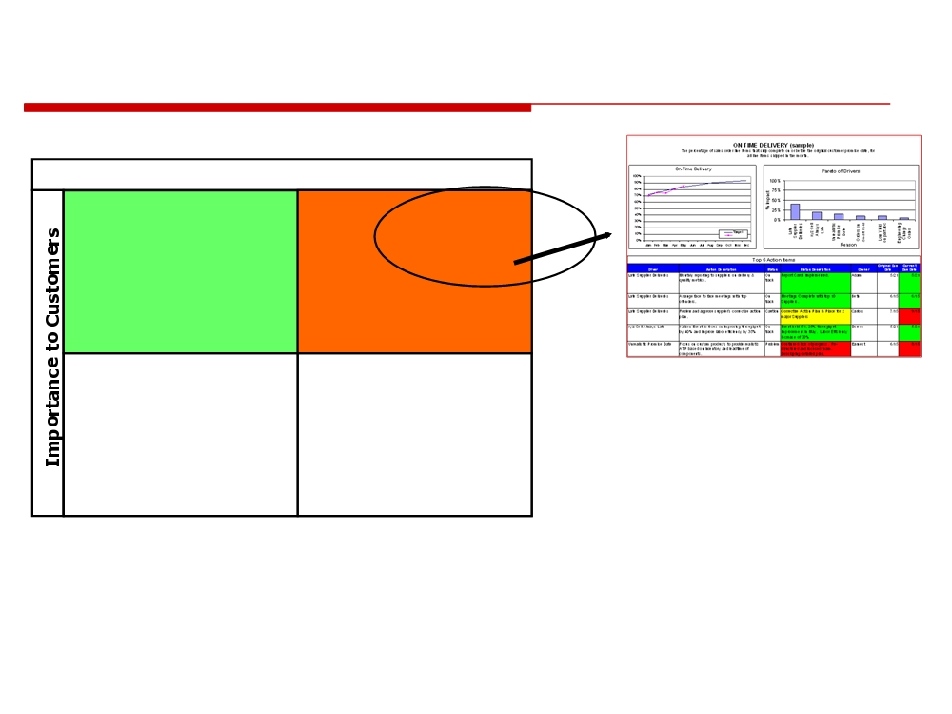
Customer Focused
Our Performance Compared to Competitors • Complete
• Quality
• OTD
High
• Training
•
Price
Moderate-
• Shared Goals
• Complaints
to-’Low’
We’re Better
They’re Better
© 2010 CMU-ISR
6

Slide 7
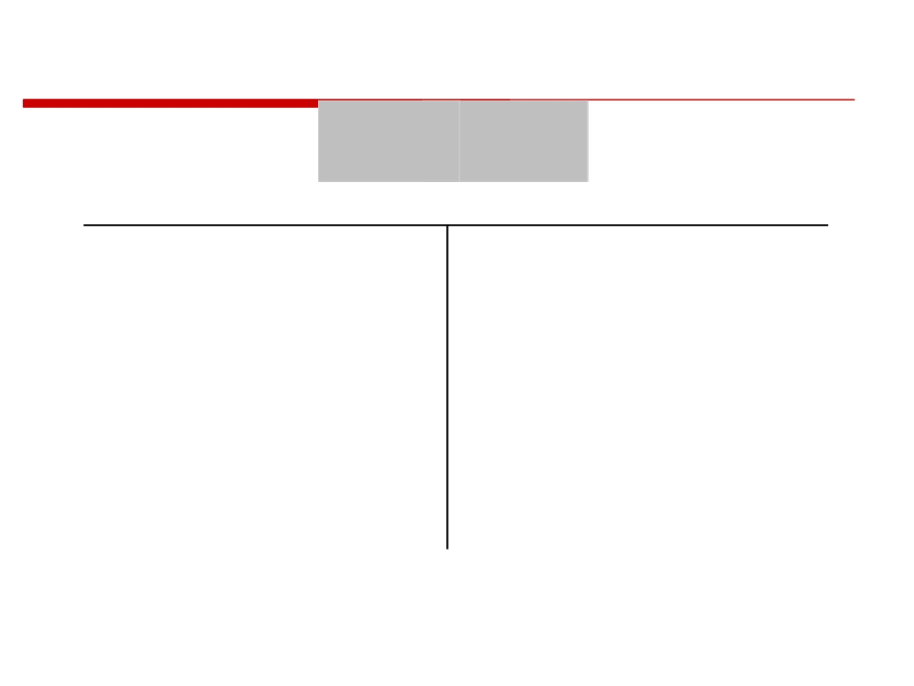
Data Driven Decisions
Y =
f (X)
To get results, should we focus our behavior on the Y or X ?
• Y
• X1 . . . XN
• Dependent
• Independent
• Output
• Input-Process
• Effect
• Cause
• Symptom
• Problem
• Monitor
• Control
• Response
• Factor
Why should we test or inspect Y, if we know this relationship?
© 2010 CMU-ISR
7

Slide 8
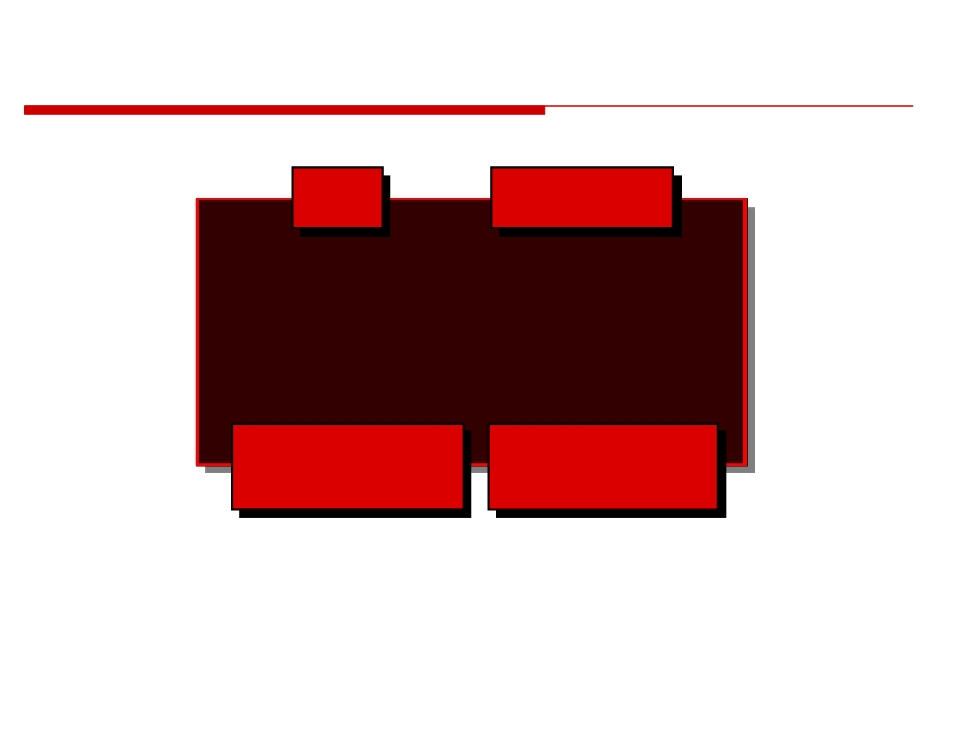
Breakthrough Performance Gains
(Distribution Shifted ± 1.5σ)
σ
PPM
2
308,537
3
66,807
4
6,210
5
233
6
3.4
Process
Defects per Million
Capability
Opportunities
Sigma is a statistical unit of measure which reflects process capability. The sigma scale of measure is perfectly correlated to such characteristics as defects-per-unit, parts-per million defective, and the probability of a failure and/or errors.
© 2010 CMU-ISR
8

Slide 9
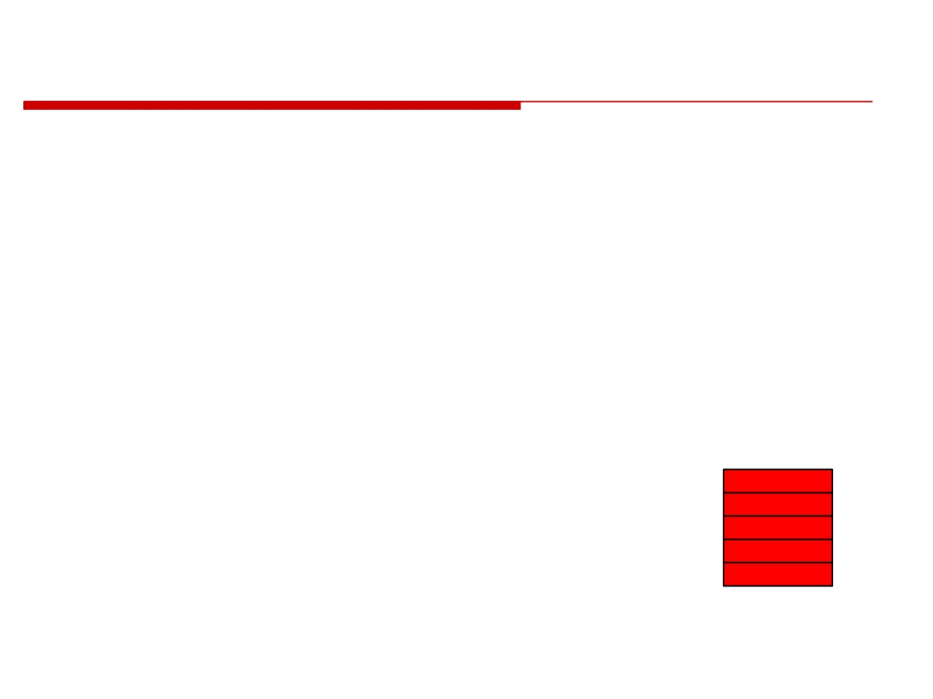
Define
Six Sigma Methodology • Define
• Measure • Analyze
• Improve
• Control
Define
Measure Analyze Improve Control
© 2010 CMU-ISR
9

Slide 10
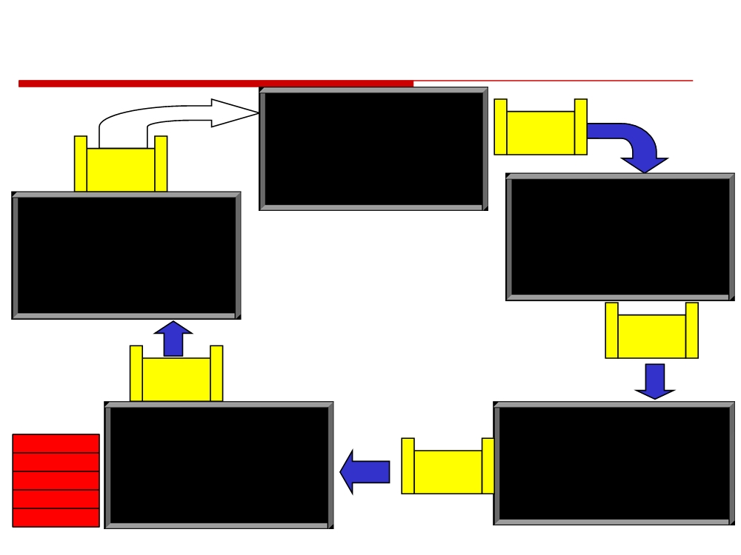
Roadmap
Define
Next Project
❑ Customers, Value, Problem Statement
Validate
❑ Scope, Timeline, Team
Project $
Celebrate
❑ Primary/Secondary & Metrics
Project $
❑ Current Value Stream Map
Measure
Control
❑ Voice Of Customer (QFD)
❑ Assess specification / Demand
❑ Document process (WIs, Std Work)
❑ Measurement Capability
❑ Mistake proof
❑ Correct the measurement system
❑ Analyze change in metrics
❑ Process map, Spaghetti, Time obs.
❑ Value Stream Review
❑ Measure OVs & IVs / Queues
❑ Prepare final report
Validate
Project $
Validate Project $
Improve
Analyze (and fix the obvious)
Define
❑ Optimize KPOVs & test the KPIVs
❑ Root Cause (Pareto, C&E, brainstorm)
Measure
❑ Redesign process, set pacemaker
Validate
❑ Find all KPOVs & KPIVs
Analyze
❑ 5S, MRS
Project $
❑ FMEA, DOE, critical Xs, VA/NVA
Improve
❑ Visual controls
❑ Graphical Analysis, ANOVA
Control
❑ Value Stream Plan
❑ Future Value Stream Map
© 2010 CMU-ISR
10

Slide 11
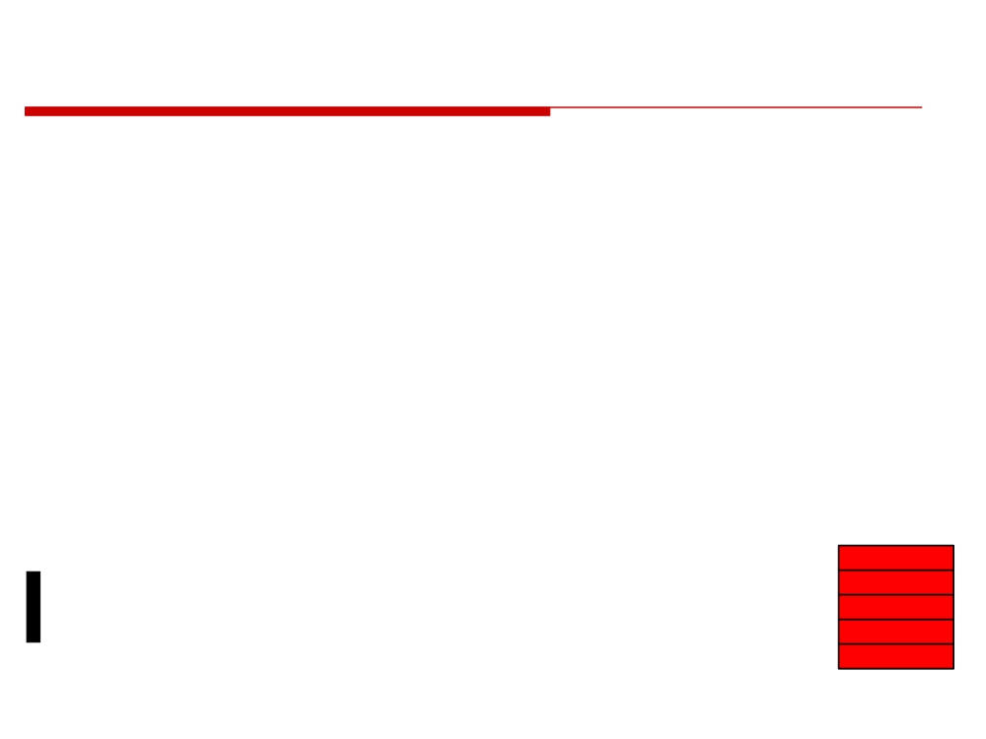
Define
Key Items
• Customers, Value, Problem Statement • Scope, Timeline, Team
• Primary/Secondary & OpEx Metrics • Current Value Stream Map
• Voice of Customer (QFD)
•(Quality Function Deployment)
Define
Measure Analyze Improve Control
© 2010 CMU-ISR
11

Slide 12
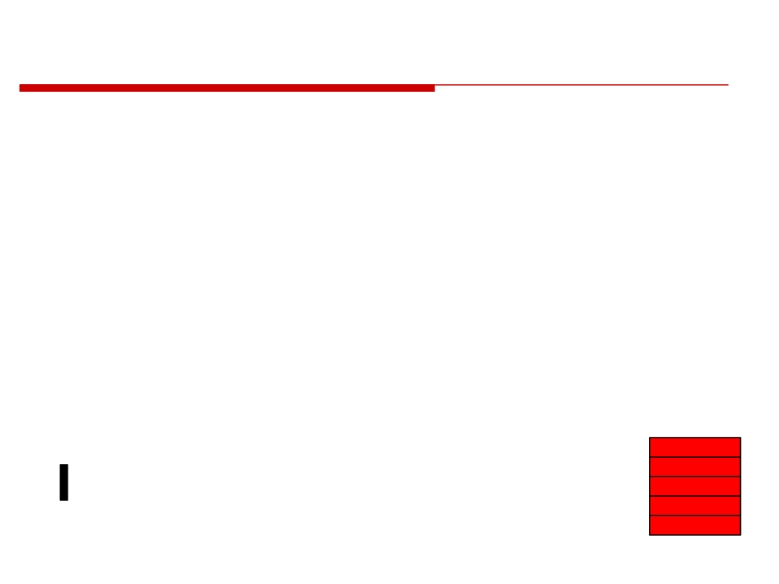
Measure
• Establish Measurement Capability
• Validate the database (transactional)
• Gage R&R (Repeatability & Reproducibility) • Calibration is not enough
• Many (or most) measurement systems are not capable
• How good is the data you are using to make decisions?
• Fix the Measurement System
• Enables calculation of process capability • Enables calculation of alpha & beta risks
Define
Measure Analyze
This step is often skipped
Improve
Control
© 2010 CMU-ISR
12

Slide 13
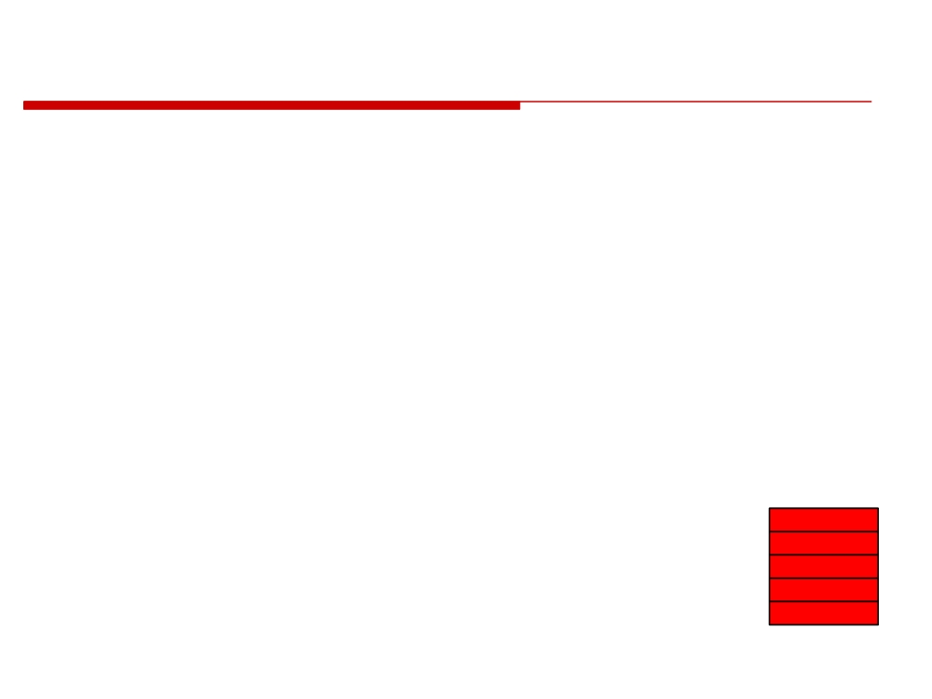
Analyze
(and fix the obvious issues)
• Find all KPOVs & KPIVs
•
(Key Process Output Variables; Key Process Input
Variables)
• FMEA, DOE, critical Xs, VA/NVA
•(Failure Modes Effects Analysis; Design Of Experiment; Variance Analysis, Numerical)
• Graphical Analysis, ANOVA
•(ANOVA-Analysis Of Variance)
Define
• Future Value Stream Map
Measure Analyze
Improve
Control
© 2010 CMU-ISR
13

Slide 14
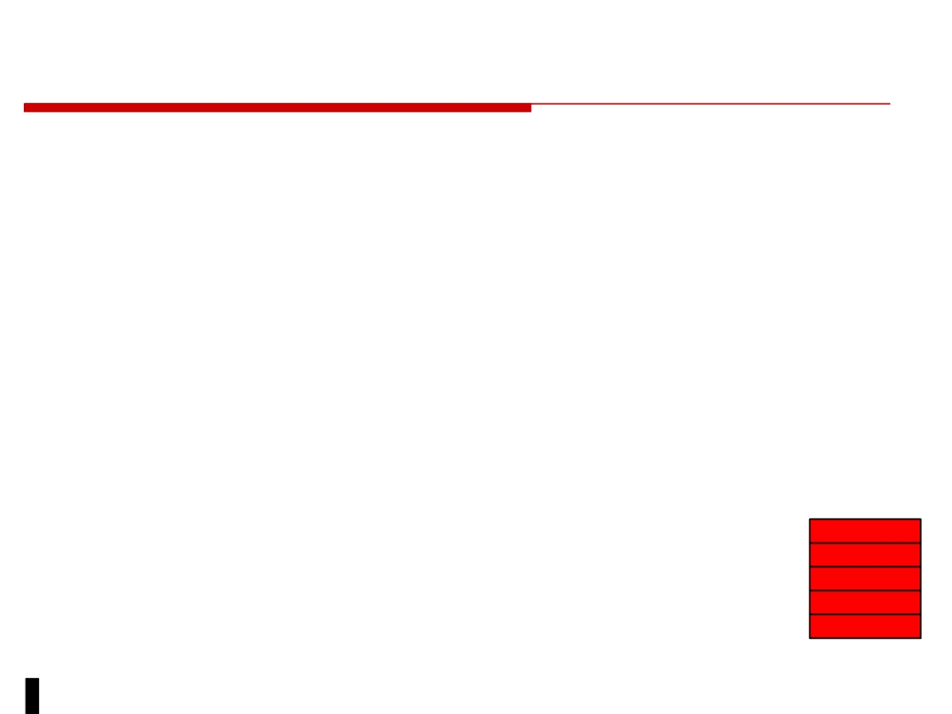
Improve
• Optimize KPOVs & Test the KPIVs
•
(Key Process Output Variables; Key Process Input
Variables)
• Redesign Process, Set Pacemaker
•
5S, MRS
•
(5S - Sort, Systematize, Sweep, Standardize, Self
Discipline; Material Replenishment System)
• Visual Controls
Define
Measure
• Value Stream Plan
Analyze
Improve
Control
© 2010 CMU-ISR
14

Slide 15
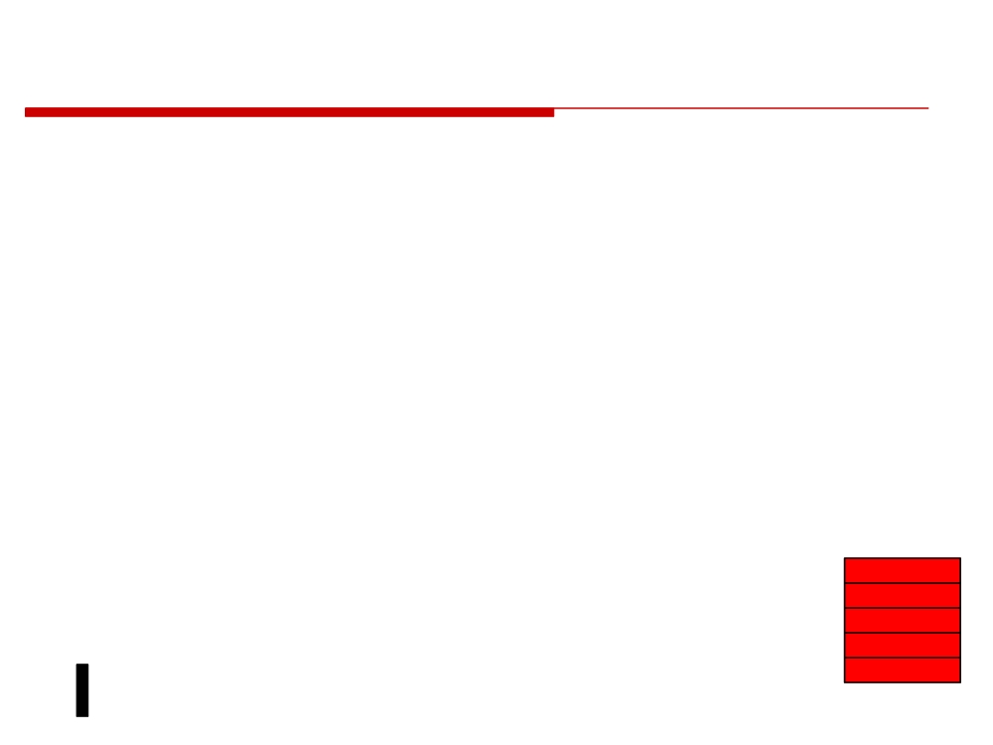
Control
Management of Change
• Owned by project champion and value stream manager
• Critical to long term success of project
• Physical and cultural changes Measurement Controls
• On-going metrics
Visual Controls
Define
• Enable workers to self-manage the process
Measure
Analyze
Improve Control
© 2010 CMU-ISR
15

Slide 16

Project Selection
Impact
• Business Impact
• Revenue Growth
• Cost Reduction
• Capital Reduction
• Key Business Objectives • On Time Delivery
• Lead Time
• Quality
• Customer Satisfaction
• Impact on Operational Excellence Metrics
© 2010 CMU-ISR
16

Slide 17
Evaluate and Rank Suggestions
Effort and Risk
• Effort Required
• Probability of Success
• People Resources
• Technical Risk
• Capital Resources
• Data available
• Duration of Project
• Knowledge of process
• Management Risk
• Aligned with objectives • Support by value
• Impact vs. Risk vs.
stream manager
Effort
• Assess ROI (Return On Investment)
• Assign priorities to projects
© 2010 CMU-ISR
17

Slide 18
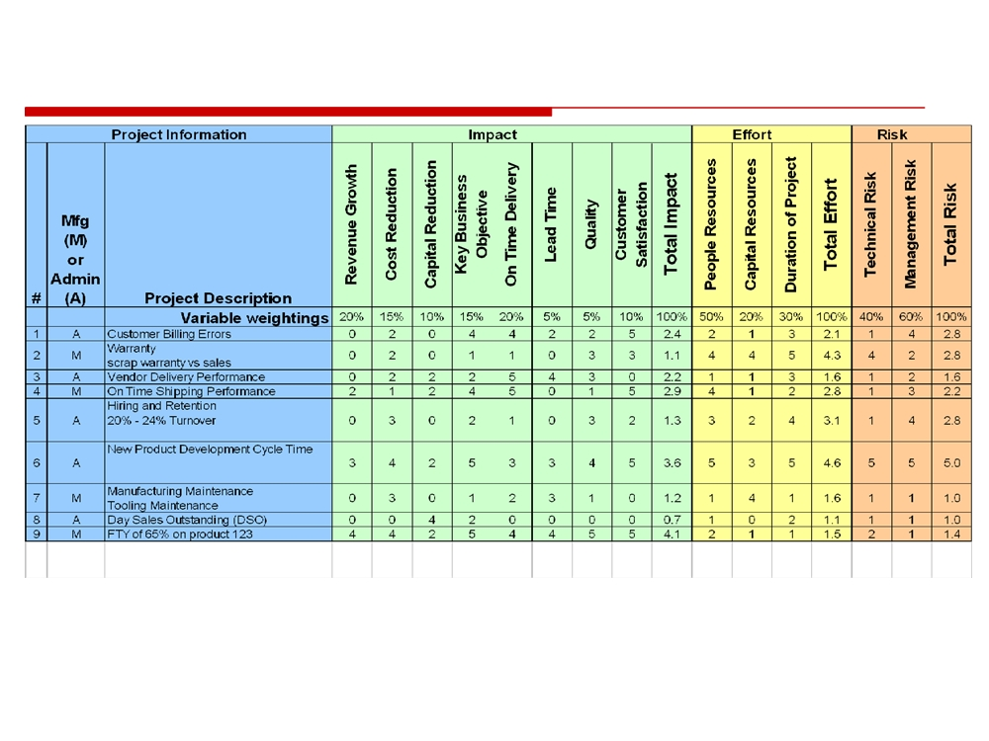
Evaluate and Rank Suggestions
Example Tool to Rank Projects
0106-01 Project Rating.xls
Operational Excellence Training
18

Slide 19
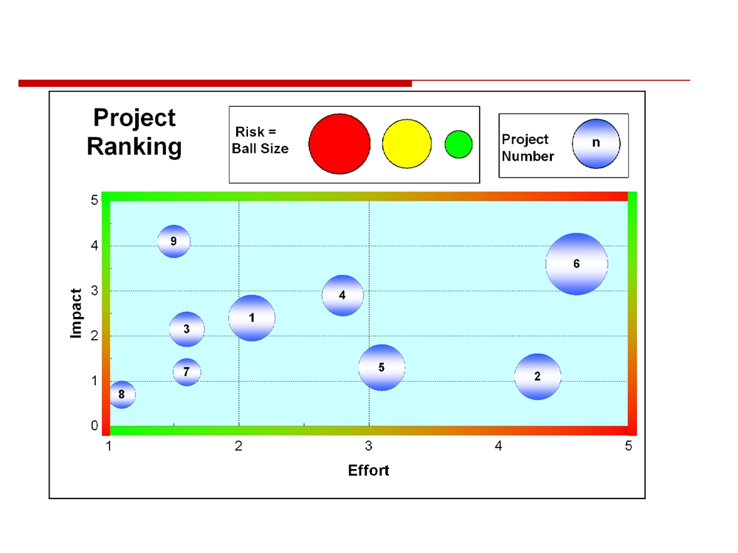
Example Chart
Example chart to rank projects
0106-01 Project Rating.xls
© 2010 CMU-ISR
19

Slide 20
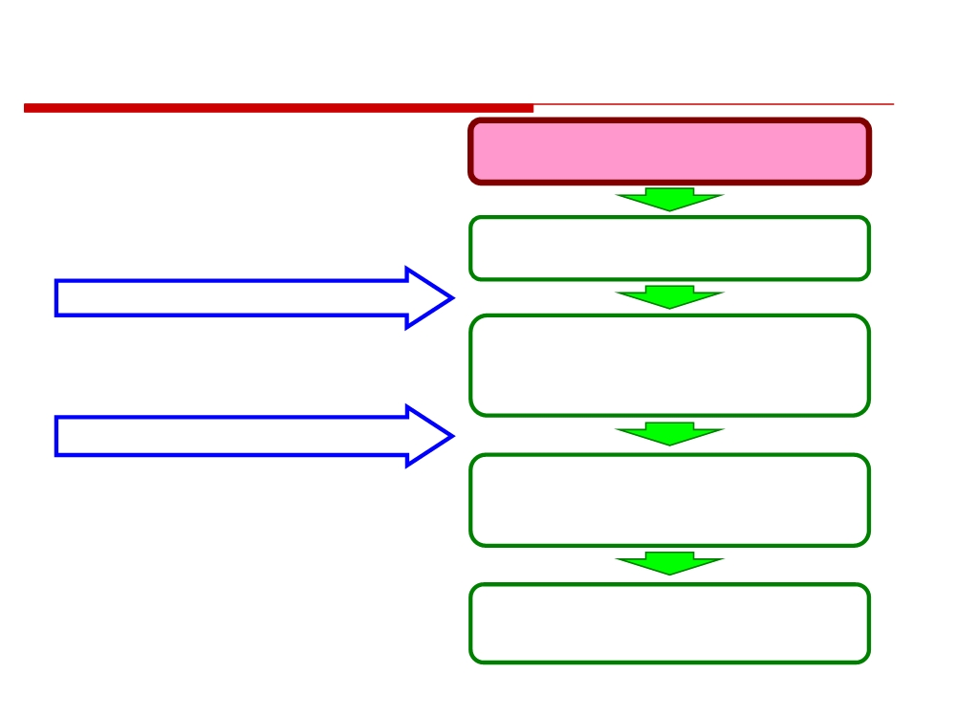
Basic Implementation
Roadmap
Identify Customer Requirements
Understand and Define
Entire Value Streams
Vision (Strategic Business Plan)
Deploy Key Business Objectives
- Measure and target (metrics) - Align and involve all employees - Develop and motivate
Continuous Improvement (DMAIC)
Define, Measure, Analyze, Improve
Identify root causes, prioritize, eliminate waste, make things flow and pulled by customers
Control
-Sustain Improvement -Drive Towards Perfection
© 2010 CMU-ISR
20

Slide 21
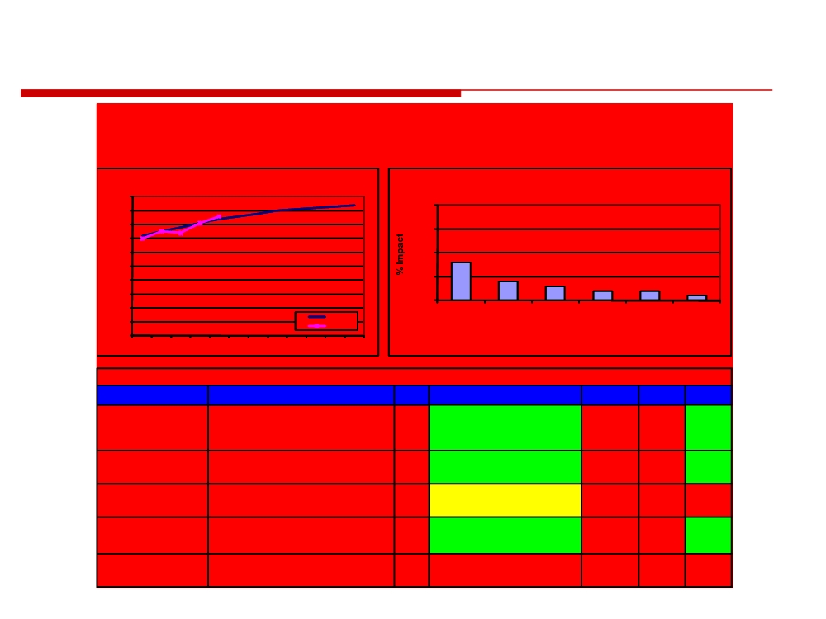
On Time Delivery Sample
ON TIME DELIVERY (sample)
The percentage of sales order line items that ship complete on or before the original customer promise date, for all line items shipped in the month.
Top 5 Action Items
Driver
Action Description
Status
Status Description
Owner
Original Due
Current
Late Supplier Deliveries
Monthly reporting to suppliers on delivery &
On
Report Cards Implemented.
Adam
Date
5/21
Due Date
quality metrics.
track
5/21
Late Supplier Deliveries
Arrange face to face meetings with top
On
Meetings Complete with top 10
Beth
6/15
6/15
offenders.
track
Suppliers.
Late Supplier Deliveries
Review and approve supplier's corrective action
Caution
Corrective Action Plan in Place for 2
Carlos
7/15
9/15
plan.
major Suppliers
xyz Cell Always Late
Kaizen Event to focus on improving throughput
On
Event held 5/1. 25% throughput
Doreen
5/21
5/21
by 40% and improve labor efficiency by 35%
track
improvement in May. Labor Efficiency
Increase of 30%
Unrealistic Promise Date
Focus on custom products to provide realistic
Problem
Continued lack of progress. Re-
Earnest
6/15
8/15
ATP based on inventory and leadtime of
structured and focused team.
components.
Developing detailed plan.
© 2010 CMU-ISR
21

Slide 22
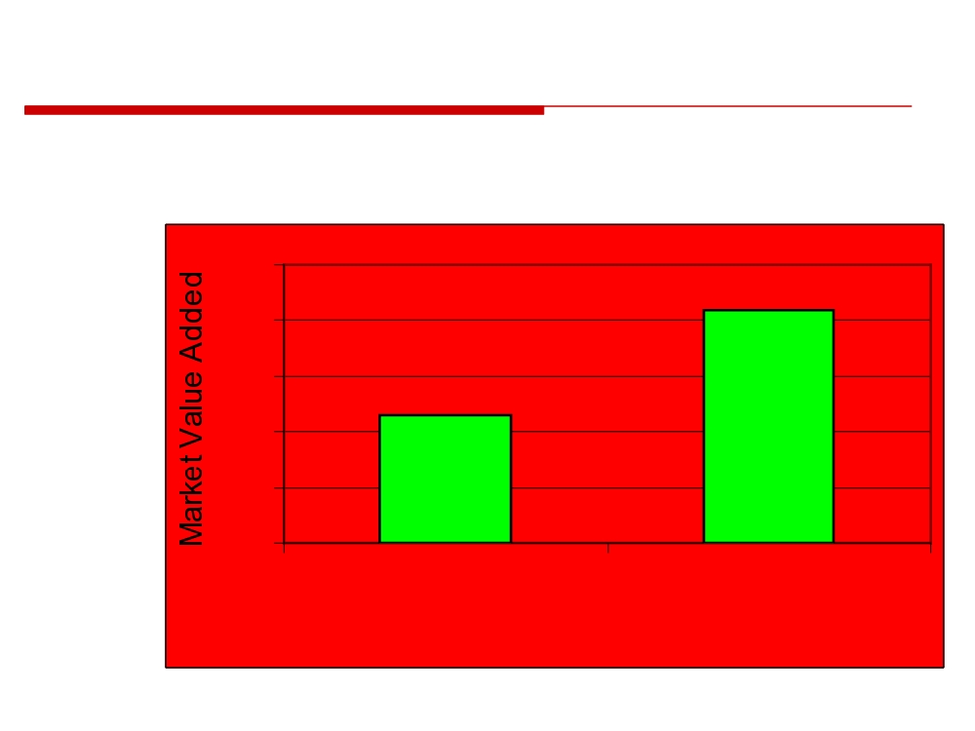
Does it Work?.
The top companies in Customer Satisfaction grow MVA at nearly twice the rate of their poor-performing counterparts.
50
In Billions $
$42
40
1999
73 companies
30
Ralston Purina
$23
Quaker Oats Hilton Hotels
20
Coca-Cola Unilever
etc.
10
0
Low
High
Customer Satisfaction Index Score
Source: American Customer Satisfaction Index, U Michigan, HBR, 2001
© 2010 CMU-ISR
22

Slide 23
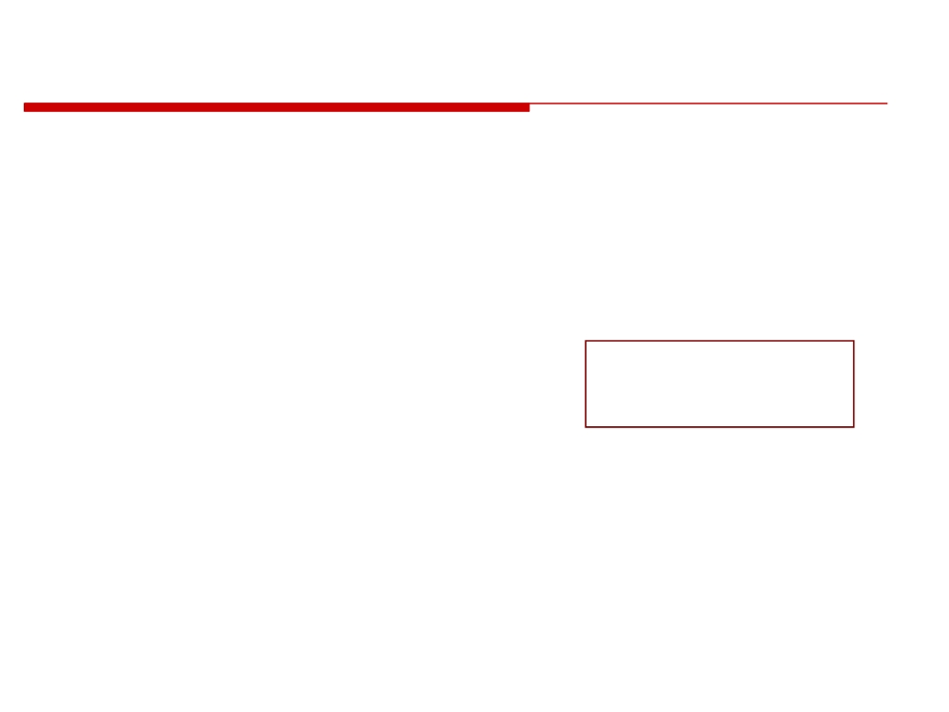
Making it Happen
Three major roles
• Implementer
• Learns the tools
• Works the process
• Solves day to day problems
• Manager
Where do you
• Learns the methodology
need to focus?
• Manages a value stream • Reviews project teams
• Leader
• Establishes the vision for the future • Sets priorities
• Encourages
© 2010 CMU-ISR
23

Slide 24
What is Cost of Poor Quality?
• In addition to the direct costs associated with finding and fixing defects, “Cost of Poor Quality” also includes these hidden items:
- cost of failing to meet customer expectations the first time - opportunity for increased efficiency
- potential for higher profits - loss in market share
- increase in production cycle time
- labor associated with ordering replacement material - costs associated with disposing of defects
• For most companies today, the cost of poor quality is likely to be 25 % of sales.
• In almost every company where the COPQ is unknown, the COPQ exceeds the profit margin.
© 2010 CMU-ISR
25

Slide 25
What About Lean, TOC, TQM
Six Sigma
• Remove defects, minimize variance
Lean (Lean Development, Manufacturing)
• Remove waste, shorten the flow
TOC (Theory of Constraints)
• Remove and manage constraints TQM (Total Quality Management)
• Continuous improvement
© 2010 CMU-ISR
26

Slide 26
Homework Assignment
Investigate Six Sigma
Investigate Lean

