Slide 1
Software Process & Quality Management
Mel Rosso-Llopart © 2010
Process Improvement Five Steps
Step 1 - Organize and Prioritize
Mel Rosso-Llopart
Senior Lecturer, Executive Education Program Institute for Software Research
Carnegie Mellon University

Slide 2

Agenda
Understanding Change
How Do you Guide Change
▪ Models of Change and Improvement • ODA, Shewhart, IDEAL
© 2010 CMU-ISR
2

Slide 3
Managing Organizational Change
“Change is great when you are the agent; it is only bad when you are the object.”
Douglas Sherwin
Basic Process
• Unfreezing the organization • Planning the change
• Implementing the change
• Refreezing
*Douglas Sherwin, “Strategy for Winning Employee Commitment,” HBR, 1975.
© 2010 CMU-ISR
4

Slide 4
Unfreezing
• Need to overcome resistance
• Managers must help encourage needed changes
•
“Walk the walk, rather than talk the talk”
•
3 ways to make people aware
• Make problems more obvious
• Point out the problems for all to see
• Wait for someone to find the problem and then acknowledge the change needed
© 2010 CMU-ISR
5

Slide 5
Planning the Change
• Use Agents to plan change
• Enthusiastic (Champions)
• Technically and Politically capable of understanding
• Have respect for the people the deal with
• Have Management’s confidence and support
• Look for participation in planning
© 2010 CMU-ISR
6

Slide 6
Implementing the Change
• Purely technical changes rarely affect working habits, can be implemented quickly
• Changes requiring behavior change must be more deliberate; Time to
• Understand
• Accept
• Adapt
• Most important consideration is continuing evidence of progress
© 2010 CMU-ISR
7

Slide 7

Refreezing
• Make the change permanent
• Some changes are obvious and helpful and will remain easily
• Some are lost because of “short term goals”
• Set goals to keep from “un-freezing”
© 2010 CMU-ISR
8

Slide 8
5 Step Process to Insure Refreezing
1. Keep change management group in place longer
2. Modify organizations policies and procedures to reflect changes
3. Use measurement to foster change
4. Establish dedicated staff if complex
5. Educate, train, show
© 2010 CMU-ISR
9

Slide 9
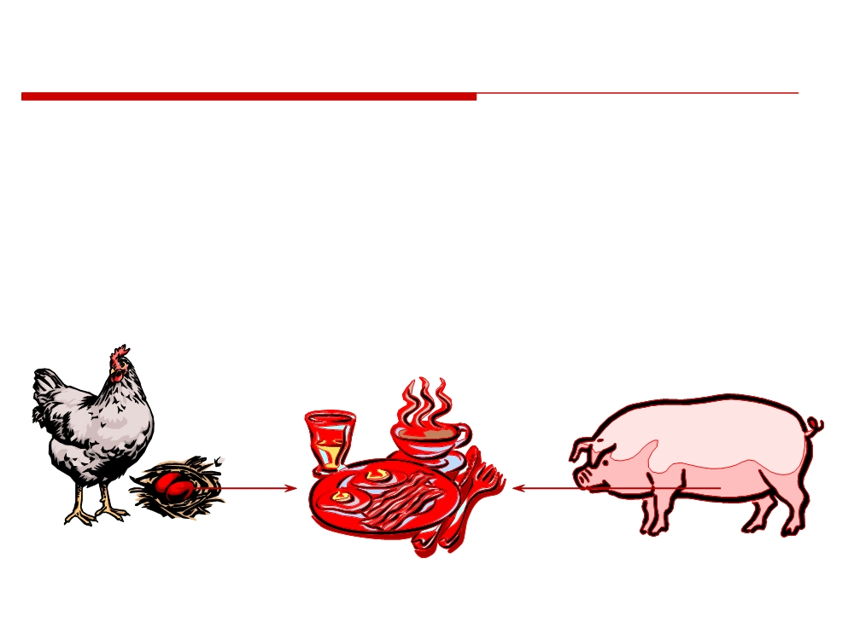
How Do You Change?
It is difficult to “sell” process improvement
• getting buy-in for process is difficult
• even when you have buy-in, you may not have commitment
Who is committed to the breakfast?..
Senior management commitment is critical!!!
© 2010 CMU-ISR
10

Slide 10
Conditions for Change
Definitions
D = dissatisfaction with the status quo
occurs in chaotic organizations
V = vision of a future state
visionaries see a way to do “it” better F = first steps towards the vision
the bold ones act on the vision R = resistance to change
many are afraid of change and resist it and will quit before they will change
© 2010 CMU-ISR
11

Slide 11
Conditions for Change
if D
* V * F
> R
then
“change will occur”
Where:
D = dissatisfaction with the status quo V = vision of a future state
F = first steps towards the vision R = resistance to change
V,F,R typically requires management commitment
(courtesy of Mark Paulk)
© 2010 CMU-ISR
12

Slide 12
Three Quick Models for Change
• You will see these models repeated throughout all the future discussions
• ODA - The simplest and the core of most of the change and improvement efforts.
• Shewhart Cycle (Deming) - An upgrade to ODA by checking the results against a plan.
• IDEAL - The SEI model for improvement which provides the most disciplined change.
© 2010 CMU-ISR
13

Slide 13

Disciplined Change
• Promoting change without a current understanding of state, and a plan of where you want to be, is more harmful than a well understood chaotic environment!
“If you don’t know where you are going, any road will do” - Chinese Proverb
© 2010 CMU-ISR
14

Slide 14
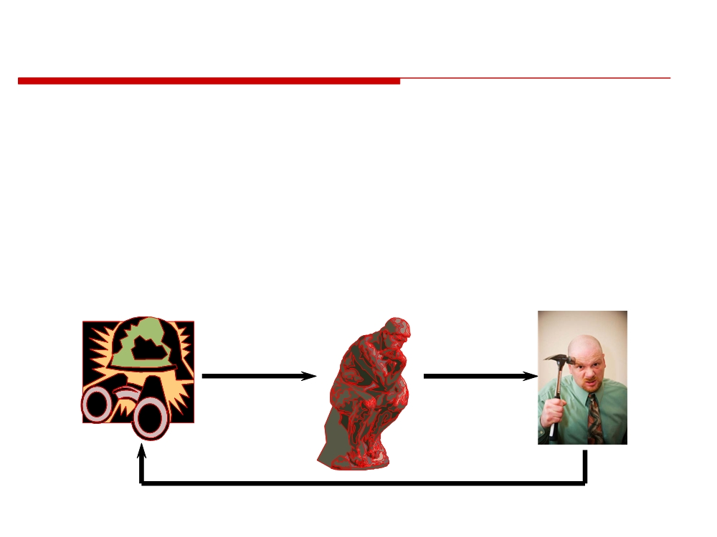
Disciplined Change - ODA
Government Field Operations Manual (~1940)
The ODA Loop:
Observe
Decide
Act
???
© 2010 CMU-ISR
15

Slide 15
ODA Guidance for Change
Identify business goals
First attempts should identify areas for easy improvement
• “low hanging fruit”
• progressively address more difficult issues
Identify and involve stakeholders - find out what everyone does (Best Practices)
Document and review your improvement plan
© 2010 CMU-ISR
16

Slide 16
ODA Guidance for Change (cont)
Decide what data will be collected, what will be measured, and how it will be measured
• must map data to business goals
Acquire senior management commitment
Obtain baseline measurements before implementing change
Build on early success
• implement more complex improvement
© 2010 CMU-ISR
17

Slide 17
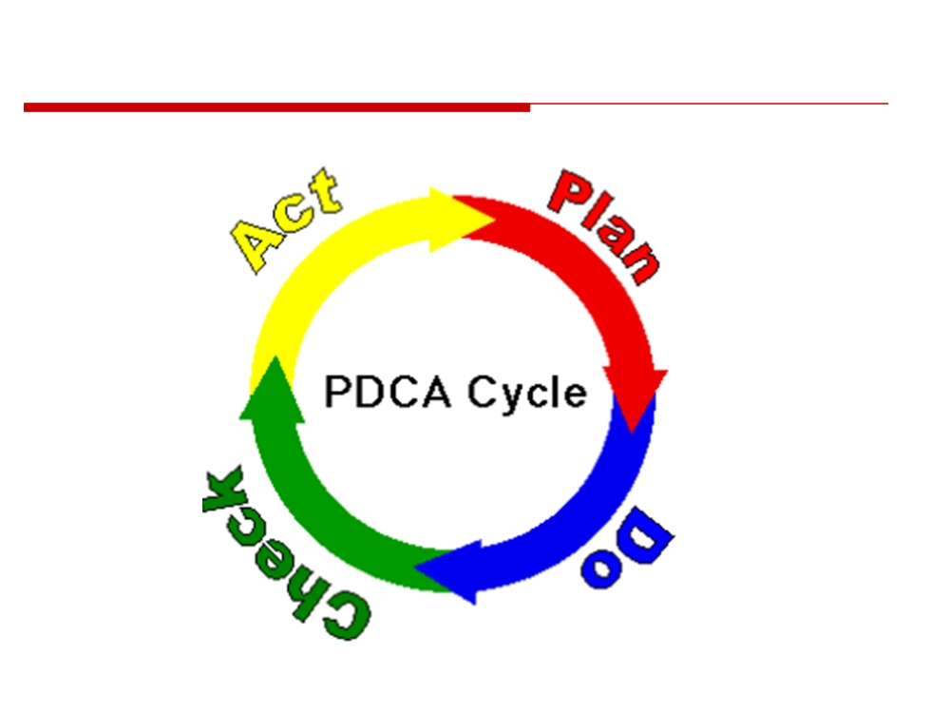
Disciplined Change - Shewhart
© 2010 CMU-ISR
18

Slide 18
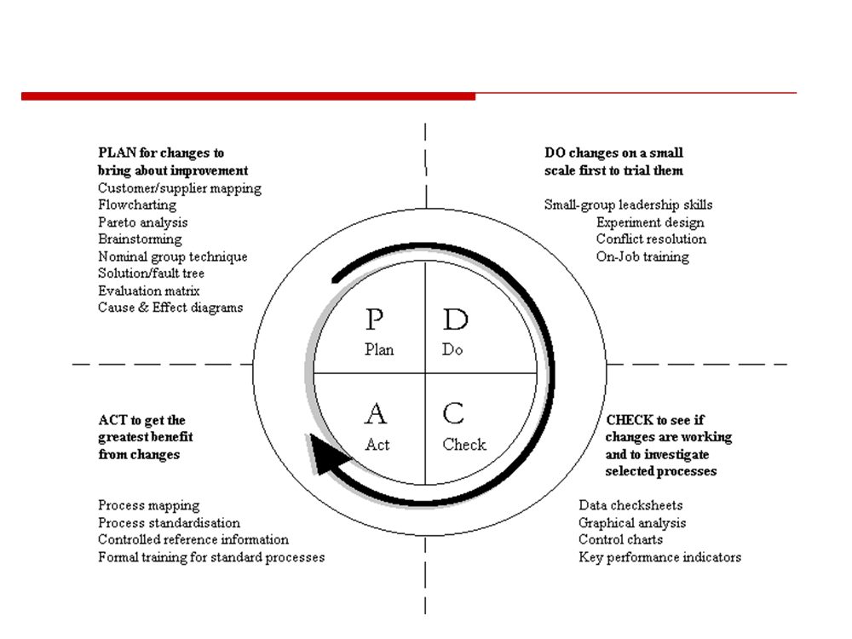
PDCA and Continuous Improvement
© 2010 CMU-ISR
19

Slide 19
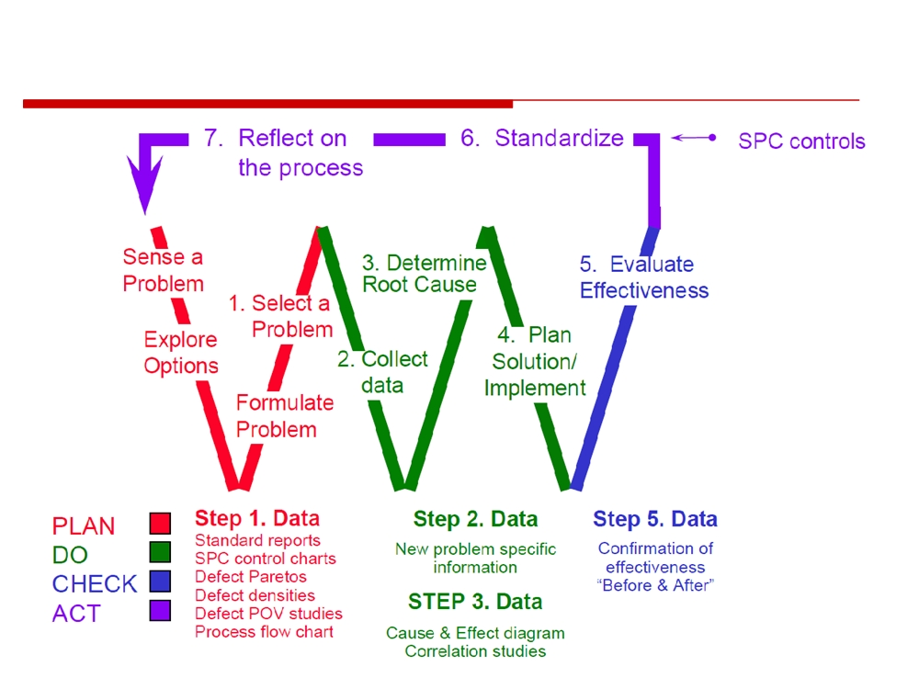
Basic Improvement Model
© 2010 CMU-ISR
20

Slide 20

The IDEAL Model
The model consists of five phases
1) Initiating
Learning
2) Diagnosing
Analyze
Propose
and
Future
Validate
Implement
3) Establishing
Actions
Solution
Refine
4) Acting
Solution
Stimulus for Change
Set
Build
Charter
Acting
Context
Sponsorship
Infrastructure
Pilot/Test
5) Learning
Initiating
Solution
Characterize
Current
&
Desired
States
Create Solution
Diagnosing
Develop
Recommendations
Plan
Set
Develop
Actions
Priorities
Approach
Establishing
© 2010 CMU-ISR
21

Slide 21
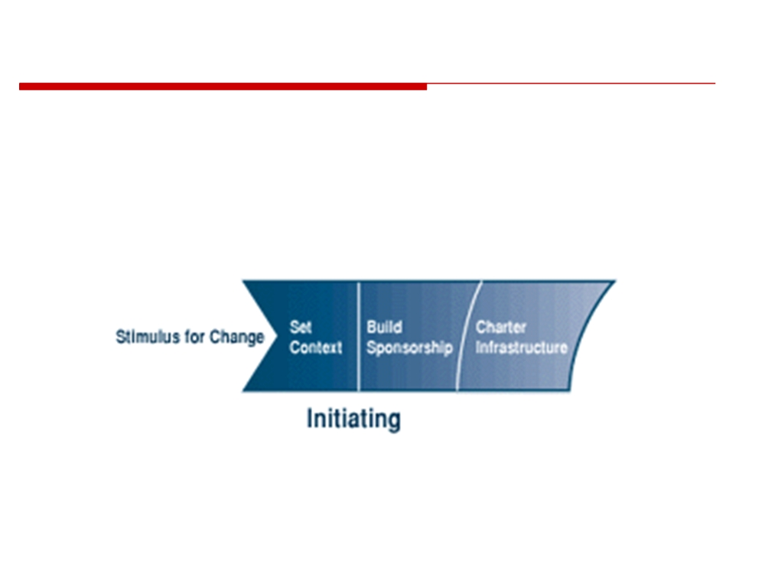
The IDEAL Model - Initiating
Initiating: Laying the groundwork for a successful improvement effort
© 2010 CMU-ISR
22

Slide 22
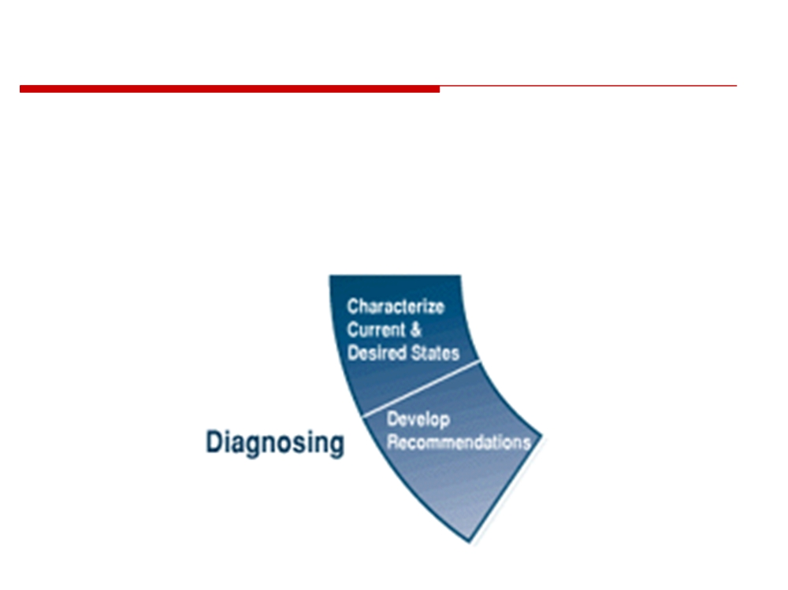
The IDEAL Model - Diagnosing
Diagnosing: Determining where you are relative to where you want to be.
© 2010 CMU-ISR
23

Slide 23
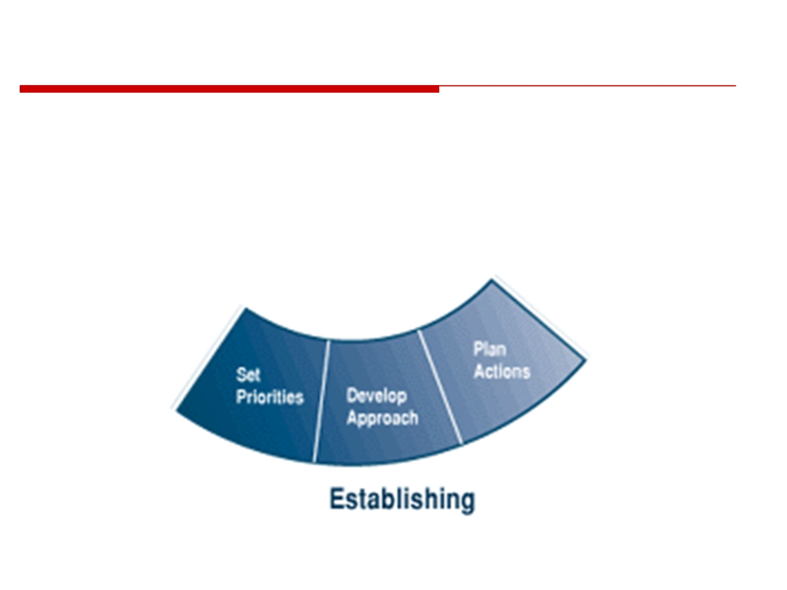
The IDEAL Model - Establishing
Establishing: Planning the specifics of how you will reach your destination.
© 2010 CMU-ISR
24

Slide 24
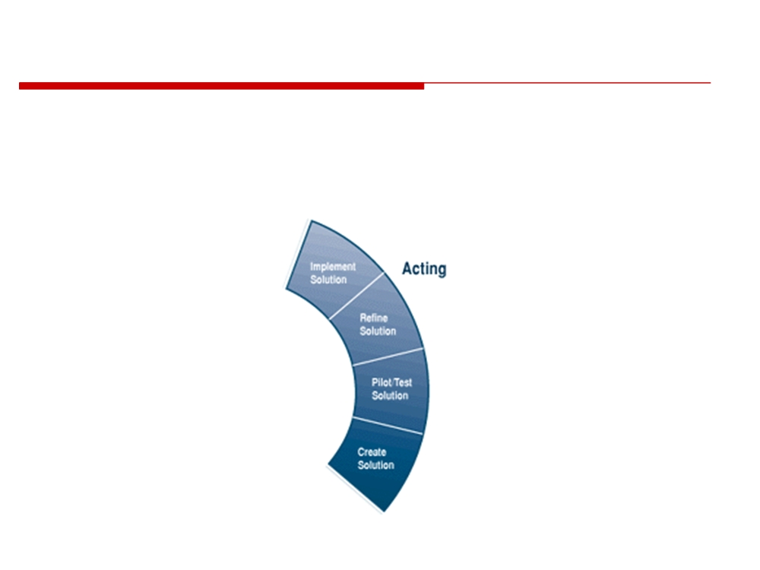
The IDEAL Model - Acting
Acting: Doing the work according to the plan.
© 2010 CMU-ISR
25

Slide 25
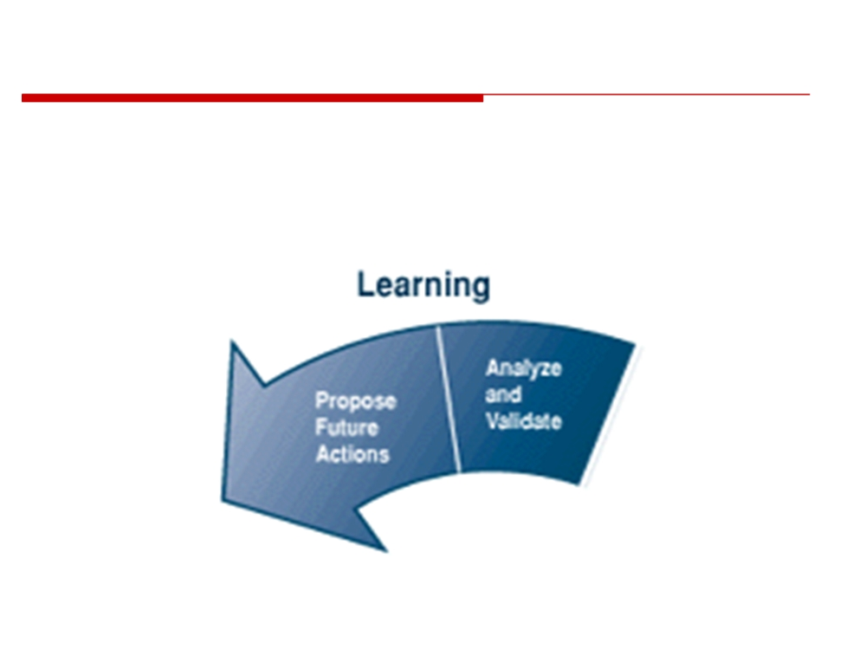
The IDEAL Model - Learning
Learning: Learning from the experience and improving your ability to adopt new technologies in the future.
© 2010 CMU-ISR
26

Slide 26
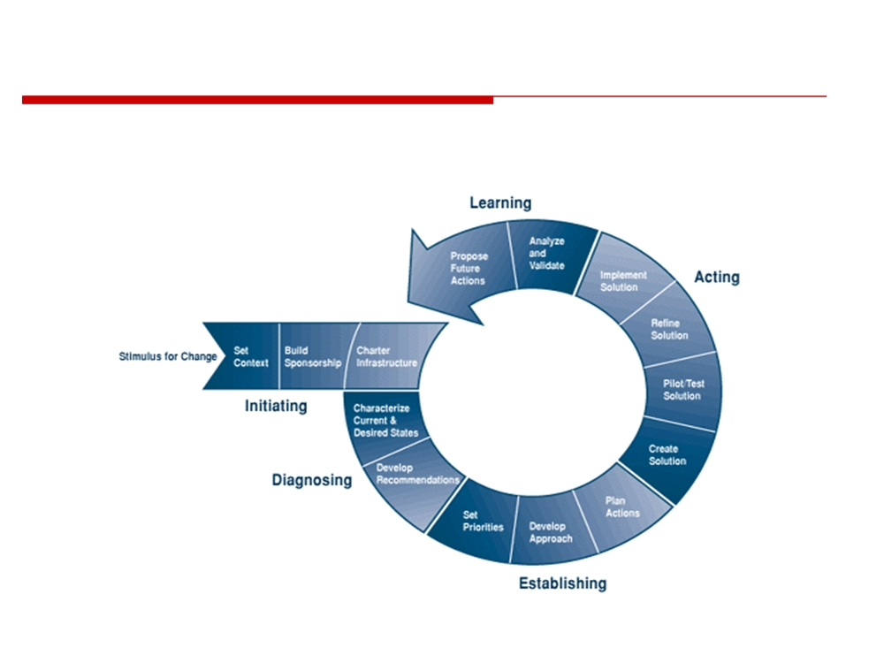
The IDEAL Model
Putting it All Together...
© 2010 CMU-ISR
27

Slide 27
Homework
Investigate:
ODA
PDCA
IDEAL

