Slide 1
Software Process & Quality Management
Mel Rosso-Llopart © 2010
Step 2 - Design a Process
Mel Rosso-Llopart
Senior Lecturer, Executive Education Program Institute for Software Research
Carnegie Mellon University

Slide 2
Process Improvement Five Steps
Step 1 - Organize and Prioritize
Step 2 - Design a Process
Step 3 - Assess a Software Process
Step 4 - Develop an Improvement Plan
Step 5 - Measure Improvement and Progress

Slide 3
Basic Process Organization change
• Unfreezing the organization • Planning the change
• Implementing the change
• Refreezing
The ODA Loop
The IDEAL Model
1) Initiating
2) Diagnosing
3) Establishing
4) Acting
5) Learning

Slide 4

What This is About
Things you can do to capture and help design a process.
Process Models
Process Guides
IDEF
Structured Text
ETVX
Templates/Forms
Statemate®
Decision Trees/Tables
Flowcharts
Checklists
DFDs
Activity Networks
© 2010 CMU-ISR
2

Slide 5

IDEF
•
Created in the late ‘70s
•
IDEF stands for Integrated DEFinition Language.
•
Provides a common, public-domain language for modeling
and describing:
•
Processes
•
Data
•
Requirements
•
Functions
•
Has been used to improve hundreds of enterprises
•
IDEF is a standard modeling technique for all US Government
agencies, and many private companies.
© 2010 CMU-ISR
4

Slide 6
IDEF Languages
• IDEF0 - Activity Modeling
• IDEF1 - Data modeling (not in use)
• IDEF1X - Data modeling*
• IDEF1X97, aka, IDEFObject, aka IEEE 1320.2
- Data modeling with O-O extension
• IDEF2 - Simulation Modeling (dynamics model)
• IDEF3 - Process capture method
• IDEF4 - Object-Oriented Design Method
• IDEF5 - Ontology Description
* 99% of the time when someone talks about “their IDEF” they mean IDEF0 and IDEF1X (and there’s no way to know which one)
© 2010 CMU-ISR
5

Slide 7
IDEF0 Activity Modeling Language
• Originated in the commercial sector as Structured Analysis Design Technique (SADT)
• Standardized as FIPS 183,
• Later withdrawn, NIST did not want to duplicate industry standards
• Heavily used in DoD
• DoD Architecture Framework OV-5, Operational Activity Model
• Support the structured decomposition of processes and associated data.
© 2010 CMU-ISR
6

Slide 8
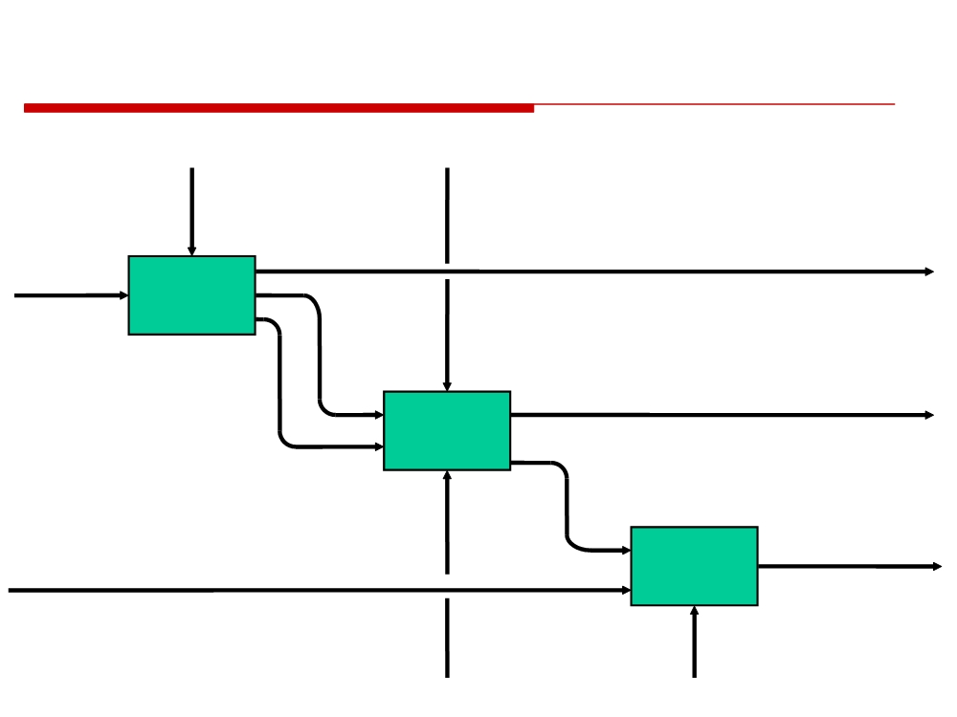
Example
IDEF0 Activity Model
sales
postal
policy
regulations
rejected order
order
Receive
Orders
order
details
shipping
shipment
details
Ship
Orders
shipping
confirmation
Receive
invoice
payment
Payments
packaging
accounting
machine
software
© 2010 CMU-ISR
7

Slide 9
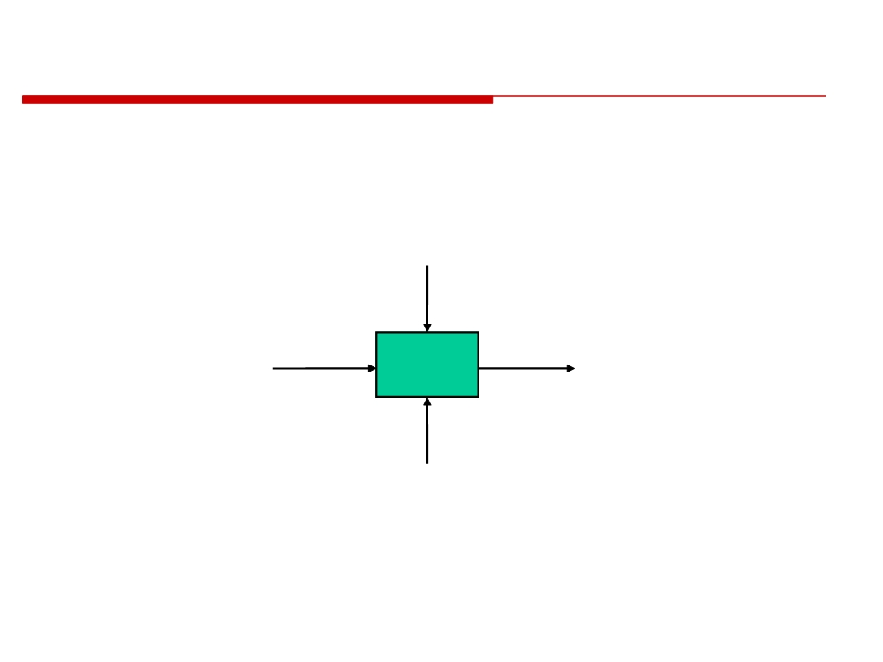
IDEF0 Model Components
CONTROL
- Data that restricts or provides direction for an activity
- Required for every activity
INPUT
OUTPUT
- Information or
materials used
- Information or
to produce
Activity
materials
activity outputs
produced by the
activity
- Not required
for every
- Required for
activity
every activity
MECHANISM
- Performs the activity (people, machines, systems, etc.)
- Required for every activity
© 2010 CMU-ISR
8

Slide 10
IDEF3- Process Description Model
• IDEF3 is a mechanism for collecting and documenting processes.… IDEF3 captures the behavioral aspects of an existing or proposed system.
• Also temporal information, including precedence and causality relationships associated with enterprise processes
• The resulting IDEF3 descriptions provide a structured knowledge base for constructing analytical and design models.
• Unlike simulation languages that build predictive mathematical models, IDEF3 builds structured descriptions.
• These descriptions capture information about what a system actually does or will do and also provide for the organization and expression of different user views of the system.
© 2010 CMU-ISR
9

Slide 11
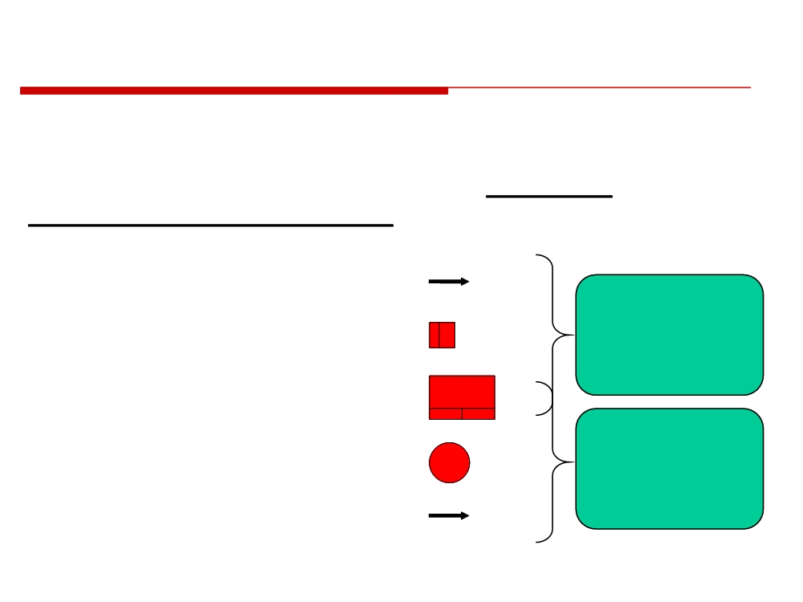
IDEF3- Process Description Model
The development of an IDEF3 Process Flow Description consists of expressing facts, collected from domain experts, in terms of five basic descriptive building blocks.
Activity
Denoted as arcs
Process
Logic
Description
Denoted as junction boxes
Diagram
Unit of Behavior
Denoted as boxes
Object
Object State
State
Denoted as circles
Transition
Network
State Transition
Denoted as arcs
© 2010 CMU-ISR
10

Slide 12
Example
IDEF3- Process Description Model
Organizing Structure: Scenario
A scenario can be thought of as a recurring situation, a set of situations that describe a typical class of problems addressed by an organization or system, or the setting within which a process occurs.
Example Scenario:
Parts enter the shop ready for the primer coat to be applied. We apply one very heavy coat of primer paint at a very high temperature. The paint is allowed to dry in a bake oven after which a paint coverage test is performed on the part. If the test reveals that not enough primer paint has been sprayed on the surface of the part, the part is re-routed through the paint shop again. If the part passes the inspection, it is routed to the next stop in the process.
© 2010 CMU-ISR
11

Slide 13






Example
IDEF3- Process Description Model
Organizing Structure: Scenario
A scenario can be thought of as a recurring situation, a set of situations that describe a typical class of problems addressed by an organization or system, or the setting within which a process occurs.
Example Scenario:
Parts enter the shop ready for the primer coat to be applied. We apply one very heavy coat of primer paint at a very high temperature. The paint is allowed to dry in a bake oven after which a paint coverage test is performed on the part. If the test reveals that not enough primer paint has been sprayed on the surface of the part, the part is re-routed through the paint shop again. If the part passes the inspection, it is routed to the next stop in the process.
© 2010 CMU-ISR
11

Slide 14
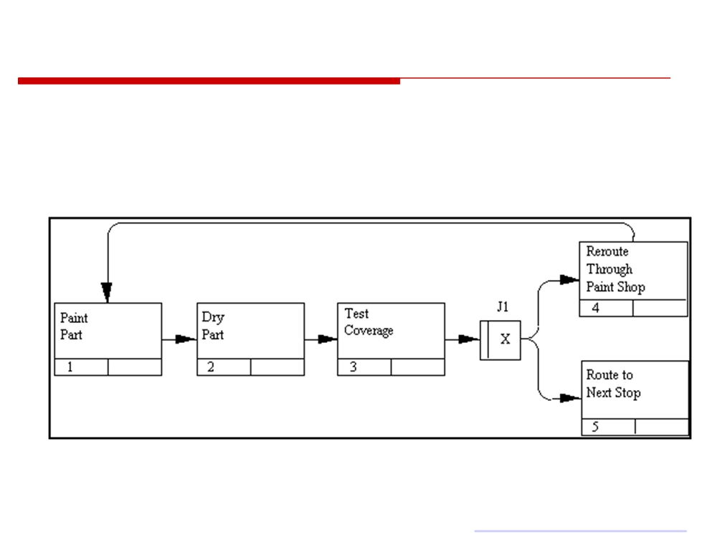
Example
IDEF3- Process Description Model
Process Description Diagram of the Example
© 2010 CMU-ISR12 Source: http://www.idef.com/idef3.html

Slide 15
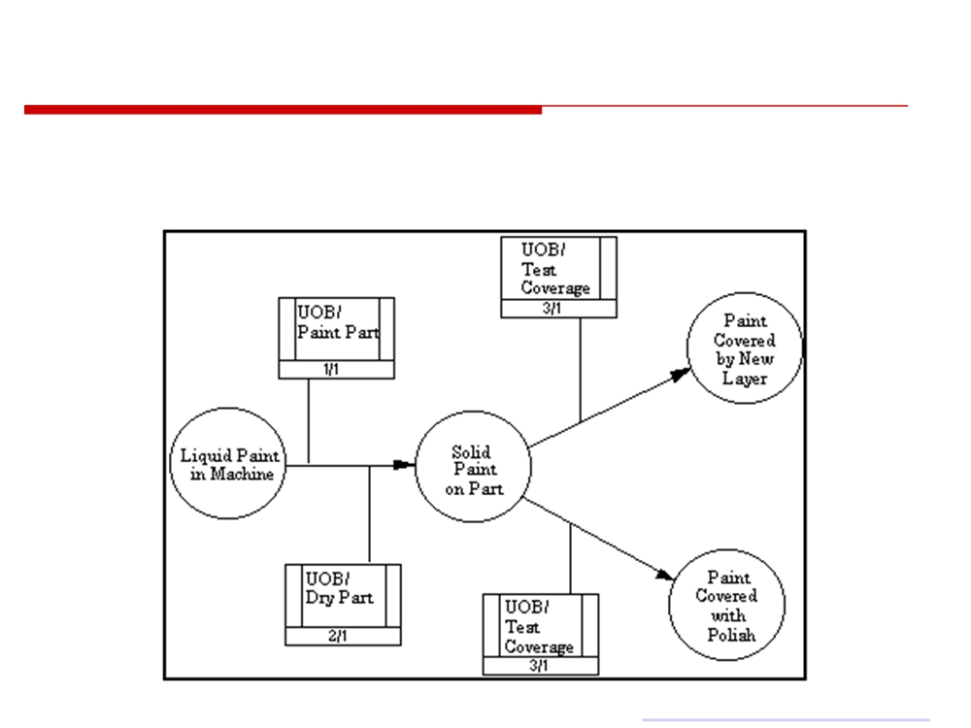
Example
IDEF3- Process Description Model
Object State Transition Network of the Example
© 2010 CMU-ISR13 Source: http://www.idef.com/idef3.html

Slide 16
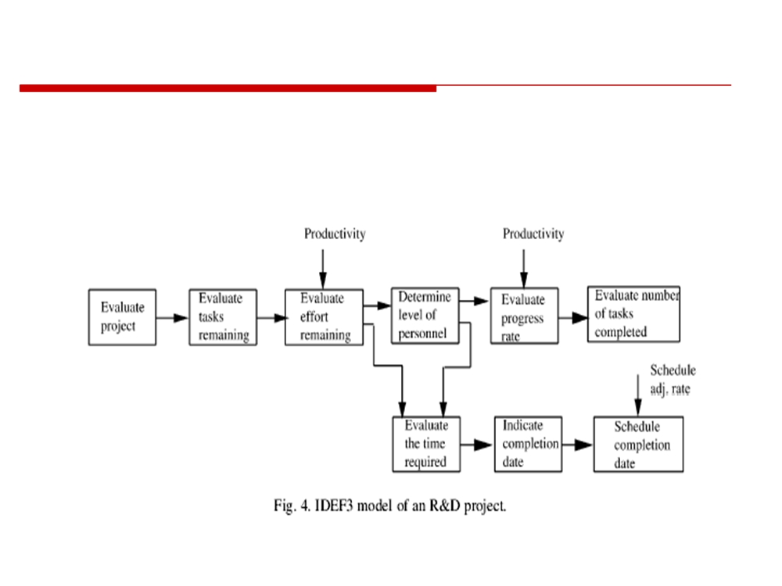
Example
IDEF3- Process Description Model
Other Example
© 2010 CMU-ISR
Source: (Zakarian & Kusiak, 2001)
14

Slide 17
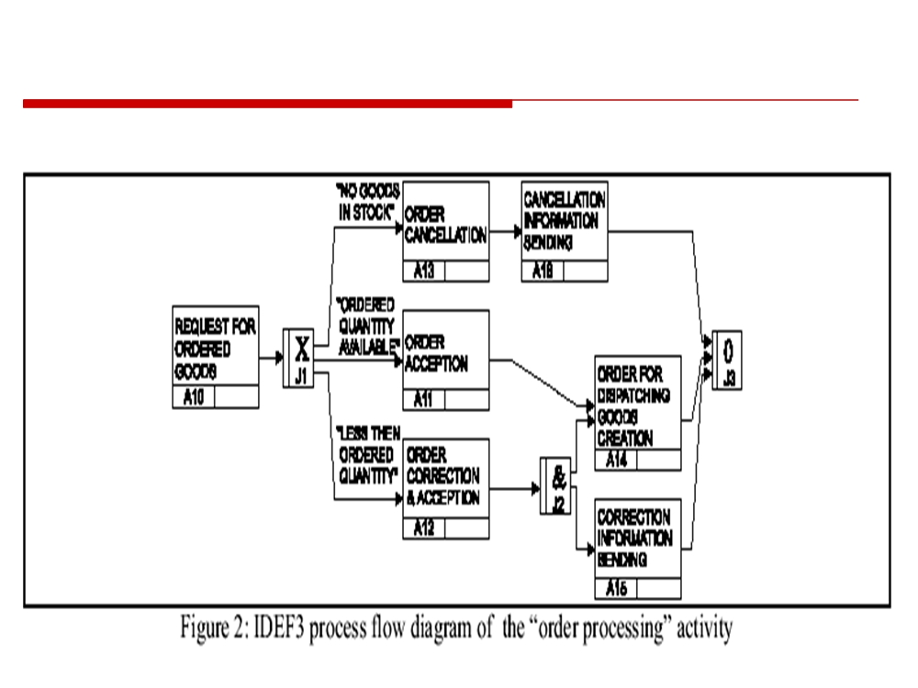
Example
IDEF3- Process Description Model
One more Example
© 2010 CMU-ISR
15

Slide 18
IDEF is tool for...
...describing
...managing
...and improving complex processes and systems
To do this, we need a common framework for visualizing the processes and the systems they support, and a methodology for representing both.
© 2010 CMU-ISR
16

Slide 19

IDEF (0 and 1X)
Is the unified modeling methodology that embraces management and user concerns in systems and process
management.
www.feacinstitute.org
202-
546-7927
17

Slide 20
Types of Models
Activity Models
Data Models
Activity models are
Data models define the
graphic representations
information requirements
of functions and
of the process.
processes.
Used for building computer
Are hierarchical
applications, databases,
Decomposed to the
and repositories.
needed level of detail.
Track flow of information
Track inputs, controls,
mechanism, and outputs.
through functional areas.
IDEF0
IDEF1x
© 2010 CMU-ISR
18

Slide 21
Model Vs Reality
Models represent reality in a form that can be easily controlled, evaluated, and manipulated.
Complex, poorly understood processes become manageable when broken down into their component parts.
Models can be used for analysis of the simplest processes; or the most complex systems with lifecycle costs in the millions of dollars
www.feacinstitute.org
202-
546-7927
19

Slide 22
Process Analysis
IDEF models gather the data for analysis:
Cost: Activity-based costing, functional economic analysis
Time: Timeline, cycle time, run time, turn-around times, sequence, hierarchy, dependencies. Quality: Quality metrics, comparisons between past, present, and future , TQM, CQI.
Redundant, over-lapping, non-value- added processes become apparent while
building the model.
www.feacinstitute.org
202-
546-7927
20

Slide 23
Benefits
• IDEF0 reveals redundant and non-value- added processes.
• IDEF0 documents the AS-IS-- the processes, the relationships between them, and the logical breakdown of those functions into their sub-processes and properties for baseline evaluation and further analysis.
• IDEF0 begins the road map from the AS-IS to the TO-BE.
© 2010 CMU-ISR
21

Slide 24

Benefits
(continued)
• IDEF0 provides a means for communicating and presenting results.
• IDEF0 establishes a forum and a structure for data gathering and knowledge acquisition.
• IDEF0 identifies opportunities for improvements.
• IDEF0 reveals data relationships and incongruities.
• IDEF0 identifies and categorizes information entities which form the foundation for information modeling (IDEF1x).
www.feacinstitute.org
202-
546-7927
22

Slide 25
IDEF is Not a Substitute For...
thinking...
intelligence... or experience,
But it can expose their
absence!
www.feacinstitute.org
202-
546-7927
23

Slide 26
ETVX Background
• ETVX was developed in the 1980s by IBM to document their processes.
• The model is based on four steps or activities to successfully complete a process, these are represented by the abbreviations ETVX.
"E" stands for the entry criteria (sometimes also called inputs) that must be satisfied before the series of tasks are performed;
"T" represents the tasks to be performed;
"V" stands for the verification and validation process to ensure that right tasks have been performed and completed and finally; "X" represents the exit criteria to complete the task successfully.
• Tasks can be further sub-divided to more detailed descriptions.
© 2010 CMU-ISR
24

Slide 27
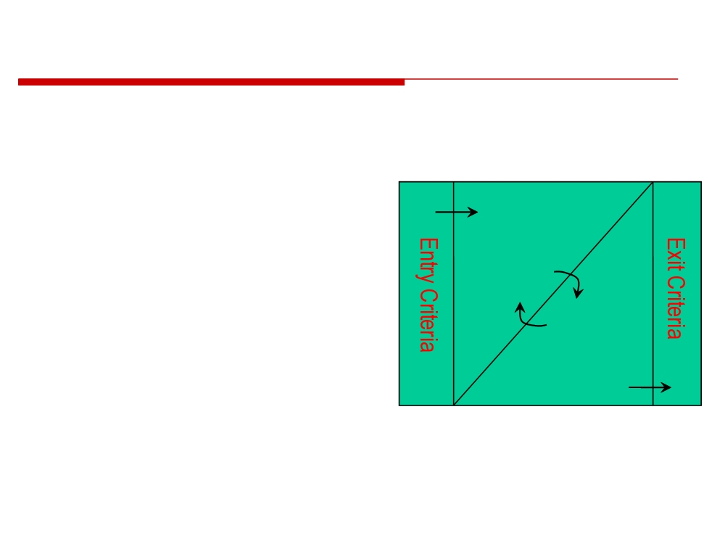
Planning Task
Expressed as ETVX
• Entry Criteria
• Before starting • Tasking
Tasking
• Validation
• Exit Criteria
• After Done
Validation
© 2010 CMU-ISR
25

Slide 28

Entry Criteria
• Project Planning
Questions to ask:
Process
What is needed to begin the Task?
• List of Objectives to
Complete
What are the main
Constraints?
• List of Available
Are there Dependency
Resources to Work
tasks?
on the Project
What Resources & Standards?
• Critical Dates for the
Project
Tasking
Validation
© 2010 CMU-ISR
26

Slide 29

Tasking
• Estimation of tasks
Questions to ask:
• Process activation
What must be done in
the task?
• Resource allocation
What Process to
• Tracking the
follow?
schedule
What Artifacts to
produce?
What Measures are to be taken?
Tasking
Expected results?
Validation
IE. Test plan
© 2010 CMU-ISR
27

Slide 30

Validation
• Actuals compared with estimates
• Artifacts generated by process are of sufficient quality to meet customer needs
• Resources are utilized to generate actuals, produce artifacts and complete tasks associated with project
• The tasks on the project have all achieved their exit criteria
Tasking
Validation
© 2010 CMU-ISR
28

Slide 31

Validation - 2
• Expected Product Quality • Quality is free (P. Crosby) • ...But it costs time
Tasking
Validation
© 2010 CMU-ISR
29

Slide 32
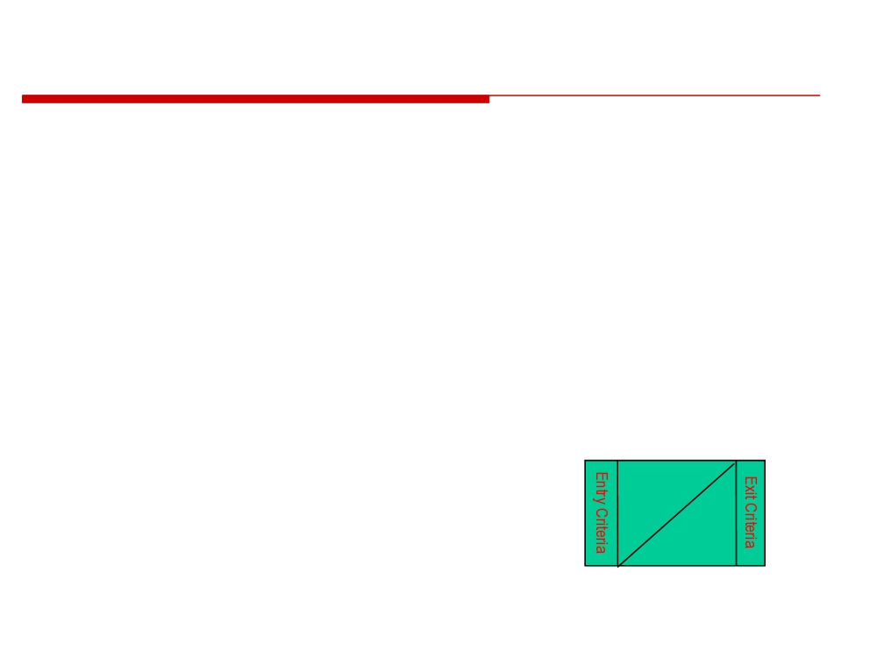
Validation
Quick Questions to Ask
• How do you know the task is complete? • Have the artifacts been checked? • Has the process been followed? • Are the measures captured?
Tasking
Validation
© 2010 CMU-ISR
30

Slide 33
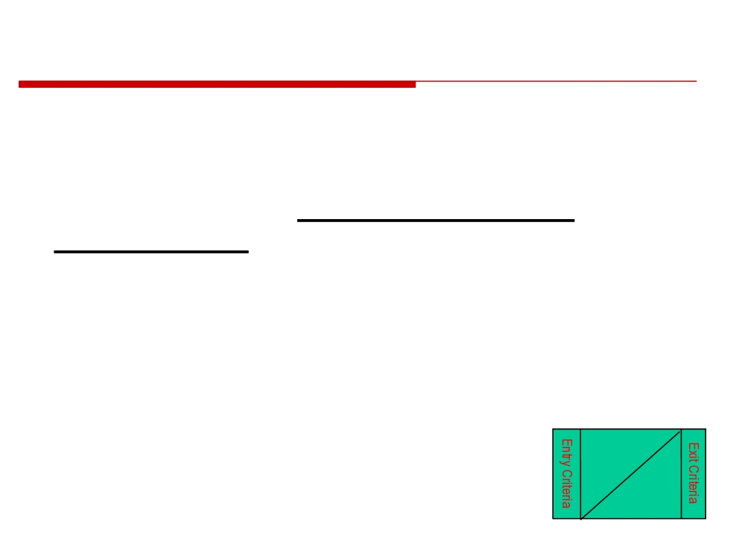
Exit Criteria
• All tasks are completed and actual time of completion recorded for future estimates
• All artifacts that meet the customer requirements are delivered to the customer
• All resources are de-allocated from the project and customer payment received for delivered products
• All committed tasks on the schedule are completed
Tasking
Validation
Managing Software
©Carnegie Mellon
31
Development
University
31

Slide 34

Exit Criteria
Quick Questions
• What do we expect to exist when done with the task?
• What is the next step?
• Are notifications required?
• What do we expect to be captured from this task being completed?
Tasking
Validation
© 2010 CMU-ISR
32

Slide 35
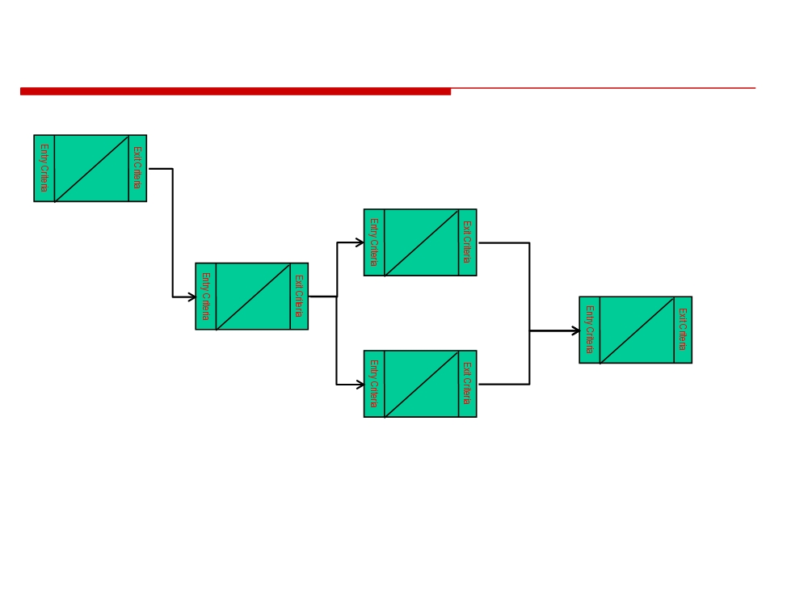
Design a Chain of ETVX Tasks
Tasking
Validation
Tasking
Validation
Tasking
Validation
Tasking
Validation
Tasking
Validation
© 2010 CMU-ISR
33

Slide 36

References
Colquhoun, G.J, Baines, R.W, Crossley, Roger, A State of the Art Review of IDEF0, International Journal of Computer Integrated Manufacturing, Vol. 6, No. 4, 1993, pp. 252-264.
(2) Introduction to IDEF Methodology, USACE LCM Manager’s Guide Version-2
http://www.usace.army.mil/ci/impolicy/lcmis/lcma3.pdf (4) Bosilj-Vuksic’s paper (http://oliver.efzg.hr/~vbosilj/iceis2000.pdf)
© 2010 CMU-ISR
36

Slide 37
Homework Assignment
Investigate:
IDEF
ETVX

