Slide 1
Software Process & Quality Management
Mel Rosso-Llopart © 2014
Step 3 - Assess a Software Process
Mel Rosso-Llopart
Senior Lecturer, Executive Education Program Institute for Software Research
Carnegie Mellon University

Slide 2

IDEF is tool for...
...describing
...managing
...and improving complex processes and systems
To do this, we need a common framework for visualizing the processes and the systems they support, and a methodology for representing both.
© 2010 CMU-ISR
16

Slide 3
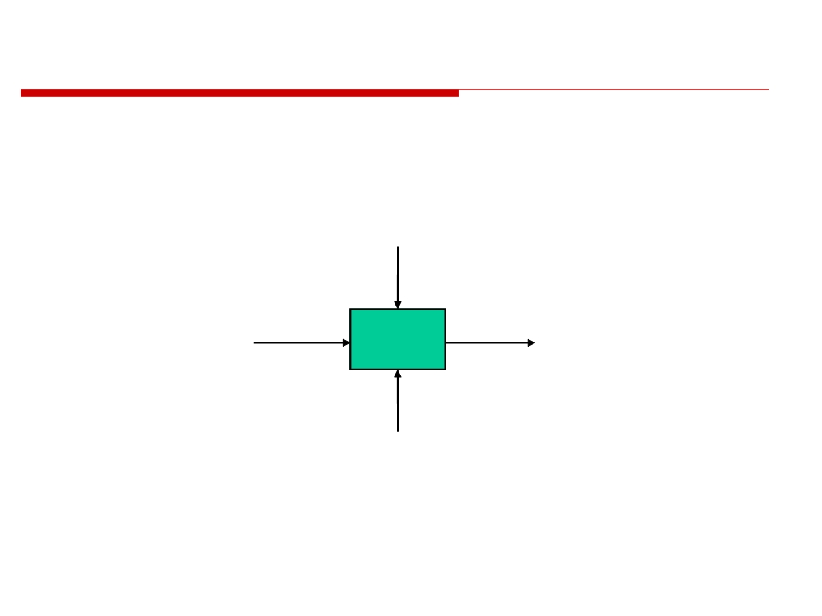
IDEF0 Model Components
CONTROL
- Data that restricts or provides direction for an activity
- Required for every activity
INPUT
OUTPUT
- Information or
materials used
- Information or
to produce
Activity
materials
activity outputs
produced by the
activity
- Not required
for every
- Required for
activity
every activity
MECHANISM
- Performs the activity (people, machines, systems, etc.)
- Required for every activity
© 2010 CMU-ISR
8

Slide 4
Process Capability Assessment
• Intended as a means to assess the extent to which an organization's processes follow best practices.
• By providing a means for assessment, it is possible to identify areas of weakness for process improvement.
• There have been various process assessment and improvement models but the SEI work has been most influential.
© 2014 CMU-ISR
3

Slide 5
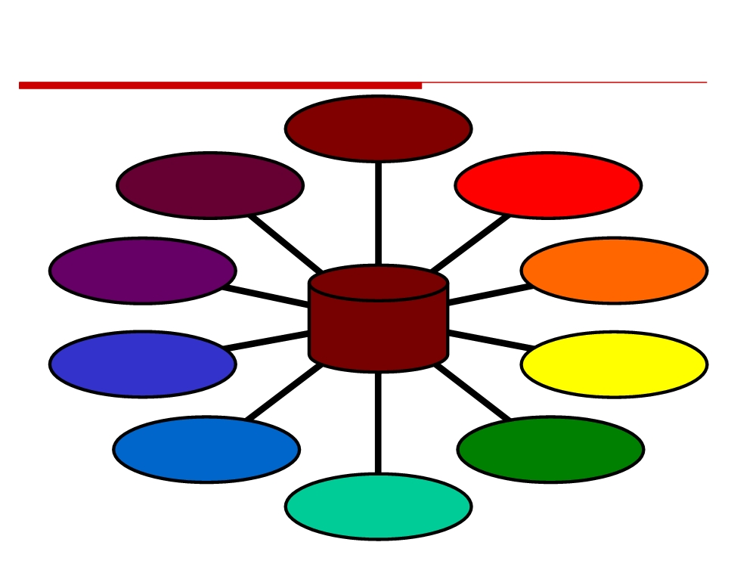
BEST PRACTICE SOURCES
Company
Visits
Workshops
Technology
& Meetings
Vendors
BMP
Conferences
Program
BEST
Literature
PRACTICES
Corporate
Review
Handbooks
Panel of
Telephone
Experts
Discussions
Consulting
Experience
© 2014 CMU-ISR
4

Slide 6

IMPROVING PRODUCT DEVELOPMENT
How well are we
Requirements
Empowerment
doing? What improvements
definition
Solids
are needed? Where do we
Product
modeling
start? Should we
planning
Integrated
product
benchmark?
teams
Design
Early
re-use
involvement
Product data
management
Design for
manufacturability
Resource
Top-down
management
design
Configuration
management
Early supplier
involvement
QFD
Project
Analysis &
CAE
planning
simulation
The Product Development Best Practices and Assessment
software and methodology provide an objective way for
identifying opportunities and planning improvements
© 2014 CMU-ISR
5

Slide 7

Why Do an ASSESSMENT?
• Benchmark the company’s product/service development process against best practices and industry performance
• Determine the extent that new product development best practices are being utilized
• Identify high-payoff improvement opportunities for improvement
• Establish a metric to measure progress in improving product development
© 2014 CMU-ISR
6

Slide 8
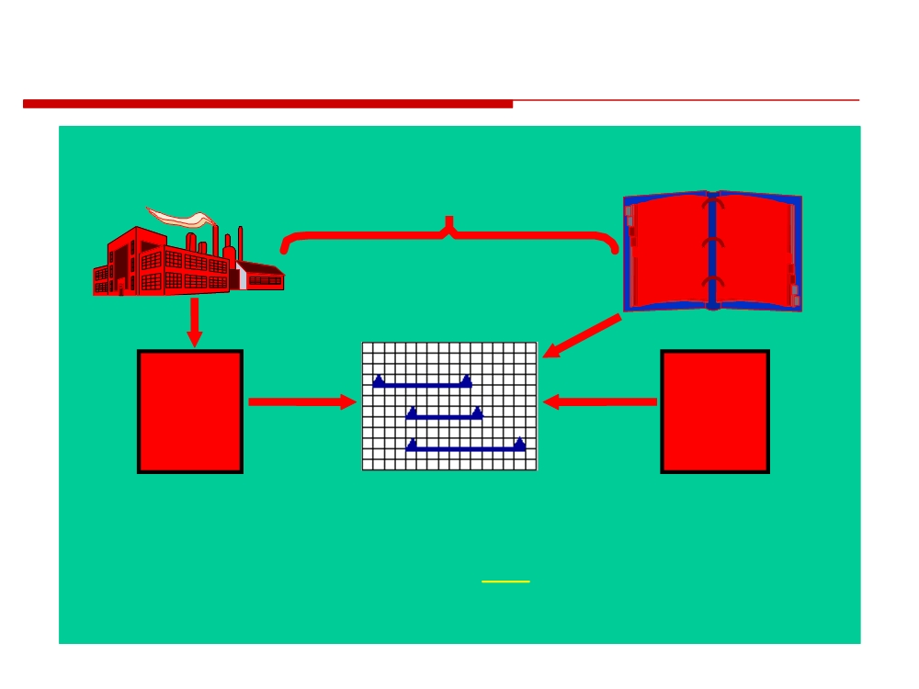
DEVELOPING AN IMPROVEMENT PLAN
CURRENT
BEST PRACTICES
SITUATION
GAP
IMPROVEMENT
PLAN
What’s possible
Product
Business
Development
Strategy
Assessment
(Strategic
Where are
What is
Levers)
the
important
Weaknesses
1. Assess current
2. Determine priorities
situation
based on strategy
3. Develop a plan
& Best Practices
to close gap
© 2014 CMU-ISR
7

Slide 9
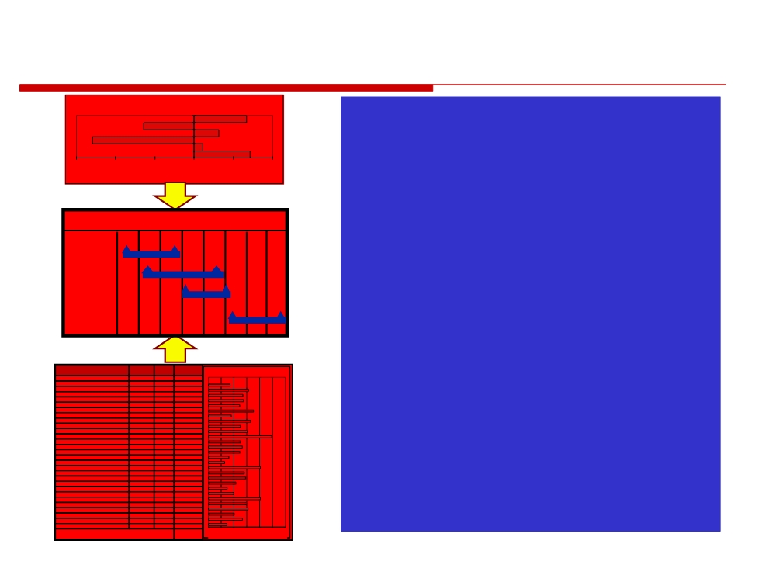
DEVELOPING THE ACTION
PLAN
GAP - INTENDED VS. IMPLIED STRATEGY
1. Identify performance gaps
6
5
relative to categories
4 3 2
-3
-2
-1
1
0
1
2
GAP
2. Identify strategy gaps and
Plan
associated practices
Task 1
3.
Examine individual practices
Task 2
Task 3
with low performance & high
Task 4
importance in large gap
categories & strategies
Assessment Category
Assessment
Company
BEST PRACTICES GAP
Business & Product Strategy
Weight
Weight
Effectiveness
Product & Pipeline Management
0.5
1
3.2
Technology Management
1
1
3.7
4.
Look for logical relationships &
Management Leadership
0.75
1
2.8
Early Involvement
1
1
4.5
Product Development Teams
1
1
5.1
Organizational Environment
1.5
1
5.3
Process Management
1
1
6.4
precedence among practices
Process Improvement
1
1
3.4
Understanding the Customer
0.75
1
3.3
Requirements & Specifications Mgt.
1
1
3.9
Development Process Integration
1.5
1
3.4
Supplier/Subcontractor Integration
1
1
5.0
Product Launch
1
1
4.7
Configuration Management
1
1
5.1
Design Assurance
1
1
6.8
Project & Resource Management
0.75
1
6.6
5.
Develop the action plan & gain
Design for Manufacturability
1.25
1
3.5
Product Cost Management
1
1
4.4
Robust Design
1
1
4.2
Integrated Test Design & Program
1
1
5.7
Design for Operation & Support
0.75
1
6.1
Product Data
0.75
1
4.7
consensus to the plan
Design Automation
1.25
1
3.5
Simulation and Analysis
1.25
1
5.2
Computer-Aided Manufacturing
1
1
3.8
Collaborative Tools & Technology
0.75
1
4.6
Knowledge Management
0.75
1
2.9
0.5
1
4.2
0
2
4
6
8
10
12
Weighted Total
4.5
Bigger gap indicates greater improvement opportunity
© 2014 CMU-ISR
8

Slide 10
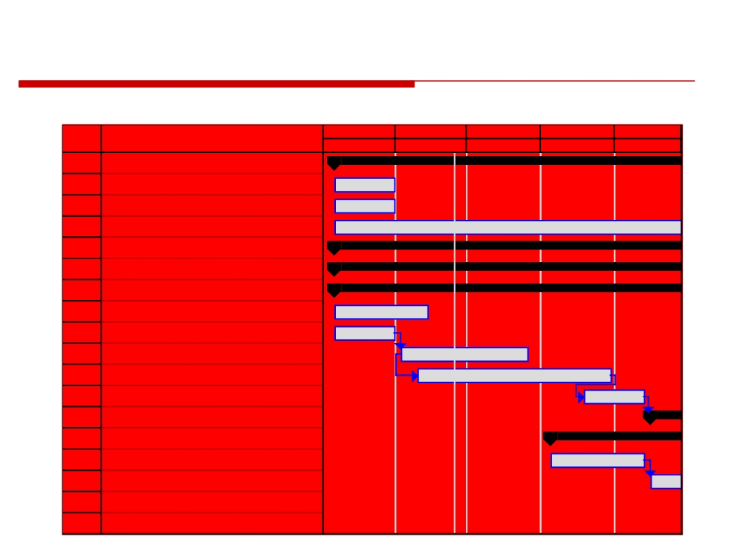
ACTION / IMPROVEMENT PLAN
Based on the gap analysis, put together a plan for improvement
October
November
December
January
February
ID
Task Name
Oct
Nov
Dec
Jan
Feb
1
PLAN & PREPARE
2
Create IPD Handbook
3
Conduct Management Meetings
4
Maintain Plan & Identify Additional Actions
5
RESTRUCTURE ORGANIZATION
14
PLAN FACILITIES & COLLOCATE
24
ESTABLISH IPT's
25
Hire Facilitator
26
Plan for Launching Teams
27
Conduct Team Launch Process for Teams
28
Implement & Support Teams
29
Identify Issues and Follow-up Actions
30
Implement PMT & SIT
37
ESTABLISH BUSINESS PROCESSES
38
Develop Enterprise Plan
39
Define Enterprise Processes
40
Develop Phased Implementation Plan
41
Develop Tailored Program Process
© 2014 CMU-ISR
9

Slide 11

THREE OPTIONS FOR AN ASSESSMENT
1. Consultant-led assessment
• Greater objectivity and frame of reference • Overcomes organizational politics
• Expertise in quickly identifying issues and planning improvements
2. Self-assessment using software packages available
• Inexpensive
• Less guidance on correctness
3. Internal resources training workshop
• Compromise with expense, yet provides oversight and guidance for planning improvements
© 2014 CMU-ISR
10

Slide 12

To Recap
• Companies need continuing effort to improve product development practices and process
• A product development strategy needs to be explicitly defined • Product development practices and process need to be aligned with strategic objectives
• Benchmarking & best practice databases aid identification of best practices
• A self-critical approach and competitive imperative are needed as a basis for significant improvement
• Improvement efforts should be focused on areas that will have the greatest payback
• Improvement efforts should address organization, process and technology in a balanced way
© 2014 CMU-ISR
11

Slide 13
Process Assessment Method
An objective model-independent method to assess the capability of an organization to meet the process goals.
© 2014 CMU-ISR
12

Slide 14
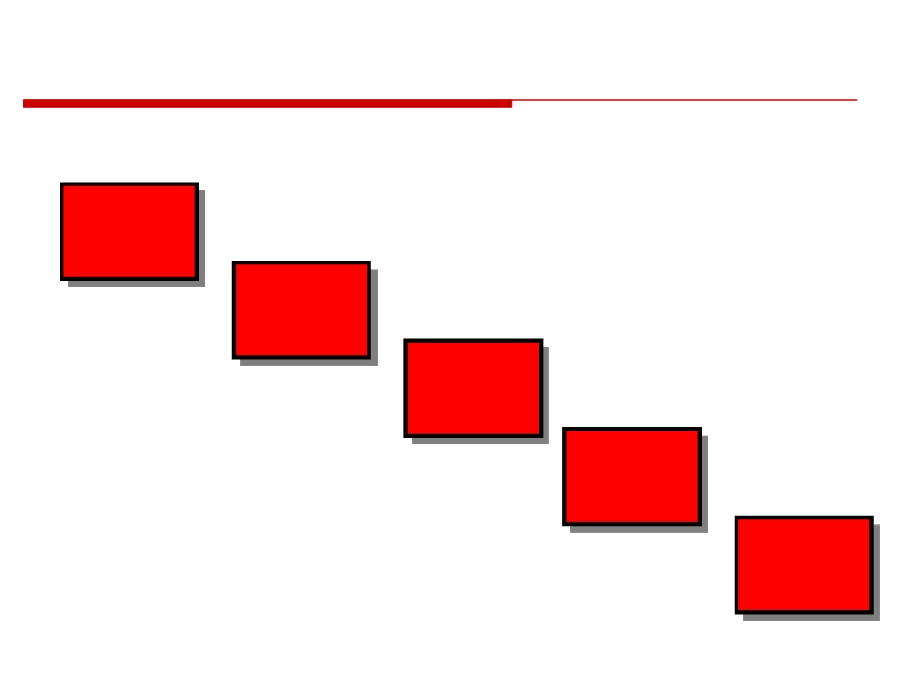
Assessment Stages
Stage 1
Initiation
Stage 2
Preparation
Stage 3
Assessment
Stage 4
Analysis and
Reporting
Stage 5
Closure
© 2014 CMU-ISR
14

Slide 15
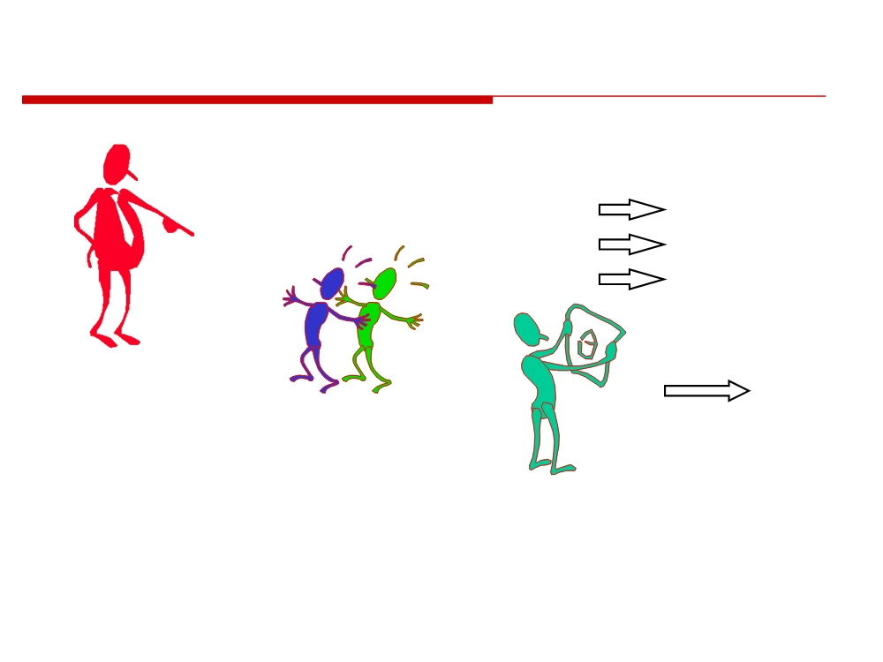
The Key Players (Stage 0)
Goal Ratings
Process ratings Maturity Level
Sponsor initiates
Further
assessment
Analysis &
Assessors
Action
collect and
Planning
rate data
Lead Assessor manages team and assures quality
© 2014 CMU-ISR
15

Slide 16
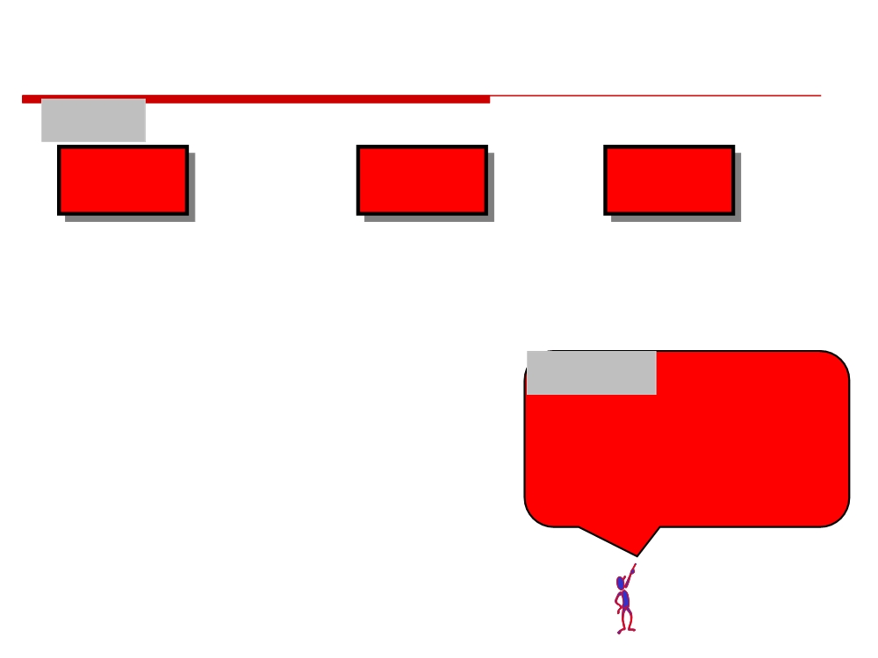
Initiation (Stage 1)
Tasks
Sanction
Define the
the
Select the
inputs
business case
Resources
• identify the assessment purpose
• costs and benefits
• select Lead Assessor
• select the assessment model
• decision to proceed
• define goals for the assessment • identify the business drivers • identify constraints
• document assumptions
Outputs
• identify additional information gathering requirements
• assessment purpose
• identify feedback and output requirements
• constraints
• complete the assessment brief
• assessment goals
• confidentiality agreements
• quality measures to be collected
© 2014 CMU-ISR
16

Slide 17
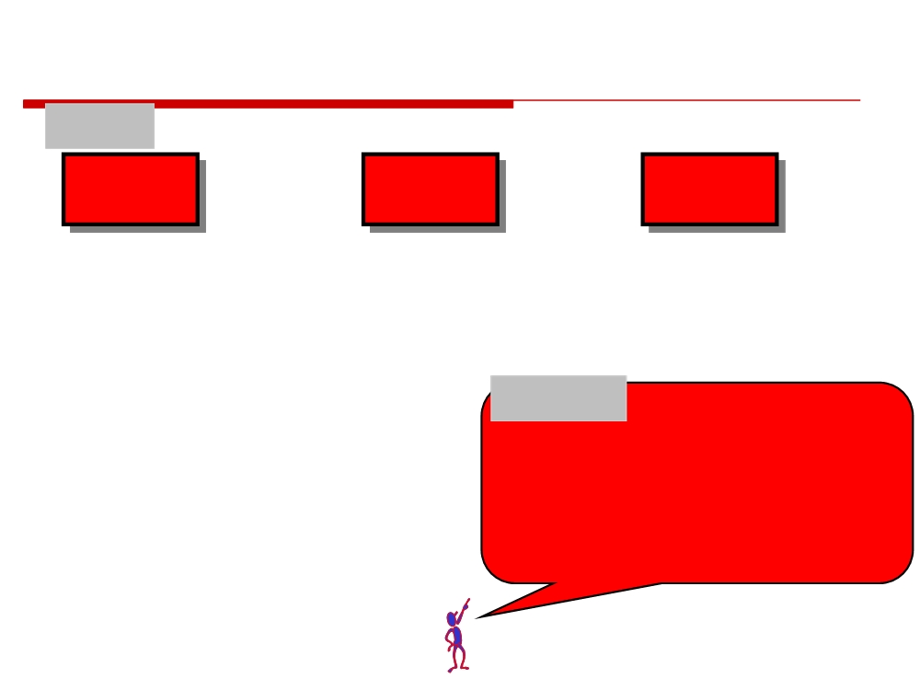
Preparation (Stage 2)
Tasks
Determine
Plan
Prepare
Scope
Assessment
Personnel
• select processes to assess
• select assessment team
• prepare assessment team
• determine the context
• assessment team roles
• prepare organizational unit
• determine sample size
• estimating resources
• select instances
• determine control mechanisms
• document review
• completing the assessment plan
• select participants
Outputs
• determine targets (capability levels)
• assessment scope
• requirements of a conformant assessment • organizational units to be assessed • confidentiality arrangements • assessment plan and schedule • participant feedback requirements
© 2014 CMU-ISR
17

Slide 18
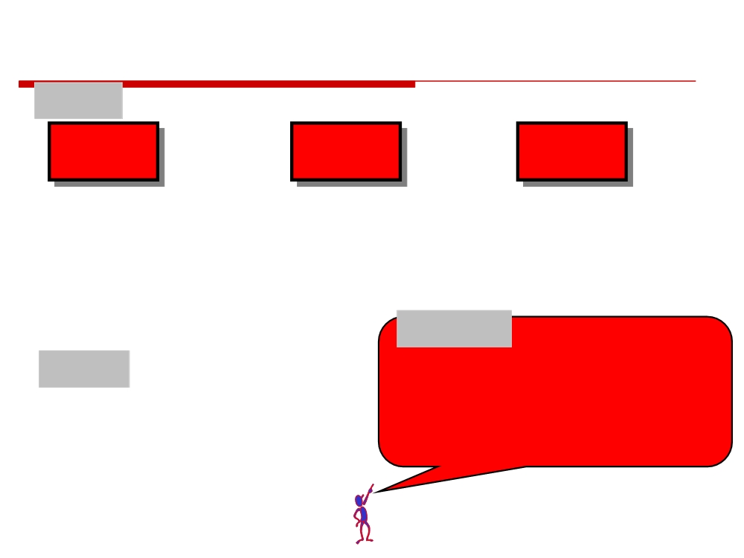
Assessment (Stage 3)
Tasks
Gather
Assess
Reach
Information
Capability
Consensus
• conduct interviews
• consolidate the findings
• on ALL ratings!
• study documentation
• rate the goals
• document findings
• rate the process
• feedback initial conclusions • determine the Organizational Unit’s Capability Level
Conduct
• according assessment plan
Types
• adapt plan for changes and feedback
• data collection by interview or document
• Measurement only (no analysis)
• data review for process ratings
• Findings & Recommendations
• assessors agree on ratings before submitting
• Findings & Action Planning
them to the Lead Assessor
© 2014 CMU-ISR
18

Slide 19
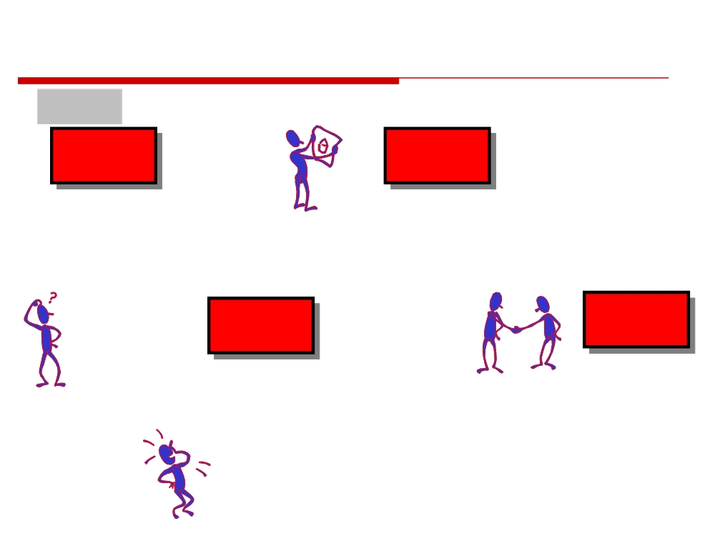
Analysis & Reporting (Stage 4)
Tasks
Analyse
Identify
Findings
Action Plan
• Strengths & Weaknesses
• Prioritise improvements according impact &
• Gap Analysis
effort against business drivers
• Improvement
• Cost/benefit Analysis
Opportunities Identified
• Schedule of improvement roll-out
Disseminate
Issue
Findings
Final Report
• Semi-formal interactive
• Management findings &
feedback session
recommendations
• Summary assessment process & key players
• Results compared with targets • Detailed process findings
© 2014 CMU-ISR
19

Slide 20
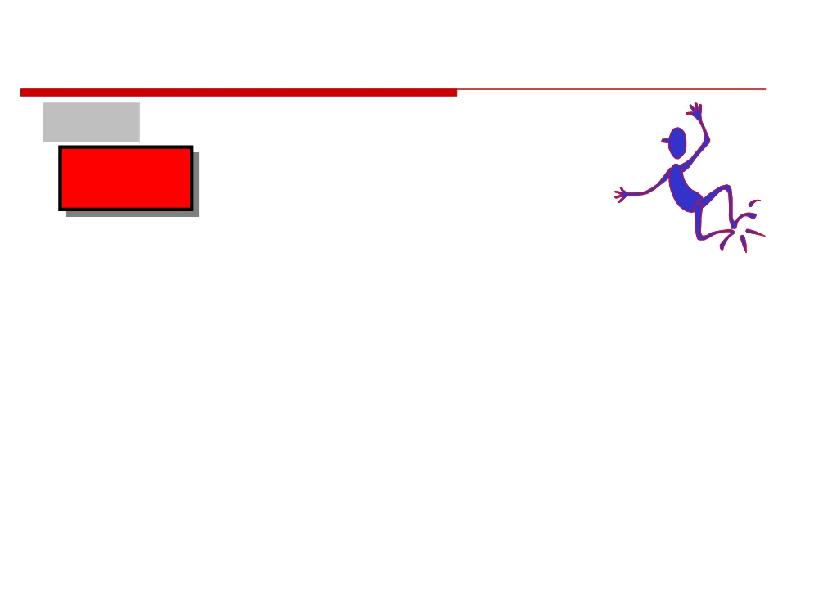
Closure (Stage 5)
Tasks
Post-Assessment Review
• results of the analysis of the participants feedback forms • the assessments’ achievements against its goals • the overall level of confidence in the assessments results • any problems the assessors experienced during the assessment including problems with the use of the method
• the successes achieved
• the techniques used during the assessment
• the organizational unit and the Sponsor's response to the results
• Lead Assessor ensures that the Assessment Conformance Checklist is complete and signed-off.
© 2014 CMU-ISR
20

Slide 21
Homework:
Investigate Process Assessments

