Slide 1
Software Process & Quality Management
Mel Rosso-Llopart © 2010
Step 5 - Measure Improvement and Progress
Mel Rosso-Llopart
Senior Lecturer, Executive Education Program Institute for Software Research
Carnegie Mellon University

Slide 2

Agenda
▪ What does measurement mean ▪ Types of measurement
▪ What to measure
▪ Measurement toward a goal ▪ Metrics and how to use
© 2010 CMU-ISR
2

Slide 3

Measurement
• Lord Kelvin (1824-1904): When you can measure what you are speaking about, and express it into numbers, you know something about it; but when you cannot measure it, when you cannot express it in numbers, your knowledge is unsatisfactory kind.
• Tom De Marco: You can't control what you can't measure
© 2010 CMU-ISR
3

Slide 4
Definitions
• Measurement is a process where quantitative or qualitative values are given to real world entities according to well defined rules
• Metric
• A quantitative measure of the degree to which a system, component, or process possesses a given attribute (IEEE definition) • Metrics numerically characterize "simple" attributes
• Measure
• An objective assignment of the number or symbol to an entity in order to characterize an attribute
• Measures are "functions" of metrics which can be used to assess or predict more "complex" attributes
• Direct measurement of an attribute is measurement which does not depend on the measurement of any other attribute
• Indirect measurement of an attribute is measurement which involves the measurement of one or more attributes
© 2010 CMU-ISR
4

Slide 5
Classification of Metrics
• Product vs. process metrics
• Process improvement e.g. duration estimation accuracy • Product quality improvement e.g. release quality (f/kNLOC)
• Subjective vs. objective metrics
• Subjective metrics require human judgment • Objective metrics can be measured "mechanically"
• Direct and indirect metrics
• Some metrics easy to measure directly e.g. lines of code, number of faults
• Some metrics have to be computed from direct metrics e.g complexity, quality
© 2010 CMU-ISR
5

Slide 6
What to Measure?
• First we have to identify the information we will need from our process
• After that we identify the metrics needed • NOT VICE VERCA!
• Measurement process lies on process improvement needs, not on needs only to measure something
© 2010 CMU-ISR
6

Slide 7
Traps
• Are the products comparable with respect to requirements, size, complexity etc.?
• Are the projects comparable with respect to staffing, time pressure, stability etc.?
• Have the data been collected in the same way, are the error data collected during the same project phases?
• Is the model reasonable?
• Are the assumptions we have made reasonable?
• If the assumptions are built on previous experience, is the experience
• still relevant?
• relevant for this project?
• How much do our conclusions depend on a single observation or a few observations?
© 2010 CMU-ISR
7

Slide 8
When we use the Results
• Be careful when extrapolating the results • Always check the data
• Remember:
garbage in … garbage out
© 2010 CMU-ISR
8

Slide 9
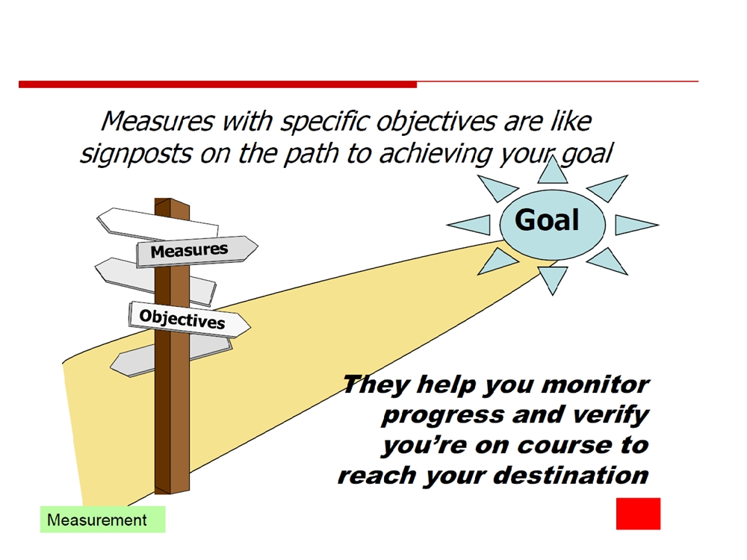
Measurement Toward Goal
© 2010 CMU-ISR
9

Slide 10

Selecting Measures
1. Do the measures align and are they goal oriented?
2. Are you measuring something people care about?
3. Will the measure be useful to help drive change?
4. Where will you get the data? 5. Will it be feasible to collect and report in a timely way?
© 2010 CMU-ISR
10

Slide 11
When and Where to use Metrics Data?
• Management decisions
• Continuous process improvement
• During project lifecycle (e.g. progress)
• Follow up and analyze of project's process (audits, CMM assessments)
• Metric analyze sessions of a project
• Analyzing the project in the end (Final Report) • Training
• Motivating project members to improvement activities
The main goal is to serve as
the basis of making decisions
© 2010 CMU-ISR
11

Slide 12

Uses of Measurement
• Can be applied to the software process with the intent of improving it on a continuous basis
• Can be used throughout a software project to assist in estimation, quality control, productivity assessment, and project control
• Can be used to help assess the quality of software work products and to assist in tactical decision making as a project proceeds
12
© 2010 CMU-ISR
12

Slide 13

Reasons to Measure
• To characterize in order to
• Gain an understanding of processes, products, resources, and environments
• Establish baselines for comparisons with future assessments • To evaluate in order to
• Determine status with respect to plans • To predict in order to
• Gain understanding of relationships among processes and products
• Build models of these relationships • To improve in order to
• Identify roadblocks, root causes, inefficiencies, and other opportunities for improving product quality and process performance
13
© 2010 CMU-ISR
13

Slide 14
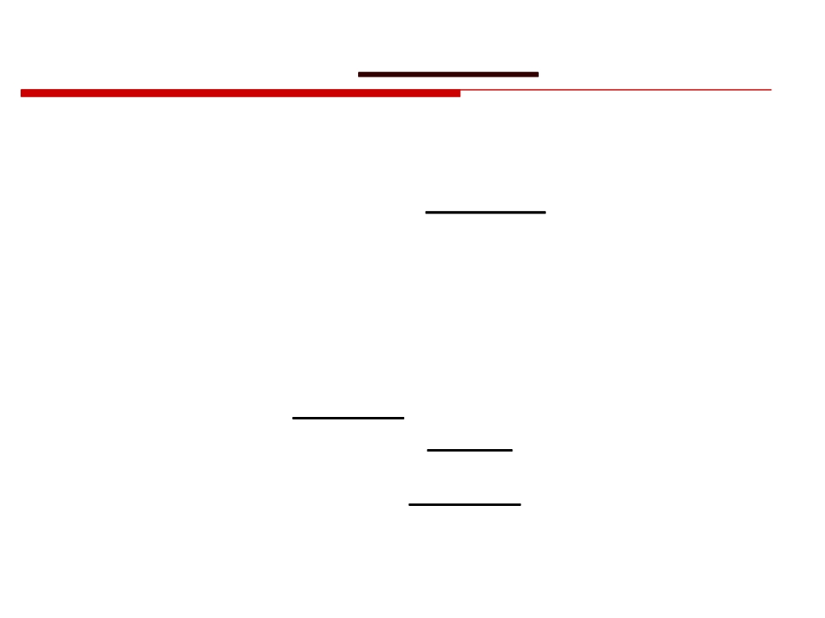
Metrics in the Process Domain
• Process metrics are collected across all projects and over long periods of time
• They are used for making strategic decisions • The intent is to provide a set of process indicators that lead to long-term software process improvement
• The only way to know how/where to improve any process is to
• Measure specific attributes of the process • Develop a set of meaningful metrics based on these attributes
• Use the metrics to provide indicators that will lead to a strategy for improvement
(More on next slide)
(More on next slide)
14
© 2010 CMU-ISR
14

Slide 15

Metrics in the Process Domain
(continued)
• We measure the effectiveness of a process by deriving a set of metrics based on outcomes of the process such as
• Errors uncovered before release of the software • Defects delivered to and reported by the end users
• Work products delivered • Human effort expended • Calendar time expended • Conformance to the schedule
• Time and effort to complete each generic activity
15
© 2010 CMU-ISR
15

Slide 16

Etiquette of Process Metrics
• Use common sense and organizational sensitivity when interpreting metrics data
• Provide regular feedback to the individuals and teams who collect measures and metrics
• Don’t use metrics to evaluate individuals
• Work with practitioners and teams to set clear goals and metrics that will be used to achieve them
• Never use metrics to threaten individuals or teams • Metrics data that indicate a problem should not be considered “negative”
• Such data are merely an indicator for process improvement • Don’t obsess on a single metric to the exclusion of other important metrics
16
© 2010 CMU-ISR
16

Slide 17

Metrics for Software Quality
• Correctness
• This is the number of defects per KLOC, where a defect is a verified lack of conformance to requirements
• Defects are those problems reported by a program user after the program is released for general use
• Maintainability
• This describes the ease with which a program can be corrected if an error is found, adapted if the environment changes, or enhanced if the customer has changed requirements
• Mean time to change (MTTC) : the time to analyze, design, implement, test, and distribute a change to all users
• Maintainable programs on average have a lower MTTC
17
© 2010 CMU-ISR
17

Slide 18

Arguments for Software Metrics
• Most software developers do not measure, and most have little desire to begin
• Establishing a successful company-wide software metrics program can be a multi-year effort
• But if you do not measure, there is no real way of determining whether you are improving
• Measurement is used to establish a process baseline from which improvements can be assessed
• Software metrics help people to develop better project estimates, produce higher-quality systems, and get products out the door on time
18
© 2010 CMU-ISR
18

Slide 19

Establishing a Metrics Baseline
• By establishing a metrics baseline, benefits can be obtained at the software process, product, and project levels
• The same metrics can serve many masters
• The baseline consists of data collected from past projects • Baseline data must have the following attributes
• Data must be reasonably accurate (guesses should be avoided) • Data should be collected for as many projects as possible
• Measures must be consistent (e.g., a line of code must be interpreted consistently across all projects)
• Past applications should be similar to the work that is to be estimated
• After data is collected and metrics are computed, the metrics should be evaluated and applied during estimation, technical work, project control, and process improvement
19
© 2010 CMU-ISR
19

Slide 20
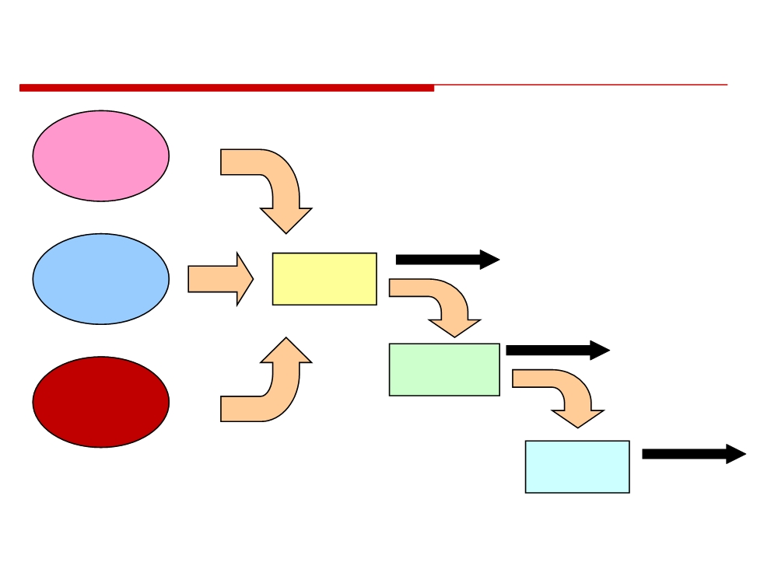
Software Metrics Baseline Process
Software
Engineering
Process
Measures
Software
Data
Project
Collection
Metrics
Metrics
Software
Computation
Product
Indicators
Metrics
Evaluation
20
© 2010 CMU-ISR
20

Slide 21
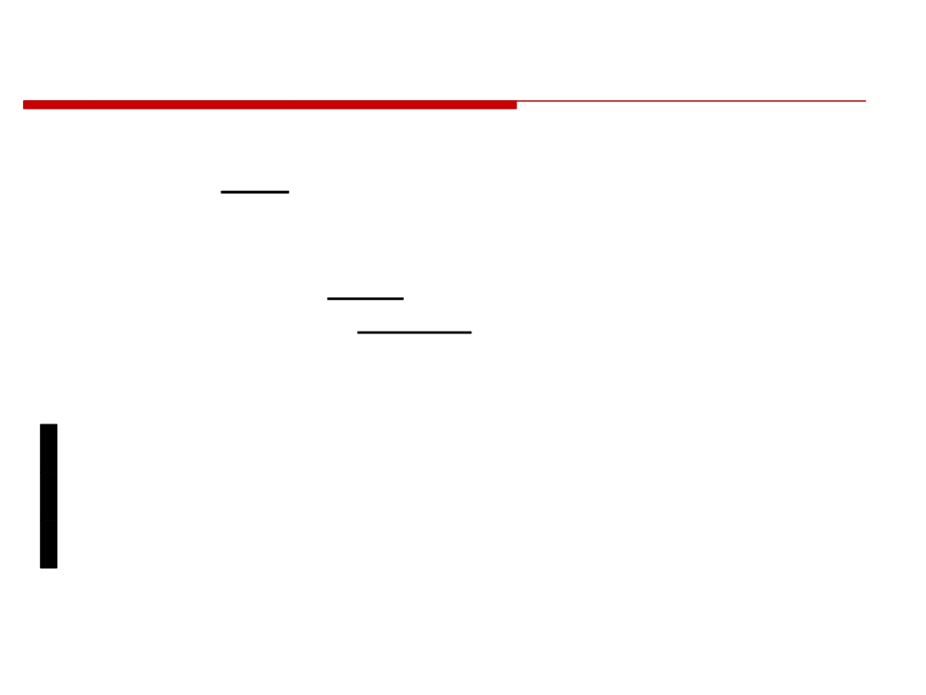
Getting Started with Metrics
1) Understand your existing process
2) Define the goals to be achieved by establishing a metrics program
3) Identify metrics to achieve those goals
• Keep the metrics simple
• Be sure the metrics add value to your process and product
4) Identify the measures to be collected to support those metrics
(More on next slide)
(More on next slide)
21
© 2010 CMU-ISR
21

Slide 22

Getting Started with Metrics (continued)
5) Establish a measurement collection process
a) What is the source of the data?
b) Can tools be used to collect the data? c) Who is responsible for collecting the data? d) When are the data collected and recorded? e) How are the data stored?
f)
What validation mechanisms are used to ensure the data are
correct?
6) Acquire appropriate tools to assist in collection and assessment
7) Establish a metrics database
8) Define appropriate feedback mechanisms on what the metrics indicate about your process so that the process and the metrics program can be improved
22
☺ 
© 2010 CMU-ISR
22

Slide 23
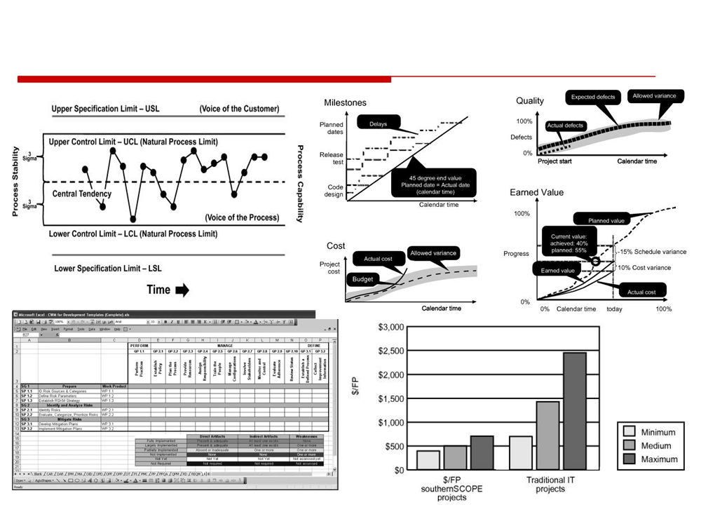
Showing Progress - Indicators
© 2010 CMU-ISR
23

Slide 24
Homework
Investigate Software Metric

