Slide 1
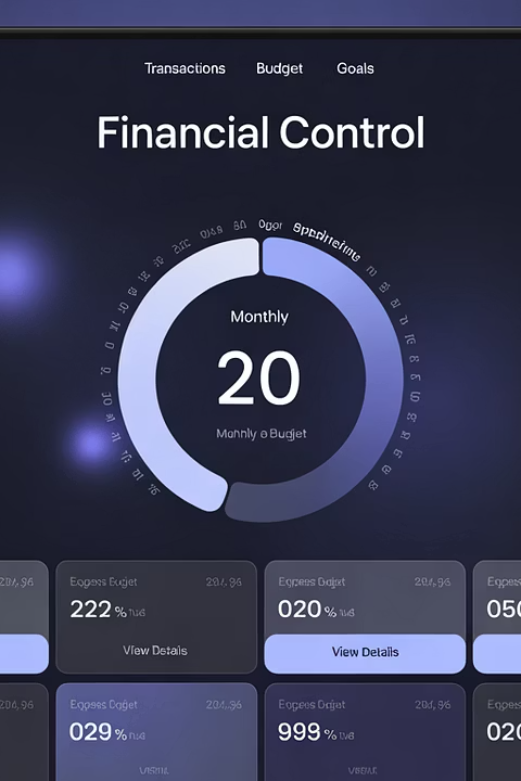
CashCompass Version 2
Programming project by David
Contact: dav.lehmann.24@lehre.mosbach.dhbw.de | Discord ID: r0llz
Github: https://github.com/dav-lehmann-24/Programming-Project-V2

Slide 2
Development Progress: From Version 1 to Version 2
Original Version 1
Current Version 2
Eclipse IDE with GUI editor
Switch to IntelliJ IDEA
Java Swing for the user interface
Use of Gradle as build tool
6 classes with Gui.Java as entry point
JavaFX for more modern user interface
Approaches to OOP principles with weaknesses
12 classes with MainFX.java as entry point
No user authentication
Complete implementation of OOP principles
Data storage in JSON file
User authentication with Bcrypt
Currency selection implemented
PostgreSQL database instead of JSON file
Technology Stack
The new version is based on a modern, extended tech stack:
Java with Gradle as build management tool
JavaFX
Graphic components in JavaFX
Bcrypt encryption for user authentication
PostgreSQL as robust relational database

Slide 3
Challenges, Limitations and Future Perspectives
Challenges
Planned Extensions
The development of Version 2 presented us with complex technical tasks:
Several improvements can be considered for future versions:
Abandoning a GUI editor, required a trial-and-error approach in design
Extended filter functions for more precise analysis of income and expenses
Learning the JavaFX framework
Refactoring the application according to OOP principles
Real-time conversion between different currencies with current exchange rates
Database integration and configuration
Implementation of database queries
Recurring transactions and reminders
Provide a setup script for automatic database schema creation
Migration to a web-based application for cross-platform accessibility
Applied Concepts from the Classroom and Beyond
The project demonstrates the practical application of various advanced programming concepts:
Concepts learned from last semester
GUI development with JavaFX
Object-oriented programming
Secure authentication with Bcrypt encryption
Dependency management with Gradle
Relational database integration with PostgreSQL queries

