Slide 1
Data and Tools
A Framework for Integrating multi-scale Agro-Biophysical and Socio-economic Datasets
Exposing Hidden Hunger – 2015 HelpMeViz Vizathon Bread for the World Institute, Washington DC, May 30, 2015
Notes:
Data and tools available on our website and what we have in the pipeline for 2013.

Slide 2


What We Do…
“HarvestChoice generates knowledge products to help guide strategic decisions to improve the well-being of the poor in sub-Saharan Africa through more productive and profitable farming. (…) HarvestChoice’s evolving list of knowledge products includes maps, datasets, working papers, country briefs, user-oriented tools, and spatial and economic models designed to target the needs of investors, policymakers, and research analysts who are working to improve the food supply of the world's poor.”
Questions we try to answer:
“Where are the poor and what is their welfare status?”
“On what farming systems do poor most depend?”
“What are the constraints of such farming systems?”
“What investments and innovations might best sustainably raise farm productivity?”
Notes:
Knowledge organization, we provide open data and analysis products. Health and Nutrition at the core of the problems we tackle. Food supply is both source of income and consumption!!

Slide 3
Two different types of data
Harvest choice mapping tool: Macro scale
Advantage: it provides an integrated view of the characteristics of each region (socio-demographics, agriculture, climate, ...)
Challenge for analysis: to extract the information of interest from the vast multitude of data
Household surveys: Micro scale
Advantage: it provides detailed information at the individual or household level
Challenge for analysis: to aggregate and summarize the information into meaningful descriptive statistics

Slide 4
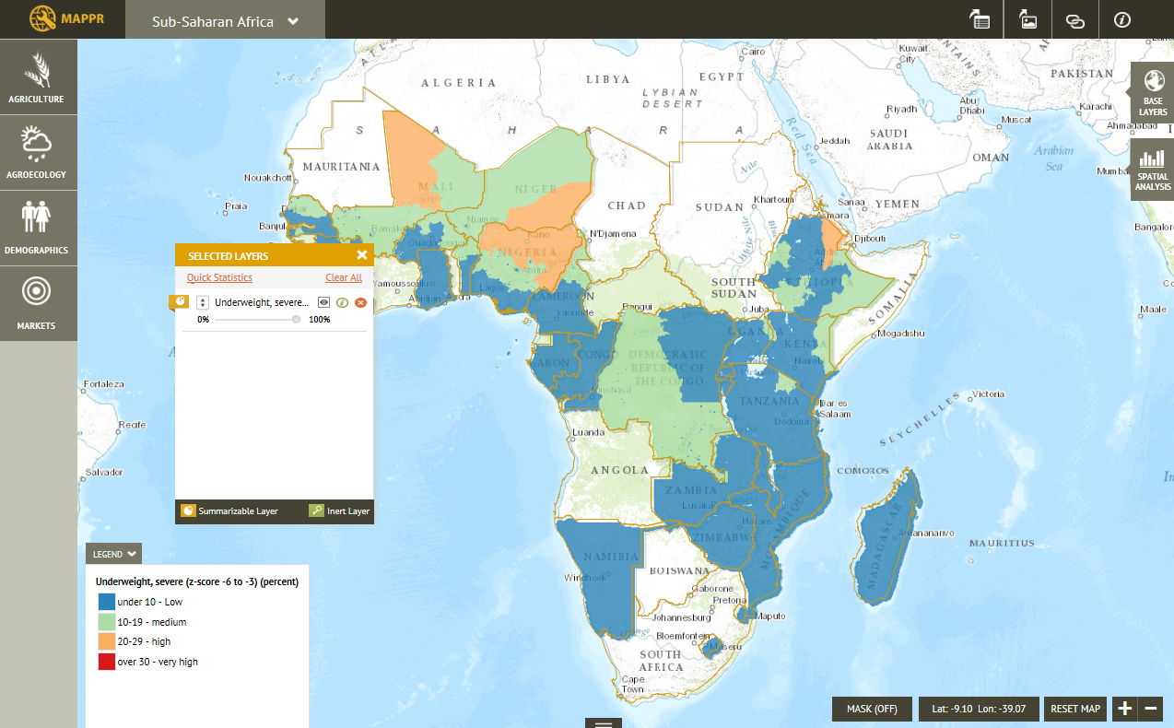
Macro Scale: Mapping Tool
Notes:
Combine several indicators, see how they interact, see how the different characteristics are distributed across space

Slide 5
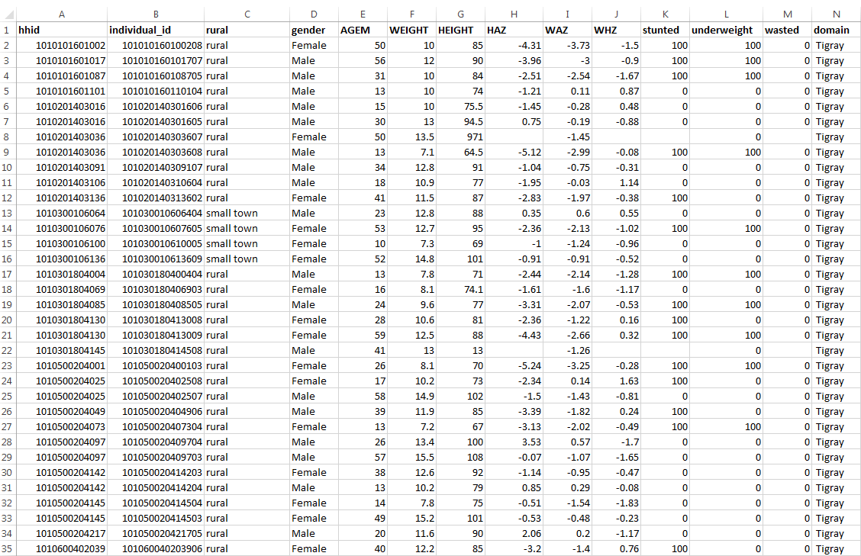
Micro Scale: Household Surveys
Notes:
Collection of individual information. Bottom up approach, can compute whatever statistic of interest
Distribution of weight, height, calories intake, malnutrition by age, by gender, by region, …

Slide 6
Information publicly available through HarvestChoice website (MAPR, TABLR)
Agro-ecology
Climate
Demography
Population
Elevation
Land cover and use
Agro-ecological domains
Income sources and poverty
Health and Nutrition
Soil resources
Markets
Markets network
Travel time
Agriculture
Yield
Harvest area
Livestock
Production
Ports network
Notes:
Data: Our data holdings (ref. Susana’s schematic). To be updated, incl. items in the pipeline. Distinguish between primary and secondary sources.

Slide 7
Health, Nutrition, Population and Poverty
Anthropometrics
Mother’s age
Mother’s height
Mother’s weight
Nutrition indicators (DHS)
child anthropometric indicators (stunting, wasting, underweight)
Body Mass Index (BMI)
infant/young child breastfeeding practices
iron and vitamin supplementation
infant and child under 5 mortality rate
percentage of children with diarrhea
wealth index
Population
Total population
Population density
Poverty indicators
Per capita expenditure
Gini index
Poverty headcount ratio
Poverty density
Poverty gap
Poverty Severity
Notes:
DHS: Demography and health program, USAID funded project to collect information on health, nutrition and demography.

Slide 8
Open-Data Platform http://havestchoice.org/
Other Models, Calculators
MAPPR
TABLR
HarvestChoice Website
LSMS-ISA
CGIAR and BMGF Project Mapping Tools
Africa RISING
FAOSTAT
Data API (RESTful)
Map/Tile Service (WMS)
Time-series spatial indicators
HarvestChoice CELL5M catalog of 750+ 10 km resolution spatial indicators
Calibration
Up/down scaling
Data harmonization
Bio-physical land use, soils, climate, pests (IIASA, CRU, USGS, UMN, AgMIP)
Production SPAM (land cover, admin records, IIASA GAEZ suitability)
Socio-Economic pop. poverty, factor productivity (LSMS, ag. census, DHS, FAO)
Markets, Infrastructure road networks, transportation

Slide 9
Ethiopia and Malawi household surveys
Anthropometrics: outcome indicators
HAZ: height for age z-score
WAZ: weight for age z-score
WHZ: weight for height z-score
Underweight: Low weight for age
Stunted: Low height for age
Wasted: Low weight for height
Nutrition: input indicators
Intakes: calories, proteins, vitamins, iron, calcium, … (quantity and shares)
Indication on whether the households consumes enough of them
Indexes:
Dietary Diversity Index (DDI)
Household Dietary Diversity Score (HDDS)
Shannon Index
Simpson Index

Slide 10
About
IFPRI ifpri.org
The International Food Policy Research Institute (IFPRI) seeks sustainable solutions for ending hunger and poverty. IFPRI is one of 15 centers supported by the Consultative Group on International Agricultural Research (CGIAR), an alliance of 64 governments, private foundations, and international and regional organizations.
HarvestChoice harvestchoice.org
HarvestChoice generates knowledge products to help guide strategic investments to improve the well-being of poor people in sub-Saharan Africa through more productive and profitable farming. To do this, a novel and spatially explicit evaluation framework is being developed and deployed. By design, primary knowledge products are currently targeted to the needs of investors, policymakers and program managers, as well as the analysts and technical specialists who support them.
HarvestChoice Team at IFPRI
JAWOO KOO crop/technology modeling, biophysical constraints
CARLO AZZARRI micro-economics, sub-national poverty, nutrition
BELIYOU HAILE M&E, micro-economics
APURBA SHEE M&E, data modeling
ELODIE VALETTE diffusion of innovation, peri-urban agriculture
CINDY COX technical writer, technology evaluation
CLEO ROBERTS farming systems characterization
MARIA COMANESCU web development, programming
MELANIE BACOU microeconomics, CRP mapping
QUEENIE GONG crop production statistics data management
HO-YOUNG KWON crop and soil process modeling
ULRIKE WOOD-SICHRA data management, SPAM, DREAM
ZHE GUO GIS coordinator, market access
IVY ROMERO administrative coordinator
SARA SIGNORELLI: Micro-economics, M&E
Notes:
To find out more… and credits

