Slide 1
Big Data Cloud Platform SQL, Linux and GPU
Ming Li
Hui Lin

Slide 2
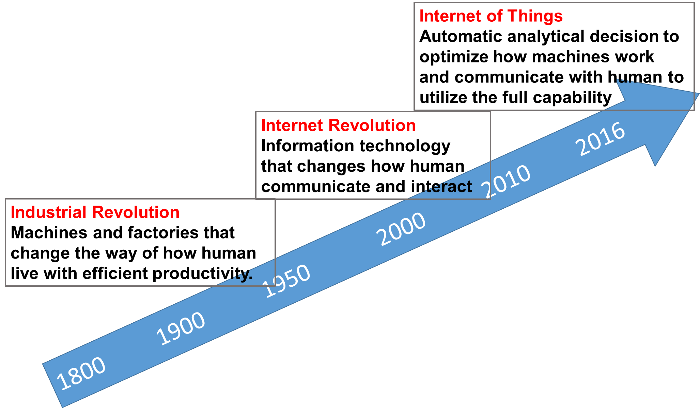
New Wave of Industrial Revolution
PB
TB
KB

Slide 3
History of Statistician in the America
Data in the cloud
Data in one computer’s disk
or memory
Data in
tapes or punch cards
American Statistical Association
1839
First Statistical Laboratory in US Universities
1934
Data Science Revolution
2001
Now
2017
Data in
pieces of
paper
Easy access to data
become universal in all areas
Iowa State University
with study of Agriculture
2nd oldest continuously operating professional society in the US

Slide 4
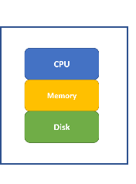
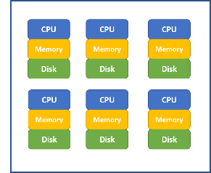
Big Data Cloud Framework
Cluster of Computers
(Cloud)
Single Computer
(Local)
Shared disk
Shared memory
Parallel computation
Data redundancy
Low coast hardware
Professionally managed
Scalability to process large dataset
Centralized data source for each retrieval
Robust and reliability for model safety
Worry-free behind sense maintenance
Production ready for easy implementation
Automatic refresh and scheduled update

Slide 5
Hadoop / MapReduce / Spark
Hadoop build on Commodity Hardware
Low cost and scalable by simply added more hardware
Low reliability (such as regular hard disk failures)
Need robust file system to ensure data safety
HDFS (Hadoop Distributed File System)
Cut data into small segments (i.e. 64MB) as blocks
Duplicate each data block N times (i.e. N=3) and save it across the cluster
Master node saves all the data mapping information
Data nodes save actual data blocks
When a few data nodes are down, data is still safe
MapReduce Operation (Demo)
Spark
Build on top of HDFS and other cluster file systems
Provide in-memory computation for faster speed
Provide parallel algorithm for many machine learning methods (MLib)
Provide easy to use interface for data scientist

Slide 6
Cloud Environments Providers
Amazon AWS cloud environment
Microsoft Azure cloud environment
Google cloud platform
Databricks Community Edition
For beginners, Databricks provides an easy to use cloud system for learning purpose.
It provides a user-friendly web-based notebook environment that can create Hadoop/Spark/GPU cluster on the fly to run R/Python/Scala/SQL.
Some reference:
https://docs.databricks.com/user-guide/faq/sparklyr.html
http://spark.rstudio.com/index.html

Slide 7
Databricks Big Data Platform
Two short videos for how to create a free account and use Databricks community edition which can run R / Python / SQL / Scala:
https://youtu.be/vx-3-htFvrg
https://youtu.be/0HFujX3t6TU
Notebook that contains all the steps can be imported from: https://databricks-prod-cloudfront.cloud.databricks.com/public/4027ec902e239c93eaaa8714f173bcfc/2961012104553482/3725396058299890/1806228006848429/latest.html

Slide 8
Library Installation
First, we need to install sparklyr package which enables the connection between master or local node to Spark cluster environments.
As it will install more than 10 dependencies, it may take more than 5 minutes to finish. Be patient while it is installing!
Once the installation finishes, load the sparklyr package as illustrated by the following code:
if (!require("sparklyr")) { install.packages("sparklyr") }
library(sparklyr)

Slide 9
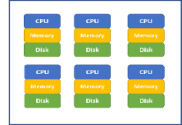

Create Connection
we need to create a Spark Connection to link the local node running the R notebook to the Spark environment. The options for different environments are different, here we set “method” option to “databricks”:
The created Spark Connection (i.e. sc) will be the pipe that connects R notebook to the Spark Cluster.
sc <- spark_connect(method = "databricks")
Spark Cluster
R Notebook
Spark Connection
sc

Slide 10
Establish Connection to Spark DataFrame
For illustration purpose, we will use the iris dataset which is part of the dplyr package:
library(dplyr) head(iris)
Copy local R data frame: iris to Spark DataFrame iris and we can refer Spark DataFrame iris through iris_tbl:
iris_tbl <- sdf_copy_to(sc = sc, x = iris, overwrite = T)
Spark Cluster
R Notebook
Spark Connection
sc
iris_tbl
iris
We can also establish connection between local R object my_df_tbl to existing Spark DataFrame my_df: my_df_tbl <- tbl(sc, my_df)

Slide 11
Manipulate Spark DataFrame Through R
Once connection is established, we can always refer iris_tbl in R notebook to operate on Spark DataFrame iris using the scalable computation power of Spark cluster
iris_tbl %>% mutate(Sepal_Width = ROUND(Sepal_Width * 2) / 2) %>% group_by(Species, Sepal_Width) %>% summarize(count = n(), Sepal_Length = mean(Sepal_Length),
stdev = sd(Sepal_Length))
With the sparklyr packages, we can use many functions in dplyr to Spark DataFrame directly to iris_tbl, same as we are applying dplyr functions to a local R data frame.
The advantage is more significant when the Spark DataFrame is huge (such as large enough to take 20GB of memory)

Slide 12
Collect Result Back to R Notebook
Even though we can run many of the dplyr functions on Spark DataFrame, we cannot apply functions from other packages to Spark DataFrame direction (such as ggplot()).
To use functions from other packages, we need to bring data (usually aggregated and much smaller in size) back to R Notebook using collect() function.
Once the data is brought back to R Notebook, we can use any library. With code below, iris_summary is a local R object
iris_summary <- iris_tbl %>% mutate(Sepal_Width = ROUND(Sepal_Width * 2) / 2) %>% group_by(Species, Sepal_Width) %>% summarize(count = n(), Sepal_Length = mean(Sepal_Length),
stdev = sd(Sepal_Length)) %>% collect

Slide 13
Apply Statistical and Machine Learning Models to Spark DataFrame Through R
One of the BIGGEST advantage in that there are many popular statistical and machine learning models developed (i.e. MLlib) to apply to Spark DataFrame to leverage the scalable computation power of Spark Cluster.
There models include: linear regression, logistic regression, Survival Regression, Generalized Linear Regression, Decision Trees, Random Forests, Gradient-Boosted Trees, Principal Components Analysis, Naive-Bayes, K-Means Clustering.
Conveniently, we can use R notebook to call functions to apply these machine learning algorithms to Spark DataFrame which enable minimum effort for statistician to leverage the Spark environment.

Slide 14
Fit Regression to Spark DataFrame
We can call ml_linear_regression to fit a linear regression model to Spark DataFrame iris by referring to iris_tbl
The response variable is "Sepal_Length“
The explanatory variables are "Sepal_Width", "Petal_Length", "Petal_Width“
The fitted results are stored in fit1
fit1 <- ml_linear_regression(x = iris_tbl, response = "Sepal_Length", features = c("Sepal_Width", "Petal_Length", "Petal_Width"))
summary(fit1)

Slide 15
Fit K-means Cluster to Spark DataFrame
We can call ml_kmeans() to fit a k-mean clustermodel to Spark DataFrame iris by referring to iris_tbl
The variables are "Petal_Length", "Petal_Width"
The fitted results are stored in fit2
We can then apply the model to a specific dataset (in this case the original dataset) using sdf_predict() function
Finally we can use collect() function to bring results back to R Notebook for further analysis
fit2 <- ml_kmeans(x = iris_tbl, centers = 3, features = c("Petal_Length", "Petal_Width"))
Print(fit2)
prediction = collect(sdf_predict(fit2, iris_tbl))

Slide 16
Quick Summary
In the above a few sub-sections, we illustrated:
The relationship between local node (i.e. where R notebook is running) and Spark Clusters (i..e where massive data are stored and computation are done)
Sparklyr library to established the connection of local node and Spark Cluster
How to copy a local data frame to a Spark DataFrames (please note if your data is already in Spark environment, there is no need to copy).
Establish connection between local R object my_df_tbl to existing Spark DataFrame my_df: my_df_tbl <- tbl(sc, my_df)
How to manipulate Spark DataFrames for data cleaning and preprocessing through dplyr functions
How to fit statistical and machine learning models to Spark DataFrame in a truly parallel manner
How to collect information from Spark DataFrames back to a local R object (i.e. local R data frame) for future analysis
List of functions in Sparklyr: http://spark.rstudio.com/reference/index.html

Slide 17
Database Management (SQL)
One of the key elements that many Statistician lack, but really easy to learn!
This section is a brief overview introduction and students need to watch videos for more detail.

Slide 18
Why Database Management System
When the data is beyond flat files or Excel files, a database management system (DBMS) is need to management data
DBMS provides a much better way to efficiently store, organize, retrieve, and update data to ensure data integrity and safety
Extract/Transform/Load jobs (i.e. ETL) are commonly used for data preprocessing, exploratory study and feature engineering in batch
Multiple users operate (read or write access) at the same time with flexible scheduling capability
A lot of work is done under the hood at different DBMS, and users can focus on writing SQL scripts for each job
SQL standards make it easy to deal with different DBMS systems (i.e. Teradata, SQL Server, MySQL) including the modern big data infrastructure (i.e. Hadoop/Hive and Spark)

Slide 19
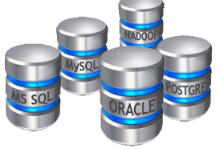


Why Database Management System (DBMS)?
Storage capacity far beyond flat files
Much more efficiently data store, organize, retrieve, and update
Much enhanced data safety and security
Multiple user with centralized data source
Schedule and automatic extract, transform, load jobs
Real time processing and updating in production
Many detailed under the hood
Common scripting language SQL
SQL
Structed Query Language
SQL is a standard
Key skill set in industry for analytics jobs
Self-sufficient to obtain needed data
SQL has a standard that vendors follow
SQL is easy to learn and skills are portable
Big data cloud platform also use SQL-like tools

Slide 20
Main Database Concepts
Database → Table → Rows & Columns → one data cell
Schema: detailed description of relations among tables in a database, as well as definition of each columns in a table
View: a virtual table composed of fields from one or more base tables. Usually used to protect data as view can only be read and cannot be changed
Table is the same as R data frame but can be much larger with hundred millions of rows and hundreds of columns
Mechanism for fast data retrieval: Key / Partition / Index
Row-oriented (efficient for retravel records) vs. column-oriented (efficient for analytics) databases
Disk (MySQL) vs. in memory (Hana) databases
Distributed and parallel databases (Hive and Spark)

Slide 21
Main SQL functions
Simple data retrieval using SELECT statement
Combine data from multiple tables using JOIN and UNION
Sort data using ORDER BY
Aggregating using GROUP BY
Subset selection using WHERE and HAVING
Change data using UPDATE, INSERT, and DELETE
A few videos that describe the basic SQL functions through my YouTube channel: https://www.youtube.com/playlist?list=PLtqstN-ayEb0H5AAo6_V5qEzWs0D-igpw

Slide 22
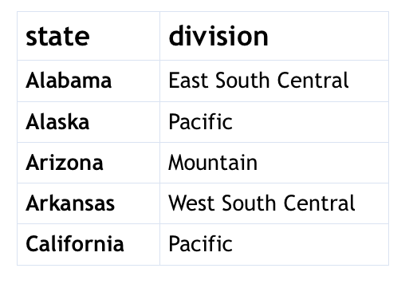
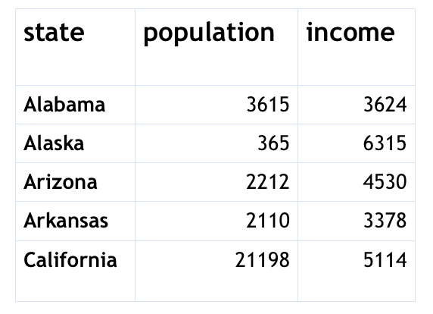
Two Tables Used in Demo
divisions
metrics
We use the Databrick Community Edition to create the above two tables by using the divisions.csv and metrics.csv flat files.
Details can be found in this video: https://youtu.be/H5LxjaJgpSk for uploading flat files to Databrick Cloud environment to create tables.

Slide 23
Import SQL Notebook
SQL notebook that contains all the demo SQL scripts:
https://databricks-prod-cloudfront.cloud.databricks.com/public/4027ec902e239c93eaaa8714f173bcfc/2961012104553482/4213233595765185/1806228006848429/latest.html

Slide 24
Basic SQL Statements
show database: show current databases in the system
create database db_name: create a new database with name db_name
drop database db_name: delete database db_name (be careful!)
use db_name: set up the current database to be used such that you can use table names directly, otherwise you can use db_name.tbl_name to refer the table you’d like to use
show tables: show all the tables within the currently used database
describe tbl_name: show the structure of table with name tbl_name (i.e. list of column name and data type)
drop tbl_name: delete a table with name tbl_name (be careful!)
select * from metrics limit 10: show the first 10 rows of a table
Please note different DBMS systems may have their own syntax for certain functions. For example the last statement could be:
select top 10 * from metrics
Select * from metrics where rownum <= 10

Slide 25
Simple SELECT Statement
SELECT is used to extract specific information (i.e. column or columns) FROM one or multiple tables.
It can be used together with WHERE to define specific rows and then ORDER BY to order the results.
We can also apply certain operations on existing columns to get a new columns

Slide 26
Aggregation Functions and GROUP BY
For aggregation function (such as max(), min(), avg(), count()), it takes all the rows that match WHERE condition (if any) and return one number.
The following statement will calculate the maximum, minimum, and average population for all states starts with letter A to E.
GROUP BY can be used to find the aggregated value based on groups that can be defined by one or more columns.

Slide 27
Join Multiple Tables
Each table usually contains a piece of specific information
Oftentimes we need to JOIN multiple tables to achieve a specific task
Three types of JOIN
INNER JOIN: keep only rows that match the join condition from both tables
LEFT JOIN: rows from inner join + unmatched rows from the first table
RIGHT JOIN: rows from inner join + unmatched rows from the second table
FULL JOIN: rows from inner join + unmatched rows from both tables

Slide 28
Linux System Command
Another element that some Statistician lack, but really easy to start!

Slide 29
Why Linux Operation System?
Most production system and big data system requires Linux operation system knowledge
Multiple user system that allow many user to use at the same time
High reliability and availability that the system can run days or months without restarts
It is easy to start and obtain the basic knowledge for every day usage
It is indeed take time to be an expert in using it

Slide 30
Common Linux Commands
ls : show files in current directory
pwd : display current directory and path
mkdir dir_name : create a new directory
cd dir_path: change directory through its path
cd .. : go one directory level up
cp file1 file2 : copy file1 to file2
mv file1 file2: rename file1 to file2
head file : show the first a few rows of file
tail file : show last a few rows of file
top : show current running job
who : list all users that log in the system

Slide 31
GPU
Many of the machine learning methods are based on linear algebra, especially deep learning algorithms
The traditional CPU design is not optimized to handle large-size-matrix linear algebra operations
GPU is an efficient alternative
In Databricks Community Edition, we can create machines with GPUs
Relatively easy deployment for a few packages such as TensorFlow
Still difficult to extend to general problems
A brief introduction: https://databricks.com/blog/2016/10/27/gpu-acceleration-in-databricks.html

