Slide 1
Survey form options
Collecting data for student community.

Slide 2
SRC survey team
Focus on engaging student community
Feedback or surveys?
Data being used for what?
Security

Slide 3
Current situation
Limited information
Lots of different places
Needs to be centralized and de-idenfitied

Slide 4

Pre-Covid19
Socials
Email
Word of mouth
Word of month
Socials

Slide 5
SRC information sources
Email
FB
Magazine
Canvas

Slide 6
Post-Covid19
Teams
Email
Socials
Word of month
Socials

Slide 7
Doesn’t work like this really
Key outcomes of interest are students voices and platform of data collection just needs to be accounted for
Combining datasets brings with it one key issue.
UNIQUE identifier
For the SRC this identifier belongs with the personal dataset that is confidential
This then needs to be added or collected in a clear way on all platforms

Slide 8
Doesn’t look much different?
Data looks different….
Teams collection
Other meta-www use data
Security of data stored

Slide 9
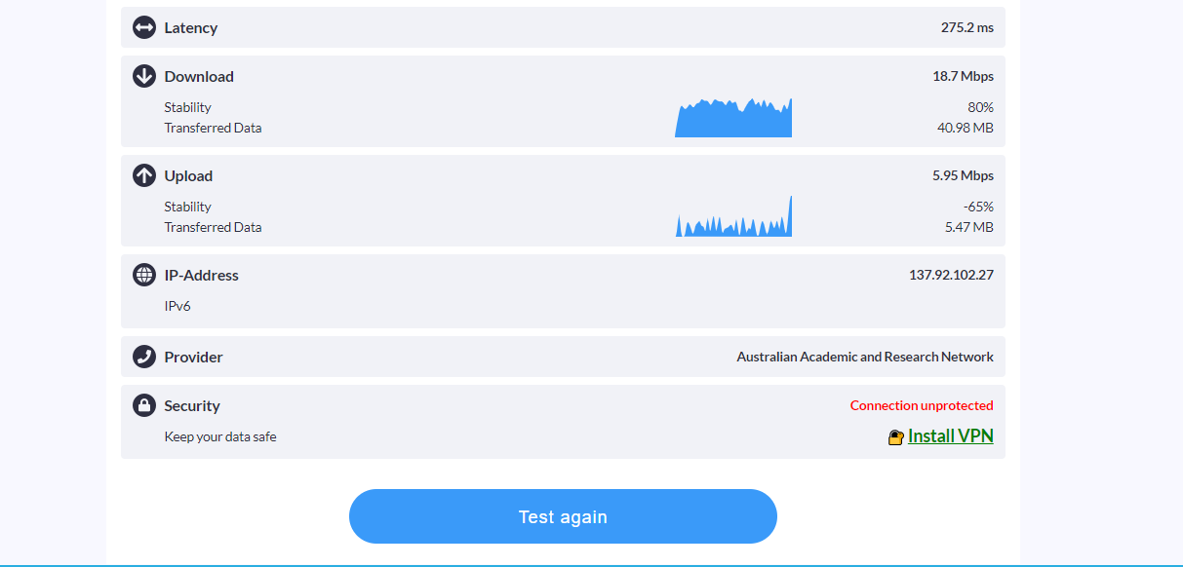

Slide 10
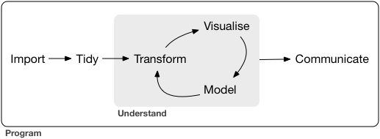
Observation, research and data collection

Slide 11
Tidy pipes: An approach to scientific research alongside communities
Observation, research and data collection

Slide 12
Built on `tidyverse`

Slide 13
Social inputs…
FB
https://www.facebook.com/notes/surveygizmo/slider-questions-are-here/10150759799995651/
LinkIN
INSTa
Twitter
Email (UC chat)

Slide 14
Import: data collected from
hard copies
Online
email
Fb and twitter page?

Slide 15
data collected from
hard copies
Online
email
Fb and twitter page?
Import

Slide 16
DataFlow
Q_id | question
1 | My academic success this semester will be
2 | The support available to me from the university is
3 | My academic success this semester will be
4 | The support available to me from the university is
5 | My academic success this semester will be
6 | I had enough time to adjust to online learning
7 | My GPA will be affected
8 | Family life has become harder
9 | Money is short
Socials
Email
Word of month
Data

Slide 17
Survey3
twitter
Survey1
facebook
Survey2
facebook
Survey4
Survey…i
Combined data

Slide 18
MPD example
Two packages
Dataspice
workflowr

Slide 19
Survey3
twitter
Survey1
facebook
Survey2
facebook
Survey4
Survey…i
Combined data

Slide 20
Being careful of replicates
Here we can create something called `pseudo-replication` easily
This is counting one individual twice or more
This bias data in ways we all know
To account for this, a structured database will reduced the likelihood of statistical errors like this coming into the analysis stages of the SRC surveys
To begin with these platforms (and surverys on them) need to be analysised seperately.

Slide 21
Data sheet structure
Q_number | answer | id | GlobalQno
1 | 1 | 1
1 | 1 | 2
1 | 1 | 4
1 | 3 | 3
1 | 3 | 5
2 | 4 | 3
2 | 2 | 6
2 | 2 | 3
2 | 2 | 2
Analysis uses a simple csv database:
- structure for using this data.
All additional structure
Document using `dataspice`

Slide 22
Q13
Q21
Q11
Q42
Q11
Q13
Q21
Q42
Q21
Q13
Q11
Q21
Q13
Q3
Q42
Q2
Q13
Q21
Q11
Q42
Q1
Q11
Q4
Q42
Q21
Q13
Q21
Q13
Q11
Q42
Q11
Q42
Q21
Q13
Q11
Questions?
Q42

Slide 23

Questions
Q_id | question
1 | My academic success this semester will be
2 | The support available to me from the university is
3 | My academic success this semester will be
4 | The support available to me from the university is
5 | My academic success this semester will be
6 | I had enough time to adjust to online learning
7 | My GPA will be affected
8 | Family life has become harder
9 | Money is short
Student voice but new body (to begin with)
Baseline groups?
Survey number undertaken
Time entered
Removed (why?)
Access only to SRC for now?

Slide 24
Q2
Q3
Q1
Q4
Q21
Q13
Q11
Question
Q42
Data
Analysis
Results

Slide 25
Data sheet structure
Analysis uses a simple structured `.csv` database
All additional structure and complexity is scalable
Document using current open science framework `dataspice`

Slide 26

id
Meta-data attached to each survey used/conducted.
Database structure
Collection
Meta-data attached to each survey used/conducted.
Data
Each survey is given a general survey number #001 onwards
Id database (encrypted) and stored offline?
Central question csv
One csv file for each survey
Sheme to define metadata using shiny apps
Analysis
Each analysis a different project that accesses data at … etc and give an analysis number #a001 onwards

Slide 27
Questions
Data
Analysis
Results
Each survey is given a general survey number #001 onwards
Each survey has a unique set of assumptions, objectives and outcomes to meet. These are added to a database of different analysis to make future analysis quicker
Published in our weekly newsletter to begin with
Student voice but new body (to begin with)
Generated from Student town hall (to begin with)
Database of questions linked to surveys done

Slide 28
Questions
Data
Analysis
Results
Student voice but new body (to begin with)
Each survey is given a general survey number #001 onwards
Each survey has a unique set of assumptions, objectives and outcomes to meet. These are added to a database of different analysis to make future analysis quicker
Published in our weekly newsletter to begin with
Generated from Student town hall (to begin with)
Database of questions linked to surveys done

Slide 29
Questions
Student voice but new body (to begin with)
Generated from Student town hall (to begin with)
Database of questions linked to surveys done

Slide 30
Q21
Q13
Q3
Q2
Q13
Q21
Q11
Q42
Q1
Q11
Q4
Q42
Q21
Q13
Q11
Question
Q42
Q21
Q13
Q11
Q42
Data
Analysis
Results

Slide 31
Q_number | answer | id | GlobalQno
1 | 1 | 1
1 | 1 | 2
1 | 1 | 4
1 | 3 | 3
1 | 3 | 5
2 | 4 | 3
2 | 2 | 6
2 | 2 | 3
2 | 2 | 2
surveyNum | question | Q_id | Survey_type | Start_date | noRespond
1 | My academic success this semester will be | 1
1 | The support available to me from the university is | 2
1 | My academic success this semester will be | 3
Questions
Data
Analysis
Results

Slide 32
Data sheet structure
Analysis uses a simple csv database:
- structure for using this data.
All additional structure
Document using `dataspice`
surveyNum | question | Q_id | Survey_type | Start_date | noRespond
1 | My academic success this semester will be | 1
1 | The support available to me from the university is | 2
1 | My academic success this semester will be | 3
Q_number | answer | id | GlobalQno
1 | 1 | 1
1 | 1 | 2
1 | 1 | 4
1 | 3 | 3
1 | 3 | 5
2 | 4 | 3
2 | 2 | 6
2 | 2 | 3
2 | 2 | 2
surveyNum | question | Q_id | Survey_type | Start_date | noRespond
1 | My academic success this semester will be | 1
1 | The support available to me from the university is | 2
1 | My academic success this semester will be | 3
surveyNum | question | Q_id | Survey_type | Start_date | noRespond
1 | My academic success this semester will be | 1
1 | The support available to me from the university is | 2
1 | My academic success this semester will be | 3
surveyNum | question | Q_id | Survey_type | Start_date | noRespond
1 | My academic success this semester will be | 1
1 | The support available to me from the university is | 2
1 | My academic success this semester will be | 3
surveyNum | question | Q_id | Survey_type | Start_date | noRespond
1 | My academic success this semester will be | 1
1 | The support available to me from the university is | 2
1 | My academic success this semester will be | 3
surveyNum | question | Q_id | Survey_type | Start_date | noRespond
1 | My academic success this semester will be | 1
1 | The support available to me from the university is | 2
1 | My academic success this semester will be | 3

Slide 33
surveyNum | question | Q_id | Survey_type | Start_date | noRespond
1 | My academic success this semester will be | 1
1 | The support available to me from the university is | 2
1 | My academic success this semester will be | 3
surveyNum | question | Q_id | Survey_type | Start_date | noRespond
1 | My academic success this semester will be | 1
1 | The support available to me from the university is | 2
1 | My academic success this semester will be | 3
surveyNum | question | Q_id | Survey_type | Start_date | noRespond
1 | My academic success this semester will be | 1
1 | The support available to me from the university is | 2
1 | My academic success this semester will be | 3
surveyNum | question | Q_id | Survey_type | Start_date | noRespond
1 | My academic success this semester will be | 1
1 | The support available to me from the university is | 2
1 | My academic success this semester will be | 3
Questions
Q_number | answer | id | GlobalQno
1 | 1 | 1
1 | 1 | 2
1 | 1 | 4
1 | 3 | 3
1 | 3 | 5
2 | 4 | 3
2 | 2 | 6
2 | 2 | 3
2 | 2 | 2
Data
Analysis
Results

Slide 34
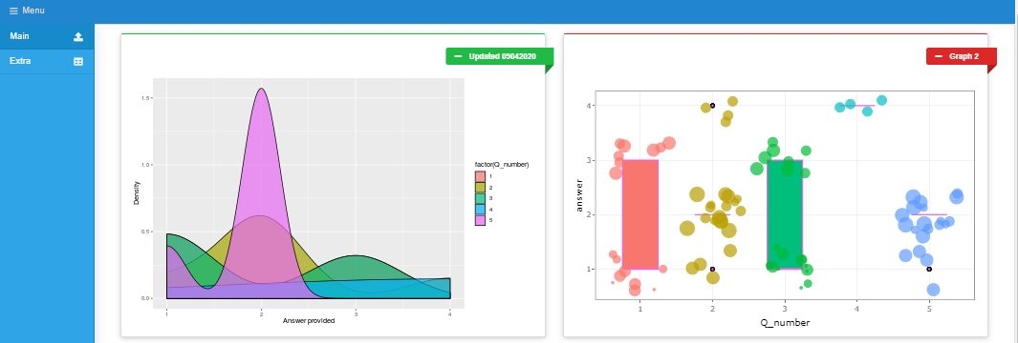
Data sheet structure
QuestionDB
Q_id | question
1 | My academic success this semester will be
2 | The support available to me from the university is
3 | My academic success this semester will be
4 | The support available to me from the university is
5 | My academic success this semester will be
6 | I had enough time to adjust to online learning
7 | My GPA will be affected
8 | Family life has become harder
9 | Money is short
A formal database structure for using this data.
Document using `dataspice`
Open
Management-level
Summaries data
Private
Summaries data
surveyNum | question | Q_id | Survey_type | Start_date | noRespond
1 | My academic success this semester will be | 1
1 | The support available to me from the university is | 2
1 | My academic success this semester will be | 3
RespondentDB
Q_number | answer | id
1 | 1 | 1
1 | 1 | 2
1 | 1 | 4
1 | 3 | 3
1 | 3 | 5
2 | 4 | 3
2 | 2 | 6
2 | 2 | 3
2 | 2 | 2
REPORT
Responsibility of survey conductor
Private
REPORT
id | email | Facualty | survey1 | survey2
1 | bla bla | bla bla | bla bla | bla bla
2 | bla bla | bla bla | bla bla | bla bla
4 | bla bla | bla bla | bla bla | bla bla
3 | bla bla | bla bla | bla bla | bla bla
5 | bla bla | bla bla | bla bla | bla bla
3 | bla bla | bla bla | bla bla | bla bla
6 | bla bla | bla bla | bla bla | bla bla

Slide 35
Data sheet structure
QuestionDB
Q_id | question
1 | My academic success this semester will be
2 | The support available to me from the university is
3 | My academic success this semester will be
4 | The support available to me from the university is
5 | My academic success this semester will be
6 | I had enough time to adjust to online learning
7 | My GPA will be affected
8 | Family life has become harder
9 | Money is short
A formal database structure for using this data.
Document using `dataspice`
Open
Management-level
Summaries data
Private
Summaries data
surveyNum | question | Q_id | Survey_type | Start_date | noRespond
1 | My academic success this semester will be | 1
1 | The support available to me from the university is | 2
1 | My academic success this semester will be | 3
RespondentDB
Q_number | answer | id
1 | 1 | 1
1 | 1 | 2
1 | 1 | 4
1 | 3 | 3
1 | 3 | 5
2 | 4 | 3
2 | 2 | 6
2 | 2 | 3
2 | 2 | 2
REPORT
Responsibility of survey conductor
Private
REPORT
id | email | Facualty | survey1 | survey2
1 | bla bla | bla bla | bla bla | bla bla
2 | bla bla | bla bla | bla bla | bla bla
4 | bla bla | bla bla | bla bla | bla bla
3 | bla bla | bla bla | bla bla | bla bla
5 | bla bla | bla bla | bla bla | bla bla
3 | bla bla | bla bla | bla bla | bla bla
6 | bla bla | bla bla | bla bla | bla bla

Slide 36
Data sheet structure
QuestionDB
Q_id | question
1 | My academic success this semester will be
2 | The support available to me from the university is
3 | My academic success this semester will be
4 | The support available to me from the university is
5 | My academic success this semester will be
6 | I had enough time to adjust to online learning
7 | My GPA will be affected
8 | Family life has become harder
9 | Money is short
A formal database structure for using this data.
Document using `dataspice`
Open
Management-level
Summaries data
Private
Summaries data
surveyNum | question | Q_id | Survey_type | Start_date | noRespond
1 | My academic success this semester will be | 1
1 | The support available to me from the university is | 2
1 | My academic success this semester will be | 3
RespondentDB
Q_number | answer | id
1 | 1 | 1
1 | 1 | 2
1 | 1 | 4
1 | 3 | 3
1 | 3 | 5
2 | 4 | 3
2 | 2 | 6
2 | 2 | 3
2 | 2 | 2
REPORT
Responsibility of survey conductor
Private
REPORT
id | email | Facualty | survey1 | survey2
1 | bla bla | bla bla | bla bla | bla bla
2 | bla bla | bla bla | bla bla | bla bla
4 | bla bla | bla bla | bla bla | bla bla
3 | bla bla | bla bla | bla bla | bla bla
5 | bla bla | bla bla | bla bla | bla bla
3 | bla bla | bla bla | bla bla | bla bla
6 | bla bla | bla bla | bla bla | bla bla

Slide 37
REPORT
Q_id | question
1 | My academic success this semester will be
2 | The support available to me from the university is
3 | My academic success this semester will be
4 | The support available to me from the university is
5 | My academic success this semester will be
6 | I had enough time to adjust to online learning
7 | My GPA will be affected
8 | Family life has become harder
9 | Money is short
Battleground….
id | email | Facualty | survey1 | survey2
1 | bla bla | bla bla | bla bla | bla bla
2 | bla bla | bla bla | bla bla | bla bla
4 | bla bla | bla bla | bla bla | bla bla
3 | bla bla | bla bla | bla bla | bla bla
5 | bla bla | bla bla | bla bla | bla bla
3 | bla bla | bla bla | bla bla | bla bla
6 | bla bla | bla bla | bla bla | bla bla
SRC
surveyNum | question | Q_id | Survey_type | Start_date | noRespond
1 | My academic success this semester will be | 1
1 | The support available to me from the university is | 2
1 | My academic success this semester will be | 3
Management-level
surveyNum | question | Q_id | Survey_type | Start_date | noRespond
1 | My academic success this semester will be | 1
1 | The support available to me from the university is | 2
1 | My academic success this semester will be | 3
surveyNum | question | Q_id | Survey_type | Start_date | noRespond
1 | My academic success this semester will be | 1
1 | The support available to me from the university is | 2
1 | My academic success this semester will be | 3
surveyNum | question | Q_id | Survey_type | Start_date | noRespond
1 | My academic success this semester will be | 1
1 | The support available to me from the university is | 2
1 | My academic success this semester will be | 3

Slide 38





Data sheet structure
SurveyDB
Q_id | question
1 | My academic success this semester will be
2 | The support available to me from the university is
3 | My academic success this semester will be
4 | The support available to me from the university is
5 | My academic success this semester will be
6 | I had enough time to adjust to online learning
7 | My GPA will be affected
8 | Family life has become harder
9 | Money is short
Private
Summaries data
Q_number | answer | id
1 | 1 | 1
1 | 1 | 2
1 | 1 | 4
1 | 3 | 3
1 | 3 | 5
2 | 4 | 3
2 | 2 | 6
2 | 2 | 3
2 | 2 | 2
Summaries data
Management-level
Open
RespondentDB
id | email | Facualty | survey1 | survey2
1 | bla bla | bla bla | bla bla | bla bla
2 | bla bla | bla bla | bla bla | bla bla
4 | bla bla | bla bla | bla bla | bla bla
3 | bla bla | bla bla | bla bla | bla bla
5 | bla bla | bla bla | bla bla | bla bla
3 | bla bla | bla bla | bla bla | bla bla
6 | bla bla | bla bla | bla bla | bla bla
Private

Slide 39
Data sheet structure
SurveyDB
Q_id | question
1 | My academic success this semester will be
2 | The support available to me from the university is
3 | My academic success this semester will be
4 | The support available to me from the university is
5 | My academic success this semester will be
6 | I had enough time to adjust to online learning
7 | My GPA will be affected
8 | Family life has become harder
9 | Money is short
Summaries data
Private
Q_number | answer | id
1 | 1 | 1
1 | 1 | 2
1 | 1 | 4
1 | 3 | 3
1 | 3 | 5
2 | 4 | 3
2 | 2 | 6
2 | 2 | 3
2 | 2 | 2
Summaries data
Management-level
Open
RespondentDB
id | email | Facualty | survey1 | survey2
1 | bla bla | bla bla | bla bla | bla bla
2 | bla bla | bla bla | bla bla | bla bla
4 | bla bla | bla bla | bla bla | bla bla
3 | bla bla | bla bla | bla bla | bla bla
5 | bla bla | bla bla | bla bla | bla bla
3 | bla bla | bla bla | bla bla | bla bla
6 | bla bla | bla bla | bla bla | bla bla
Private

Slide 40
Data inputs…
FB
https://www.facebook.com/notes/surveygizmo/slider-questions-are-here/10150759799995651/
LinkIN
INSTa
Twitter
Email

Slide 41
DataFlow
Q_id | question
1 | My academic success this semester will be
2 | The support available to me from the university is
3 | My academic success this semester will be
4 | The support available to me from the university is
5 | My academic success this semester will be
6 | I had enough time to adjust to online learning
7 | My GPA will be affected
8 | Family life has become harder
9 | Money is short
Socials
Email
Word of month
Data

Slide 42
Import: data collected from
hard copies
Online
email
Fb and twitter page?

Slide 43
Starting from nothing

Slide 44
DataFlow
Q_id | question
1 | My academic success this semester will be
2 | The support available to me from the university is
3 | My academic success this semester will be
4 | The support available to me from the university is
5 | My academic success this semester will be
6 | I had enough time to adjust to online learning
7 | My GPA will be affected
8 | Family life has become harder
9 | Money is short
Socials
Email
Word of month
Data
Anthony

Slide 45
DataFlow
ARTICLE
to
MAG
Socials
Email
Word of month
Visualisation
Data

Slide 46
DataFlow
ARTICLE
to
MAG
Socials
Email
Word of month
Visualisation
Data

Slide 47

Data
Question number | Q_text
1 | 1
1 | 1
1 | 1
1 | 3
1 | 3
2 | 4
UC-SRC
Question number | answer | id
1 | 1 | 1
1 | 1 | 2
1 | 1 | 4
1 | 3 | 3
1 | 3 | 5
2 | 4 | 3
id | key | email | phone | contact | notes
1 | 1
2 | 1
4 | 1
3 | 3
5 | 3
3 | 4

Slide 48
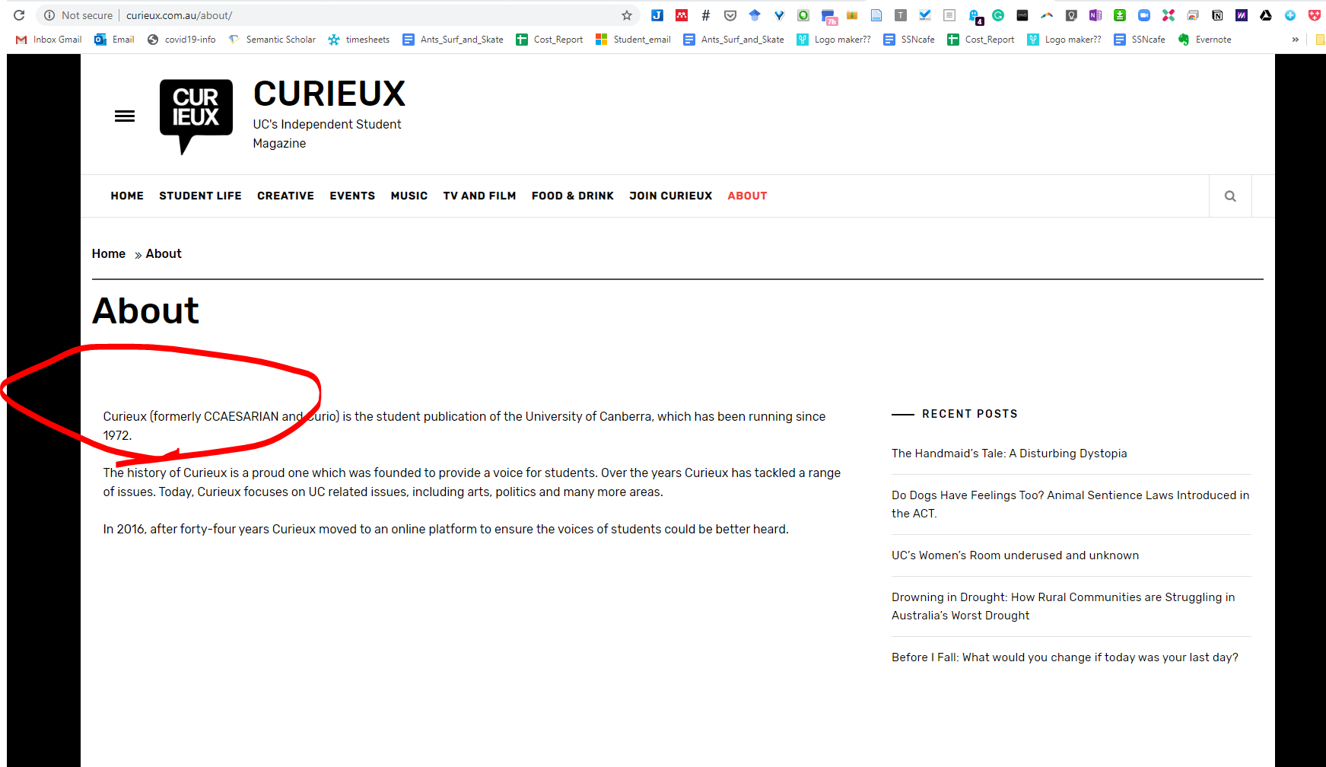
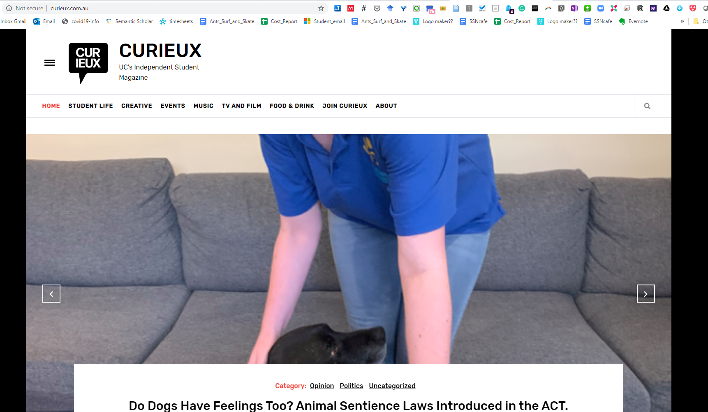
Analysis
UC-SRC
Question number | answer | id
1 | 1 | 1
1 | 1 | 2
1 | 1 | 4
1 | 3 | 3
1 | 3 | 5
2 | 4 | 3
Growth
Time

Slide 49
UC-SCR
Survey team regulation
ARTICLE
to
MAG
UC-SCR
co-ordination
input essential
Curious editors etc
Socials
Email
Word of month
Visualizations
Data
Anthony

Slide 50
Data pipeline
Socials
Email
Word of month
News (UC centric)
Data

Slide 51
DataFlow
ARTICLE
to
MAG
Socials
Email
Word of month
Visualisation
Data
Anthony

Slide 52
Comms Options
Visualisation
What do our student body want to know?
Visualisation
Visualisation
Visualisation
Visualisation
Visualisation
Publish online (blog and streams) mag comes out xx months
Visualisation
Create content based of what people want
Visualisation
Visualisation
Collect information
Visualisation
Visualisation
Visualisation
Data
Analysis
Results

Slide 53
Publication cycle
Week One
Week Two
Week Three
Week Four
It is important because it is a sampling design that effects the number and type of response the community gives.

Slide 54
Publication cycle
Week One
Week Two
Week Three
Week Four
Headline article (editors control)

Slide 55
How to DOOOO this…

Slide 56
Without both Stoats and Rats
With Stoats and Rats removed
Rat MNA
Rat MNA
Beech seed
Mouse abundance
Beech seed
Mouse abundance
Only Stoats removed
Only rats removed
Rat MNA
Rat MNA
Beech seed
Mouse abundance
Beech seed
Mouse abundance

Slide 57
Without both Stoats and Rats
With Stoats and Rats removed
Rat MNA
Rat MNA
Beech seed
Mouse abundance
Beech seed
Mouse abundance
Only Stoats removed
Only rats removed
Rat MNA
Rat MNA
Beech seed
Mouse abundance
Beech seed
Mouse abundance

Slide 58
Without both Stoats and Rats
With Stoats and Rats removed
Rat MNA
Rat MNA
Beech seed
Mouse abundance
Beech seed
Mouse abundance
Only Stoats removed
Only rats removed
Rat MNA
Rat MNA
Beech seed
Mouse abundance
Beech seed
Mouse abundance

Slide 59
references
Shiny in education references

Slide 60
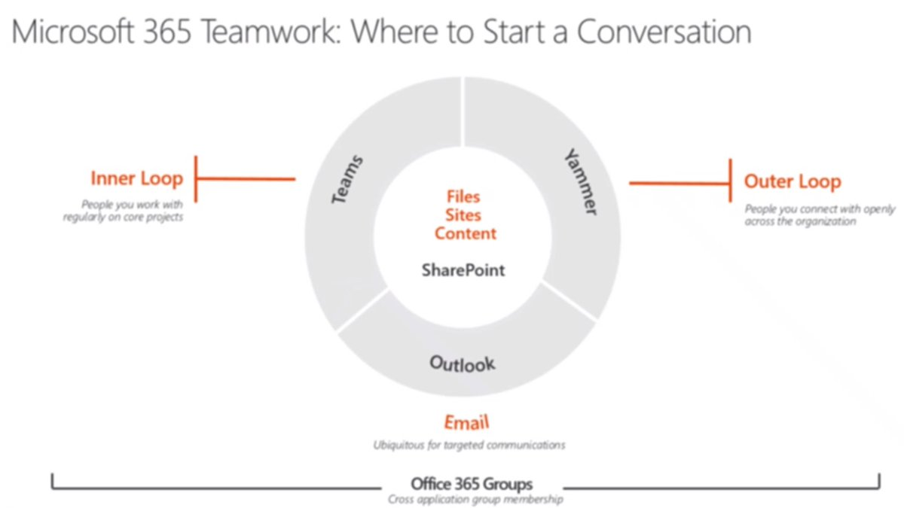
Software stack

