Slide 1
Server-Free Web Apps
Or… how to lose weight quickly

Slide 2
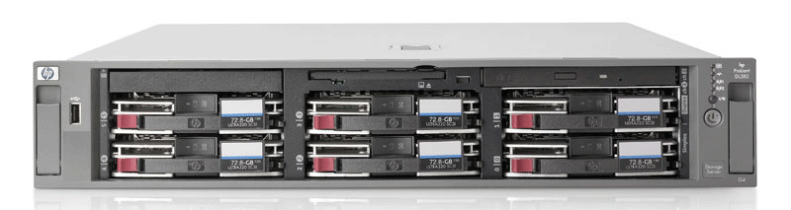

A Long, Long Time Ago…
Page
Frame
http://…/
GET HTTP/1.0
file://…/
GET HTTP/1.0

Slide 3





It was the best of times…
Page
Frame
Data (async)
http://…/
GET HTTP/1.1
POST
PUT
DELETE

Slide 4
…it was the worst of times.
Disk
Page
Frame
Data (async)
http://…/
GET HTTP/1.1
POST
PUT
DELETE
file://…/
GET
POST
PUT
DELETE
Page
Frame
Data (async)

Slide 5

Wouldn’t it be nice…
Disk
Page
Frame
Data (async)
file://…/
GET HTTP/1.1
POST
PUT
DELETE

Slide 6
ewsjs: Yes, We Can!
A Web server…
… in the browser!
Simulate everything
Look like a server
Well-designed clients are ignorant

Slide 7
The Way We Were…
Browser
Framework (optional)
App

Slide 8
Look, Ma, no server!
Browser
Logic
ewsjs
Disk
Framework (optional)
App

Slide 9
INSTALL.txt
Download: http://github.com/deitch/ewsjs
Include ewsjs.js
<script src=“path/to/ewsjs.js” type=“text/javascript”></script>
Write your own handler logic
Include your logic file
<script src=“path/to/ewsjs-impl.js” type=“text/javascript”></script>
Switch intelligently

Slide 10

Logic?
ewsjs provides
Your mission, should you…
EWS global
Ajax call interception
Load from file with caching
URL rewriting
Register handlers per path
Register auto handler
Register URL rewrites

Slide 11
Register Handlers
Tell EWS what path to send to which function
EWS.registerHandler(“/some/path”,handler)
Include parameters, if you want
EWS.registerHandler(“/users/:user/app/:app”,handler)
Handler signature
handler = function(method, url, headers, data, db, params)
// method: one of “GET”, “POST”, “DELETE, “PUT
// url: original url called (not the rewritten one)
// headers: headers of the original request as JavaScript object
// data: parameters of the original request as JavaScript object
// db: internal EWS cache
// params: path parameters, e.g. {user: “avi”, app: “god”}

Slide 12
Register Auto Handler
Fallback handler
EWS.registerAuto(handler)
Handler signature
handler = function(config)
// config object with the following properties:
// method: one of “GET”, “POST”, “DELETE, “PUT
// url: original url called (not the rewritten one)
// headers: headers of the original request as JavaScript object
// data: parameters of the original request
// db: internal EWS cache

Slide 13
Register Rewrites
JavaScript RegExp or String rewriting
Change one path to another
EWS.registerRewrite(“/old/path/abc”,”/new/path/abc”);
Use RegExp, capture elements
EWS.registerRewrite(/^\/old\/path\/(.*)/,”/new/path/$1”);

Slide 14
Switch Intelligently
Enable EWS
EWS.enable(boolean enabled);
One way: look at your original path
EWS.enable(window.location.protocol === "file:”);

Slide 15
Working Demo

Slide 16
Be Productive!
Thanks!
Avi Deitcher
avi@deitcher.net

