Slide 1
Quantum Information and Computing
Assignment 1
Davide Bacilieri 2089214

Slide 2
Number precision tests
In the integer case, with 2 bytes of memory the number 2000000 overflowed, giving an error at compilation time that could be disabled using the `-fno-range-check` flag, while the 4 byte case worked as expected.
In the real number case, the standard precision real did not register any change after the addition, due to the second number being 11 orders of magnitude smaller than the first and thus smaller than the least recordable distance in the mantissa. This was solved in the double precision case thanks to the extra byte available for recording the mantissa.

Slide 3
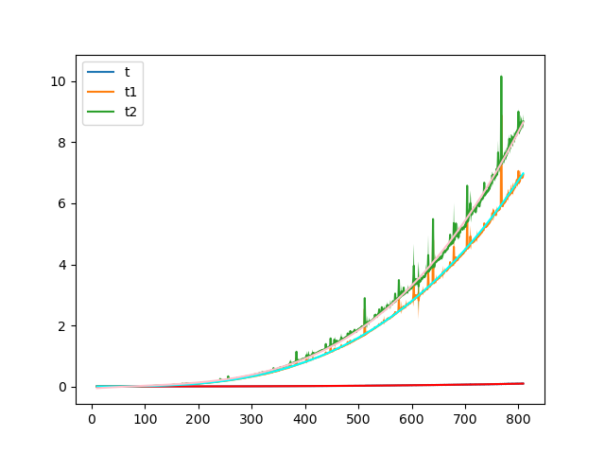
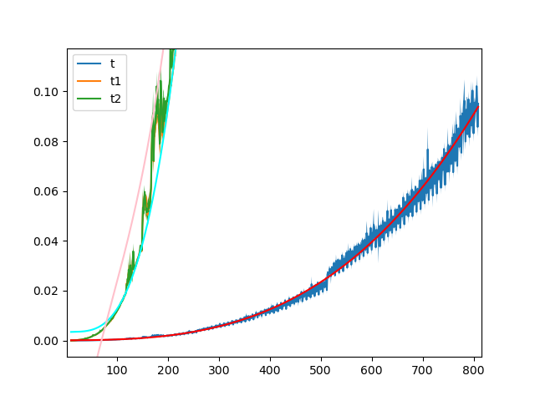
Scaling of matrix-matrix multiplication
Scaling of the builtin function `matmul` (t) and two different handwritten algortihms (t1, t2), shown as the area within (μ-σ, μ+σ) of 10 runs for each point. The lines are the fits found with np.polyfit at degree 3 for each series.
The graph on the right is an enlargement of the first, to better show the `matmul` case.
Time [s]
Time [s]
N
N

Slide 4
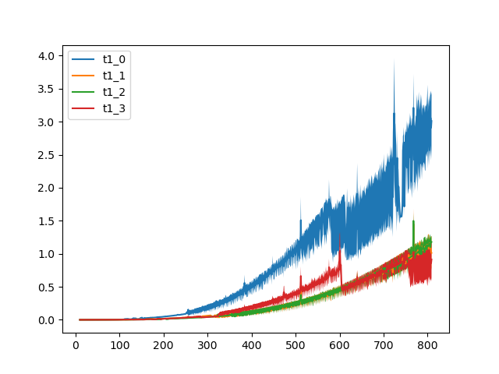
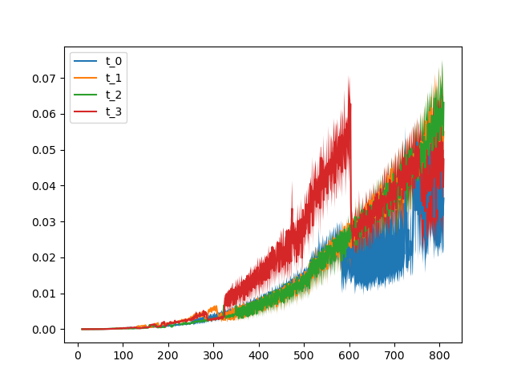
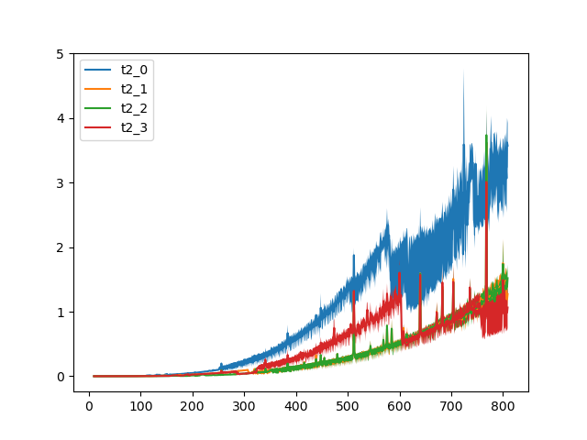
Different optimizations
The three graphs show the different dependency on N of the algorithms depending on the level of optimization selected at compile time (from -O0 to -O3).
The data is once again shown as the area within (μ-σ, μ+σ) for 10 runs for each point.
Time [s]
Sidenote: the optimization -Ofast is not represented due to it resulting in a segmentation fault error.
N
Time [s]
Time [s]
N
N

