Slide 1
Guaranteed Shoe Company
CS782 Assignment 3b David Capps

Slide 2
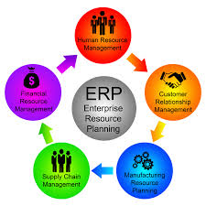
Enterprise Resource Planning (ERP)
Eliminating Data Duplications
Replacing Paper Based Products
Tracking, Management and Planning
Figure 1
Notes:
10 – 30 % data redundancies in over seas businesses, inconsistencies are fixed as well IE phone numbers don’t match
You can’t have real time data if you are tracking inventories and other core business tasks on paper
All three are dome in real time after implementation

Slide 3
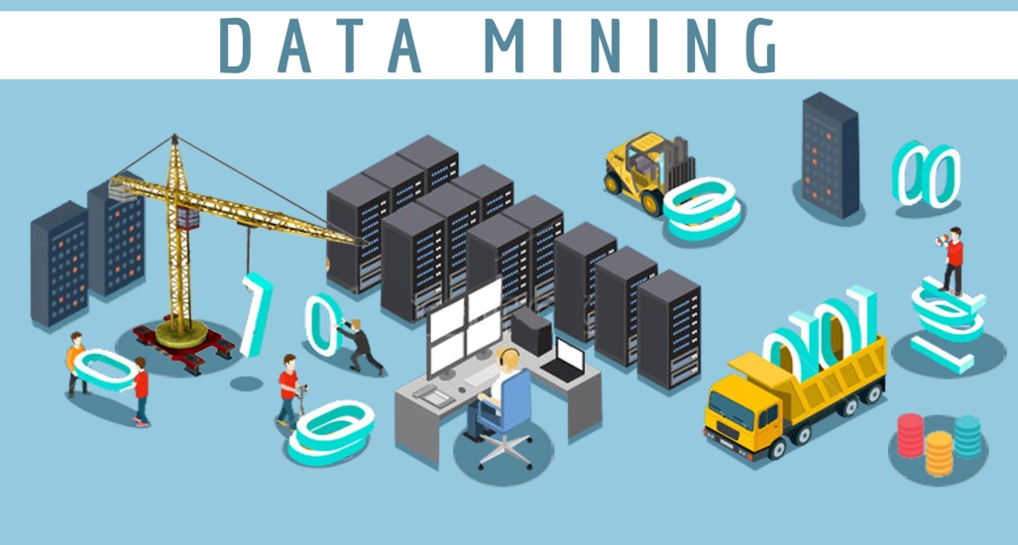
Data Mining
What Is Data Mining
Dealing With Size
Causal Random Patterns
Figure 2
Notes:
Making discoveries of knowledge to help business operations or competitive advantage
1,000 stores generate a terabyte or more data each day
Without good algorithms a data scientist and sound plans your implementation might fail

Slide 4
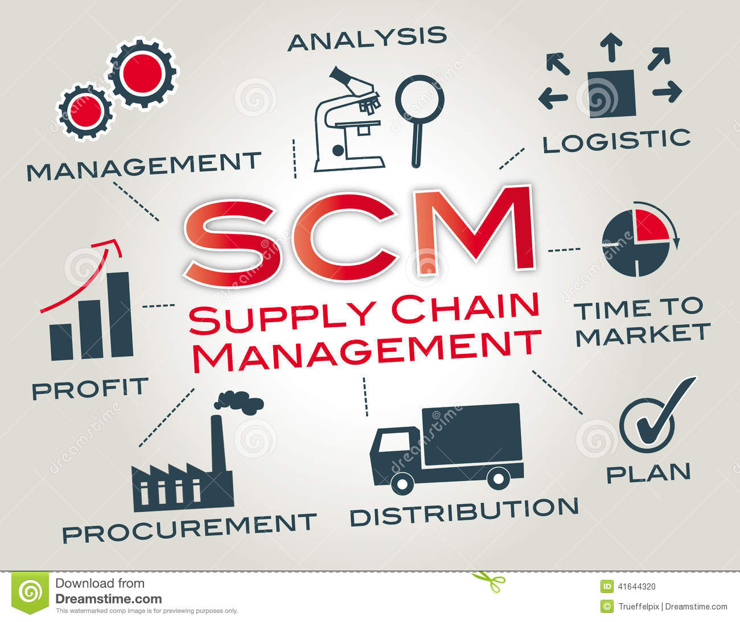
Supply Chain Management (SCM)
Demand Planning
Production Planning
Supply Planning
Notes:
Predictions of what the customer demand for shoes are. Based on sales data, weather, season ETC…
Plan to utilize production capacity to produce needed shoes for the customers from demand forecast / 100’s of shoes limited production capacity
Plan to procure all materials needed to produce shoes to fullfill Demand planning forecast and keep production of shoes going

Slide 5
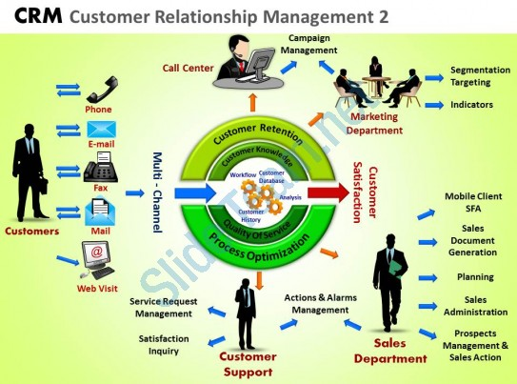
Customer Relationship Management (CRM)
Operation CRM
Analytic CRM
Collaborative CRM
Portal Based CRM
Notes:
Where direct interaction with customers at malls and indirect via e-commerce Point of sales
Allows you to target customers using historic and current data competitive advantage potential
All the ways to reach out to customers phone, tablets, computers email text chat
The portal contains whole CRM implementation in one place can assign different roles employee, customer, customer support, managers

Slide 6
References
Figure 1 http://www.mydbsync.com/blogs/wp-content/uploads/2015/01/ERP-Systems.png
Figure 2 https://www.indiadataentry.co.uk/blog/wp-content/uploads/2015/12/data-mining-services.jpg
Figure 3 https://thumbs.dreamstime.com/z/scm-supply-chain-management-flow-goods-chart-keywords-icons-41644320.jpg
Figure 4 https://www.slideteam.net/crm-customer-relationship-management-2-powerpoint-slides-and-ppt-templates-db.html

