Slide 1
Introduction
Data Monitoring and Log Analysis Suite
Author: David Contreras

Slide 2
Objective
Showcase a multithread Python-based monitoring suite and its integration with Jupyter notebooks for data analysis.
Defensive Security

Slide 3
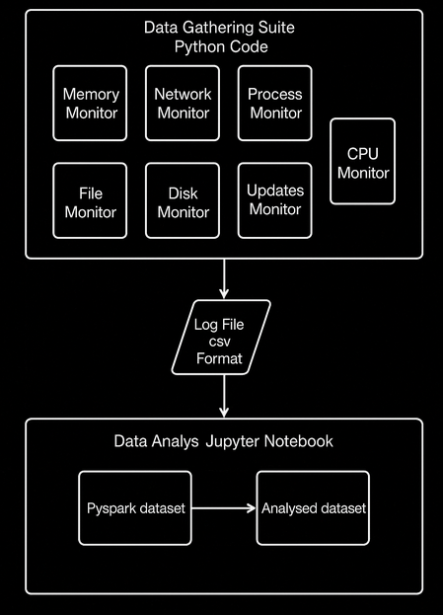

Slide 4
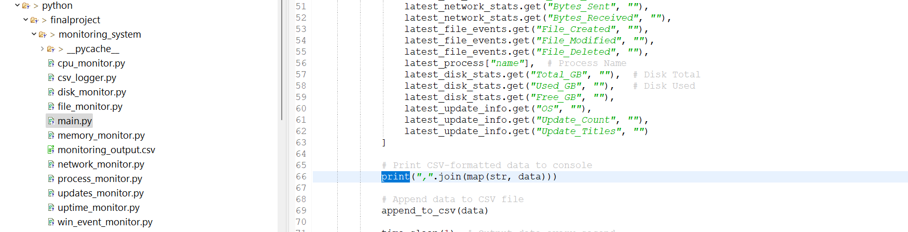
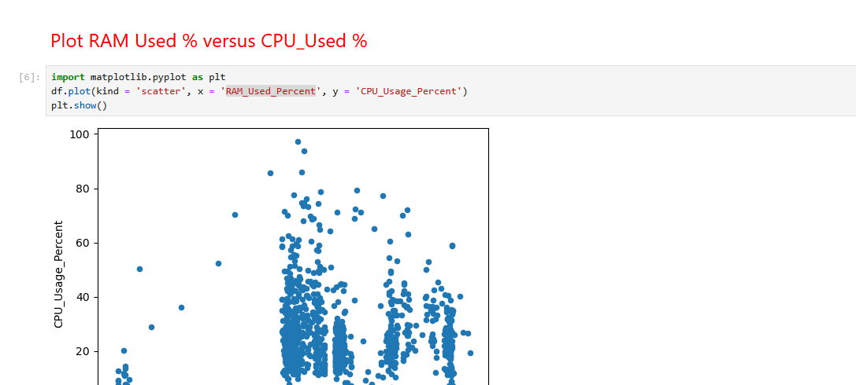
Live Presentation

Slide 5
Data Gathering Suite
Technology: Python Code
Components:
Network Monitor
File Monitor
Process Monitor
Memory Monitor
CPU Monitor
Updates Monitor
Disk Monitor
Function: Collects system activity data

Slide 6
Log File Output
Output Format: CSV (Comma-Separated Values)
Purpose: Standardized format for easy ingestion into analytical tools
Contains: Raw monitoring data from all seven modules

Slide 7
Data Analysis Environment
Tool: Jupyter Notebook
Step 1: Ingest CSV as PySpark Dataset
Step 2: Transform and Analyze Data
Output: Cleaned and structured datasets ready for insights

Slide 8
Benefits of the Pipeline
Modular: Easy to extend with more monitors
Scalable: PySpark enables large-scale data processing
Reproducible: Jupyter notebooks ensure transparency and documentation
Efficient: CSV log format simplifies data handling

Slide 9
Conclusion
This pipeline enables proactive system monitoring and efficient analysis
Combines Python flexibility with PySpark performance
Ideal for cybersecurity, performance tuning, or anomaly detection workflows

Slide 10
Technical Background

Slide 11
Why this topic
This topic was chosen to highlight the practical implementation of an end-to-end system monitoring and data analysis pipeline, which is vital in modern cybersecurity and IT operations

Slide 12
Applied Concepts
Security Concepts
System Monitoring
Anomaly Detection
Networking Concepts
Log Management

Slide 13
Research Steps Taken
Identified key monitoring targets
Wrote Python scripts for each module
Created main class to allowed each module to run in a separate thread
Used a common CSV logging class
Analyzed logs with PySpark and Jupyter
Verified compatibility with Windows and Linux

