Slide 1

Python Modules

Slide 2

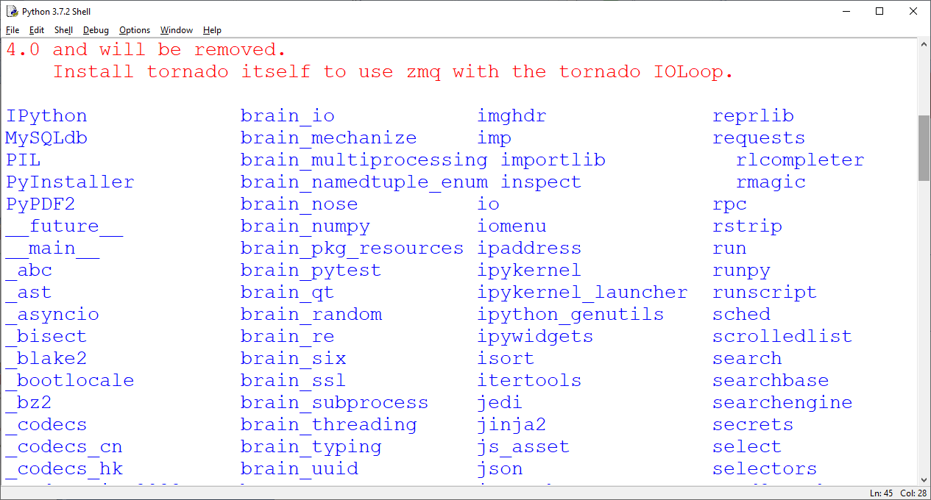
Python Modules
Python modules are the collection of in-built methods.
How to find out all available modules in your system
>>>help(“modules”)

Slide 3
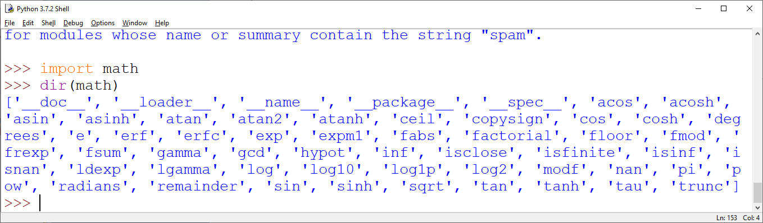
Python Modules
How to use any python modules
Import <module name>
Example:
>>>import math
How to Find out method/functions available in module
>>>dir(math)

Slide 4
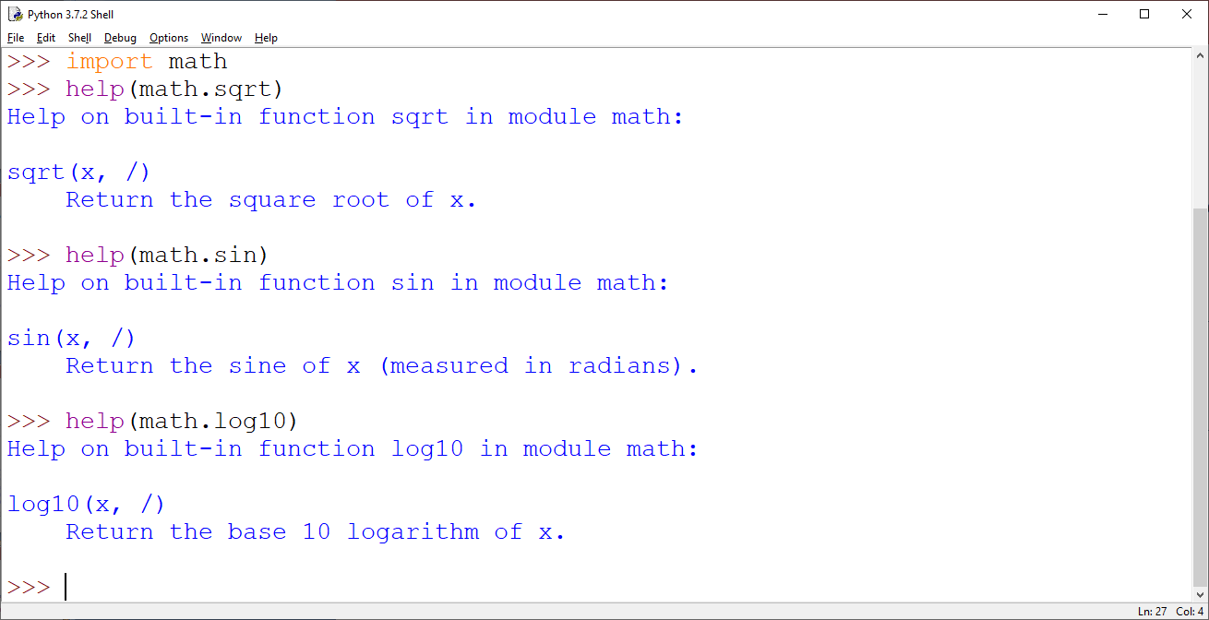
Python Modules
You can import single method/function from any module like this
>>>from math import sqrt
NOTE: Now in this case only sqrt( ) function is available to you . This is useful when you need only few functions of that module.
>>>math.sin(x) # now produce error as it is not imported
How to Know the working of a function/Functionality
In order to find out the functionality of a module function type the following
>>>help(math.sqrt)

Slide 5
Python Modules
How to use module function
Import math
n = int(input(‘Enter any number :’))
F = math.fact(n) # fact is a function defined in math module.
Print(‘Factorial of’,n,’ is :’,F)
OUTPUT
Enter any number : 6
Factorial of 6 is : 720

