Slide 1
Cyber Safety

Slide 2
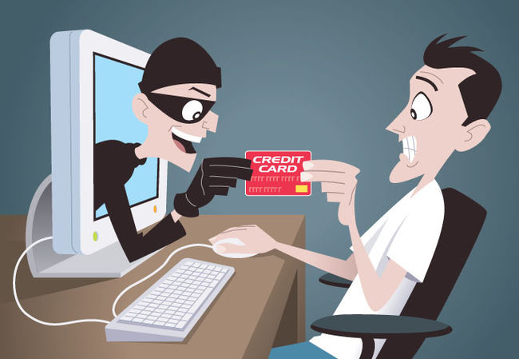

Slide 3
Identity theft is that type of that involves using someone else’s identity to steal money or gain other benefits. Online identity theft refers to an act of stealing someone personal information such as name, address, credit card no. debit card no.

Slide 4
Identity Protection While Using Internet
The people steal information and then posting as that person online. The aim of that kind of people is to use that identity for personal gains.

Slide 5
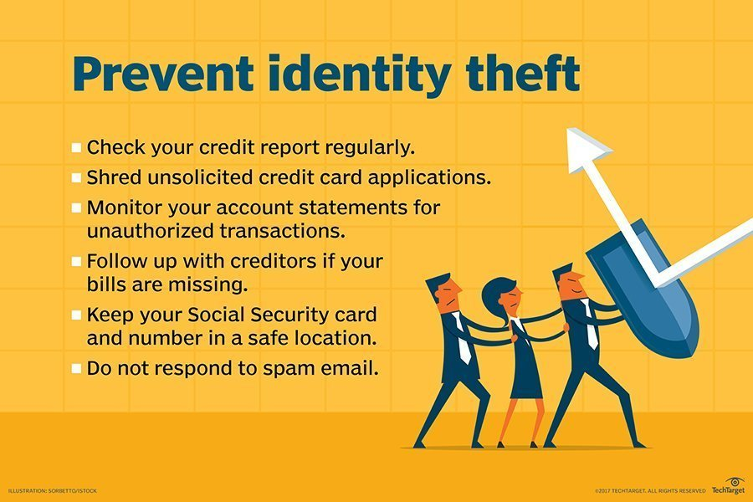
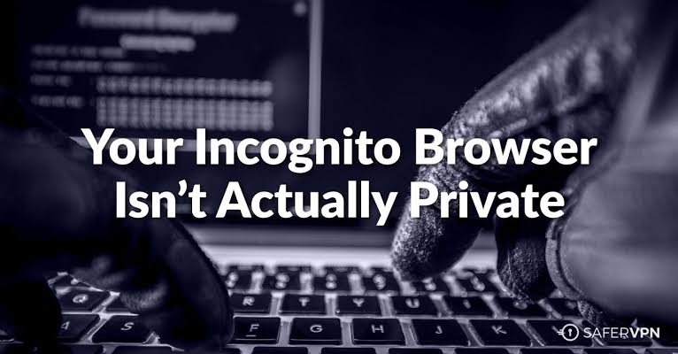
Prevent Identity Theft
To protect yourself you should follow PRIVATE BROWSING or ANONYOUS BROWSING on the internet.
You should not post your personal information on social networking websites such as Instagram , Facebook etc.

Slide 6
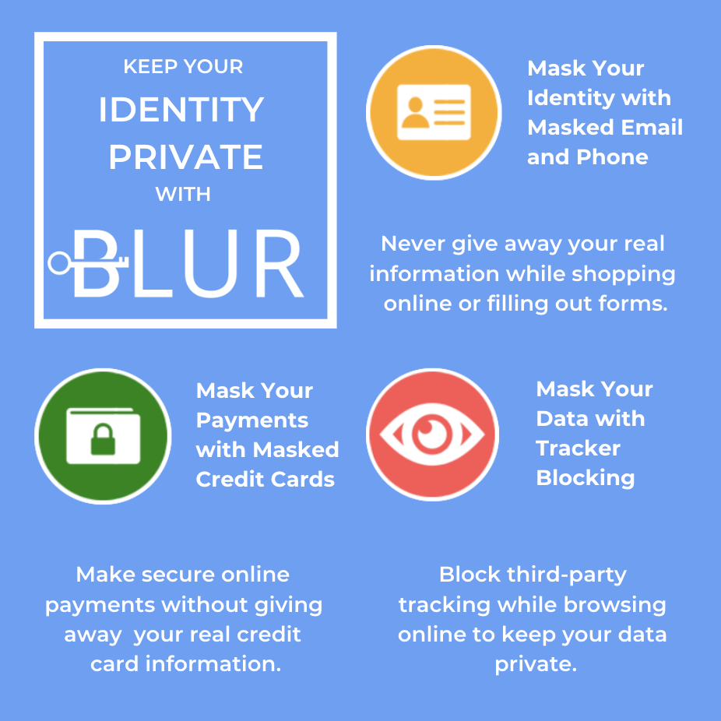
Ways of Tracking your Identity
Whenever you access or visit a website your web browser may reveal your location through your device’s IP address. It can also provide your search and browsing history which can be used by advertisers or criminals who intend to use it for some personal gains. In other words, websites track your through various methods as describes in the following figures

Slide 7
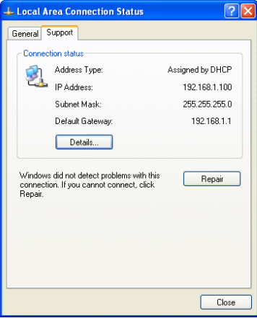
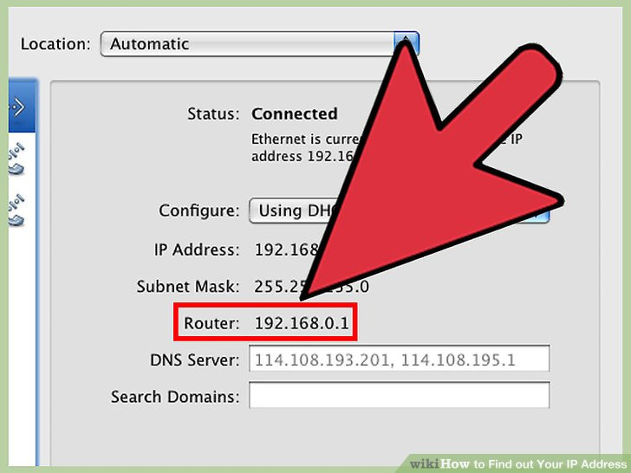
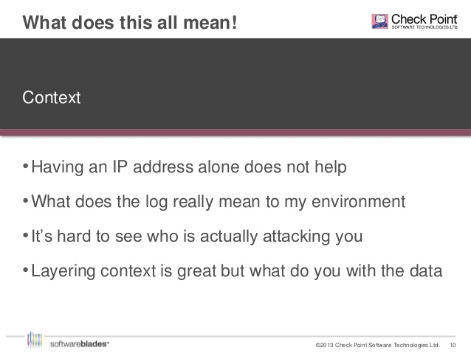
1. IP ADDRESS:
IT IS THE UNIQUE ADDRESS OF YOUR DEVICE WHEN YOU CONNECT TO THE INTERNET.WHEN YOU SHARE YOUR IP ADDRESS ON A NETWORK WITH OTHER DEVICES,A WEBSITE CAN DETERMINE YOUR GEOGRAPHICAL LOCATION.

Slide 8
2. COOKIES AND TRACKING SCRIPTS:
Cookies are some form of storage within your browser, that is generally used to store some form of IDs such as user ids and session ids, some session parameters for instance if you already agreed to a cookie gate or some personalization parameters.
They are generally split in two categories:
First party cookies: These are cookies set on your own domain, this means that you can easily create, retrieve and edit their content as you see fit when a user visit your own website. Within first party cookies you further have a class of cookies called “Same site” which provides a layer of protection against cross-site request forgery. Using Same site, only the request for data originating from the first party domain would result on the cookies being provided.
Third party cookies: These are cookies set on external domains, browser usually set restriction on accessing cookies on external domains. You are however able to usually check the information that you are creating within a session on these websites. Third party cookies are usually placed in order to do cookie synching and matching and stitching of identities across website, usually the domain of Data Management Platform (DMP) and Customer Data Platform (CDP) as well as of ad exchange.

Slide 9
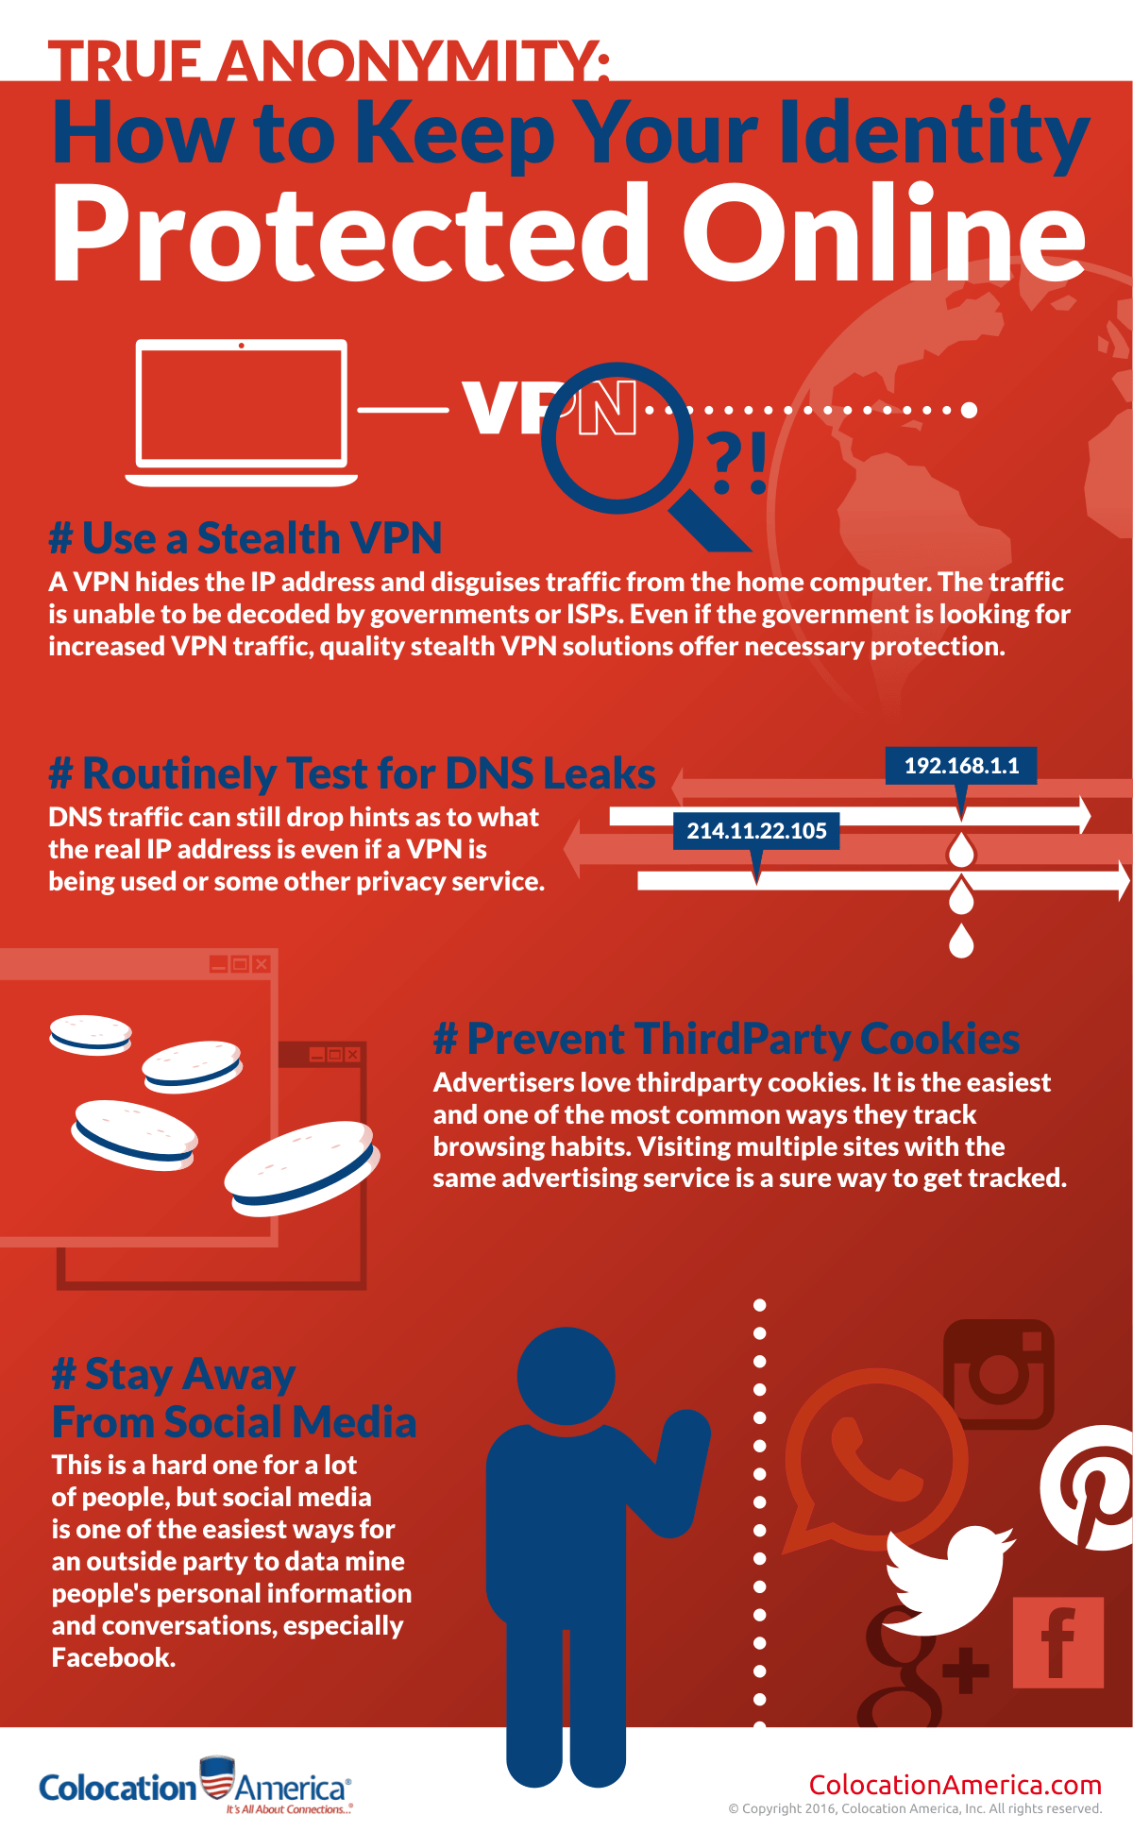
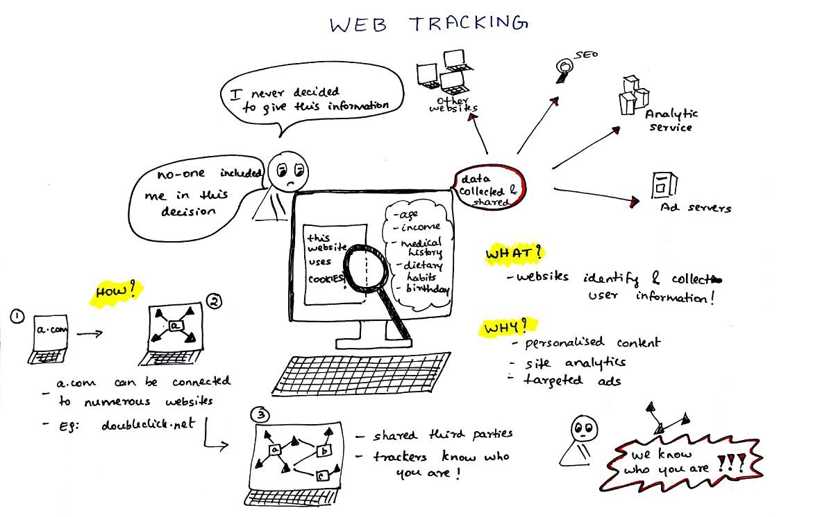

Slide 10
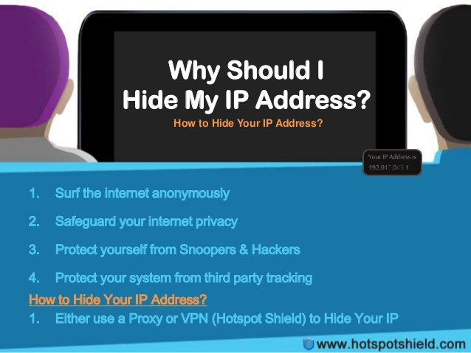
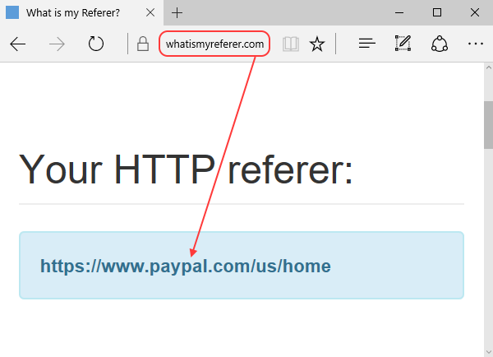
3.HTTP REFERRER:
IT IS AN HTTP HEADER FIELD THAT IDENTIFIES THE ADDRESS OF THE WEB PAGE THAT LINKS TO THE RESOURCE BEING REQUESTED BY THE USER. BY CHECKING THE REFERRER , THE NEW WEB PAGE CAN SEE WHERE THE REQUEST ORIGINATED AND CAN PASS YOUR DETAILS SUCH AS IP ADDRESS, MAIL ID, PASSWORD,ETC.,TO THESE LINKED SITES.

Slide 11
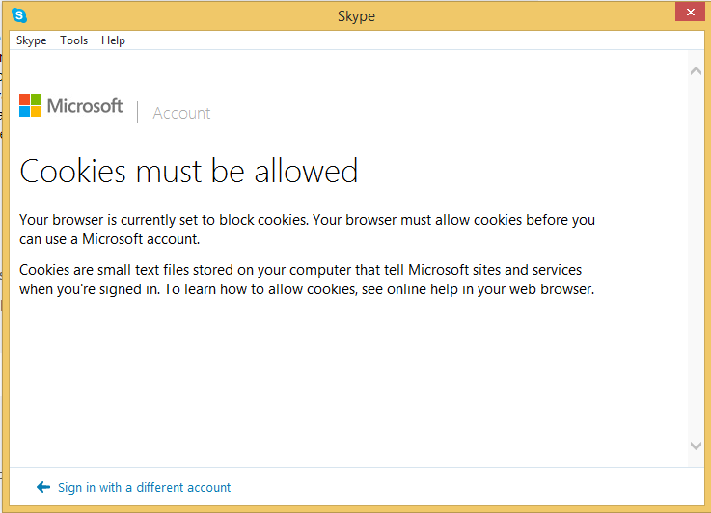
4.SUPER COOKIES
A super cookie is a type of browser cookie that is designed to be permanently stored on a user’s computer. Super cookies are generally more difficult for users to detect and remove from their devices because they cannot be deleted in the same fashion as regular cookies. Super cookies serve the same function as regular cookies in that they can contain just about any information including browsing history. authentication Details or ad-targeting data.

Slide 12
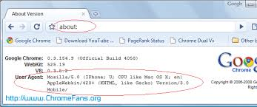

5.USER AGENT
In computing, a user agent is software (a software agent) that is acting on behalf of a user, such as a web browser that "retrieves, renders and facilitates end user interaction with Web content".^{[1]} An email reader is a mail user agent.
In many cases, a user agent acts as a client in a network protocol used in communications within a client–server distributed computing system. In particular, the Hypertext Transfer Protocol (HTTP) identifies the client software originating the request, using a user-agent header, even when the client is not operated by a user. The Session Initiation Protocol (SIP) protocol (based on HTTP) followed this usage. In the SIP, the term user agent refers to both end points of a communications session.

Slide 13


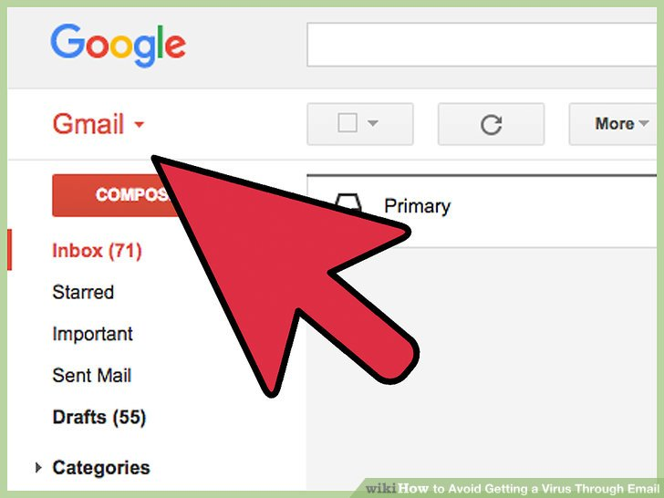
CONFIDENTIALITY OF INFORMATION

Slide 14
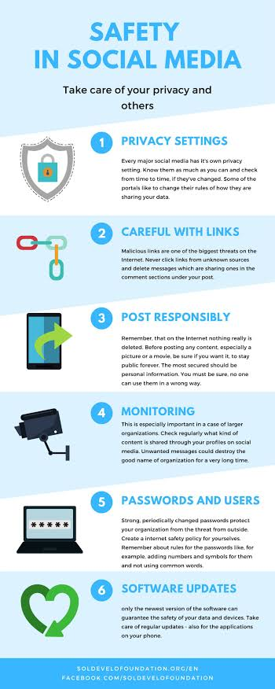
What do you mean by confidentiality of information
Confidentiality in context of computer systems allows authorized users to access sensitive and protected data .specific mechanism ensures confidentiality and safeguard data from harmful intruders.
One of the most common threats to confidentiality nowadays is password hacking in online money transaction systems.

Slide 15
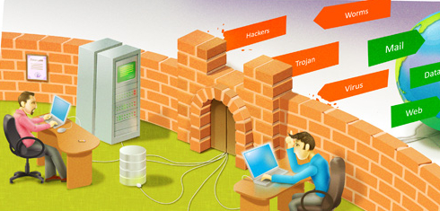
You can keep your data confidential by following ways

Slide 16

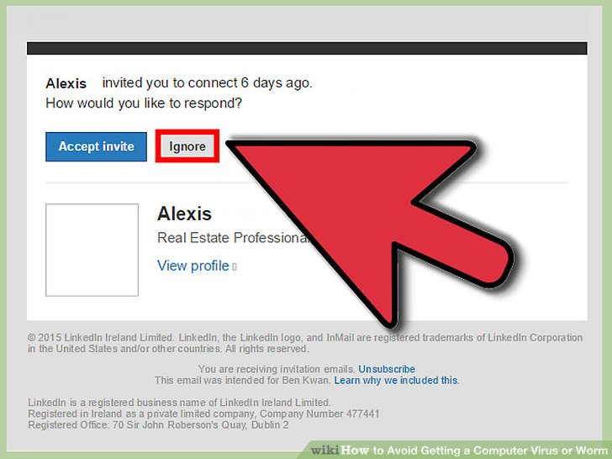
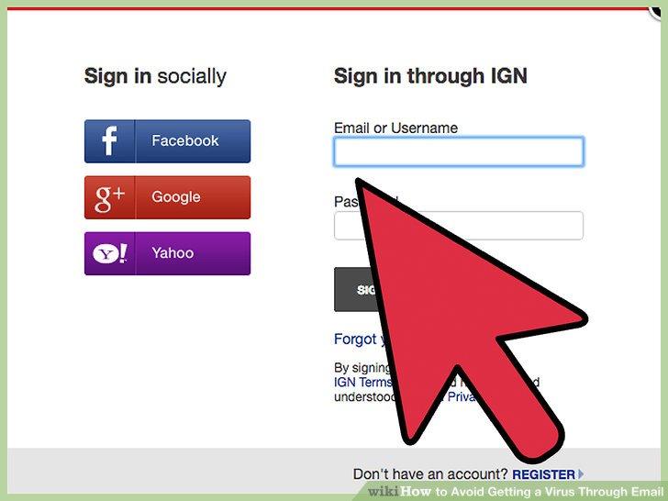
2 )AVOIDING USE OF PUBLIC COMPUTERS
Don’t save your login information .
Erase your tracks .
3 ) CAREFULLY HANDELING E –MAIL
Close or block the email after your scheduled time .
Declutter the inbox everyday.

Slide 17
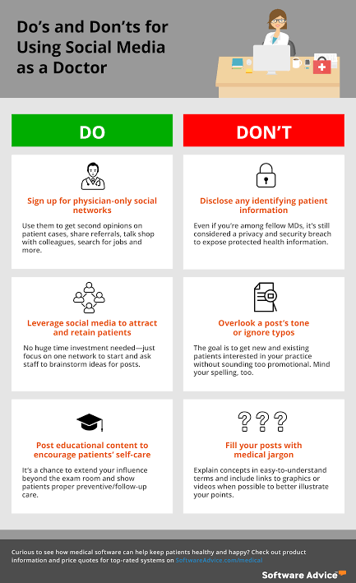
4) Browsing privately whenever possible
Browse the web privately in incognito mode .
Turn on private browsing in your web browser .
5) TAKING CAREWHILE
POSTING ON SOCIAL MEDIA
Check the ‘ABOUT ME’ SECTION .
Decide on a posting frequency .

Slide 18

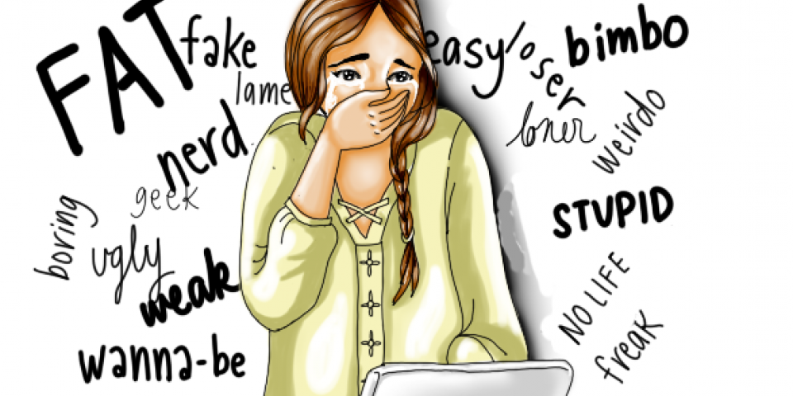
Cyber Bullying

Slide 19
Cyber Bullying
Cyberbullying is bullying that takes place using electronic technology. When people get bullied on the internet and its hurts their feelings.
Electronic technology includes devices and equipment such as
cell phones,
computers, and tablets
as well as communication tools including social media sites, text messages, chat, and websites.
Example of Cyber Bullying
Text messages or emails,
Rumors sent by email or posted on social networking sites,
Embarrassing pictures, videos, websites, or fake profiles.

Slide 20
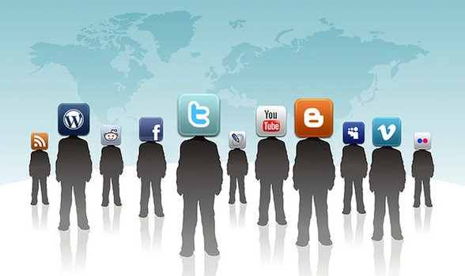
Why do children cyberbully?
Anger
Frustration
Revenge
Entertainment
To get Laugh or Reactions
Power Hungry
Because all motives for bullying are different so are the solutions and responses.

Slide 21

Effects of Cyber Bullying
Kids who are cyberbullied are more likely to:
Skip school to avoid bullies in school
Low self esteem.
Receive poor grades
Be unwilling to attend school
Loneliness
Use alcohol and drugs
Have more health problems

Slide 22
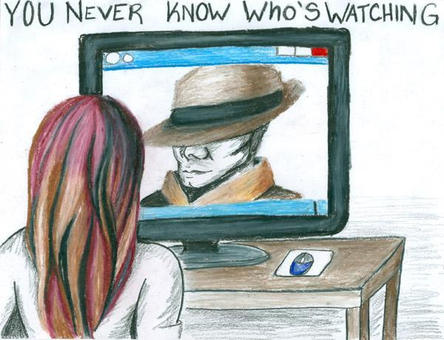
CyberStalking

Slide 23
Cyber Stalking
Cyberstalking is a new form of computer related crime occurring in our society.
It means when a person is followed or pursued online invading his/her privacy as his/her every move watched.
It is a form of harassment that can disrupt the life of the victim and leave him/her feeling very afraid and threatened.
Cyberstalking usually occurs with women, who are stalked or harassed by men, or with children who are stalked by adult predators or pedophiles.
Cyber Stalker need not have to leave their home to find, or harass their targets and has no fear of physically violence since they believe that they cannot be physically touched in cyberspace.
They use Internet, e-mail and other electronic communication devices to stalk persons.

Slide 24
Cyber Stalking
The core areas where the stalking takes place are;
live chat rooms/flaming
e-mail,
discussion forums and
message boards.

Slide 25
Safely Browsing Website

Slide 26
Few Terms
Adware : software that automatically displays or downloads advertising material such as banners or pop-ups when a user is online, generates revenue for its developer by automatically generating online advertisements in the user interface of the software or on a screen presented to the user during the installation process
Malware :Malware, or malicious software, is any program or file that is harmful to a computer user. Types of malware can include computer viruses, worms, Trojan horses and spyware. Malware is any software intentionally designed to cause damage to a computer, server, client, or computer network.

Slide 27
Safely Browsing Website
Viruses : A computer virus is a type of computer program that, when executed, replicates itself by modifying other computer programs and inserting its own code. When this replication succeeds, the affected areas are then said to be "infected" with a computer virus
Trojans : In computing, a Trojan horse, or Trojan, is any malware which misleads users of its true intent. The term is derived from the Ancient Greek story of the deceptive Trojan Horse that led to the fall of the city of Troy.

Slide 28
Safely Communicating Data
Secure Connections : A secure connection is a connection that is encrypted by one or more security protocols to ensure the security of data flowing between two or more nodes.
Eavesdropping : Eavesdropping is the act of secretly or stealthily listening to the private conversation or communications of others without their consent. This type of attack normally takes place while data is in transmission.
Phising : Phishing is a method of trying to gather personal information using deceptive e-mails and websites.
Phishing is a cyber attack that uses disguised email as a weapon. The goal is to trick the email recipient into believing that the message is something they want or need — a request from their bank, for instance, or a note from someone in their company — and to click a link or download an attachment.

