Slide 1

Python Modules

Slide 2

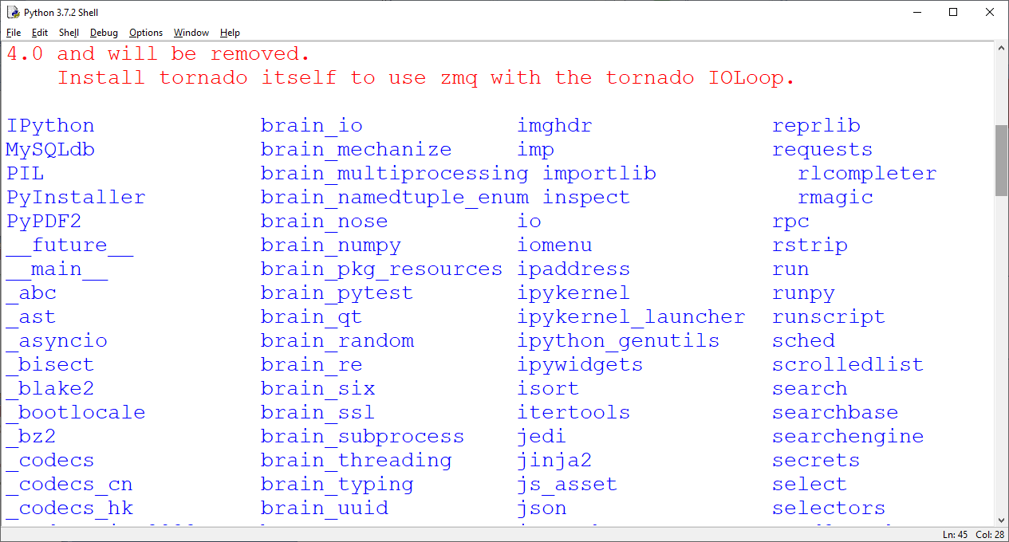
Python Modules
Python modules are the collection of in-built methods.
How to find out all available modules (installed ) in your system
>>>help(“modules”)

Slide 3
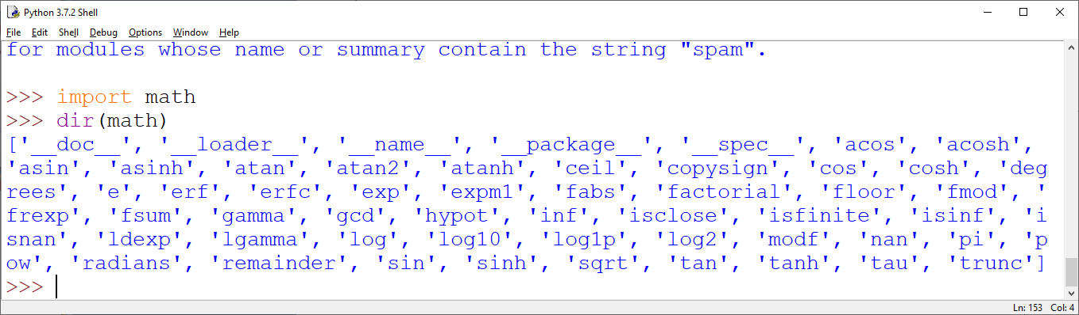
Python Modules
How to use any python modules
Import <module name>
Example:
>>>import math
How to Find out method/functions available in module
>>>dir(math)

Slide 4
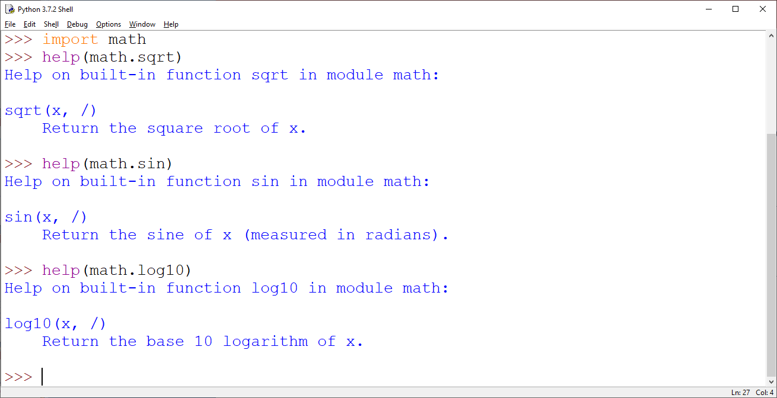
Python Modules
You can import single method/function from any module like this
>>>from math import sqrt
NOTE: Now in this case only sqrt( ) function is available to you . This is useful when you need only few functions of that module.
>>>math.sin(x) # now produce error as it is not imported
How to Know the working of a function/Functionality
In order to find out the functionality of a module function type the following
>>>help(math.sqrt)

Slide 5
Python Modules
You can import single method/function from any module like this
>>>from math import sqrt
NOTE: Now in this case only sqrt( ) function is available to you . This is useful when you need only few functions of that module.
>>>math.sin(x) # now produce error as it is not imported
How to Know the working of a function/Functionality
In order to find out the functionality of a module function type the following
>>>help(math.sqrt)

Slide 6
Python Modules
How to use module function
#program to find out factorial of any number n using math function
import math
n = int(input('Enter any integer number :'))
num = math.factorial(n) # function is used with module name
print('Factorial of ',n,'is :',num)
OUTPUT
Enter any integer number :23
Factorial of 23 is : 25852016738884976640000
import math as m
n = int(input('Enter any integer number :'))
num = m.factorial(n)
print('Factorial of ',n,'is :',num)
import math.factorial
n = int(input('Enter any integer number :'))
num = factorial(n)
print('Factorial of ',n,'is :',num)

Slide 7
Python Modules
few important math module function
import math as m
p= m.pow(3,4)
print(p)
c = m.ceil(3.78)
print(n)
f = m.floor(3.78)
print(f)
result = m.sqrt(64)
print(result)
result1= m.fabs(-4.1234)
print(result1)

Slide 8
Python Module - random
few important random module function
import random as r
p= r.random()
print(p)
c = r.randint(1,10)
print(n)
f = r.randrange(1,20,2)
print(f)

Slide 9
Python Module - statistics
few important random module function
import statistics as s
p= s.mean(10,20,30,40,50)
print(p)
c = r.median(1,3,5,6,56,6,6,6,6,6,,6,7,34,23,23,56,7,8,89,89,78,56,4,34,23,23,23,10)
print(n)
f = s.mode(1,1,4,4,6,6,7,7,7,8,8,8,9,9,9,8,7,5,56,5,7,8,8,9,3)
print(f)

