Slide 1
ecDNA_EGFR
(Z) Instrument
+κ
EGFR_expression
(X) Exposure
Migration
Outcome
VEGF Secretion
Outcome
Proliferation
Outcome
Survival
Outcome
Hypoxia
Mediator
O2_local
Confounder

Slide 2
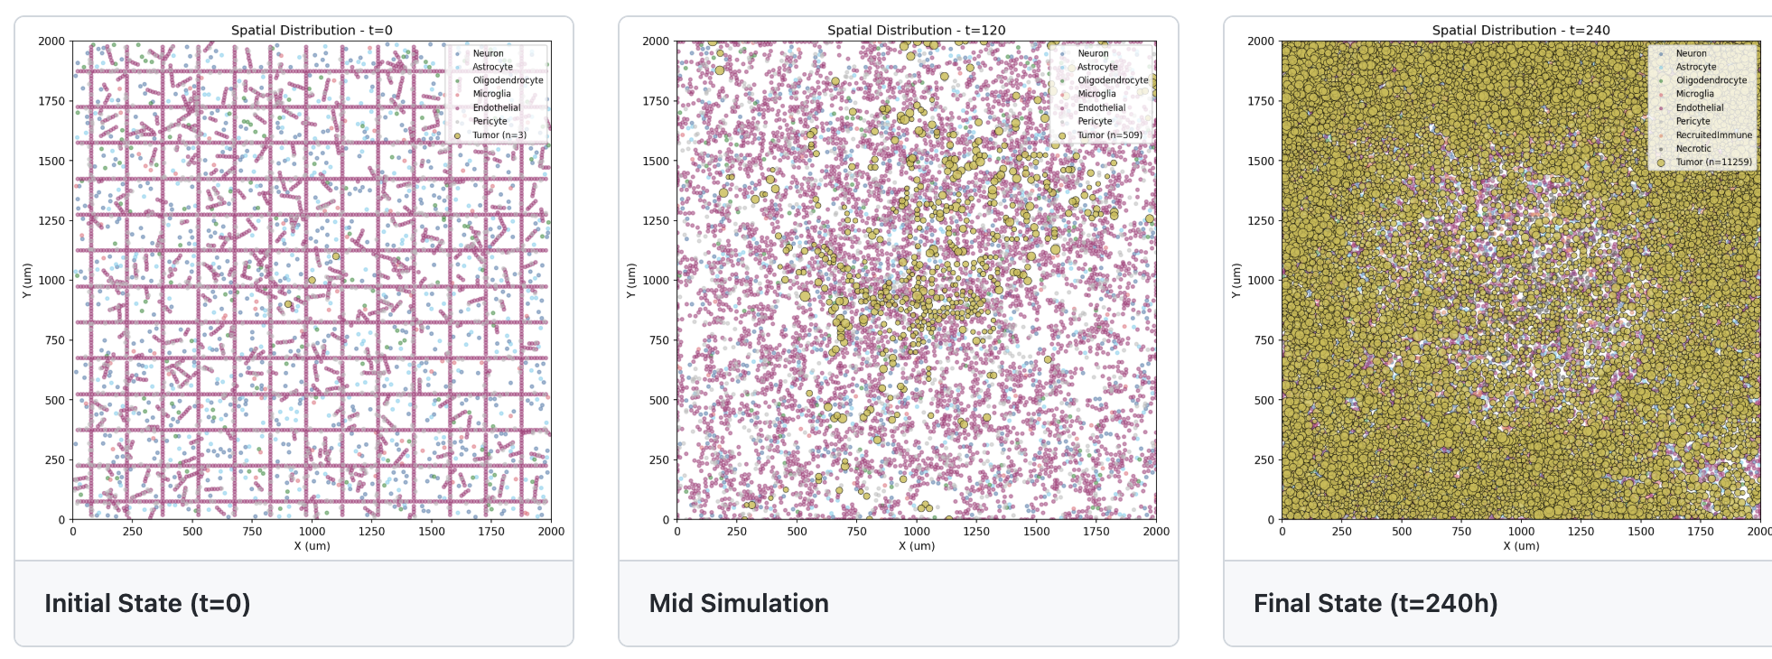
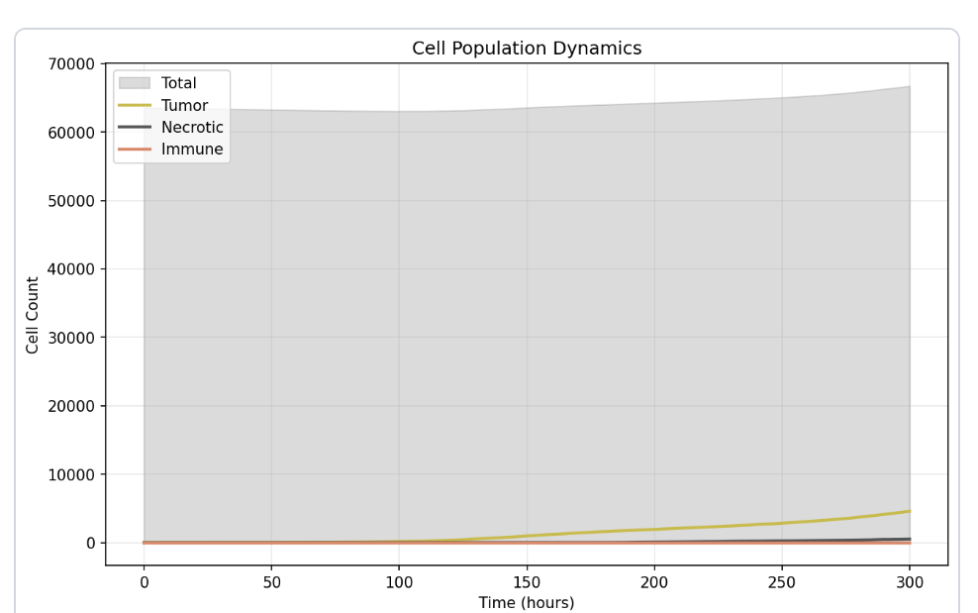
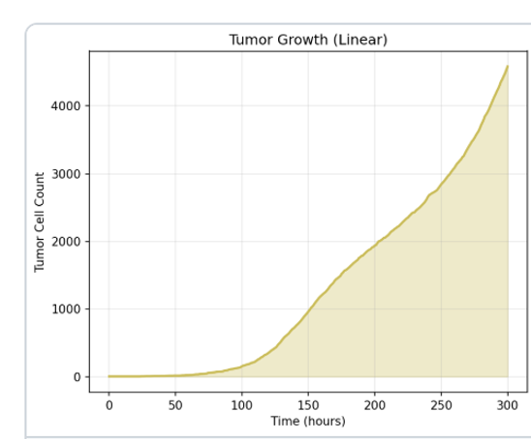
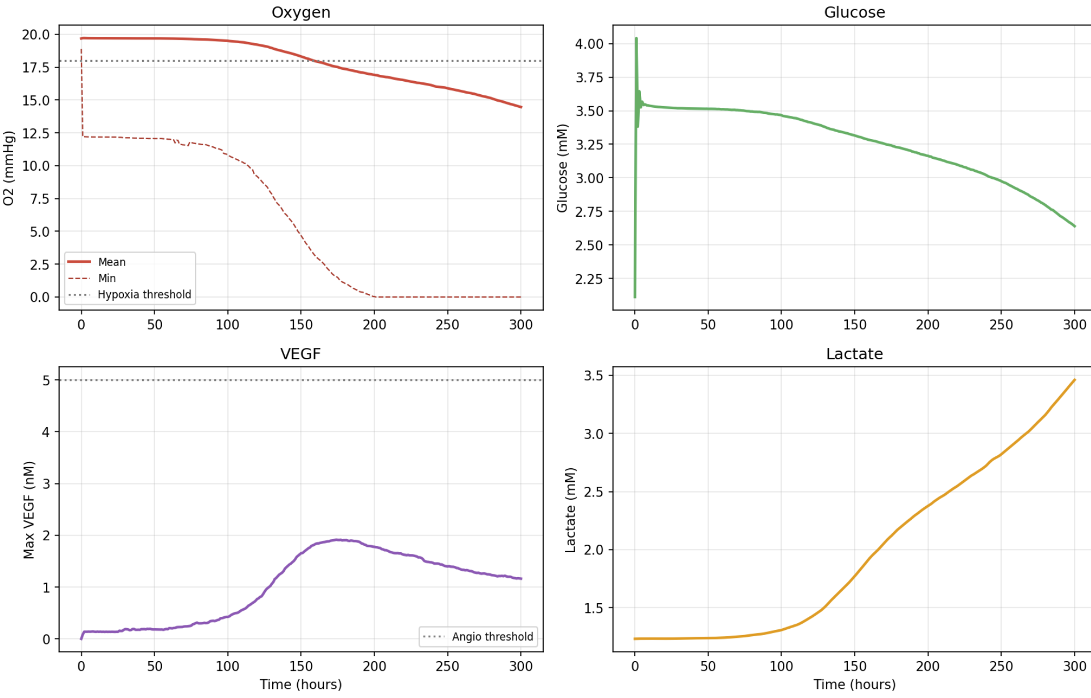
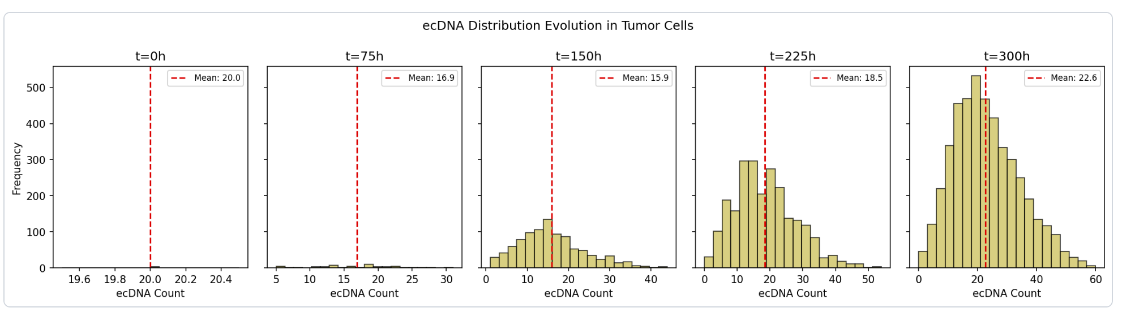
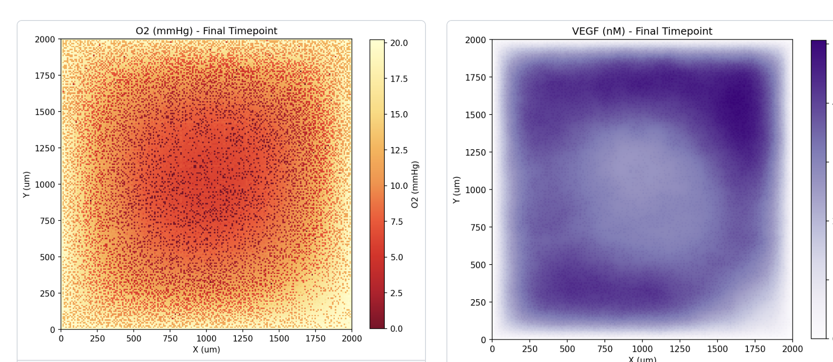
A. Example Simulation: Spatial Organization
C. Population Dynamics
B. Environmental Dynamics
D. ecDNA Distribution
E. Spatial Gradients (Final Timepoint)

Slide 3
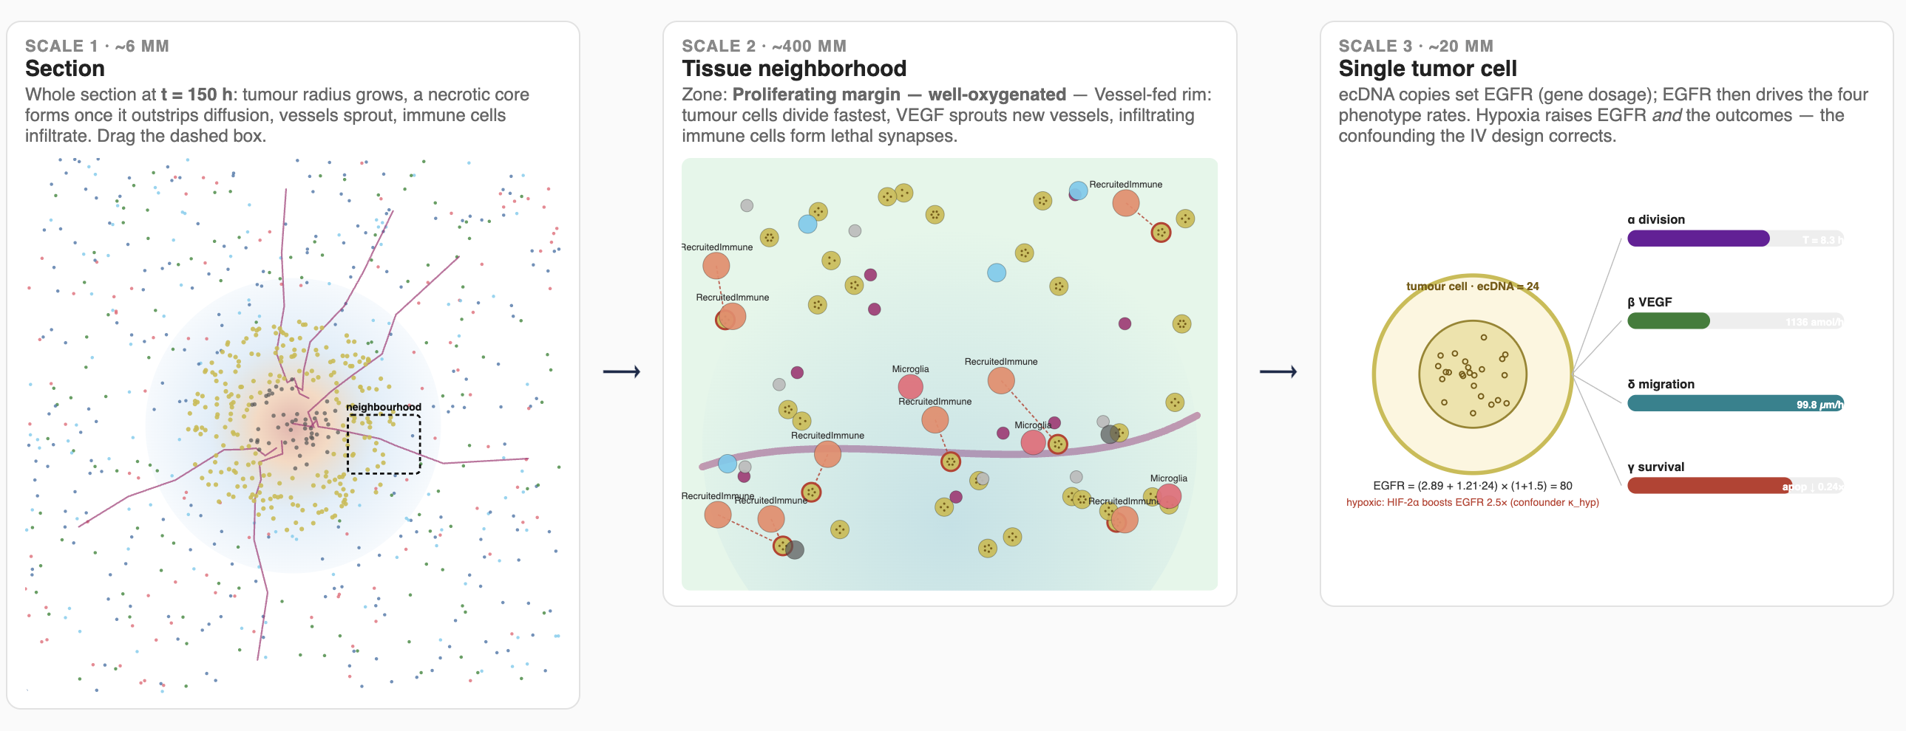
A. MULTI-SCALE STATE
Neur
Astro
Oligo
Micro
Endo
Peri
Tumor
Imm
Necr
B. Per-hour Simulation
Phase 1 - ENVIRONMENT
Phase 2 - CELL BEHAVIORS
Phase 3 - ANGIOGENESIS
Diffusion of O2 / glucose /
VEGF / lactate
Thomas implicit solver,
1 / dt diffusion sub-steps
Shuffled iteration over
all living cells
(see detail below)
VEGF-driven sprouting
from endothelial cells
Vessel maturation
Tissue Scale
Domain 10x30 mm, env grids (O2, glucose, VEGF, lactate)
Vascular density, spatial hash (20 um buckets)
Phase 4 - IMMUNE RECRUITMENT
Phase 5 - CLEANUP
Phase 6 - OUTPUT
Spawn immune from
vasculature where VEGF
proxy > threshold
Lyse necrotic cells
Update spatial hash /
occupancy index
Write cells / env TSV
Append lineage.tsv
Progress log
Cellular Scale
Per-cell state: type, position, cycle phase, ecDNA_count,
O2_local, glucose local, EGFR_expression,
Is hypoxic, is alive, lineage parent id
C. Tumor cell (state vector)
Mitosis event
Binomial(N, 0.5) split of
parent ecDNA to daughters
VEGF field (env)
diffusion + decay,
source = tumor secretion
O2_local
(env grid sample)
ecDNA
EGFR
Molecular Scale
ecDNA segregation: Binomial(N, 0.5)
EGFR ~ gene dosage + HIF-1α upregulation
VEGF, migration, survival modulated by EGFR
HIF
VEGF secretion
Angiogenesis
(Phase 3): sprouting if
VEGF > threshold
migration
survival
Daughter tumor cells
division rate
Apoptosis / necrosis sink
hypoxia x multiplier
lysed in Phase 5

