Slide 1
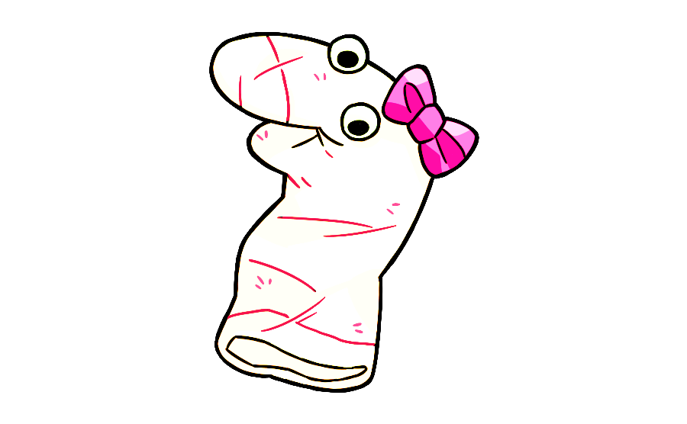
Before we read stories about Suzy and Andy, let’s meet my friend Maggie first.

Slide 2

Before we read stories about Suzy and Andy, let’s meet my friend Maggie first. She is learning to speak English and she has some questions for you.

Slide 3


Before we read stories about Suzy and Andy, let’s meet my friend Maggie first. She is learning to speak English and she has some questions for you.
Now, let’s help Maggie learn English!

Slide 4

Maggie is unsure what is right to say. Let’s hear what she says first before we help her! This is what she says:
I put socks on my feet.
I put socks on my feets.

Slide 5
Is it right or wrong for Maggie to say:
I put socks on my feet.
Please say your answer out loud. When you finish, click ”Next”.

Slide 6
Is it right or wrong for Maggie to say:
I put socks on my feets.
Please say your answer out loud. When you finish, click ”Next”.

Slide 7
Okay. This is what Maggie says:
I live in Maple Street.
I live on Maple Street.

Slide 8
Is it right or wrong for Maggie to say:
I live in Maple Street.
Please say your answer out loud. When you finish, click ”Next”.

Slide 9
Is it right or wrong for Maggie to say:
I live on Maple Street.
Please say your answer out loud. When you finish, click ”Next”.

Slide 10

Wow, Maggie has learned lots of English because of you.
Thanks for helping Maggie!

