Slide 1


Welcome and thank you so much for participating in our game!
Today you are going to meet my friend Maggie. Maggie is very curious about what things are for. You and Maggie are going to look at lots of pictures together so you can teach her about what things are for. There are no right or wrong answers in the game! You can say whatever it is that you think.
Ok let’s meet Maggie first!

Slide 2
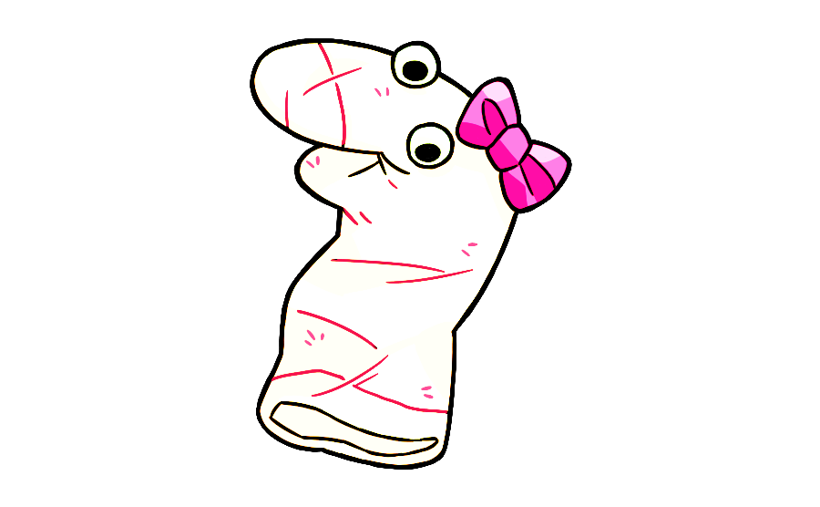
Before you teach the curious Maggie about what things are for, let’s teach Maggie some English first.

Slide 3



Maggie is learning to speak English and she has some questions for you.
Now, let’s help Maggie learn English!

Slide 4






Now it’s time to teach Maggie about different things.
To start, click next.

Slide 5


THE END
Thank you very much for your participation!

Slide 6
THE END
Thank you very much for your participation!

