Slide 1
xans_changed

Slide 2
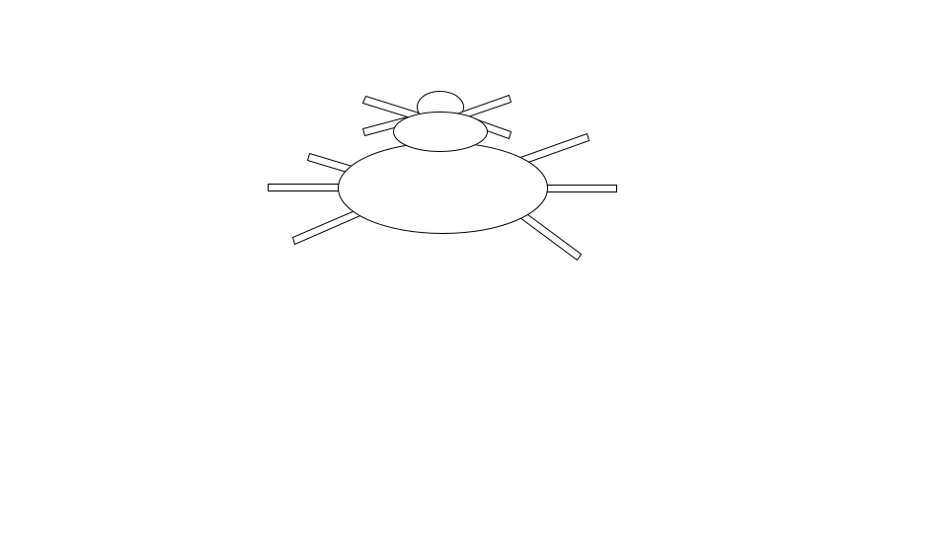
On a distant planet, there exist two kinds of creatures: Zerps and Xans.
Zerps and Xans both have the same basic shape:
But Zerps and Xans are also different.

Slide 3
Xans have markings on them which appear as red spots. They also have a true purpose, which is to make honey and pollinate flowers. And they have XYZ DNA.
Xans have the causal structure shown here: the XYZ DNA causes Xans to make honey and pollinate flowers and to have red spots.
Xans
True Purpose
Markings
Make honey and pollinate flowers
Red
spots
DNA
XYZ

Slide 4
Zerps have markings on them which appear as blue spots. They also have a true purpose, which is to spin webs to catch and kill insects. And they have ABC DNA.
Zerps have the causal structure shown here: the ABC DNA causes Zerps to spin webs to catch and kill insects and to have blue spots.
Zerps
True Purpose
Markings
Spin webs to catch and kill insects
Blue
spots
DNA
ABC

Slide 5
Some very talented and skilled scientists, Suzy and Andy, decide that they are going to perform special operations on Xans.
Throughout the study, you will encounter various creatures that result from these special operations. For each creature, you will decide whether it is a Xan or a Zerp.

Slide 6
Xans
Zerps
True Purpose
Markings
True Purpose
Markings
Make honey and pollinate flowers
Red
spots
Spin webs to catch and kill insects
Blue
spots
Now, to make sure you have read the instructions and understand the differences between Xans and Zerpuestions.
DNA
DNA
XYZ
ABC
Now, to make sure you have read the instructions and understand the differences between Xans and Zerps, we will ask you a few questions.

Slide 7
Xans
Zerps
True Purpose
Markings
True Purpose
Markings
Make honey and pollinate flowers
Red
spots
Spin webs to catch and kill insects
Blue
spots
Now, to make sure you have read the instructions and understand the differences between Xans and Zerpuestions.
DNA
DNA
XYZ
ABC
Xans and Zerps have the same basic shape but have different markings, true purposes and DNA.

Slide 8
Xans
Zerps
True Purpose
Markings
True Purpose
Markings
Make honey and pollinate flowers
Red
spots
Spin webs to catch and kill insects
Blue
spots
Now, to make sure you have read the instructions and understand the differences between Xans and Zerpuestions.
DNA
DNA
XYZ
ABC
Two scientists, Andy and Suzy, will be performing special operations on Xans.

Slide 9
Xans
Zerps
True Purpose
Markings
True Purpose
Markings
Make honey and pollinate flowers
Red
spots
Spin webs to catch and kill insects
Blue
spots
Now, to make sure you have read the instructions and understand the differences between Xans and Zerpuestions.
DNA
DNA
XYZ
ABC
Xans have red spots and Zerps have blue spots.

Slide 10
Xans
Zerps
True Purpose
Markings
True Purpose
Markings
Make honey and pollinate flowers
Red
spots
Spin webs to catch and kill insects
Blue
spots
Now, to make sure you have read the instructions and understand the differences between Xans and Zerpuestions.
DNA
DNA
XYZ
ABC
Xans have ABC DNA and Zerps have XYZ DNA.

Slide 11
Xans
Zerps
True Purpose
Markings
True Purpose
Markings
Make honey and pollinate flowers
Red
spots
Spin webs to catch and kill insects
Blue
spots
Now, to make sure you have read the instructions and understand the differences between Xans and Zerpuestions.
DNA
DNA
XYZ
ABC
The true purpose of Xans is to make honey and pollinate flowers while the true purpose of Zerps is to spin webs to catch and kill insects.

Slide 12
Xans
Zerps
True Purpose
Markings
True Purpose
Markings
Make honey and pollinate flowers
Red
spots
Spin webs to catch and kill insects
Blue
spots
Now, to make sure you have read the instructions and understand the differences between Xans and Zerpuestions.
DNA
DNA
XYZ
ABC
You will now encounter various creatures that result from the special operations that Suzy and Andy perform on Xans. For each creature, you will decide whether it is a Xan or a Zerp after the special operation.

Slide 13

Suzy and Andy perform a special operation on a Xan.
The special operation changed the true purpose
It no longer makes honey and pollinates flowers. Instead it spins webs to catch and kill insects.
True Purpose
Markings
True Purpose
Markings
Make honey and pollinate flowers
Red
spots
Spins webs to catch and kill insects
Red
spots
DNA
DNA
XYZ
XYZ
Do you think the creature after the special operation is a Xan or a Zerp?

Slide 14
Suzy and Andy perform a special operation on a Xan.
The special operation changed the
markings
It no longer has red spots. Instead it has blue spots.
True Purpose
Markings
True Purpose
Markings
Make honey and pollinate flowers
Red
spots
Make honey and pollinate flowers
Blue
spots
DNA
DNA
XYZ
XYZ
Do you think the creature after the special operation is a Xan or a Zerp?

Slide 15
Suzy and Andy perform a special operation on a Xan.
The special operation changed the
DNA
It no longer has XYZ DNA, red spots, or makes honey and pollinate flowers.
Instead it has ABC DNA, blue spots and spins webs to catch and kill insects.
True Purpose
Markings
True Purpose
Markings
Make honey and pollinate flowers
Red
spots
Spins webs to catch and kill insects
Blue
spots
DNA
DNA
XYZ
ABC
Do you think the creature after the special operation is a Xan or a Zerp?

Slide 16
zerps_changed

Slide 17
On a distant planet, there exist two kinds of creatures: Zerps and Xans.
Zerps and Xans both have the same basic shape:
But Zerps and Xans are also different.

Slide 18
Zerps have markings on them which appear as blue spots. They also have a true purpose, which is to spin webs to catch and kill insects. And they have ABC DNA.
Zerps have the causal structure shown here: the ABC DNA causes Zerps to spin webs to catch and kill insects and to have blue spots.
Zerps
True Purpose
Markings
Spin webs to catch and kill insects
Blue
spots
DNA
ABC

Slide 19
Xans have markings on them which appear as red spots. They also have a true purpose, which is to make honey and pollinate flowers. And they have XYZ DNA.
Xans have the causal structure shown here: the XYZ DNA causes Xans to make honey and pollinate flowers and to have red spots.
Xans
True Purpose
Markings
Make honey and pollinate flowers
Red
spots
DNA
XYZ

Slide 20
Some very talented and skilled scientists, Suzy and Andy, decide that they are going to perform special operations on Zerps.
Throughout the study, you will encounter various creatures that result from these special operations. For each creature, you will decide whether it is a Zerp or a Xan.

Slide 21
Zerps
Xans
True Purpose
Markings
True Purpose
Markings
Spin webs to catch and kill insects
Blue
spots
Make honey and pollinate flowers
Red
spots
Now, to make sure you have read the instructions and understand the differences between Xans and Zerpuestions.
DNA
DNA
ABC
XYZ
Now, to make sure you have read the instructions and understand the differences between Zerps and Xans, we will ask you a few questions.

Slide 22
Zerps
Xans
True Purpose
Markings
True Purpose
Markings
Spin webs to catch and kill insects
Blue
spots
Make honey and pollinate flowers
Red
spots
Now, to make sure you have read the instructions and understand the differences between Xans and Zerpuestions.
DNA
DNA
ABC
XYZ
Zerps and Xans have the same basic shape but have different markings, true purposes and DNA.

Slide 23
Zerps
Xans
True Purpose
Markings
True Purpose
Markings
Spin webs to catch and kill insects
Blue
spots
Make honey and pollinate flowers
Red
spots
Now, to make sure you have read the instructions and understand the differences between Xans and Zerpuestions.
DNA
DNA
ABC
XYZ
Two scientists, Andy and Suzy, will be performing special operations on Zerps.

Slide 24
Zerps
Xans
True Purpose
Markings
True Purpose
Markings
Spin webs to catch and kill insects
Blue
spots
Make honey and pollinate flowers
Red
spots
Now, to make sure you have read the instructions and understand the differences between Xans and Zerpuestions.
DNA
DNA
ABC
XYZ
Zerps have blue spots and Xans have red spots.

Slide 25
Zerps
Xans
True Purpose
Markings
True Purpose
Markings
Spin webs to catch and kill insects
Blue
spots
Make honey and pollinate flowers
Red
spots
Now, to make sure you have read the instructions and understand the differences between Xans and Zerpuestions.
DNA
DNA
ABC
XYZ
Zerps have XYZ DNA and Xans have ABC DNA.

Slide 26
Zerps
Xans
True Purpose
Markings
True Purpose
Markings
Spin webs to catch and kill insects
Blue
spots
Make honey and pollinate flowers
Red
spots
Now, to make sure you have read the instructions and understand the differences between Xans and Zerpuestions.
DNA
DNA
ABC
XYZ
The true purpose of Zerps is to spin webs to catch and kill insects while the true purpose of Xans is to make honey and pollinate flowers.

Slide 27
Zerps
Xans
True Purpose
Markings
True Purpose
Markings
Spin webs to catch and kill insects
Blue
spots
Make honey and pollinate flowers
Red
spots
Now, to make sure you have read the instructions and understand the differences between Xans and Zerpuestions.
DNA
DNA
ABC
XYZ
You will now encounter various creatures that result from the special operations that Suzy and Andy perform on Zerps. For each creature, you will decide whether it is a Zerp or a Xan after the special operation.

Slide 28
Suzy and Andy perform a special operation on a Zerp.
The special operation changed the true purpose
It no longer spins webs to catch and kill insects. Instead it makes honey and pollinates flowers.
True Purpose
Markings
True Purpose
Markings
Spin webs to catch and kill insects
Blue
spots
Make honey and pollinate flowers
Blue
spots
DNA
DNA
ABC
ABC
Do you think the creature after the special operation is a Zerp or a Xan?

Slide 29
Suzy and Andy perform a special operation on a Zerp.
The special operation changed the
markings
It no longer has blue spots. Instead it has red spots.
True Purpose
Markings
True Purpose
Markings
Spin webs to catch and kill insects
Blue
spots
Spin webs to catch and kill insects
Red
spots
DNA
DNA
ABC
ABC
Do you think the creature after the special operation is a Zerp or a Xan?

Slide 30
Suzy and Andy perform a special operation on a Zerp.
The special operation changed the
DNA
It no longer has ABC DNA, blue spots, or spins webs to catch and kill insects.
Instead it has XYZ DNA, red spots and makes honey and pollinates flowers.
True Purpose
Markings
True Purpose
Markings
Spin webs to catch and kill insects
Blue
spots
Make honey and pollinate flowers
Red
spots
DNA
DNA
ABC
XYZ
Do you think the creature after the special operation is a Zerp or a Xan?

