Slide 1
You are traveling to a new planet called Nebular. And you will be learning about the animals that live on this uncharted planet. Throughout you will be shown creatures on this planet and be asked to categorize them.
Please click next to see the first creature.

Slide 2
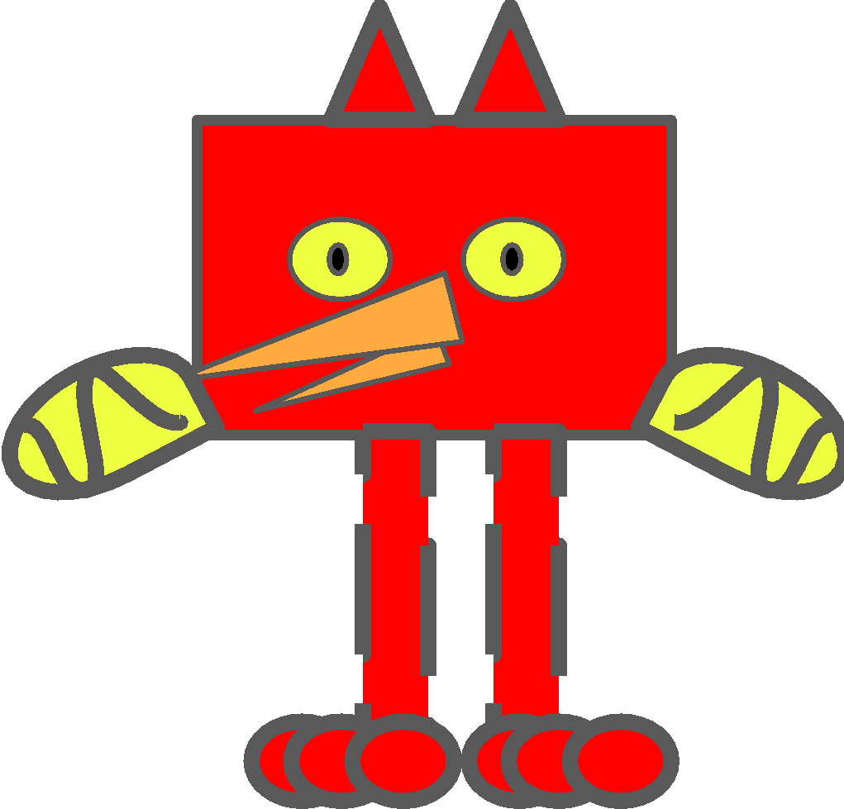
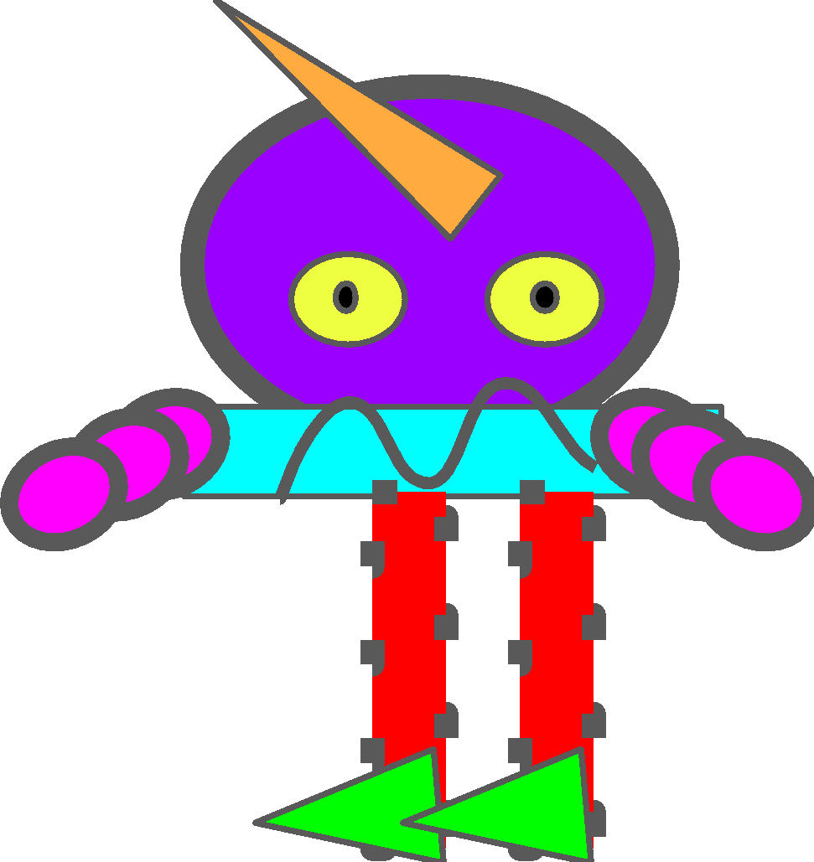
The creatures in the box below are Xans.
Xan
Xan

Slide 3

The creatures in the box below are Xans.
Xan
Xan
The purpose of Xans is to pollinate pink flowers.
Purpose
Pollinate Pink Flowers

Slide 4

Xans have relatively simple insides that consist of a biological mechanism that pollinates pink flowers.
Xan
Xan
Mechanism
Purpose
He
Lom
Dio
Pollinates Pink Flowers
He stimulates sensors in the Lom.
The Lom generates pollen.
The pollen is transported from the Lom to the Dio.
The end result is pink flower pollination.

Slide 5
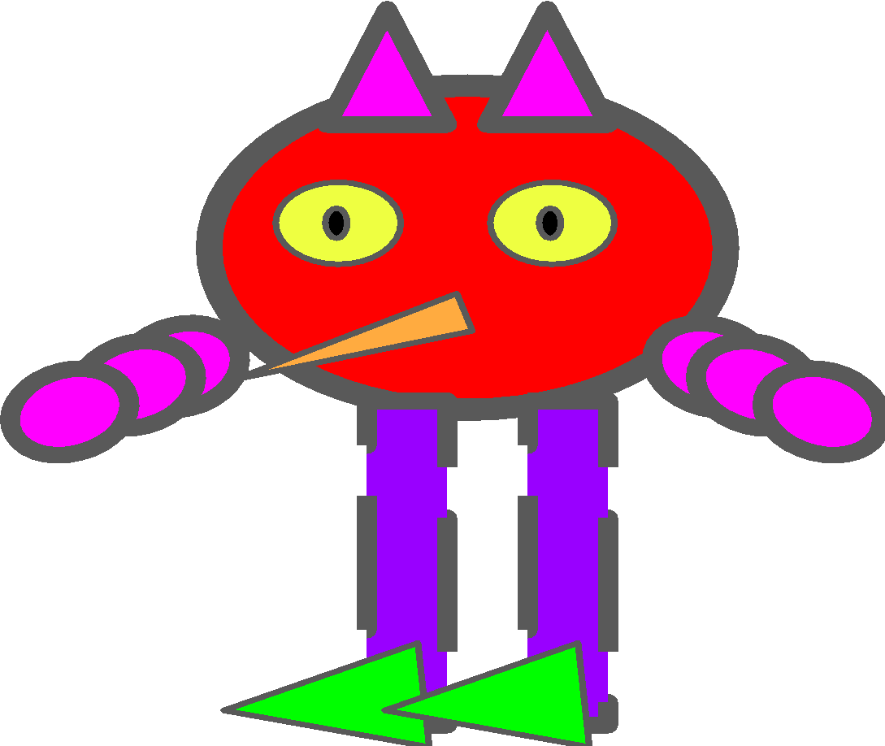
You come across this creature.
Its purpose is to pollinate pink flowers.
Purpose
Pollinates Pink Flowers

Slide 6
You come across this creature.
Its purpose is to pollinate pink flowers.
And it has relatively simple insides that consist of a biological mechanism that pollinates pink flowers.
Mechanism
Purpose
He
Sid
Dio
Pollinates Pink Flowers
He stimulates sensors in the Sid.
The Sid generates pollen.
The pollen is transported from the Sid to the Dio.
The end result is pink flower pollination.

Slide 7

Mechanism
Purpose
He
Lom
Dio
Pollinates Pink Flowers
Xan
Xan
Mechanism
Purpose
He
Sid
Dio
Pollinates Pink Flowers
The creatures on the top and bottom have different mechanisms (as reflected in the blue circles) and the same purpose (as reflected in the purple circles).

Slide 8
Mechanism
Purpose
He
Lom
Dio
Pollinates Pink Flowers
Xan
Xan
Mechanism
Purpose
He
Sid
Dio
Pollinates Pink Flowers
To what extent do you think that the creature on the bottom is a Xan?

Slide 9

You come across this creature.
Its purpose is to decompose blue apples.
Purpose
Decompose Blue Apples

Slide 10
You come across this creature.
Its purpose is to decompose blue apples.
And it has relatively simple insides that consist of a biological mechanism that decomposes blue apples.
Mechanism
Purpose
He
Lom
Dio
Decomposes Blue Apples
He stimulates sensors in the Lom.
The Lom generates enzymes.
The enzymes are transported from the Lom to the Dio.
The end result is decomposition of blue apples.

Slide 11
Mechanism
Purpose
He
Lom
Dio
Pollinates Pink Flowers
Xan
Xan
Mechanism
Purpose
He
Lom
Dio
Decomposes Blue Apples
The creatures on the top and bottom have the same mechanisms (as reflected in the blue circles) and different purposes (as reflected in the purple circles).

Slide 12
Mechanism
Purpose
He
Lom
Dio
Pollinates Pink Flowers
Xan
Xan
Mechanism
Purpose
He
Lom
Dio
Decomposes Blue Apples
To what extent do you think that the creature on the bottom is a Xan?

Slide 13
The creatures in the box below are Jigs.
Jig
Jig

Slide 14
The creatures in the box below are Jigs.
Jig
Jig
The purpose of Jigs is to make purple honey.
Purpose
Make Purple Honey

Slide 15
Jigs have relatively simple insides that consist of a biological mechanism that makes purple honey.
Jig
Jig
Mechanism
Purpose
Zid
Gem
Blo
Makes Purple Honey
Zid transports sugars to the Gem.
The Gem mixes the sugars.
The sugars are transported from the Gem to the Blo.
The end result is purple honey.

Slide 16
You come across this creature.
Its purpose is to make purple honey.
Purpose
Make Purple Honey

Slide 17
You come across this creature.
Its purpose is to make purple honey.
And it has relatively simple insides that consist of a biological mechanism that makes purple honey.
Mechanism
Purpose
Zid
Del
Blo
Makes Purple Honey
Zid transports sugars to the Del.
The Del mixes the sugars.
The sugars are transported from the Del to the Blo.
The end result is purple honey.

Slide 18
Mechanism
Purpose
Zid
Jig
Jig
Gem
Blo
Makes Purple Honey
Mechanism
Purpose
Zid
Del
Blo
Makes Purple Honey
The creatures on the top and bottom have different mechanisms (as reflected in the blue circles) and the same purpose (as reflected in the purple circles).

Slide 19
Mechanism
Purpose
Zid
Jig
Jig
Gem
Blo
Makes Purple Honey
Mechanism
Purpose
Zid
Del
Blo
Makes Purple Honey
To what extent do you think that the creature on the bottom is a Jig?

Slide 20
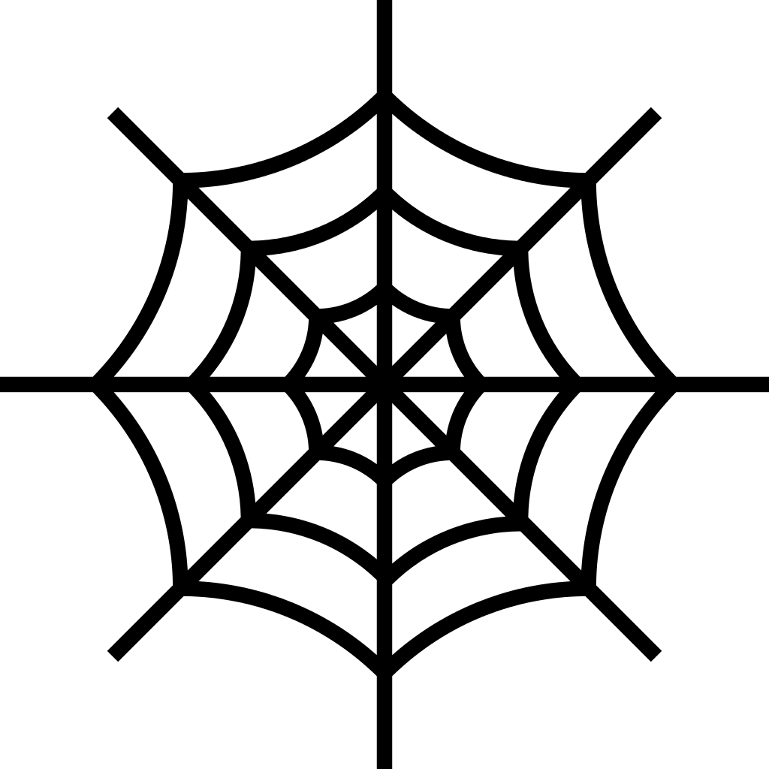
You come across this creature.
Its purpose is to spin black webs.
Purpose
Spin Black Webs

Slide 21
You come across this creature.
Its purpose is to spin black webs.
And it has relatively simple insides that consist of a biological mechanism that spins black webs.
Mechanism
Purpose
Zid
Gem
Blo
Spins Black Webs
Zid transports sugars to the Gem.
The Gem mixes the sugars.
The sugars are transported from the Gem to the Blo.
The end result is black webs.

Slide 22
Mechanism
Purpose
Zid
Jig
Jig
Gem
Blo
Makes Purple Honey
Mechanism
Purpose
Zid
Gem
Blo
Spins Black Webs
The creatures on the top and bottom have the same mechanisms (as reflected in the blue circles) and different purposes (as reflected in the purple circles).

Slide 23
Mechanism
Purpose
Zid
Jig
Jig
Gem
Blo
Makes Purple Honey
Mechanism
Purpose
Zid
Gem
Blo
Spins Black Webs
To what extent do you think that the creature on the bottom is a Jig?

Slide 24
The creatures in the box below are Zerps.
Zerp
Zerp

Slide 25
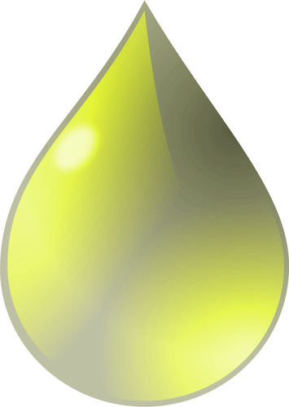
The creatures in the box below are Zerps.
Zerp
Zerp
The purpose of Zerps is to purify yellow water.
Purpose
Purify Yellow Water

Slide 26
Zerps have relatively simple insides that consist of a biological mechanism that purifies yellow water.
Zerp
Zerp
Mechanism
Purpose
Dm
Hye
Ma
Purifies Yellow Water
Dm distills the yellow water.
Hye purifies the yellow water.
The water is transported from the Hye to the Ma.
The end result is purified yellow water.

Slide 27
You come across this creature.
Its purpose is to purify yellow water.
Purpose
Purify Yellow Water

Slide 28
You come across this creature.
Its purpose is to purify yellow water.
And it has relatively simple insides that consist of a biological mechanism that purifies yellow water.
Mechanism
Purpose
Dm
Cie
Ma
Purifies Yellow Water
Dm distills the yellow water.
Cie purifies the yellow water.
The water is transported from the Cie to the Ma.
The end result is purified yellow water.

Slide 29
Mechanism
Purpose
Dm
Zerp
Zerp
Hye
Ma
Purifies Yellow Water
Mechanism
Purpose
Dm
Cie
Ma
Purifies Yellow Water
The creatures on the top and bottom have different mechanisms (as reflected in the blue circles) and the same purpose (as reflected in the purple circles).

Slide 30
Mechanism
Purpose
Dm
Zerp
Zerp
Hye
Ma
Purifies Yellow Water
Mechanism
Purpose
Dm
Cie
Ma
Purifies Yellow Water
To what extent do you think that the creature on the bottom is a Zerp?

Slide 31
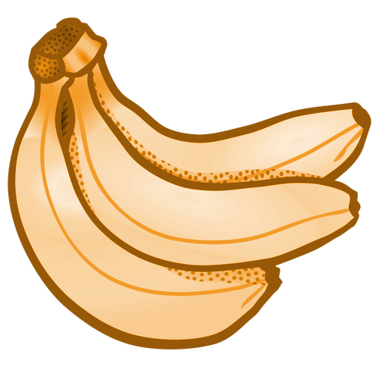
You come across this creature.
Its purpose is to putrefy orange bananas.
Purpose
Putrefy Orange Bananas

Slide 32
You come across this creature.
Its purpose is to putrefy orange bananas.
And it has relatively simple insides that consist of a biological mechanism that putrefies orange bananas.
Mechanism
Purpose
Dm
Hye
Ma
Putrefies Orange Bananas
Dm sends microbes to the Hye.
Hye mixes the microbes.
The microbes are transported from the Hye to the Ma.
The end result is putrefaction of orange bananas.

Slide 33
Mechanism
Purpose
Dm
Zerp
Zerp
Hye
Ma
Purifies Yellow Water
Mechanism
Purpose
Dm
Hye
Ma
Putrefies Orange Bananas
The creatures on the top and bottom have the same mechanisms (as reflected in the blue circles) and different purposes (as reflected in the purple circles).

Slide 34
Mechanism
Purpose
Dm
Zerp
Zerp
Hye
Ma
Purifies Yellow Water
Mechanism
Purpose
Dm
Hye
Ma
Putrefies Orange Bananas
To what extent do you think that the creature on the bottom is a Zerp?

