Slide 1


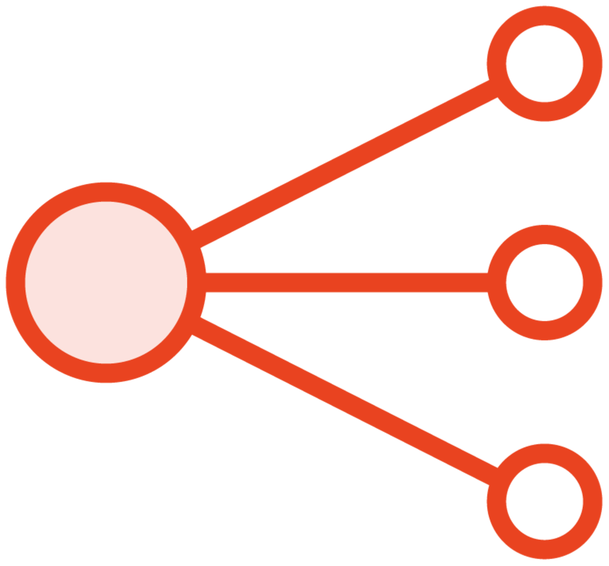


jumpbox-server
web-server-A
public subnet
10.0.20.0/24 private subnet
Network Load Balancer
us-west-2a
database-server
web-server-B
public subnet
10.0.21.0/24 private subnet
us-west-2b
VPC

