Slide 1
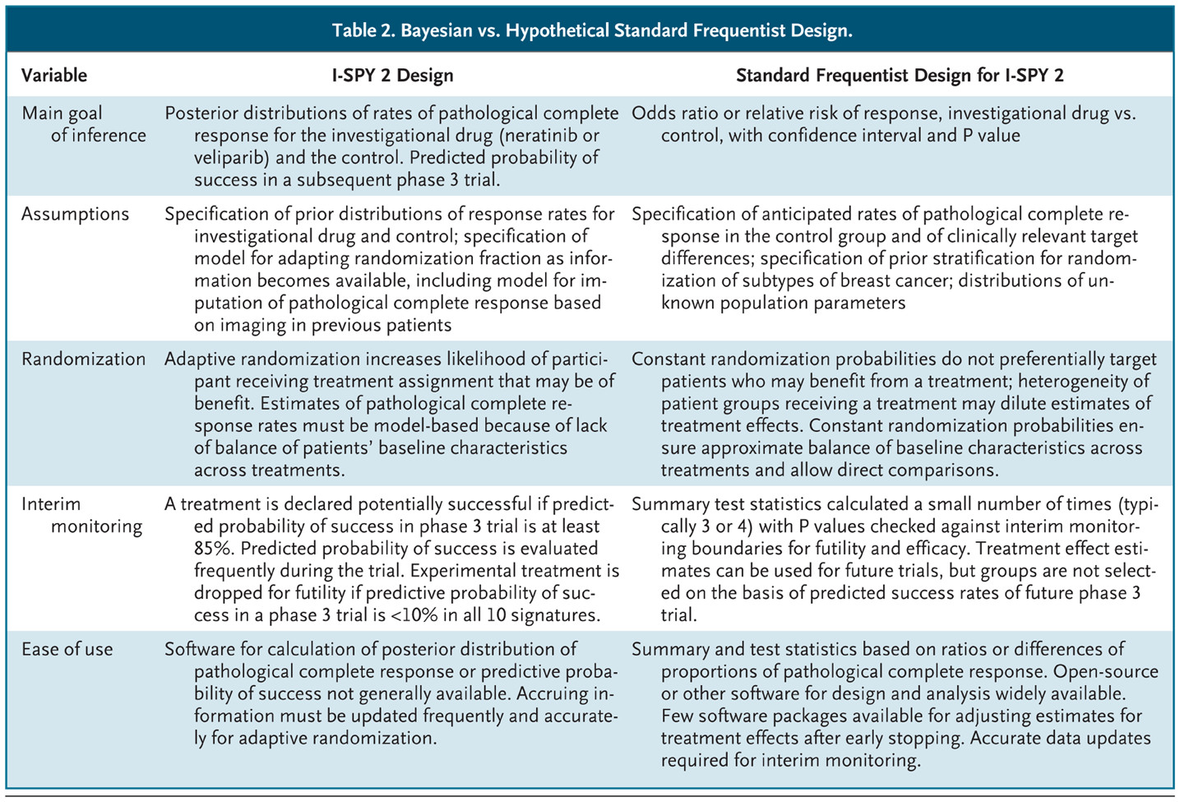

Harrington D, Parmigiani G. N Engl J Med 2016;375:7-9.
Bayesian vs. Hypothetical Standard Frequentist Design.

