Slide 1
ADIDAS
2020–2021 EXECUTIVE PERFORMANCE REPORT
Sales, product, and geographic performance across 50 states, 6 retailers, and 6 product lines.
Prepared by
Idika Dave-Manny | Data Analyst

Slide 2
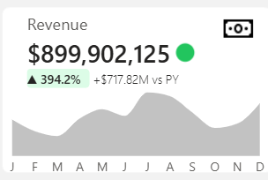
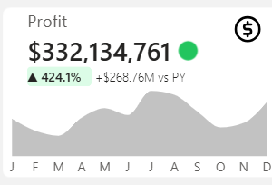
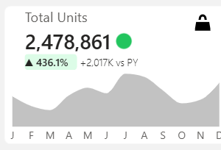
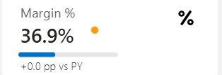

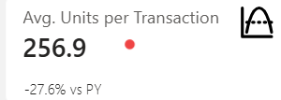


EXECUTIVE SUMMARY
Company-wide results, full period vs. prior year
READING THE PERIOD
Every headline metric grew triple digits year-over-year, but the drop in units-per-transaction (-27.6%) alongside a flat margin suggests growth is coming from more, smaller transactions rather than bigger baskets — a channel and pricing story explored on the following slides.
ADIDAS // 2020–2021 EXECUTIVE REPORT
2

Slide 3
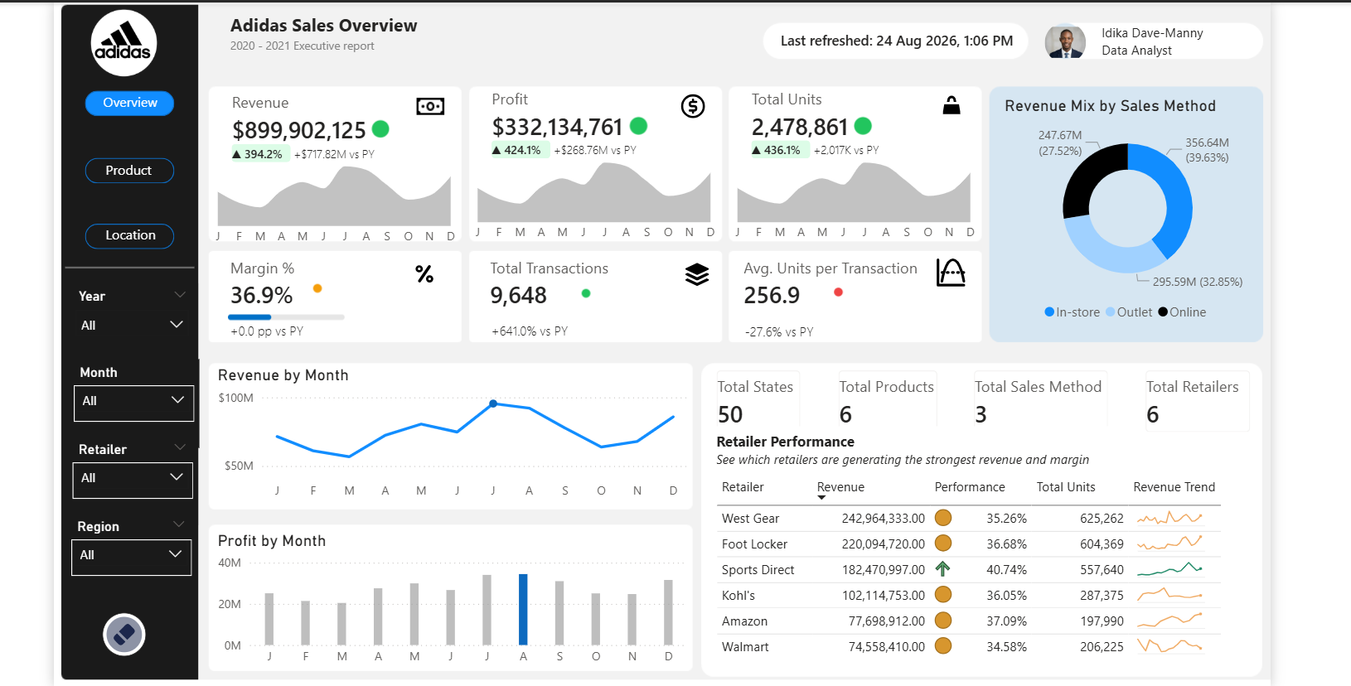
SALES TRENDS & CHANNEL MIX
Revenue peaks mid-year; online leads the channel mix
Revenue mix skews digital
Online accounts for 39.6% of revenue ($356.6M) — the single largest channel, ahead of Outlet (32.9%) and In-store (27.5%).
Mid-year demand spike
Monthly revenue climbs from ~$60M in January to a peak above $90M around July, then eases into Q4.
West Gear and Foot Locker lead retailers
West Gear ($243.0M) and Foot Locker ($220.1M) generate the most revenue; Sports Direct posts the strongest margin at 40.7%.
Source: Adidas Sales Overview dashboard
RETAILER PERFORMANCE
Retailer | Revenue | Margin | Units
West Gear | $242.96M | 35.3% | 625,262
Foot Locker | $220.09M | 36.7% | 604,369
Sports Direct | $182.47M | 40.7% | 557,640
Kohl's | $102.11M | 36.1% | 287,375
ADIDAS // 2020–2021 EXECUTIVE REPORT
3

Slide 4
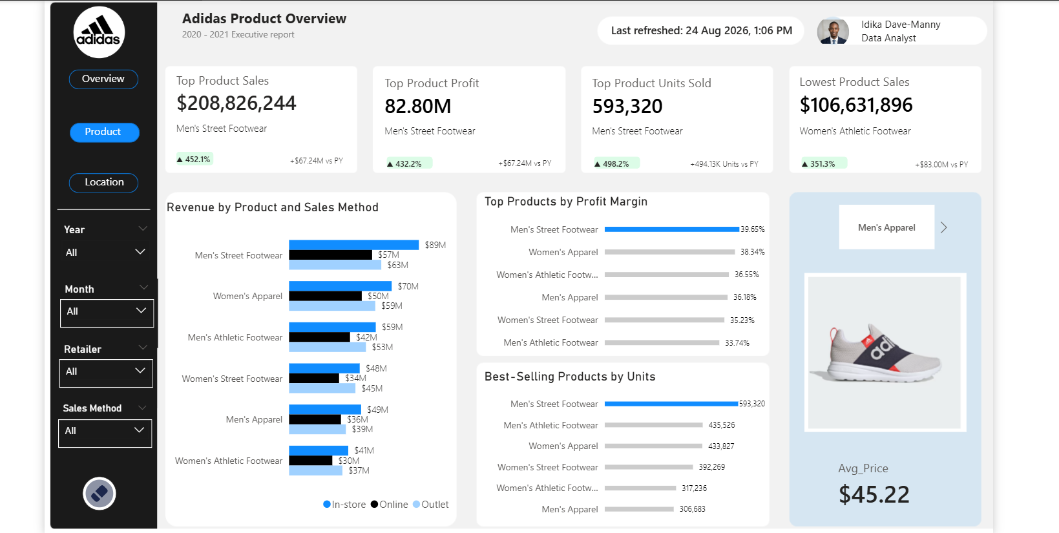
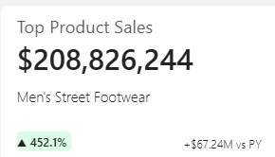
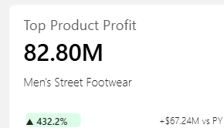
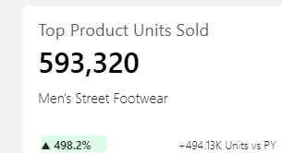
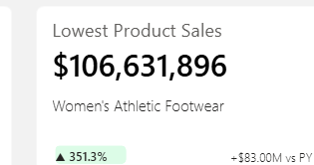
PRODUCT PERFORMANCE
Men's Street Footwear is the breakout performer
Men's Street Footwear dominates on every metric
$208.8M in sales, $82.8M profit, and 593K units sold — up 452%, 432%, and 498% vs. prior year respectively.
Highest margin, not just highest volume
The category also carries the best profit margin at 39.65%, ahead of Women's Apparel (38.3%) and Men's Apparel (36.2%).
Women's Athletic Footwear is the laggard
At $106.6M it's the lowest-selling line, though still up 351.3% YoY — the growth story lifted every category, just unevenly.
Source: Adidas Product Overview dashboard
ADIDAS // 2020–2021 EXECUTIVE REPORT
4

Slide 5
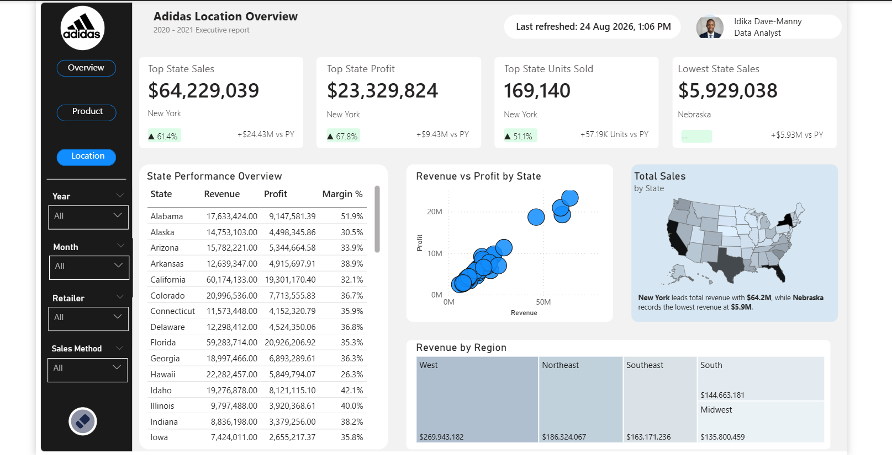
GEOGRAPHIC PERFORMANCE
Revenue and profit move together — New York leads by a wide margin
New York is the standout state
$64.2M revenue, $23.3M profit, and 169K units sold — all category leaders, each up 51–68% vs. prior year.
Revenue and profit scale together
The scatter plot shows a tight, near-linear relationship: high-revenue states (CA, FL, NY) also post the highest profit, with no major margin outliers.
The West leads regionally, but is closely followed
West ($269.9M) and Northeast ($186.3M) top the region split, while Nebraska is the lowest single state at just $5.93M.
Source: Adidas Location Overview dashboard
REVENUE BY REGION
ADIDAS // 2020–2021 EXECUTIVE REPORT
5

Slide 6
KEY TAKEAWAYS & RECOMMENDATIONS
01
02
Protect and extend the footwear win
Lean further into online
Men's Street Footwear leads on sales, profit, and margin — prioritize inventory and marketing spend to defend and grow this line into 2022.
Online is already the top channel at 39.6% of revenue; test online-exclusive drops and expanded fulfillment to compound that lead.
03
04
Investigate the basket-size decline
Target Midwest and South for expansion
Avg. units per transaction fell 27.6% even as transactions grew — worth confirming whether this reflects intentional smaller-format promotions or a pricing/assortment gap.
These regions trail West and Northeast by $130M+; replicate New York/California retailer mix and promotions where regional fit allows.
Idika Dave-Manny · Data Analyst · Adidas 2020–2021 Executive Report

