Slide 1

Pokémon Tableau Course
13 lessons · 2 days · one Pokémon battle dataset
One deck for instructors and students — use side by side with the lesson plans.

Slide 2
How this course is organized
• 📘 Instructor LP — your script, sheet by sheet (course/shared/lesson_plans/)
• 📊 Instructor workbook — pre-built demo (course/instructor/workbooks/)
• 🎓 Student blank workbook — students start here (course/student/workbooks_blank/)
• ✅ Student answer key — compare after attempting (course/student/workbooks/)
• 🗂️ Raw data — every CSV the lessons use (course/shared/raw_data/)
• 🖼️ This deck — open per lesson alongside the workbook

Slide 3
Per-lesson layout in this deck
• 1️⃣ Divider — lesson title, Pokémon image
• 2️⃣ Dataset — which CSVs, which joins
• 3️⃣ Instructor demo — every sheet, in order
• 4️⃣ Calculated fields — every formula
• 5️⃣ Dashboard — size and sheet order (when present)
• 6️⃣ Student assignment — blank path, what to build, answer-key path

Slide 4
Day 1 — Agenda
• Lesson 01 — Intro to Tableau (45 min)
◦ Interface tour, dimensions vs measures
• Lesson 02 — Basic Visuals (60 min)
◦ Bar, line, scatter, pie, treemap, heatmap
• Lesson 03 — Advanced Visuals (60 min)
◦ Time series and multi-encoding marks
• Lesson 04 — Joins & Data Modeling Intro (60 min)
◦ Join battles with venue
• Lesson 05 — Joins + Advanced Visualizations (60 min)
◦ Three-table join
• Lesson 06 — Day 1 Story Recap (45 min)
◦ Tableau Stories

Slide 5
Day 2 — Agenda
• Lesson 07 — Day 2 Warm-up (30 min)
◦ Trainer exploration
• Lesson 08 — Groups & Sets (60 min)
◦ Custom segmentation
• Lesson 09 — Calculations (60 min)
◦ Conditional logic, aggregates, math
• Lesson 10 — Mapping (45 min)
◦ Geographic visualization
• Lesson 11 — Dashboards (60 min)
◦ Combine views, add interactivity
• Lesson 12 — LOD Calculations (60 min)
◦ FIXED, INCLUDE, EXCLUDE
• Lesson 13 — Master Reference (office hours)
◦ Instructor apex workbook

Slide 6
LESSON 01
Intro to Tableau
Interface tour, dimensions vs measures
45 min · Day 1

Slide 7
Lesson 01 — Dataset
• pokemon.csv

Slide 8
Lesson 01 — Instructor Demo
Walk these sheets in the workbook, in order:
1. Welcome - Avg HP by Type
Mark: Bar · Rows: Avg([hp]) · Cols: [type1]

Slide 9
Lesson 01 — Student Assignment
• Time budget: 45 min
•
• 1. Open the blank workbook: student/workbooks_blank/01_intro_blank.twbx
• 2. Build 1 sheet matching the instructor demo
•
• Stuck? Compare against: student/workbooks/01_intro_student.twbx
• Save your file as: 01_intro_<your-initials>.twbx

Slide 10

LESSON 02
Basic Visuals
Bar, line, scatter, pie, treemap, heatmap
60 min · Day 1

Slide 11
Lesson 02 — Dataset
• pokemon.csv

Slide 12
Lesson 02 — Instructor Demo (1/3)
Walk these sheets in the workbook, in order:
1. 01 Bar - Count by Type
Mark: Bar · Rows: Count([name]) · Cols: [type1]
2. 02 Bar Sorted - Avg Attack by Type
Mark: Bar · Rows: Avg([attack]) · Cols: [type1]
3. 03 Side-by-Side - Att vs Def
Mark: Bar · Rows: Avg([attack]) · Cols: [type1], [Legendary Label]
4. 04 Stacked Bar - Type Mix by Gen
Mark: Bar · Rows: Count([name]) · Cols: [generation]
color: [type1]

Slide 13
Lesson 02 — Instructor Demo (2/3)
Walk these sheets in the workbook, in order:
5. 05 Line - Avg Total by Gen
Mark: Line · Rows: Avg([base_total]) · Cols: [generation]
6. 06 Area - Count by Gen
Mark: Area · Rows: Count([name]) · Cols: [generation]
7. 07 Scatter - Att vs Def
Mark: Circle · Rows: Avg([defense]) · Cols: Avg([attack])
color: [type1]
8. 08 Bubble - Sized by HP
Mark: Circle · Rows: Avg([defense]) · Cols: Avg([attack])
color: [type1] | size: Avg([hp])

Slide 14
Lesson 02 — Instructor Demo (3/3)
Walk these sheets in the workbook, in order:
9. 09 Heat Map - Type x Gen
Mark: Square · Rows: [type1] · Cols: [generation]
color: Count([name])
10. 10 Text Table - Stat Summary
Mark: Text · Rows: [type1] · Cols: Avg([base_total])
11. 11 Treemap - Pokemon by Type
Mark: Square · Rows: — · Cols: —
color: [type1] | size: Count([name])

Slide 15
Lesson 02 — Calculated Fields
Legendary Label (string)
IIF([is_legendary]=1, "Legendary", "Standard")

Slide 16
Lesson 02 — Student Assignment
• Time budget: 60 min
•
• 1. Open the blank workbook: student/workbooks_blank/02_basic_visuals_blank.twbx
• 2. Build 11 sheets matching the instructor demo
• 3. Create 1 calculated field (formulas on the calc slide)
•
• Stuck? Compare against: student/workbooks/02_basic_visuals_student.twbx
• Save your file as: 02_basic_visuals_<your-initials>.twbx

Slide 17

LESSON 03
Advanced Visuals
Time series and multi-encoding marks
60 min · Day 1

Slide 18
Lesson 03 — Dataset
• battles.csv

Slide 19
Lesson 03 — Instructor Demo (1/3)
Walk these sheets in the workbook, in order:
1. 01 Time Series - Battles by Month
Mark: Line · Rows: Count([battle_id]) · Cols: Month([battle_date])
2. 02 Discrete Time - Battles by Quarter
Mark: Bar · Rows: Count([battle_id]) · Cols: Quarter([battle_date])
3. 03 Heat Map - Format x Weather
Mark: Square · Rows: [battle_format] · Cols: [weather_condition]
color: Count([battle_id])
4. 04 Box Plot Data - Margin by Format
Mark: Circle · Rows: [winning_margin] · Cols: [battle_format]
color: [winning_side]

Slide 20
Lesson 03 — Instructor Demo (2/3)
Walk these sheets in the workbook, in order:
5. 05 Stacked Bar - Wins by Side and Format
Mark: Bar · Rows: Count([battle_id]) · Cols: [battle_format]
color: [winning_side]
6. 06 Scatter - Turns vs Margin
Mark: Circle · Rows: Avg([winning_margin]) · Cols: [battle_turns]
color: [Margin Tier] | size: Avg([attendance])
7. 07 Trend - Avg Attendance Over Time
Mark: Line · Rows: Avg([attendance]) · Cols: Month([battle_date])
color: [battle_format]
8. 08 Bullet-style - Title vs Regular
Mark: Bar · Rows: Avg([attendance]) · Cols: [Title Match Label]

Slide 21
Lesson 03 — Instructor Demo (3/3)
Walk these sheets in the workbook, in order:
9. 09 Slope - Margin by Weather
Mark: Line · Rows: Avg([winning_margin]) · Cols: [weather_condition]
10. 10 Highlight Table - Format x Margin Tier
Mark: Square · Rows: [Margin Tier] · Cols: [battle_format]
color: Count([battle_id])

Slide 22
Lesson 03 — Calculated Fields
Title Match Label (string)
IIF([title_match_flag]=1, "Title Match", "Regular")
Margin Tier (string)
IF [winning_margin] >= 100 THEN "Blowout" · ELSEIF [winning_margin] >= 50 THEN "Decisive" · ELSEIF [winning_margin] >= 20 THEN "Solid" · ELSE "Close" · END

Slide 23
Lesson 03 — Student Assignment
• Time budget: 60 min
•
• 1. Open the blank workbook: student/workbooks_blank/03_advanced_visuals_blank.twbx
• 2. Build 10 sheets matching the instructor demo
• 3. Create 2 calculated fields (formulas on the calc slide)
•
• Stuck? Compare against: student/workbooks/03_advanced_visuals_student.twbx
• Save your file as: 03_advanced_visuals_<your-initials>.twbx

Slide 24
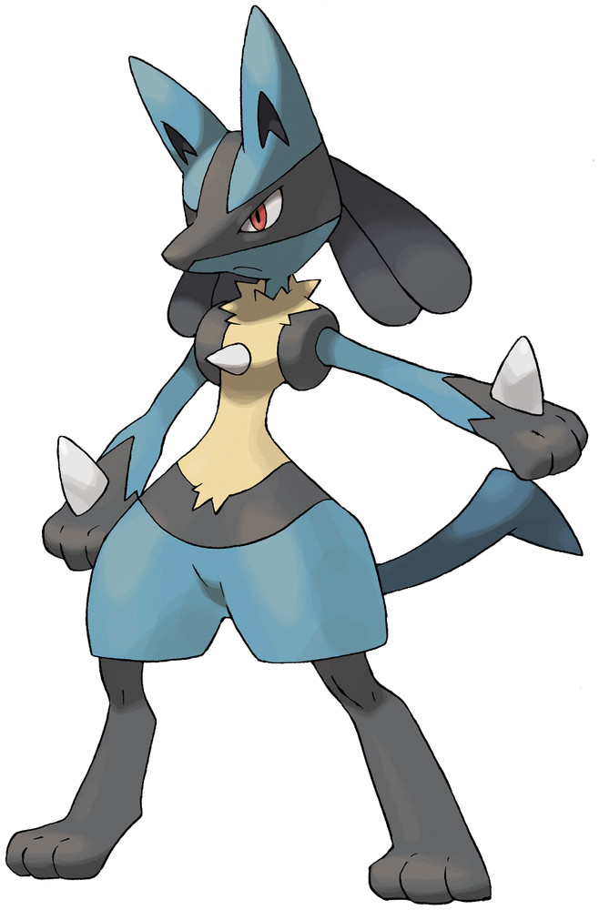
LESSON 04
Joins & Data Modeling Intro
Join battles with venue
60 min · Day 1

Slide 25
Lesson 04 — Dataset
• 2 CSVs joined inside Tableau:
◦ battles.csv (alias: battles)
◦ venue.csv (alias: venue)
•
• Joins configured:
◦ battles.venue_id = venue.venue_id (left)

Slide 26
Lesson 04 — Instructor Demo (1/2)
Walk these sheets in the workbook, in order:
1. 01 Battles by Region (joined field)
Mark: Bar · Rows: Count([battle_id]) · Cols: [venue_region]
2. 02 Avg Attendance by Venue Type
Mark: Bar · Rows: Avg([attendance]) · Cols: [venue_venue_type]
3. 03 Fill Rate by Prestige Tier
Mark: Bar · Rows: Avg([Fill Rate]) · Cols: [venue_prestige_tier]
4. 04 Indoor vs Outdoor Margin
Mark: Bar · Rows: Avg([winning_margin]) · Cols: [venue_indoor_outdoor]

Slide 27
Lesson 04 — Instructor Demo (2/2)
Walk these sheets in the workbook, in order:
5. 05 Battles by Venue Name (top 10)
Mark: Bar · Rows: Count([battle_id]) · Cols: [venue_venue_name]
6. 06 Format Mix by Region
Mark: Bar · Rows: Count([battle_id]) · Cols: [venue_region]
color: [battle_format]

Slide 28
Lesson 04 — Calculated Fields
Fill Rate (real)
[attendance] / [venue_capacity]

Slide 29
Lesson 04 — Student Assignment
• Time budget: 60 min
•
• 1. Open the blank workbook: student/workbooks_blank/04_joins_intro_blank.twbx
• 2. Build 6 sheets matching the instructor demo
• 3. Create 1 calculated field (formulas on the calc slide)
•
• Stuck? Compare against: student/workbooks/04_joins_intro_student.twbx
• Save your file as: 04_joins_intro_<your-initials>.twbx

Slide 30
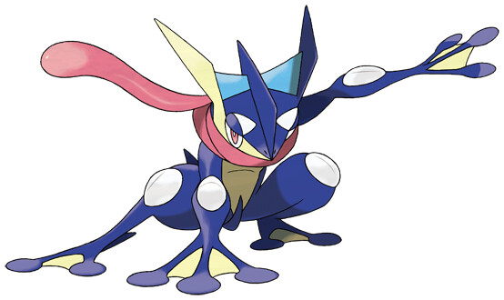
LESSON 05
Joins + Advanced Visualizations
Three-table join
60 min · Day 1

Slide 31
Lesson 05 — Dataset
• 3 CSVs joined inside Tableau:
◦ battle_participant.csv (alias: battle_participant)
◦ pokemon.csv (alias: pokemon)
◦ trainer.csv (alias: trainer)
•
• Joins configured:
◦ battle_participant.pokemonid = pokemon.pokedex_number (left)
◦ battle_participant.trainer_id = trainer.trainer_id (left)

Slide 32
Lesson 05 — Instructor Demo (1/2)
Walk these sheets in the workbook, in order:
1. 01 Avg Power by Pokemon Type
Mark: Bar · Rows: Avg([adjusted_power]) · Cols: [pokemon_type1]
color: [Legendary Label]
2. 02 Win Rate by Trainer Class
Mark: Bar · Rows: Avg([is_winner]) · Cols: [trainer_trainer_class]
3. 03 Experience Tier Performance
Mark: Bar · Rows: Avg([is_winner]) · Cols: [trainer_experience_tier]
color: [Gym Leader Label]
4. 04 Region x Type Heat Map
Mark: Square · Rows: [pokemon_type1] · Cols: [trainer_home_region]
color: Count([battle_participant_id])

Slide 33
Lesson 05 — Instructor Demo (2/2)
Walk these sheets in the workbook, in order:
5. 05 Legendary MVP Rate
Mark: Bar · Rows: Avg([is_mvp_flag]) · Cols: [Legendary Label]
6. 06 Gym Leader Win Rate by Type
Mark: Bar · Rows: Avg([is_winner]) · Cols: [pokemon_type1]
color: [Gym Leader Label]

Slide 34
Lesson 05 — Calculated Fields
Legendary Label (string)
IIF([pokemon_is_legendary]=1, "Legendary", "Standard")
Gym Leader Label (string)
IIF([trainer_is_gym_leader]=1, "Gym Leader", "Regular")

Slide 35
Lesson 05 — Student Assignment
• Time budget: 60 min
•
• 1. Open the blank workbook: student/workbooks_blank/05_joins_advanced_blank.twbx
• 2. Build 6 sheets matching the instructor demo
• 3. Create 2 calculated fields (formulas on the calc slide)
•
• Stuck? Compare against: student/workbooks/05_joins_advanced_student.twbx
• Save your file as: 05_joins_advanced_<your-initials>.twbx

Slide 36
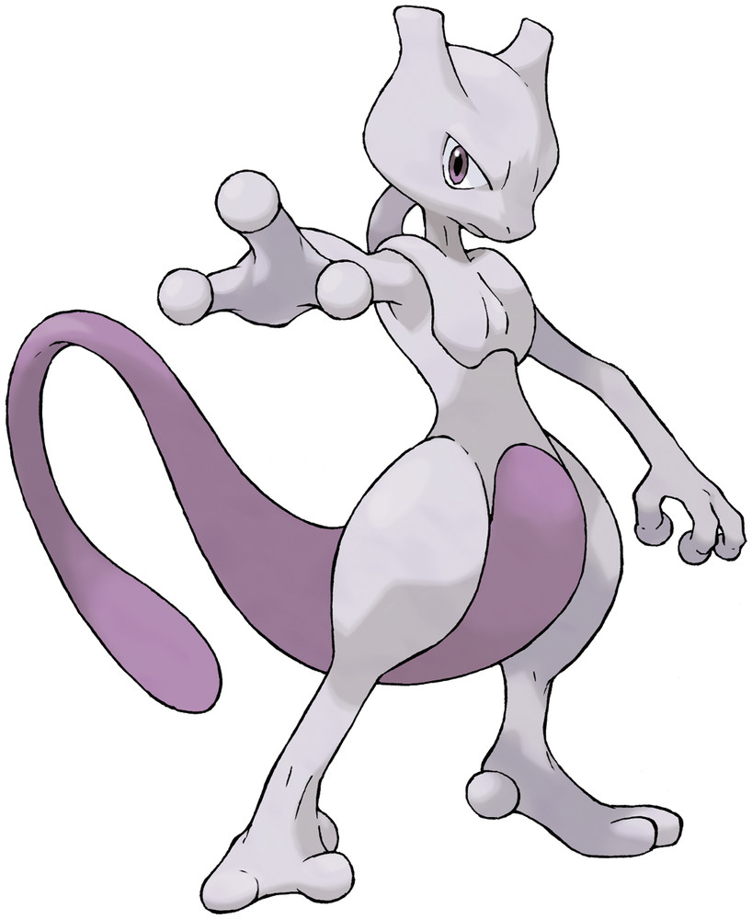
LESSON 06
Day 1 Story Recap
Tableau Stories
45 min · Day 1

Slide 37
Lesson 06 — Dataset
• battles.csv

Slide 38
Lesson 06 — Instructor Demo (1/2)
Walk these sheets in the workbook, in order:
1. Story Pt 1 - Activity Trend
Mark: Line · Rows: Count([battle_id]) · Cols: Month([battle_date])
2. Story Pt 2 - Format Popularity
Mark: Bar · Rows: Count([battle_id]) · Cols: [battle_format]
3. Story Pt 3 - Home Field Advantage
Mark: Bar · Rows: Count([battle_id]) · Cols: [winning_side]
4. Story Pt 4 - Attendance vs Margin
Mark: Circle · Rows: Avg([attendance]) · Cols: Avg([winning_margin])
color: [battle_format]

Slide 39
Lesson 06 — Instructor Demo (2/2)
Walk these sheets in the workbook, in order:
5. Story Pt 5 - Weather Effect
Mark: Bar · Rows: Avg([winning_margin]) · Cols: [weather_condition]

Slide 40
Lesson 06 — Student Assignment
• Time budget: 45 min
•
• 1. Open the blank workbook: student/workbooks_blank/06_story_blank.twbx
• 2. Build 5 sheets matching the instructor demo
•
• Stuck? Compare against: student/workbooks/06_story_student.twbx
• Save your file as: 06_story_<your-initials>.twbx

Slide 41

LESSON 07
Day 2 Warm-up
Trainer exploration
30 min · Day 2

Slide 42
Lesson 07 — Dataset
• trainer.csv

Slide 43
Lesson 07 — Instructor Demo (1/2)
Walk these sheets in the workbook, in order:
1. 01 Trainers by Region
Mark: Bar · Rows: Count([trainer_id]) · Cols: [home_region]
2. 02 Strategy vs Aggression
Mark: Circle · Rows: Avg([aggression_rating]) · Cols: Avg([strategy_rating])
color: [experience_tier]
3. 03 Preferred Types
Mark: Bar · Rows: Count([trainer_id]) · Cols: [preferred_type]
4. 04 Gym Leader Stats
Mark: Bar · Rows: Avg([Avg Rating]) · Cols: [Gym Leader Label]

Slide 44
Lesson 07 — Instructor Demo (2/2)
Walk these sheets in the workbook, in order:
5. 05 Years vs Avg Rating
Mark: Circle · Rows: Avg([Avg Rating]) · Cols: [years_experience]
color: [experience_tier]

Slide 45
Lesson 07 — Calculated Fields
Gym Leader Label (string)
IIF([is_gym_leader]=1, "Gym Leader", "Regular")
Avg Rating (real)
([strategy_rating]+[adaptability_rating]+[aggression_rating])/3

Slide 46
Lesson 07 — Student Assignment
• Time budget: 30 min
•
• 1. Open the blank workbook: student/workbooks_blank/07_warmup_blank.twbx
• 2. Build 5 sheets matching the instructor demo
• 3. Create 2 calculated fields (formulas on the calc slide)
•
• Stuck? Compare against: student/workbooks/07_warmup_student.twbx
• Save your file as: 07_warmup_<your-initials>.twbx

Slide 47

LESSON 08
Groups & Sets
Custom segmentation
60 min · Day 2

Slide 48
Lesson 08 — Dataset
• pokemon.csv

Slide 49
Lesson 08 — Instructor Demo (1/2)
Walk these sheets in the workbook, in order:
1. 01 Type Family Counts
Mark: Bar · Rows: Count([name]) · Cols: [Type Family (Group)]
2. 02 Avg Total by Type Family
Mark: Bar · Rows: Avg([base_total]) · Cols: [Type Family (Group)]
color: [Legendary Set]
3. 03 Speed Bucket Distribution
Mark: Bar · Rows: Count([name]) · Cols: [Speed Bucket (Group)]
color: [Power Tier]
4. 04 S-Tier Pokemon Set
Mark: Bar · Rows: Count([name]) · Cols: [Top Tier Set (S-Tier)]
color: [type1]

Slide 50
Lesson 08 — Instructor Demo (2/2)
Walk these sheets in the workbook, in order:
5. 05 Heavy Hitters by Type
Mark: Bar · Rows: Count([name]) · Cols: [type1]
color: [Heavy Hitter Set]
6. 06 Generation Group x Power Tier
Mark: Square · Rows: [Generation Group] · Cols: [Power Tier]
color: Count([name])
7. 07 Legendaries by Type Family
Mark: Bar · Rows: Count([name]) · Cols: [Type Family (Group)]
color: [Legendary Set]

Slide 51
Lesson 08 — Calculated Fields (1/3)
Type Family (Group) (string)
IF [type1]="fire" OR [type1]="water" OR [type1]="grass" THEN "Starter Element" · ELSEIF [type1]="dragon" OR [type1]="psychic" OR [type1]="ghost" OR [type1]="dark" THEN "Mystical" · ELSEIF [type1]="fighting" OR [type1]="rock" OR [type1]="steel" OR [type1]="ground" THEN "Physical" · ELSEIF [type1]="electric" OR [type1]="ice" OR [type1]="fairy" OR [type1]="flying" THEN "Air & Energy" · ELSE "Common" · END
Legendary Set (string)
IIF([is_legendary]=1, "In - Legendary", "Out - Standard")
Top Tier Set (S-Tier) (string)
IIF([base_total] >= 600, "In - S-Tier", "Out")

Slide 52
Lesson 08 — Calculated Fields (2/3)
Speed Bucket (Group) (string)
IF [speed] >= 110 THEN "Lightning" · ELSEIF [speed] >= 80 THEN "Fast" · ELSEIF [speed] >= 50 THEN "Average" · ELSE "Slow" · END
Power Tier (string)
IF [base_total] >= 600 THEN "S-Tier" · ELSEIF [base_total] >= 500 THEN "A-Tier" · ELSEIF [base_total] >= 400 THEN "B-Tier" · ELSE "C-Tier" · END
Heavy Hitter Set (string)
IIF([attack] >= 100 AND [defense] >= 100, "In - Heavy Hitter", "Out")

Slide 53
Lesson 08 — Calculated Fields (3/3)
Generation Group (string)
IF [generation] <= 2 THEN "Classic (Gen 1-2)" · ELSEIF [generation] <= 4 THEN "Modern (Gen 3-4)" · ELSE "Recent (Gen 5+)" · END

Slide 54
Lesson 08 — Student Assignment
• Time budget: 60 min
•
• 1. Open the blank workbook: student/workbooks_blank/08_groups_sets_blank.twbx
• 2. Build 7 sheets matching the instructor demo
• 3. Create 7 calculated fields (formulas on the calc slide)
•
• Stuck? Compare against: student/workbooks/08_groups_sets_student.twbx
• Save your file as: 08_groups_sets_<your-initials>.twbx

Slide 55

LESSON 09
Calculations
Conditional logic, aggregates, math
60 min · Day 2

Slide 56
Lesson 09 — Dataset
• battle_participant.csv

Slide 57
Lesson 09 — Instructor Demo (1/3)
Walk these sheets in the workbook, in order:
1. 01 Power Lift by Side (C01)
Mark: Bar · Rows: Avg([C01 Arithmetic - Power Lift]) · Cols: [team_side]
2. 02 Power Class Mix (C05)
Mark: Bar · Rows: Count([battle_participant_id]) · Cols: [C05 Logical - IF/ELSEIF Power Class]
3. 03 Slot Roles (C06)
Mark: Bar · Rows: Count([battle_participant_id]) · Cols: [C06 Logical - CASE Slot Role]
color: [team_side]
4. 04 MVP Wins (C07)
Mark: Bar · Rows: Count([battle_participant_id]) · Cols: [C07 Logical - Compound Boolean]

Slide 58
Lesson 09 — Instructor Demo (2/3)
Walk these sheets in the workbook, in order:
5. 05 Trainer Prefix Distribution (C08)
Mark: Bar · Rows: Count([battle_participant_id]) · Cols: [C08 String - Trainer Prefix]
6. 06 Win Rate Manual (C12)
Mark: Bar · Rows: [C12 Aggregate - Win Rate Manual] · Cols: [team_side]
7. 07 Unique Counts (C13/C14)
Mark: Bar · Rows: [C13 Aggregate - COUNTD Trainers] · Cols: [team_side]
8. 08 MVP Power Total (C15)
Mark: Bar · Rows: [C15 Conditional Agg - MVP Power Sum] · Cols: [team_side]

Slide 59
Lesson 09 — Instructor Demo (3/3)
Walk these sheets in the workbook, in order:
9. 09 Lift Direction (C18)
Mark: Bar · Rows: Count([battle_participant_id]) · Cols: [C18 Sign Function - Lift Direction]
10. 10 Power Class x Side
Mark: Square · Rows: [C05 Logical - IF/ELSEIF Power Class] · Cols: [team_side]
color: Count([battle_participant_id])

Slide 60
Lesson 09 — Calculated Fields (1/7)
C01 Arithmetic - Power Lift (real)
[adjusted_power] - [base_power]
C02 Arithmetic - Power Ratio (real)
[adjusted_power] / [base_power]
C03 Arithmetic - Power per Slot (real)
[adjusted_power] / [slot_number]

Slide 61
Lesson 09 — Calculated Fields (2/7)
C04 Logical - IIF Win Label (string)
IIF([is_winner]=1, "Won", "Lost")
C05 Logical - IF/ELSEIF Power Class (string)
IF [adjusted_power] >= 600 THEN "Dominant" · ELSEIF [adjusted_power] >= 500 THEN "Strong" · ELSEIF [adjusted_power] >= 400 THEN "Balanced" · ELSE "Underdog" · END
C06 Logical - CASE Slot Role (string)
CASE [slot_number] · WHEN 1 THEN "Lead" · WHEN 2 THEN "Middle" · WHEN 3 THEN "Anchor" · ELSE "Reserve" · END

Slide 62
Lesson 09 — Calculated Fields (3/7)
C07 Logical - Compound Boolean (string)
IIF([is_winner]=1 AND [is_mvp_flag]=1, "MVP Win", "Other")
C08 String - Trainer Prefix (string)
LEFT([trainer_id], 4)
C09 String - ID Length (integer)
LEN([battle_id])

Slide 63
Lesson 09 — Calculated Fields (4/7)
C10 String - ID Upper (string)
UPPER([team_side])
C11 Type Convert - Slot as String (string)
STR([slot_number])
C12 Aggregate - Win Rate Manual (real)
SUM([is_winner]) / COUNT([battle_id])

Slide 64
Lesson 09 — Calculated Fields (5/7)
C13 Aggregate - COUNTD Trainers (integer)
COUNTD([trainer_id])
C14 Aggregate - COUNTD Pokemon (integer)
COUNTD([pokemonid])
C15 Conditional Agg - MVP Power Sum (real)
SUM(IIF([is_mvp_flag]=1, [adjusted_power], 0))

Slide 65
Lesson 09 — Calculated Fields (6/7)
C16 Conditional Agg - Wins Only (integer)
SUM(IIF([is_winner]=1, 1, 0))
C17 Null-Safe ZN Power Lift (real)
ZN([adjusted_power]) - ZN([base_power])
C18 Sign Function - Lift Direction (integer)
SIGN([adjusted_power] - [base_power])

Slide 66
Lesson 09 — Calculated Fields (7/7)
C19 ABS Function - Lift Magnitude (real)
ABS([adjusted_power] - [base_power])
C20 ROUND - Power 2-decimal (real)
ROUND([adjusted_power], 2)

Slide 67
Lesson 09 — Student Assignment
• Time budget: 60 min
•
• 1. Open the blank workbook: student/workbooks_blank/09_calculations_blank.twbx
• 2. Build 10 sheets matching the instructor demo
• 3. Create 20 calculated fields (formulas on the calc slide)
•
• Stuck? Compare against: student/workbooks/09_calculations_student.twbx
• Save your file as: 09_calculations_<your-initials>.twbx

Slide 68

LESSON 10
Mapping
Geographic visualization
45 min · Day 2

Slide 69
Lesson 10 — Dataset
• venue.csv

Slide 70
Lesson 10 — Instructor Demo (1/2)
Walk these sheets in the workbook, in order:
1. 01 Symbol Map - Venues
Mark: Automatic · Rows: Avg([lat]) · Cols: Avg([lon])
2. 02 Symbol Map - Colored by Type
Mark: Automatic · Rows: Avg([lat]) · Cols: Avg([lon])
color: [venue_type]
3. 03 Symbol Map - Sized by Capacity
Mark: Automatic · Rows: Avg([lat]) · Cols: Avg([lon])
color: [Capacity Bucket] | size: Avg([capacity])
4. 04 Map - Region Highlight
Mark: Automatic · Rows: Avg([lat]) · Cols: Avg([lon])
color: [region]

Slide 71
Lesson 10 — Instructor Demo (2/2)
Walk these sheets in the workbook, in order:
5. 05 Indoor vs Outdoor
Mark: Automatic · Rows: Avg([lat]) · Cols: Avg([lon])
color: [indoor_outdoor]
6. 06 Bar Companion - Venues by Region
Mark: Bar · Rows: Count([venue_id]) · Cols: [region]
7. 07 Bar Companion - Capacity by Type
Mark: Bar · Rows: Avg([capacity]) · Cols: [venue_type]
8. 08 Terrain Edge by Type
Mark: Bar · Rows: Avg([terrain_edge_pct]) · Cols: [venue_type]

Slide 72
Lesson 10 — Calculated Fields
Capacity Bucket (string)
IF [capacity] >= 1500 THEN "Mega (1500+)" · ELSEIF [capacity] >= 1000 THEN "Large (1000-1499)" · ELSEIF [capacity] >= 500 THEN "Mid (500-999)" · ELSE "Small (<500)" · END

Slide 73
Lesson 10 — Student Assignment
• Time budget: 45 min
•
• 1. Open the blank workbook: student/workbooks_blank/10_mapping_blank.twbx
• 2. Build 8 sheets matching the instructor demo
• 3. Create 1 calculated field (formulas on the calc slide)
•
• Stuck? Compare against: student/workbooks/10_mapping_student.twbx
• Save your file as: 10_mapping_<your-initials>.twbx

Slide 74
LESSON 11
Dashboards
Combine views, add interactivity
60 min · Day 2

Slide 75
Lesson 11 — Dataset
• 5 CSVs joined inside Tableau:
◦ battle_participant.csv (alias: battle_participant)
◦ pokemon.csv (alias: pokemon)
◦ trainer.csv (alias: trainer)
◦ battles.csv (alias: battles)
◦ venue.csv (alias: venue)
•
• Joins configured:
◦ battle_participant.pokemonid = pokemon.pokedex_number (left)
◦ battle_participant.trainer_id = trainer.trainer_id (left)
◦ battle_participant.battle_id = battles.battle_id (left)
◦ battles.venue_id = venue.venue_id (left)

Slide 76
Lesson 11 — Instructor Demo (1/2)
Walk these sheets in the workbook, in order:
1. D1 Power by Type
Mark: Bar · Rows: Avg([adjusted_power]) · Cols: [pokemon_type1]
color: [Legendary Label]
2. D2 Win Rate by Experience
Mark: Bar · Rows: Avg([is_winner]) · Cols: [trainer_experience_tier]
3. D3 Wins Over Time
Mark: Line · Rows: Avg([is_winner]) · Cols: Month([battles_battle_date])
4. D4 Region Participation
Mark: Bar · Rows: Count([battle_participant_id]) · Cols: [venue_region]

Slide 77
Lesson 11 — Instructor Demo (2/2)
Walk these sheets in the workbook, in order:
5. D5 Format Mix
Mark: Bar · Rows: Countd([battle_id]) · Cols: [battles_battle_format]
6. D6 Type x Venue Heat Map
Mark: Square · Rows: [pokemon_type1] · Cols: [venue_venue_type]
color: Avg([is_winner])

Slide 78
Lesson 11 — Calculated Fields
Legendary Label (string)
IIF([pokemon_is_legendary]=1, "Legendary", "Standard")

Slide 79
Lesson 11 — Dashboard
Name: Battle Insights Dashboard · Size: 1400 × 1400
Sheets (top → bottom):
• 1. D1 Power by Type
• 2. D2 Win Rate by Experience
• 3. D3 Wins Over Time
• 4. D4 Region Participation
• 5. D5 Format Mix
• 6. D6 Type x Venue Heat Map

Slide 80
Lesson 11 — Student Assignment
• Time budget: 60 min
•
• 1. Open the blank workbook: student/workbooks_blank/11_dashboards_blank.twbx
• 2. Build 6 sheets matching the instructor demo
• 3. Create 1 calculated field (formulas on the calc slide)
•
• Stuck? Compare against: student/workbooks/11_dashboards_student.twbx
• Save your file as: 11_dashboards_<your-initials>.twbx

Slide 81
LESSON 12
LOD Calculations
FIXED, INCLUDE, EXCLUDE
60 min · Day 2

Slide 82
Lesson 12 — Dataset
• 5 CSVs joined inside Tableau:
◦ battle_participant.csv (alias: battle_participant)
◦ pokemon.csv (alias: pokemon)
◦ trainer.csv (alias: trainer)
◦ battles.csv (alias: battles)
◦ venue.csv (alias: venue)
•
• Joins configured:
◦ battle_participant.pokemonid = pokemon.pokedex_number (left)
◦ battle_participant.trainer_id = trainer.trainer_id (left)
◦ battle_participant.battle_id = battles.battle_id (left)
◦ battles.venue_id = venue.venue_id (left)

Slide 83
Lesson 12 — Instructor Demo (1/2)
Walk these sheets in the workbook, in order:
1. 01 Trainer Win Rate Distribution (L03)
Mark: Bar · Rows: Countd([trainer_id]) · Cols: [L03 FIXED Trainer - Win Rate]
2. 02 Trainer vs Overall (L11)
Mark: Bar · Rows: Avg([L11 Comparison - Trainer vs Overall]) · Cols: [trainer_experience_tier]
3. 03 Power vs Trainer Avg (L10)
Mark: Bar · Rows: Avg([L10 Comparison - Power vs Trainer Avg]) · Cols: [slot_number]
color: [team_side]
4. 04 Pokemon Win Rate (L04)
Mark: Bar · Rows: Avg([L04 FIXED Pokemon - Win Rate]) · Cols: [pokemon_type1]

Slide 84
Lesson 12 — Instructor Demo (2/2)
Walk these sheets in the workbook, in order:
5. 05 Type x Venue Win Rate (L07)
Mark: Square · Rows: [pokemon_type1] · Cols: [venue_venue_type]
color: Avg([L07 FIXED VType - Type Win Rate])
6. 06 % of Total Power (L13)
Mark: Bar · Rows: [L13 % of Total via FIXED] · Cols: [team_side]
7. 07 Battles per Venue (L05)
Mark: Bar · Rows: Avg([L05 FIXED Venue - Battles]) · Cols: [battles_venue_id]
8. 08 Battles per Trainer (L14)
Mark: Bar · Rows: Avg([L14 Trainer Battle Count (FIXED)]) · Cols: [trainer_experience_tier]

Slide 85
Lesson 12 — Calculated Fields (1/5)
L01 FIXED - Overall Avg Power (real)
{ FIXED : AVG([adjusted_power]) }
L02 FIXED Trainer - Avg Power (real)
{ FIXED [trainer_id] : AVG([adjusted_power]) }
L03 FIXED Trainer - Win Rate (real)
{ FIXED [trainer_id] : AVG([is_winner]) }

Slide 86
Lesson 12 — Calculated Fields (2/5)
L04 FIXED Pokemon - Win Rate (real)
{ FIXED [pokemonid] : AVG([is_winner]) }
L05 FIXED Venue - Battles (integer)
{ FIXED [battles_venue_id] : COUNTD([battle_id]) }
L06 FIXED Trainer+Type - Win Rate (real)
{ FIXED [trainer_id], [pokemon_type1] : AVG([is_winner]) }

Slide 87
Lesson 12 — Calculated Fields (3/5)
L07 FIXED VType - Type Win Rate (real)
{ FIXED [venue_venue_type], [pokemon_type1] : AVG([is_winner]) }
L08 INCLUDE Battle - Avg Power (real)
{ INCLUDE [battle_id] : AVG([adjusted_power]) }
L09 EXCLUDE Side - Avg Power (real)
{ EXCLUDE [team_side] : AVG([adjusted_power]) }

Slide 88
Lesson 12 — Calculated Fields (4/5)
L10 Comparison - Power vs Trainer Avg (real)
[adjusted_power] - { FIXED [trainer_id] : AVG([adjusted_power]) }
L11 Comparison - Trainer vs Overall (real)
{ FIXED [trainer_id] : AVG([adjusted_power]) } - { FIXED : AVG([adjusted_power]) }
L12 Nested - Trainer Avg of Battle Avg (real)
{ FIXED [trainer_id] : AVG({ INCLUDE [battle_id] : AVG([adjusted_power]) }) }

Slide 89
Lesson 12 — Calculated Fields (5/5)
L13 % of Total via FIXED (real)
SUM([adjusted_power]) / { FIXED : SUM([adjusted_power]) }
L14 Trainer Battle Count (FIXED) (integer)
{ FIXED [trainer_id] : COUNTD([battle_id]) }

Slide 90
Lesson 12 — Student Assignment
• Time budget: 60 min
•
• 1. Open the blank workbook: student/workbooks_blank/12_lod_blank.twbx
• 2. Build 8 sheets matching the instructor demo
• 3. Create 14 calculated fields (formulas on the calc slide)
•
• Stuck? Compare against: student/workbooks/12_lod_student.twbx
• Save your file as: 12_lod_<your-initials>.twbx

Slide 91
LESSON 13
Master Reference
Instructor apex workbook
office hours · Day 2

Slide 92
Lesson 13 — Dataset
• 5 CSVs joined inside Tableau:
◦ battle_participant.csv (alias: battle_participant)
◦ pokemon.csv (alias: pokemon)
◦ trainer.csv (alias: trainer)
◦ battles.csv (alias: battles)
◦ venue.csv (alias: venue)
•
• Joins configured:
◦ battle_participant.pokemonid = pokemon.pokedex_number (left)
◦ battle_participant.trainer_id = trainer.trainer_id (left)
◦ battle_participant.battle_id = battles.battle_id (left)
◦ battles.venue_id = venue.venue_id (left)

Slide 93
Lesson 13 — Instructor Demo (1/3)
Walk these sheets in the workbook, in order:
1. Q1 Best Type per Venue Type
Mark: Square · Rows: [pokemon_type1] · Cols: [venue_venue_type]
color: Avg([Type x Venue Win Rate])
2. Q2 Venue Map - Battle Counts
Mark: Automatic · Rows: Avg([venue_lat]) · Cols: Avg([venue_lon])
color: [venue_venue_type] | size: Avg([Venue Battles (FIXED)])
3. Q3 Trainer Win Rate by Type
Mark: Square · Rows: [trainer_id] · Cols: [pokemon_type1]
color: Avg([Trainer x Type Win Rate])
4. Q4 Win Rate Over Time
Mark: Line · Rows: Avg([is_winner]) · Cols: Month([battles_battle_date])
color: [trainer_experience_tier]

Slide 94
Lesson 13 — Instructor Demo (2/3)
Walk these sheets in the workbook, in order:
5. Q5 Type Win Rate Over Time
Mark: Line · Rows: Avg([is_winner]) · Cols: Quarter([battles_battle_date])
color: [pokemon_type1]
6. Q6 Most Successful Pokemon
Mark: Bar · Rows: Avg([Pokemon Win Rate (FIXED)]) · Cols: [pokemon_name]
color: [Legendary Label]
7. Q7 Most Successful Pokemon Type
Mark: Bar · Rows: Avg([Pokemon Type Win Rate (FIXED)]) · Cols: [pokemon_type1]
8. Q8 Power Tier Mix by Type
Mark: Bar · Rows: Count([battle_participant_id]) · Cols: [pokemon_type1]
color: [Power Tier]

Slide 95
Lesson 13 — Instructor Demo (3/3)
Walk these sheets in the workbook, in order:
9. Q9 Type Advantage Effect
Mark: Bar · Rows: Avg([is_winner]) · Cols: [Type Advantage Match]
10. Q10 MVP Pokemon by Type
Mark: Bar · Rows: Avg([MVP Win Rate]) · Cols: [pokemon_type1]
11. Q11 Power Boost by Match
Mark: Bar · Rows: Avg([Power Boost]) · Cols: [venue_type_match_flag]
12. Q12 Region Performance
Mark: Bar · Rows: Avg([is_winner]) · Cols: [venue_region]
color: [Legendary Label]

Slide 96
Lesson 13 — Calculated Fields (1/4)
Legendary Label (string)
IIF([pokemon_is_legendary]=1, "Legendary", "Standard")
Gym Leader Label (string)
IIF([trainer_is_gym_leader]=1, "Gym Leader", "Regular")
Power Tier (string)
IF [adjusted_power] >= 600 THEN "S-Tier" · ELSEIF [adjusted_power] >= 500 THEN "A-Tier" · ELSEIF [adjusted_power] >= 400 THEN "B-Tier" · ELSE "C-Tier" · END

Slide 97
Lesson 13 — Calculated Fields (2/4)
Type Advantage Match (string)
IIF([pokemon_type1]=[venue_venue_type], "Aligned", "Not Aligned")
Power Boost (real)
[adjusted_power] - [base_power]
Pokemon Win Rate (FIXED) (real)
{ FIXED [pokemon_name] : AVG([is_winner]) }

Slide 98
Lesson 13 — Calculated Fields (3/4)
Pokemon Type Win Rate (FIXED) (real)
{ FIXED [pokemon_type1] : AVG([is_winner]) }
Trainer Win Rate (FIXED) (real)
{ FIXED [trainer_id] : AVG([is_winner]) }
Type x Venue Win Rate (real)
{ FIXED [pokemon_type1], [venue_venue_type] : AVG([is_winner]) }

Slide 99
Lesson 13 — Calculated Fields (4/4)
Trainer x Type Win Rate (real)
{ FIXED [trainer_id], [pokemon_type1] : AVG([is_winner]) }
Venue Battles (FIXED) (integer)
{ FIXED [battles_venue_id] : COUNTD([battle_id]) }
MVP Win Rate (real)
{ FIXED [pokemon_name] : AVG([is_mvp_flag]) }

Slide 100
Lesson 13 — Dashboard
Name: Pokemon Battle Universe - Apex Dashboard · Size: 1600 × 2400
Sheets (top → bottom):
• 1. Q1 Best Type per Venue Type
• 2. Q2 Venue Map - Battle Counts
• 3. Q3 Trainer Win Rate by Type
• 4. Q4 Win Rate Over Time
• 5. Q5 Type Win Rate Over Time
• 6. Q6 Most Successful Pokemon
• 7. Q7 Most Successful Pokemon Type
• 8. Q8 Power Tier Mix by Type
• 9. Q9 Type Advantage Effect
• 10. Q10 MVP Pokemon by Type
• 11. Q11 Power Boost by Match
• 12. Q12 Region Performance

Slide 101
Lesson 13 — Student Assignment
• No student activity.
• This is the instructor's apex reference — used during office hours.
• Students do not submit work for this lesson.

Slide 102
That's a wrap, Trainer.
All artifacts live in course/ — commit and share.

