Slide 1
Preventing
Hard Drug Abuse
Niko & David
Project 2 | NeueFische | Oct-08-2020

Slide 2
Agenda
1.
3.
2.
4.
Introduction
Usage Prediction
What’s going on here?
Finding those who need our help...
Data Exploration
Next Steps
What have we found out?
What’s still to come?

Slide 3

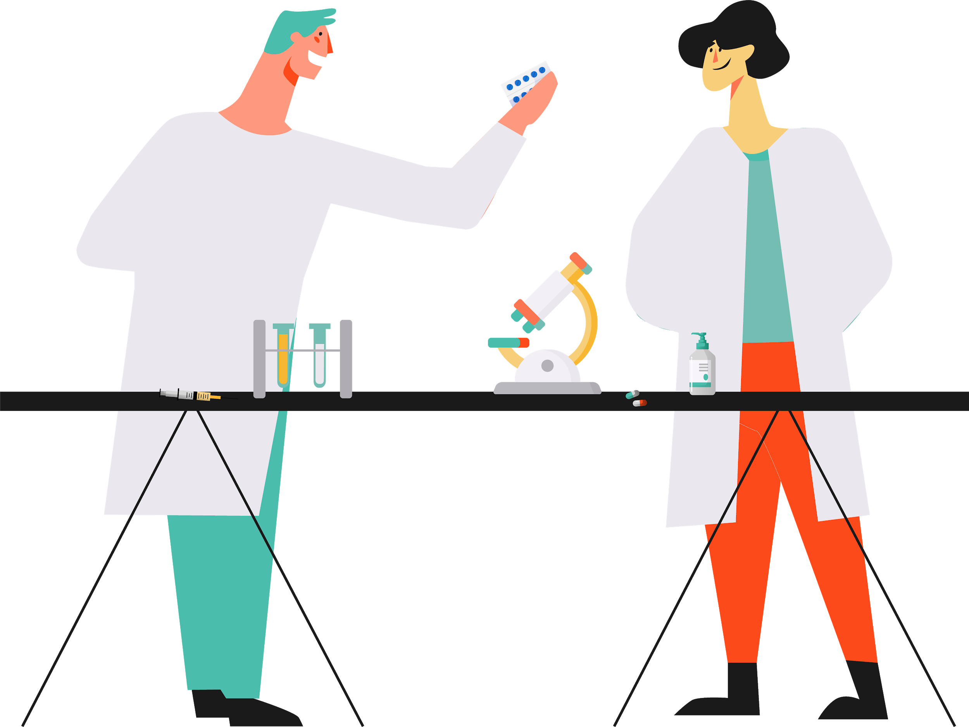
The Team
Niko
David
Former Veterinarian -
Swear an oath to save lives.
Former Business Manager -
Found out about the economical potential of the drug business.

Slide 4
The goal
Predicting future users of
hard drugs

Slide 5
1. Introduction
Data & background

Slide 6
Dataset Contents
Demographics | Psychometrics | Drugs
Age | Big5 Scores | Last Usage for 19 different drugs
Gender | Impulsiveness Score
Education Level | Sensation Seeking Score
Ethnicity
Country
1885 observations
anonymous online survey
published 2011

Slide 7
Big5 Personality Traits
Curios
Independent
Organized Hardworking
Outgoing Adventurous
Helpful Trusting
Anxious Unhappy
High
Openness
Conscientiousness
Extro version
Agreeableness
Neuroticism
Practical
Conventional
Impulsive Careless
Quiet Reserved
Critical Suspicious
Calm Even-tempered
Low

Slide 8

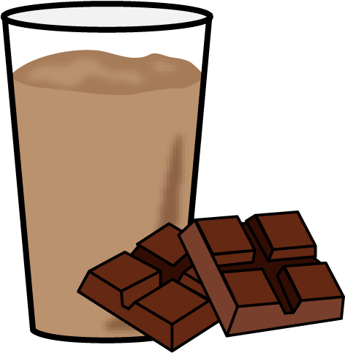
Defining Drug Categories
Based on:
Ratio effective dose / lethal dose
Potential of dependency
No drugs
Soft drugs
Hard drugs

Slide 9
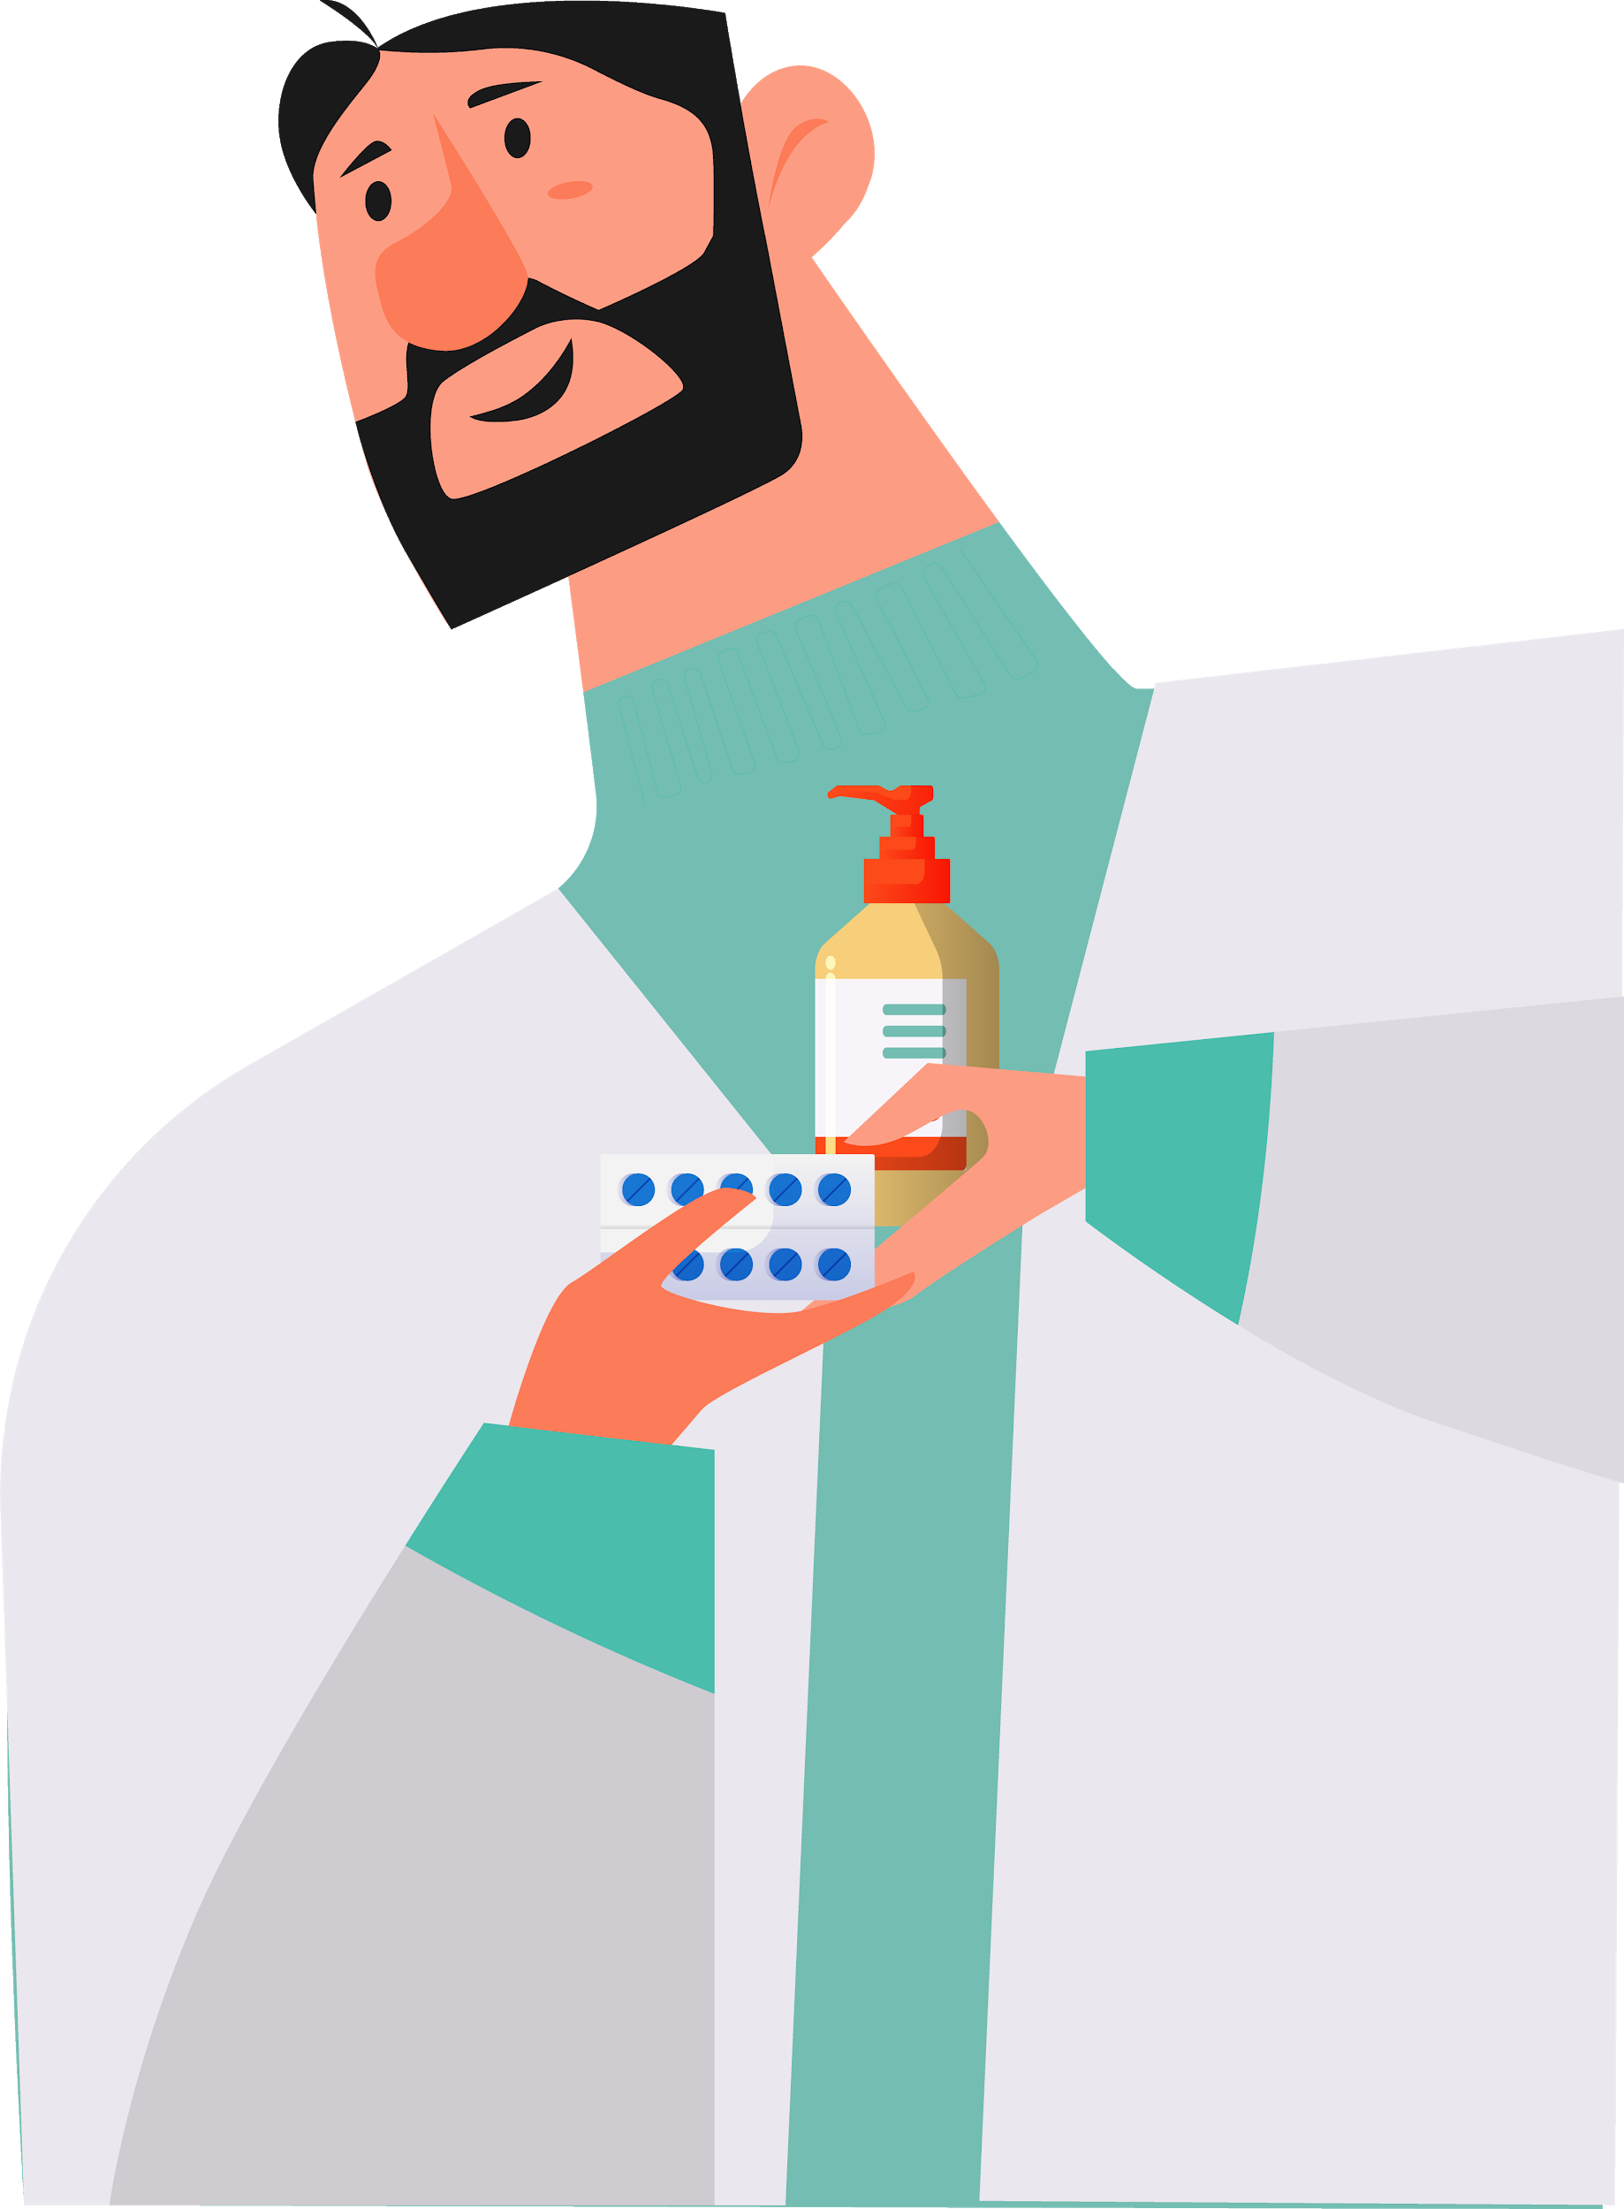
The interactive part
Soft?
Hard?
Hard
Soft
Oh no!
I mixed up all the soft and hard drugs... :-((
Coke
Cannabis
Hard
Soft
Hard
Alcohol
Ecstasy
Crack
Soft
Mushrooms
Cigarettes
Semeron

Slide 10
Drug Classification
Soft drugs
Hard drugs
Amyl
Ecstasy
Legalh
LSD
VSA
Cannabis
Shrooms
Not recognized:
Nicotine
Amphet
Benzos
Coke
Crack
Heroin
Meth
Ketamin
Not recognized:
Alcohol

Slide 11
What have we found out?
2. Data Exploration

Slide 12
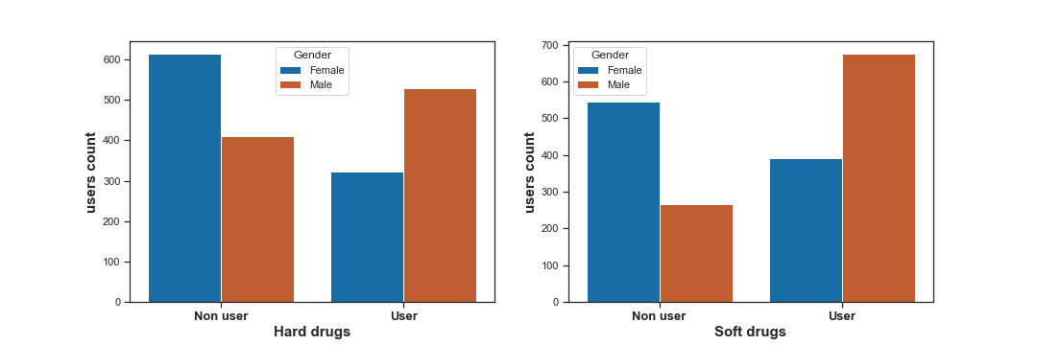
Drug Usage by Gender
54 %
71 %
42 %
31 %

Slide 13
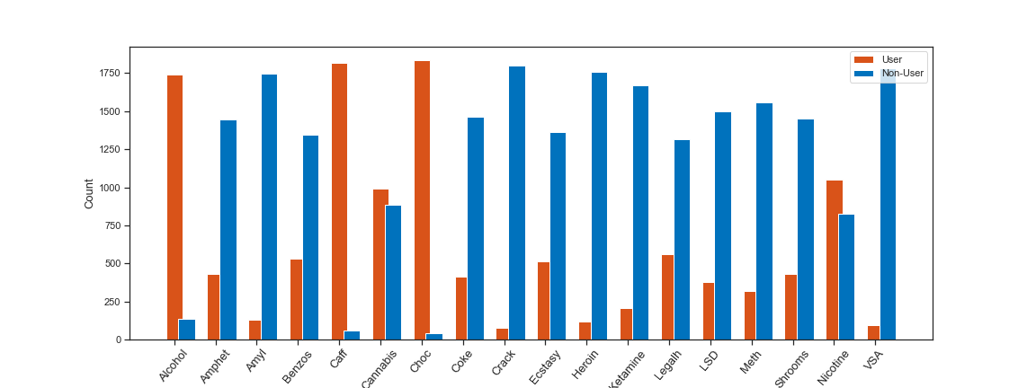
Drugs and their usage

Slide 14
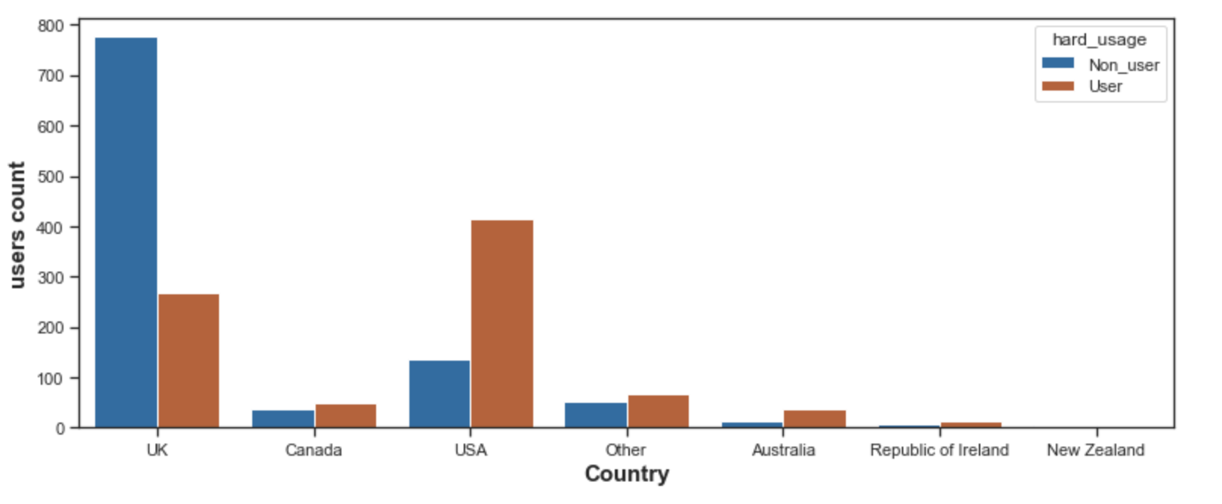
Hard Drug Usage by Country

Slide 15
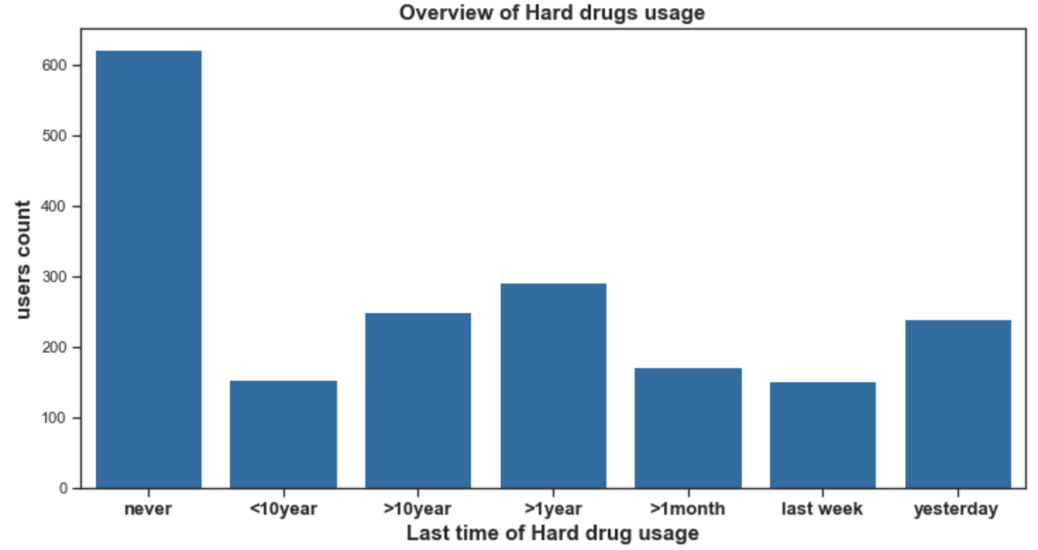
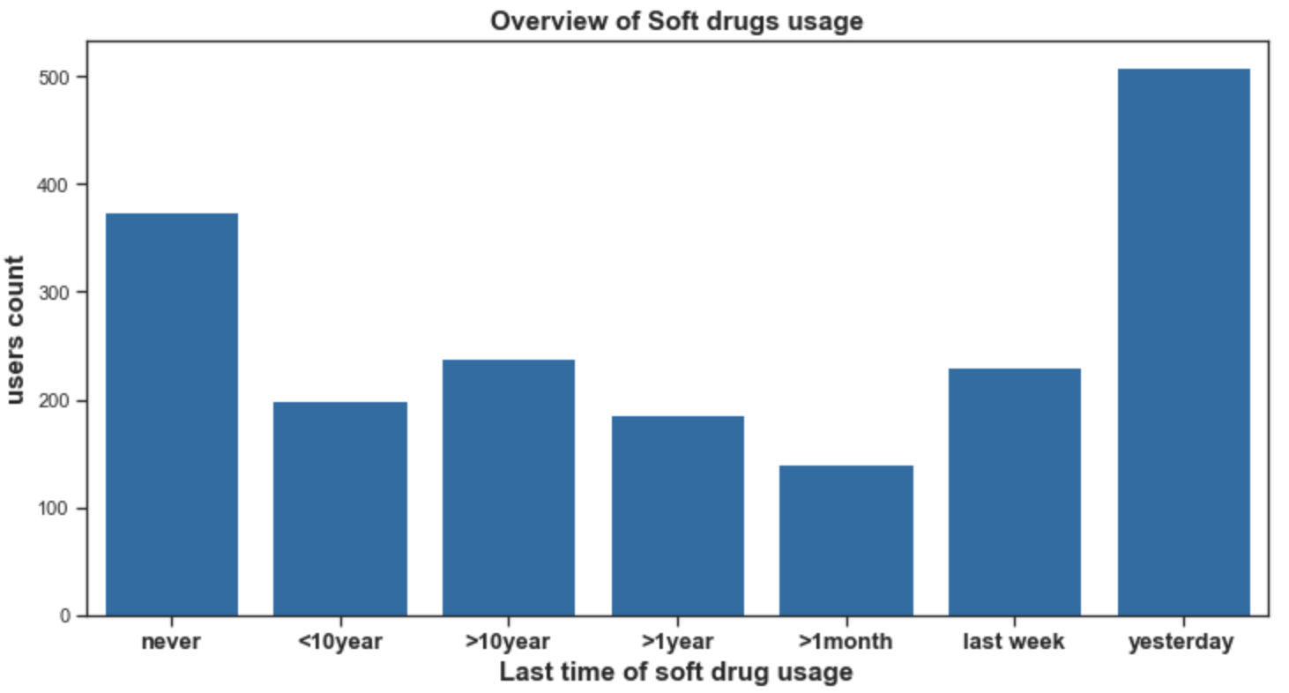
Drug Usage
and Frequency

Slide 16
3. Prediction
How is in danger of getting addicted?

Slide 17
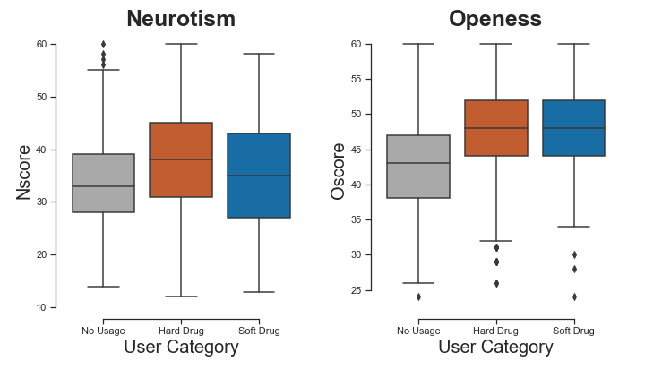
Personality traits

Slide 18
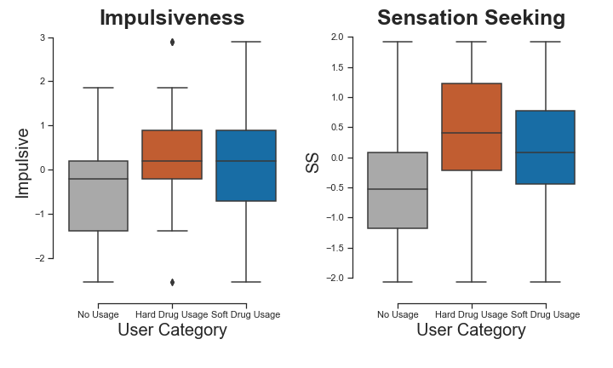
Personality traits

Slide 19

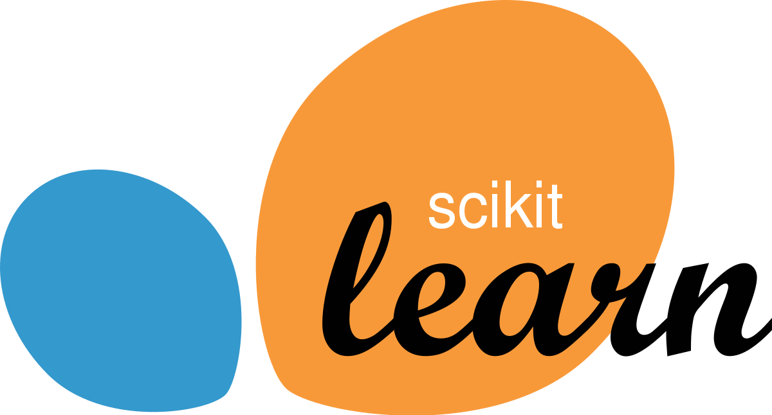
Prediction Approaches
All observations
Selected group
1877 individuals
300 individuals, selected by:
Neuroticism above mean
Openness above mean
Impulsiveness above mean
Sensation Seeking above mean.
Conscientiousness below mean

Slide 20
Predict Hard Drug Usage (all individuals)
Basic Predictions
Optimized Prediction
Random Forest | XGBoost | DecisionTree | AdaBoost | kNN | Logistic Reg | SVM
Random Forest | XGBoost | SVM ** Gridsearch for Parameters **
Best Pos. Recall: 86 %
Best Pos. Recall: 89 %
Best Accuracy: 75 %
Best Accuracy: 77 %

Slide 21
Predict Hard Drug Usage (High Scorers)
Basic Predictions
Optimized Prediction
Random Forest | XGBoost | DecisionTree | AdaBoost | kNN | Logistic Reg | SVM
Random Forest | XGBoost | SVM ** Gridsearch for Parameters **
Best Pos. Recall: 96 %
Best Pos. Recall: 97 %
Best Accuracy: 73 %
Best Accuracy: 77 %

Slide 22
Learnings and next steps
4. Conclusion

Slide 23
Main results
Openness Impulsiveness SS increase risk for drug usage
It is indeed possible to predict hard drug usage for “high scorers”
Don’t trust all data you receive (Semeron...)
Be extremely careful when dealing with features like ethnicity, country of origin, gender etc.
Do not underestimate the health risks of alcohol.

Slide 24
Next steps
Collect samples that allow the usage of the country feature and that represent the overall population of the countries
Get time-related data to find out more about the relationship between drug usage and time-related factors
Gather information about the effect of preventive actions regarding hard drug usage
Use unsupervised learning algorithm to create clusters of different drugs and personality types

Slide 25

Thanks!
All results on github
https://github.com/dave-py
https://github.com/stervet
Sources
See next slide

