Slide 1
REST Clients and Authorization

Slide 2
Making a Service Client
Generally, you will need:
  An HTTP request library (Java includes one)
  A JSON parsing library to read the response (We will use Google gson, but there are others)
  Documentation on the service interface
  Documentation on the service response format
They will often require you to register a developer account and possibly create an application with a developer or app key(s)
  This is particularly true for social networking apps, for which the application can be linked to user’s accounts other than your own.

Slide 3
Interfacing with the Service Client
How should we get this key from the user?
We don’t want to:
  Store it in the program (in the code)
  Ask the user to type it in each time (they won’t remember!)
    For now, we will – this is for testing purposes
Save it in a file?
  Make sure this file cannot be read by other users.

Slide 4
Interfacing with the Service Client
String key;
if(args.length < 1) {
System.out.println("Enter key: ");
Scanner in = new Scanner(System.in);
key = in.nextLine();
} else {
key = args[0];
}

Slide 5
Determining the Service Interface
The service provider will often publish this in their developer docs.
See the examples
Think nouns!

Slide 6
Accessing the Service: OAuth
Oauth is an authentication model used by many service providers.
Request that App be authorized against your user account, given the app’s ID (often the public part of a keypair)
User is given a URL to navigate to, and click an Authorize button
A code is given that is provided back to the requesting app

Slide 7
Parsing the Result: JSON
{
"response": {
"version": "0.1",
"termsofService": "http://www.wunderground.com/weather/api/d/terms.html",
"features": {
"conditions": 1
}
},
"current_observation": {
"image": {
"url": "http://icons-ak.wxug.com/graphics/wu2/logo_130x80.png",
"title": "Weather Underground",
"link": "http://www.wunderground.com"
},
"display_location": {
"city": "Philadelphia",
"state": "PA",
"zip": "19104",
"latitude": "39.96150970",
"longitude": "-75.19716644",
"elevation": "41.00000000"
},
"observation_location": {
"full": "University City - West Philadelphia, Philadelphia, Pennsylvania",
"city": "University City - West Philadelphia, Philadelphia",
"state": "Pennsylvania",
"latitude": "39.950554",
"longitude": "-75.211868",
"elevation": "70 ft"
},
"temp_f": 76.5,
}
}
[“current_observation”][“display_location”]
[“longitude”]
[“current_observation”][“temp_f”]

Slide 8
Parsing the Result: JSON
“forecast": {
"txt_forecast": {
"date": "5:00 PM EDT",
"forecastday": [
{
"period": 0,
"icon": "tstorms",
"icon_url": "http://icons-ak.wxug.com/i/c/k/tstorms.gif",
"title": "Sunday",
"fcttext": "Mostly cloudy with thunderstorms and rain showers. High of 88F. Winds from the SSW at 5 to 15 mph. Chance of rain 30%.",
"fcttext_metric": "Mostly cloudy with thunderstorms and rain showers. High of 31C. Breezy. Winds from the SSW at 10 to 20 km/h. Chance of rain 30%.",
"pop": "30"
}
]
}
[“forecast”][“txt_forecast”]
[“forecastday”][0][“fcttext”]

Slide 9
Setting Up a Project
You will need:
  Eclipse (www.eclipse.org)
  Temboo (www.temboo.com)
  Miscellaneous libraries -- i.e., gson (www.billmongan.com/cs275/jars/jars.tar.bz2)

Slide 10
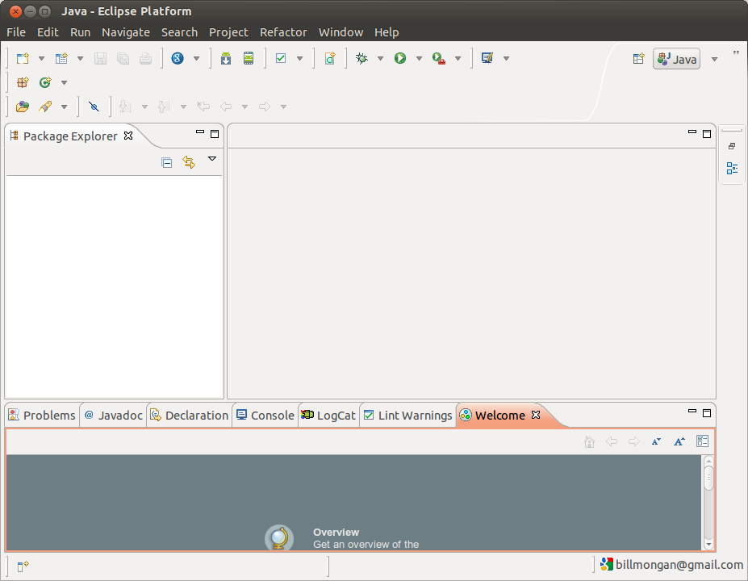
Setting Up a Project
Start Eclipse

Slide 11
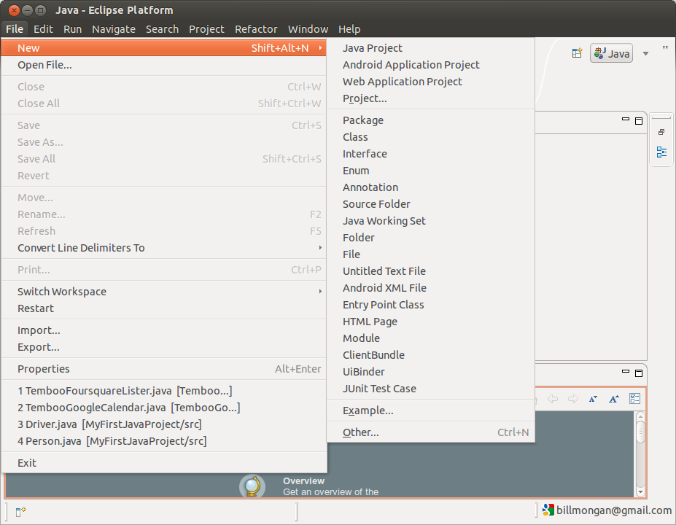
Setting Up a Project

Slide 12
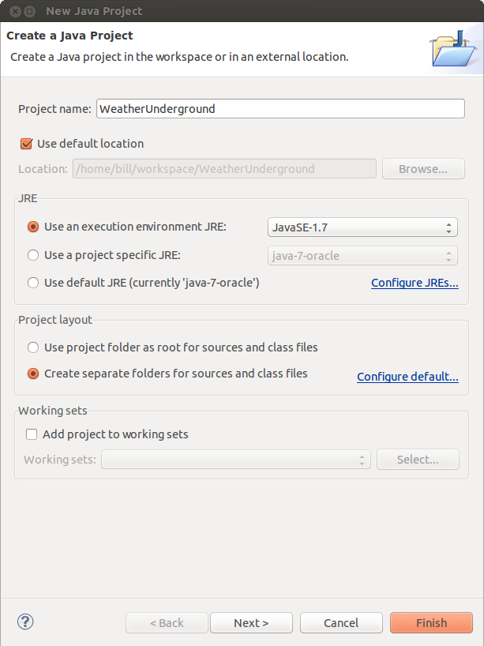
Setting Up a Project

Slide 13
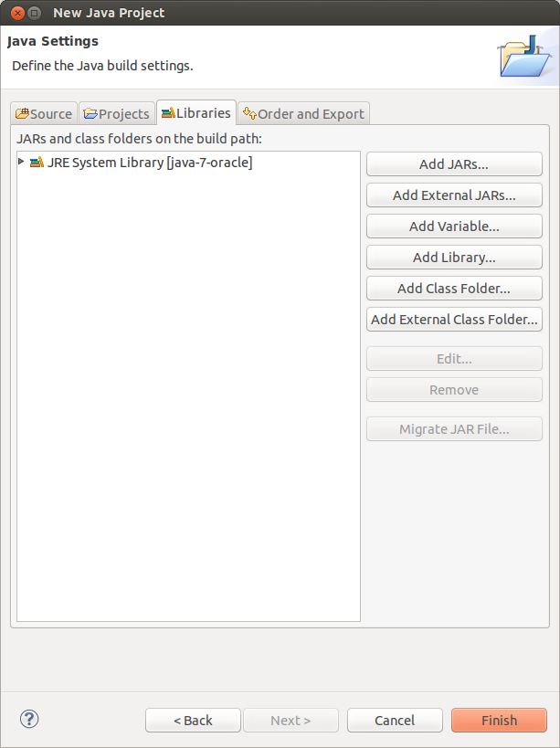
Setting Up a Project
Add External JARS
Pick these for now:
  gson
  temboo-java

Slide 14
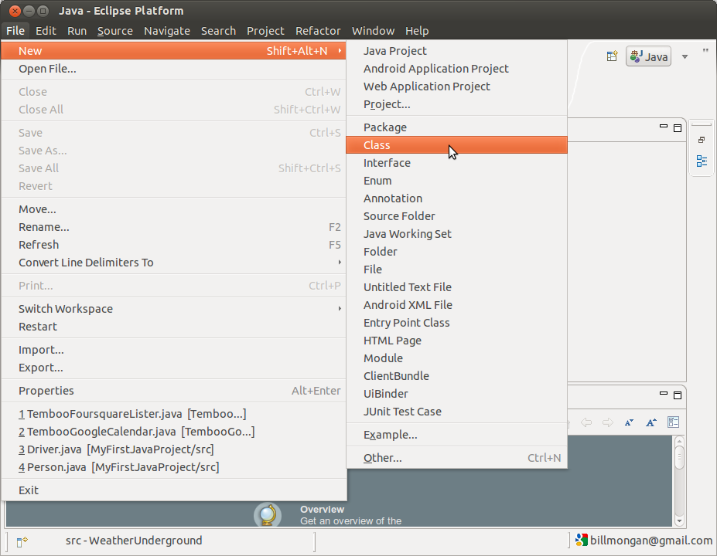
Setting Up a Project
Create a class

Slide 15
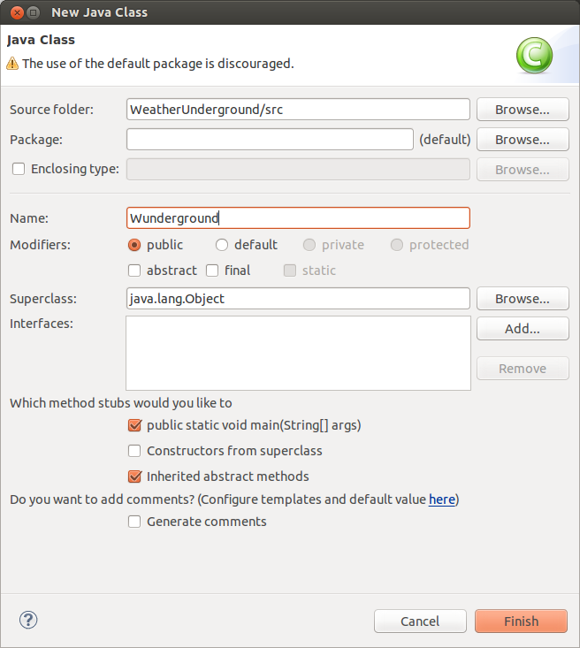
Setting Up a Project
Create a class

Slide 16
Example: Weather Underground
Documentation: http://www.wunderground.com/weather/api/
You must register for a developer key, which you will provide to Weather Underground on each of your API requests.

Slide 17
Example: Weather Underground
The API documents lots of ways we can obtain data.
One way is by zip code.
  http://api.wunderground.com/api/{YOUR KEY}/{WHAT YOU WANT}/q/{ZIP CODE}.json
  "http://api.wunderground.com/api/" + key + "/conditions/forecast/q/19104.json“
    Here, we want conditions AND forecast
    In general, don’t hardcode the zip code like this. Make it a parameter, too
      What if you want another zip code?

Slide 18
Example: Weather Underground
String sURL = "http://api.wunderground.com/api/" + key + "/conditions/forecast/q/19104.json";
How would you modify this to:
  Accept the zip code as a user parameter
  Use that parameter in the URL above
Even the .json parameter can be customized, i.e., replaced with .xml to get XML results
  We’ll stick with JSON

Slide 19
Example: Weather Underground
We could type this URL into a web browser and get back JSON data, but we want our program to do it for us.
// Connect to the URL
URL url = new URL(sURL);
HttpURLConnection request = (HttpURLConnection) url.openConnection();
request.connect();

Slide 20
Example: Weather Underground
This is like hitting “enter” on your keyboard at the browser.
The difference is that now, the results will come back as a variable in memory that we can process.
request.getContent() is a Java InputStream
  We can read this into a String, or parse it as JSON.
  In this case, it’s JSON, so we’ll parse it accordingly.
    Check the documentation to be sure (or type it into curl or a web browser to check)

Slide 21
Parsing the Result with gson
gson JSON Parser is called a Java JsonParser
It has a parse function that works on InputStream to get a JsonElement.
JsonElement:
  May be an object (something wrapped in { })
  May be an array (something wrapped in [ ])
  May be a primitive data element (for example, “my_element”: “my value”)
  We just have to tell it which one it is to “walk” the tree.

Slide 22
Parsing the Result with gson
JsonParser jp = new JsonParser();
JsonElement root = jp.parse(new InputStreamReader((InputStream) request.getContent()));

Slide 23
Recall: Using gson
{
"response": {
"version": "0.1",
"termsofService": "http://www.wunderground.com/weather/api/d/terms.html",
"features": {
"conditions": 1
}
},
"current_observation": {
"image": {
"url": "http://icons-ak.wxug.com/graphics/wu2/logo_130x80.png",
"title": "Weather Underground",
"link": "http://www.wunderground.com"
},
"display_location": {
"city": "Philadelphia",
"state": "PA",
"zip": "19104",
"latitude": "39.96150970",
"longitude": "-75.19716644",
"elevation": "41.00000000"
},
"observation_location": {
"full": "University City - West Philadelphia, Philadelphia, Pennsylvania",
"city": "University City - West Philadelphia, Philadelphia",
"state": "Pennsylvania",
"latitude": "39.950554",
"longitude": "-75.211868",
"elevation": "70 ft"
},
"temp_f": 76.5,
}
}
[“current_observation”][“display_location”]
[“longitude”]

Slide 24
Recall: Using gson
{
"response": {
"version": "0.1",
"termsofService": "http://www.wunderground.com/weather/api/d/terms.html",
"features": {
"conditions": 1
}
},
"current_observation": {
"image": {
"url": "http://icons-ak.wxug.com/graphics/wu2/logo_130x80.png",
"title": "Weather Underground",
"link": "http://www.wunderground.com"
},
"display_location": {
"city": "Philadelphia",
"state": "PA",
"zip": "19104",
"latitude": "39.96150970",
"longitude": "-75.19716644",
"elevation": "41.00000000"
},
"observation_location": {
"full": "University City - West Philadelphia, Philadelphia, Pennsylvania",
"city": "University City - West Philadelphia, Philadelphia",
"state": "Pennsylvania",
"latitude": "39.950554",
"longitude": "-75.211868",
"elevation": "70 ft"
},
"temp_f": 76.5,
}
}
The root is a json object (notice the curly brace at the top)
current_observation is a json object (again, curly braces)
temp_f is a primitive double (it’s a decimal number, and it is not in quotes)
[“current_observation”][“display_location”]
[“longitude”]

Slide 25
Example: Weather Underground
JsonObject rootobj = root.getAsJsonObject();
double temp_f = rootobj.get("current_observation").getAsJsonObject()
.get("temp_f").getAsDouble();
System.out.println(temp_f);

Slide 26
Representing Data with JSON
JSON is really just a way to represent (“serialize”) a Java object into a text document with a collection of data / other objects!
How would you model these as Java classes?

Slide 27
Recall: Using gson
“forecast": {
"txt_forecast": {
"date": "5:00 PM EDT",
"forecastday": [
{
"period": 0,
"icon": "tstorms",
"icon_url": "http://icons-ak.wxug.com/i/c/k/tstorms.gif",
"title": "Sunday",
"fcttext": "Mostly cloudy with thunderstorms and rain showers. High of 88F. Winds from the SSW at 5 to 15 mph. Chance of rain 30%.",
"fcttext_metric": "Mostly cloudy with thunderstorms and rain showers. High of 31C. Breezy. Winds from the SSW at 10 to 20 km/h. Chance of rain 30%.",
"pop": "30"
}
]
}
[“forecast”][“txt_forecast”]
[“forecastday”][0][“fcttext”]

Slide 28
Example: Weather Underground
JsonObject rootobj = root.getAsJsonObject();
String todayforecast = rootobj.get("forecast").getAsJsonObject().
get("txt_forecast").getAsJsonObject().
get("forecastday").getAsJsonArray().
get(0).getAsJsonObject().
get("fcttext").getAsString();
System.out.println(todayforecast);

Slide 29
Example: Foursquare
Developer key registration: https://developer.foursquare.com/overview/auth
  Unlike Weather Underground, it is possible to write several programs that interface with user accounts.
  In addition to a developer key, you will create application keys for each application you create.
  These will be linked to end-user keys later (this happens when you click “Allow” as a user).
Notes:
Developer API registration / documentation
Oauth procedure
Note the Oauth response key is actually JSON, so no need to copy it manually (we will for now)
Show sample JSON

Slide 30
Example: Foursquare
After you register, create an app with any app name you like.
Provide a website such as http://www.cs.drexel.edu as the “Callback URL.”
  Normally, this would be the URL of a web service you’ve created that will listen for the CODE=xxx argument (coming up) and store for querying by your app.
You will find your “Client ID” and “Client Secret” on the Foursquare developer site.
  You will need these as inputs to your program, just like you needed the user key from Weather Underground.
Notes:
Developer API registration / documentation
Oauth procedure
Note the Oauth response key is actually JSON, so no need to copy it manually (we will for now)
Show sample JSON

Slide 31
Example: Foursquare
API Documentation is available at http://developer.foursquare.com and, in particular, https://developer.foursquare.com/overview/
Your application dashboard (where you can find some key information about the apps you’ve created) is available at https://foursquare.com/developers/apps
We can do many things, but for now we will just list recent checkins made by our friends.
Notes:
Developer API registration / documentation
Oauth procedure
Note the Oauth response key is actually JSON, so no need to copy it manually (we will for now)
Show sample JSON

Slide 32
Get the Key Information
We need:
  Client ID and Client Secret (sometimes called the Consumer Key and Consumer Secret in Oauth terms)
    Effectively, this is your application key
    Notice that there are two keys instead of one, unlike Weather Underground
      Why?
  Callback URL (this must match what you provided)
  Version number (can be anything: 1, the date, …)

Slide 33
Authorizing the App to a User’s Account
We need:
  To send the user to a website to click “Allow”
    This is often done automatically, but we will do it ourselves since this is a command line program
      We will automate this process with Android later
  To get the “code” provided by Foursquare that indicates that the user clicked “Allow” and not “Deny”
  Send the user to another website with that code to get back an authorization token that we will pass to Foursquare going forward like the Weather Underground key.

Slide 34
Authorizing the App to a User’s Account
Why?
  Unlike Weather Underground, there was no user profile, so they can just give us the key to access their data.
  With Foursquare, whose user accounts should we be able to pull data for?
  Could provide user name and password, but users should not be required to give out their password!
  Oauth provides a multi-step challenge process to verify the user’s intent (logging in only to Foursquare), and getting back the key from Foursquare instead.

Slide 35
Authorizing the App to a User’s Account
The URL to “Allow” a Foursquare app is: https://foursquare.com/oauth2/authenticate?client_id=" + consumerkey + "&response_type=code&redirect_uri=" + callback
Typically, the user won’t see the code; rather, the code will be passed to a web service / site of your own, given by the callback URL.
  We’ll do this manually for now, so the callback URL is useless but required.

Slide 36
Authorizing the App to a User’s Account
System.out.println("Go to the following website and get the code, entering that here\n
https://foursquare.com/oauth2/authenticate?
client_id=" + consumerkey + "&response_type=code
&redirect_uri=" + callback);
code = in.nextLine();

Slide 37
Authorizing the App to a User’s Account
The code will appear in the URL as
http://your_callback_url/?code=ABC123
Copy the ABC123 portion and paste this into your program console at the prompt.
Next, we have to go to another URL to show Foursquare that we got the “Allow” code, and to finally get the Oauth token (a.k.a. “key” or “oauth_token”).

Slide 38
Authorizing the App to a User’s Account
The URL to trade the code for the key is:
https://foursquare.com/oauth2/access_token?client_id=" + consumerkey +
"&client_secret=" + consumersecret +
"&grant_type=authorization_code
&redirect_uri=" + callback +
"&code=" + code

Slide 39
Typical Oauth Transaction Details
The application requests a transaction ID that will be used
to match your Oauth request with the user’s login to the
service provider (in order to authorize your app to the
user’s account). The app authenticates with a public key.
Service
Provider
Your App
The response is with a transaction ID.
This can be stored on the server and
matched against the user’s transaction
in the next step.
The app is provided with an authorization URL
where the user should be redirected to login.
User

Slide 40
Typical Oauth Transaction Details
This way, the app never sees the user’s account password to authenticate.
The user also never sees the authentication details between the app and the service provider.
The app simply tells the service provider that it wishes to start a transaction, and lets the user log in. The service provider uses this to provide the app with an authorization key.
Service
Provider
Your App
The user is taken to the
Authorization URL
to log into the service,
click “Allow,” and set any
permissions.
User

Slide 41
Typical Oauth Transaction Details
The app authenticates with its public and private key
(proving that it is the app in question, just as the user
had proven itself by logging in in the previous step)
and requests the authorization key generated from the
user’s authorization in the last step.
Service
Provider
Your App
The service responds with the authorization key
if the user had indeed allowed it. This key is mapped
on the server side to any permissions that may be
applicable.
User

Slide 42
Authorizing the App to a User’s Account
System.out.println("Go to the following website and get the OAUTH Token, entering that here\n
https://foursquare.com/oauth2/access_token?
client_id=" + consumerkey +
"&client_secret=" + consumersecret +
"&grant_type=authorization_code
&redirect_uri=" + callback +
"&code=" + code);
oauth_token = in.nextLine();

Slide 43
Example: Foursquare
The response from this request is not a URL redirect, but actual data. It looks like this:
{
"access_token": “ABC123DEF456GHI789"
}
What does this look like?
Did we really need the user to copy and paste this?
  How could we do it ourselves?
For now, we will copy the ABC123DEF456GHI789 portion and paste this into the console of our program again, at the prompt.
Notes:
Developer API registration / documentation
Oauth procedure
Note the Oauth response key is actually JSON, so no need to copy it manually (we will for now)
Show sample JSON

Slide 44
Example: Foursquare
From here, we can actually access user data. Here are a few examples:
Access your own checkins:
  https://api.foursquare.com/v2/users/self/checkins
  Plus any parameters (see the documentation)
Access a list of your friends’ recent checkins:
  https://api.foursquare.com/v2/checkins/recent
  "?limit=100&oauth_token=" + oauth_token + "&v=" + version
Notes:
Developer API registration / documentation
Oauth procedure
Note the Oauth response key is actually JSON, so no need to copy it manually (we will for now)
Show sample JSON

Slide 45
Example: Foursquare
Let’s retrieve a list of friends’ recent checkins:
String sURL = "https://api.foursquare.com/v2/checkins/recent";
sURL = sURL + "?limit=100&oauth_token=" + oauth_token + "&v=" + version;
// can use request.addRequestProperty(key, value) instead of manual insertion with ?limit=100... above
Notes:
Developer API registration / documentation
Oauth procedure
Note the Oauth response key is actually JSON, so no need to copy it manually (we will for now)
Show sample JSON

Slide 46
Recall: Making an HTTP Connection
URL url = new URL(sURL);
HttpURLConnection request = (HttpURLConnection) url.openConnection();
request.connect();
Notes:
Developer API registration / documentation
Oauth procedure
Note the Oauth response key is actually JSON, so no need to copy it manually (we will for now)
Show sample JSON

Slide 47
Example: Foursquare
{
"response": {
"recent": [
{
"id": "abc123",
"createdAt": 1372597625,
"type": "checkin",
"timeZoneOffset": -240,
"user": {
"id": "12345",
"firstName": "Joe",
"lastName": "Smith",
},
"venue": {
"id": "def456",
"name": "Drexel University",
"location": {
"address": "3141 Chestnut Street",
"lat": 40,
"lng": -75,
"postalCode": "19104",
"city": "Philadelphia",
"state": "PA",
"country": "United States",
} } } ] } }
Notes:
Developer API registration / documentation
Oauth procedure
Note the Oauth response key is actually JSON, so no need to copy it manually (we will for now)
Show sample JSON

Slide 48
Recall: Parsing the Result as JSON
JsonParser jp = new JsonParser();
JsonElement root = jp.parse(new InputStreamReader((InputStream) request.getContent()));
// Assuming the root object is a { } object
JsonObject rootobj = root.getAsJsonObject();
Notes:
Developer API registration / documentation
Oauth procedure
Note the Oauth response key is actually JSON, so no need to copy it manually (we will for now)
Show sample JSON

Slide 49
Parsing the Result as JSON
JsonArray checkins = rootobj.get("response").getAsJsonObject().get("recent").getAsJsonArray();
for(int i = 0; i < checkins.size(); i++) {
try {
String fname = checkins.get(i).getAsJsonObject().get("user").getAsJsonObject().get("firstName").getAsString();
String lname = checkins.get(i).getAsJsonObject().get("user").getAsJsonObject().get("lastName").getAsString();
String venue = checkins.get(i).getAsJsonObject().get("venue").getAsJsonObject().get("name").getAsString();
Double lat = checkins.get(i).getAsJsonObject().get("venue").getAsJsonObject().get("location").getAsJsonObject().get("lat").getAsDouble();
Double lng = checkins.get(i).getAsJsonObject().get("venue").getAsJsonObject().get("location").getAsJsonObject().get("lng").getAsDouble();
System.out.println(fname + " " + lname + " was at " + venue + " located at lat, long " + lat + " " + lng);
} catch(Exception e) {
// A field was likely omitted... we should do error checking, but this is left as an exercise to the reader!
e.printStackTrace();
}
}
Notes:
Developer API registration / documentation
Oauth procedure
Note the Oauth response key is actually JSON, so no need to copy it manually (we will for now)
Show sample JSON

