Slide 1
Using Temboo To
Simplify Authorization / Data Import

Slide 2
Temboo (and other client libraries)
These service interfaces are convenient, but performing Oauth is often complicated (and differs from service provider to provider).
Sometimes, the interfaces change!
Temboo aggregates many of these Oauth procedures and interfaces into a Java library.
  It is subject to change, too, as the service interfaces change.
“Choreos” provide template code and a wizard for linking your application to the service provider and/or user account.
They also provide a web service callback URL that you should specify for your Dropbox/Twitter/etc. app, that listens for the CODE=xxx response and provides it to the Temboo choreo during the Oauth process.
Make sure your temboo account name is all lower case!

Slide 3
Temboo (and other client libraries)
Let us explore the Foursquare example in more detail to determine what code is abstracted into the Temboo library.

Slide 4
Example: Foursquare with Temboo
Temboo has library functions that allow you to perform the Oauth process, but we will continue to do this manually for now.
Once you have the Oauth Token, you can use Temboo to make function calls that return the JSON results for you, so you do not have to seek and make the HTTP calls yourself.

Slide 5
Example: Foursquare with Temboo
You can test the call using Temboo without writing any code, by pasting the key parameters into the Temboo web page and clicking “Try It Out.”
  You’ll see the JSON response
  Note that the actual JSON structure might differ from Foursquare’s, since it is being provided by Temboo now.
Doing this will also provide template code in your choice of language (Java) that you can use.

Slide 6
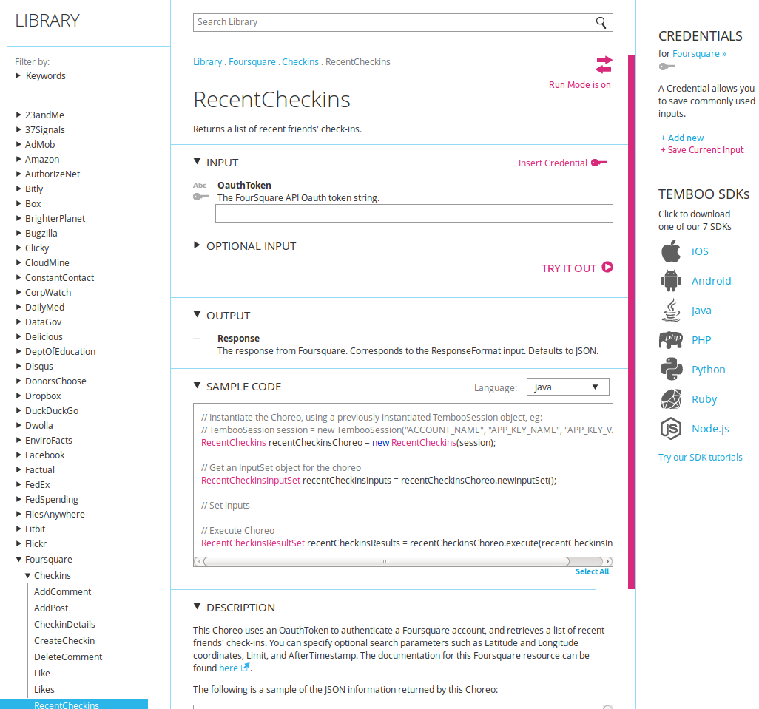
Example: Foursquare with Temboo

Slide 7
Example: Foursquare with Temboo
We need:
  Client ID and Client Secret (sometimes called the Consumer Key and Consumer Secret in Oauth terms)
    Effectively, this is your application key
    Notice that there are two keys instead of one, unlike Weather Underground
      Why?
  Callback URL (this must match what you provided)
  Oauth token (generated using the data above, as previously described)
  Temboo user name, app name, and app key

Slide 8
Example: Foursquare with Temboo
// “Log into Temboo” and start a session
TembooSession session = new TembooSession(acctName, appKeyName, appKeyValue);
RecentCheckins recentCheckinsChoreo = new RecentCheckins(session);

Slide 9
Example: Foursquare with Temboo
// Provide the inputs needed by Temboo (as seen on the previous web page).
// In this case, only the Oauth Token
RecentCheckinsInputSet recentCheckinsInputs = recentCheckinsChoreo.newInputSet();
recentCheckinsInputs.set_OauthToken(
oauth_token);

Slide 10
Example: Foursquare with Temboo
// Let Temboo do the rest
RecentCheckinsResultSet recentCheckinsResults = recentCheckinsChoreo.execute(
recentCheckinsInputs);
// For fun, print the JSON response
System.out.println("Results: " + recentCheckinsResults.get_Response());

Slide 11
Example: Foursquare with Temboo
From Temboo, the results come back as a String, not as an InputStream
  gson works with Strings, too
JsonParser fsq_jp = new JsonParser();
JsonElement fsq_root = fsq_jp.parse(recentCheckinsResults.get_Response());
JsonObject fsq_rootobj = fsq_root.getAsJsonObject();

Slide 12
Example: Foursquare with Temboo
JsonArray response_array = fsq_rootobj.get("response").getAsJsonObject().get("recent").getAsJsonArray();
for(int i = 0; i < response_array.size(); i++) {
JsonObject response = response_array.get(i).getAsJsonObject();
try {
String type = response.get("type").getAsString();
if(type.equalsIgnoreCase("checkin")) {
String fname = response.get("user").getAsJsonObject().get("firstName").getAsString();
String lname = response.get("user").getAsJsonObject().get("lastName").getAsString();
String venuename = response.get("venue").getAsJsonObject().get("name").getAsString();
String address = response.get("venue").getAsJsonObject().get("location").getAsJsonObject().get("address").getAsString();
String zip = response.get("venue").getAsJsonObject().get("location").getAsJsonObject().get("postalCode").getAsString();
System.out.println(fname + " " + lname + " checked in at " + venuename + " at " + address + ", " + zip);
} else {
System.out.println("Got a response of type " + type);
}
} catch(Exception e) {
e.printStackTrace(System.err);
}
}

Slide 13
Temboo
Why Temboo? Why not just make the HTTP call yourself?
  The interfaces / URL’s can change; it’s good Software Engineering practice to wrap these in a library (whether it is Temboo or your own)
  You will likely use each service more than once, for different data sets (different URL’s)
  You will likely use more than one service in the same application (“mashups”)
    Libraries like Temboo allow you to hide ugly HTTP connection / parameter code for a more elegant and easy to write / maintain program

Slide 14
Example: Twitter with Temboo
Similar to Foursquare in terms of Oauth process.
API Documentation and Developer Registration is available at http://dev.twitter.com

Slide 15
Example: Twitter with Temboo
You will need:
  Temboo account name, app name, app key
  Twitter developer application authorization keys:
    Twitter consumer key
    Twitter consumer secret
  Twitter user account authorization keys:
    Twitter access token
    Twitter access secret
    Twitter provides these that enable access to your own account by default
      If you use these, you do not need to do manual Oauth steps with Twitter to generate the authorization keys

Slide 16
Example: Twitter with Temboo
Let’s search for tweets by keyword (you can also post tweets, etc., just as Foursquare enables additional functionality)
TembooSession session = new TembooSession(acctName, appKeyName, appKeyValue);
Tweets tweetsChoreo = new Tweets(session);

Slide 17
Example: Twitter with Temboo
Set the input parameters (which become HTTP parameters thanks to Temboo)
TweetsInputSet tweetsInputs = tweetsChoreo.newInputSet();
tweetsInputs.set_AccessToken(twAccessToken);
tweetsInputs.set_AccessTokenSecret(twAccessSecret);
tweetsInputs.set_ConsumerKey(twConsumerKey);
tweetsInputs.set_ConsumerSecret(twConsumerSecret);
tweetsInputs.set_Query("MLB");

Slide 18
Example: Twitter with Temboo
Run the query
TweetsResultSet statusesShowResults = tweetsChoreo.execute(tweetsInputs);
System.out.println(
statusesShowResults.get_Response());

Slide 19
Example: Twitter with Temboo
Parse the results (reading the JSON response is now left as an exercise to the reader)
JsonParser jp = new JsonParser();
JsonElement root = jp.parse(statusesShowResults.get_Response());
JsonObject rootobj = root.getAsJsonObject(); // may be Json Array if it's an array, or other type if a primitive
JsonArray statuses = rootobj.get("statuses").getAsJsonArray();
for(int i = 0; i < statuses.size(); i++) {
JsonObject status = statuses.get(i).getAsJsonObject();
String text = status.get("text").getAsString();
String screen_name = status.get("user").getAsJsonObject().get("screen_name").getAsString();
System.out.println(screen_name + " said " + text);
}

Slide 20
Example: Twitter with Temboo
If you would like to use your app with other user’s accounts (i.e. to tweet as someone else), you must obtain an authorization keypair using Oauth like with Foursquare.
Temboo allows this (InitializeOauth and FinalizeOauth perform each of the steps and return a key in a JSON document)
  For details on the calls required to do this, see:
    https://dev.twitter.com/docs/auth/3-legged-authorization

Slide 21
Example: Google Calendar with Temboo
Google Calendar App Registration: https://code.google.com/apis/console
Google Calendar API Reference: https://developers.google.com/google-apps/calendar/
You will need
  Temboo user name, app name, app key
  Google client id, client secret, redirect URI
Authentication done like before, documentation available at:
https://developers.google.com/accounts/docs/OAuth2WebServer#offline

Slide 22
Example: Google Calendar with Temboo
Under Google API Console -> Services (now called APIs in the new console), make sure Google Calendar service is turned on.
If using Temboo for Oauth, the Redirect URI should be specified as per their documentation
  https://www.temboo.com/oauth_helpers/confirm_google/ as of the time of this writing
In the new console, click “Create New Client ID” and choose “Web Application” to get keys.

Slide 23
Example: Google Calendar with Temboo
To authenticate, we first go to:
"https://accounts.google.com/o/oauth2/auth?
access_type=offline
&client_id=" + client_id +
"&scope=https://www.googleapis.com/auth/calendar
&response_type=code
&redirect_uri=" + redirect_uri +
"&state=/profile
&approval_prompt=force“

Slide 24
Example: Google Calendar with Temboo
This will give us the “Allow code” like before.
See https://developers.google.com/accounts/docs/OAuth2Login for more details
Parameter | Description
access | Specifies that we want a code that allows us to work with the API going forward without the user present
client_id | Your Google client id
scope | The Google service(s) you wish to authenticate against, specified by URL and separated by + (in this case, Google Calendar)
response_type | What we want back (the Allow code)
redirect_uri | Our app’s redirect URI
state | An optional random string that serves as a session key to prevent cross-site forgery
approval_prompt | Always prompt the user to allow our app

Slide 25
Example: Google Calendar with Temboo
Find a list of API scope URL’s at https://developers.google.com/oauthplayground/
Parameter | Description
access | Specifies that we want a code that allows us to work with the API going forward without the user present
client_id | Your Google client id
scope | The Google service(s) you wish to authenticate against, specified by URL and separated by + (in this case, Google Calendar)
response_type | What we want back (the Allow code)
redirect_uri | Our app’s redirect URI
state | An optional random string that serves as a session key to prevent cross-site forgery
approval_prompt | Always prompt the user to allow our app

Slide 26
Example: Google Calendar with Temboo
Get and paste in the code, as before.
Next, request the authorization token, given the code.
Last time, we made the user type this in, but it was JSON. This time, we’ll parse it ourselves.
The only difference from earlier is that Google requires that this request be made via HTTP POST, instead of the default HTTP get.
  Instead of passing the arguments in the URL, we’ll pass them in the body of the HTTP request

Slide 27
Making an HTTP URL Request with POST Arguments
// http://www.xyzws.com/Javafaq/how-to-use-httpurlconnection-post-data-to-web-server/139
public static String executePost(String targetURL, String urlParameters)
{
URL url;
HttpURLConnection connection = null;
try {
//Create connection
url = new URL(targetURL);
connection = (HttpURLConnection)url.openConnection();
connection.setRequestMethod("POST");
connection.setRequestProperty("Content-Type",
"application/x-www-form-urlencoded");
connection.setRequestProperty("Content-Length", "" +
Integer.toString(urlParameters.getBytes().length));
connection.setRequestProperty("Content-Language", "en-US");
connection.setUseCaches (false);
connection.setDoInput(true);
connection.setDoOutput(true);

Slide 28
Making an HTTP URL Request with POST Arguments
//Send request
DataOutputStream wr = new DataOutputStream (
connection.getOutputStream ());
wr.writeBytes (urlParameters);
wr.flush ();
wr.close ();
//Get Response
InputStream is = connection.getInputStream();
BufferedReader rd = new BufferedReader(new InputStreamReader(is));
String line;
StringBuffer response = new StringBuffer();
while((line = rd.readLine()) != null) {
response.append(line);
response.append('\r');
}
rd.close();
return response.toString();

Slide 29
Making an HTTP URL Request with POST Arguments
} catch (Exception e) {
e.printStackTrace();
return null;
} finally {
if(connection != null) {
connection.disconnect();
}
}
}

Slide 30
Example: Google Calendar with Temboo
The URL to get this token is:
https://accounts.google.com/o/oauth2/token
The parameters are:
"code=" + code +
"&client_id=" + client_id +
"&client_secret=" + client_secret +
"&redirect_uri=" + redirect_uri +
"&grant_type=authorization_code"

Slide 31
Example: Google Calendar with Temboo
String authorizeURL = "https://accounts.google.com/o/oauth2/token";
String authorizeParams = "code=" + code + "&client_id=" + client_id + "&client_secret=" + client_secret + "&redirect_uri=" + redirect_uri + "&grant_type=authorization_code";
String authorizeResponse = executePost(authorizeURL, authorizeParams);

Slide 32
Example: Google Calendar with Temboo
// Extract the authorization key automatically, so the user doesn’t have to type it in
String access_token;
JsonParser oauth_jp = new JsonParser();
JsonElement oauth_root = oauth_jp.parse(authorizeResponse);
JsonObject oauth_rootobj = oauth_root.getAsJsonObject();
access_token = oauth_rootobj.get("access_token").getAsString();
System.out.println("Got oauth access token: " + access_token);

Slide 33
Example: Google Calendar with Temboo
Temboo Session to get list of Google Calendars
TembooSession session = new TembooSession(acctName, appKeyName, appKeyValue);
GetAllCalendars getAllCalendarsChoreo = new GetAllCalendars(session);

Slide 34
Example: Google Calendar with Temboo
Input Parameters
GetAllCalendarsInputSet getAllCalendarsInputs = getAllCalendarsChoreo.newInputSet();
getAllCalendarsInputs.set_ClientSecret(client_secret);
getAllCalendarsInputs.set_AccessToken(access_token);
getAllCalendarsInputs.set_ClientID(client_id);

Slide 35
Example: Google Calendar with Temboo
Execute Query
GetAllCalendarsResultSet getAllCalendarsResults = getAllCalendarsChoreo.execute(
getAllCalendarsInputs);
System.out.println(
getAllCalendarsResults.get_Response());

Slide 36
Example: Google Calendar with Temboo
Parse JSON
JsonParser jp = new JsonParser();
JsonElement root = jp.parse(getAllCalendarsResults.get_Response());
JsonObject rootobj = root.getAsJsonObject();
JsonArray items = rootobj.get("items").getAsJsonArray();
for(int i = 0; i < items.size(); i++) {
JsonObject item = items.get(i).getAsJsonObject();
String id = item.get("id").getAsString();
System.out.println("Found calendar id: " + id);
}

Slide 37
How Do I Know What the JSON Looks Like?
See the documentation for the API (or Temboo, if using Temboo)
On Temboo, you can “Try the Choreo” and see the sample output
You can also print the JSON to screen when you first receive it, and see how to parse it

Slide 38
How Do I Know What the JSON Looks Like?
Usage information and response formats:
  Using Google: https://developers.google.com/google-apps/calendar/v3/reference/calendarList/list
  Using Temboo: https://temboo.com/library/Library/Google/Calendar/GetAllCalendars/
Note that what you do and receive may differ depending on whether you are using Google directly vs. Temboo.

Slide 39
Example: Facebook with Temboo
You will need:
  Temboo account information
  Facebook app key and secret
  Temboo Java library
  Temboo Facebook library
  Gson library

Slide 40
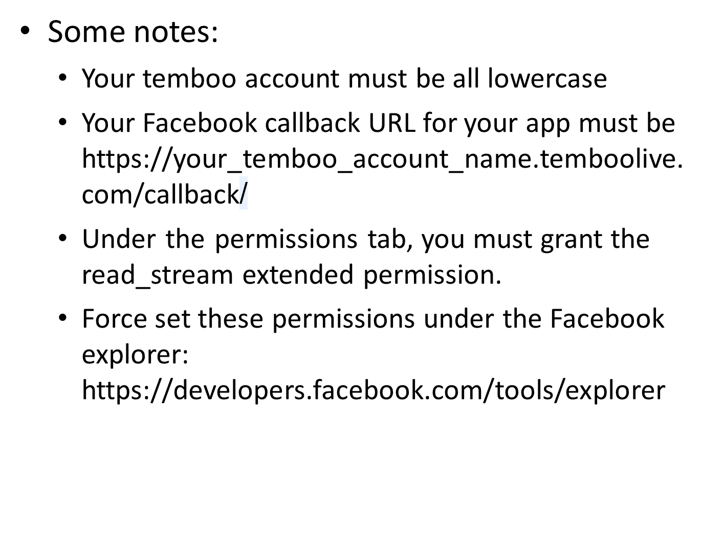
Example: Facebook with Temboo

Slide 41
Example: Facebook with Temboo
Oauth
// Facebook Oauth
InitializeOAuth initializeOAuthChoreo = new InitializeOAuth(session);
// Get an InputSet object for the choreo
InitializeOAuthInputSet initializeOAuthInputs = initializeOAuthChoreo.newInputSet();
// Set inputs
initializeOAuthInputs.set_AppKeyName(appKeyName);
initializeOAuthInputs.set_AccountName(acctName);
initializeOAuthInputs.set_AppID(fbAppId);
initializeOAuthInputs.set_AppKeyValue(appKeyValue);
// Execute Choreo
InitializeOAuthResultSet initializeOAuthResults = initializeOAuthChoreo.execute(initializeOAuthInputs);
// Send user to website to authorize and get code for finalize step
System.out.println("Visit the following website and click Allow, pressing enter here after you have done so.\n" + initializeOAuthResults.get_AuthorizationURL());
callbackID = in.nextLine().trim();
callbackID = initializeOAuthResults.get_CallbackID().trim();

Slide 42
Example: Facebook with Temboo
Oauth
// Final Oauth step
FinalizeOAuth finalizeOAuthChoreo = new FinalizeOAuth(session);
// Get an InputSet object for the choreo
FinalizeOAuthInputSet finalizeOAuthInputs = finalizeOAuthChoreo.newInputSet();
// Set inputs
finalizeOAuthInputs.set_AppKeyName(appKeyName);
finalizeOAuthInputs.set_CallbackID(callbackID);
finalizeOAuthInputs.set_AppSecret(fbAppSecret);
finalizeOAuthInputs.set_AccountName(acctName);
finalizeOAuthInputs.set_AppID(fbAppId);
finalizeOAuthInputs.set_AppKeyValue(appKeyValue);
// Execute Choreo
FinalizeOAuthResultSet finalizeOAuthResults = finalizeOAuthChoreo.execute(finalizeOAuthInputs);
fbAccessToken = finalizeOAuthResults.get_AccessToken();

Slide 43
Example: Facebook with Temboo
Data Access
// Instantiate the Choreo, using a previously instantiated TembooSession object
Friends friendsChoreo = new Friends(session);
// Get an InputSet object for the choreo
FriendsInputSet friendsInputs = friendsChoreo.newInputSet();
// Set inputs
friendsInputs.set_AccessToken(fbAccessToken);
// Execute Choreo
FriendsResultSet friendsResults = friendsChoreo.execute(friendsInputs);
String json = friendsResults.get_Response();
System.out.println(json);
// Parse the json with gson
JsonParser jp = new JsonParser();
JsonElement root = jp.parse(json);
JsonObject rootobj = root.getAsJsonObject(); // may be Json Array if it's an array, or other type if a primitive
JsonArray friendList = rootobj.get("data").getAsJsonArray();
for(int i = 0; i < friendList.size(); i++) {
String name = friendList.get(i).getAsJsonObject().get("name").getAsString();
System.out.println(name);
}

Slide 44
And So Many More
See the resources page of the course website for a list.
Programmableweb has a nice repository, too.
Imagine iterating over your Twitter contact list and finding out their favorite restaurants from Foursquare
  Privacy issues aside, at least you’d get some good gift ideas!

Slide 45
Note: Binary Data
Binary data is often represented in Base64 (text) encoding.
You will use a library to convert between binary and base64.

Slide 46
Binary Data
When sending binary data, you will often be asked to “base64 encode” (or decode) your data when sending it over a server.
This converts binary data into numbers that format into the ASCII table, so that even binary data looks like text.
This is because many protocols prefer ASCII text for transmitting data.
Temboo has an endpoint for this:

Slide 47
Binary Data
https://www.temboo.com/library/Library/Utilities/Encoding/Base64Encode/
// Instantiate the Choreo, using a previously instantiated TembooSession object, eg:
// TembooSession session = new TembooSession("ACCOUNT_NAME", "APP_KEY_NAME", "APP_KEY_VALUE");
Base64Encode base64EncodeChoreo = new Base64Encode(session);
// Get an InputSet object for the choreo
Base64EncodeInputSet base64EncodeInputs = base64EncodeChoreo.newInputSet();
// Set inputs
// Execute Choreo
Base64EncodeResultSet base64EncodeResults = base64EncodeChoreo.execute(base64EncodeInputs);

Slide 48
Binary Data
You can also do this locally (and you should, when able!)
  Requires Java 8 for this included library
java.util.Base64.Encoder be = java.util.Base64.getEncoder();
java.util.Base64.Decoder bd = java.util.Base64.getDecoder();
String data = "Hello!";
byte[] encoded = be.encode(data.getBytes());
byte[] decoded = bd.decode(encoded);
String newdata = new String(decoded);
System.out.println(data);
System.out.println(new String(encoded));
System.out.println(new String(decoded));
System.out.println(newdata);

Slide 49
Binary Data
You can also do this locally (and you should, when able!)
  Or, you can import the Apache commons-codec jar
  In the course jars package or at http://commons.apache.org/proper/commons-codec/download_codec.cgi
import org.apache.commons.codec.binary.Base64;
import org.apache.commons.codec.binary.StringUtils;
// Decode:
String decoded = StringUtils.newStringUtf8(Base64.decodeBase64(base64_string));
// Encode
String base64_string = Base64.encodeBase64String(StringUtils.getBytesUtf8(decoded));

Slide 50
Android with Temboo
You can download the Temboo jar from Temboo’s website for Java (or the appropriate library plugin for your language).
If using Android, download the Android SDK jar, and also include the jar for your chosen choreo (i.e., Google).
  They are separated into many smaller jar files for efficiency on a mobile device

