Slide 1

Activities and the Application Lifecycle
Jeff Segall
July 9, 2013

Slide 2
Activities
Provides single screen with which the user can interact
In theory, each activity should allow the user to perform some goal
Dial a phone
Send an email
Take a photo
Notes:
Show some activity examples in the emulator

Slide 3
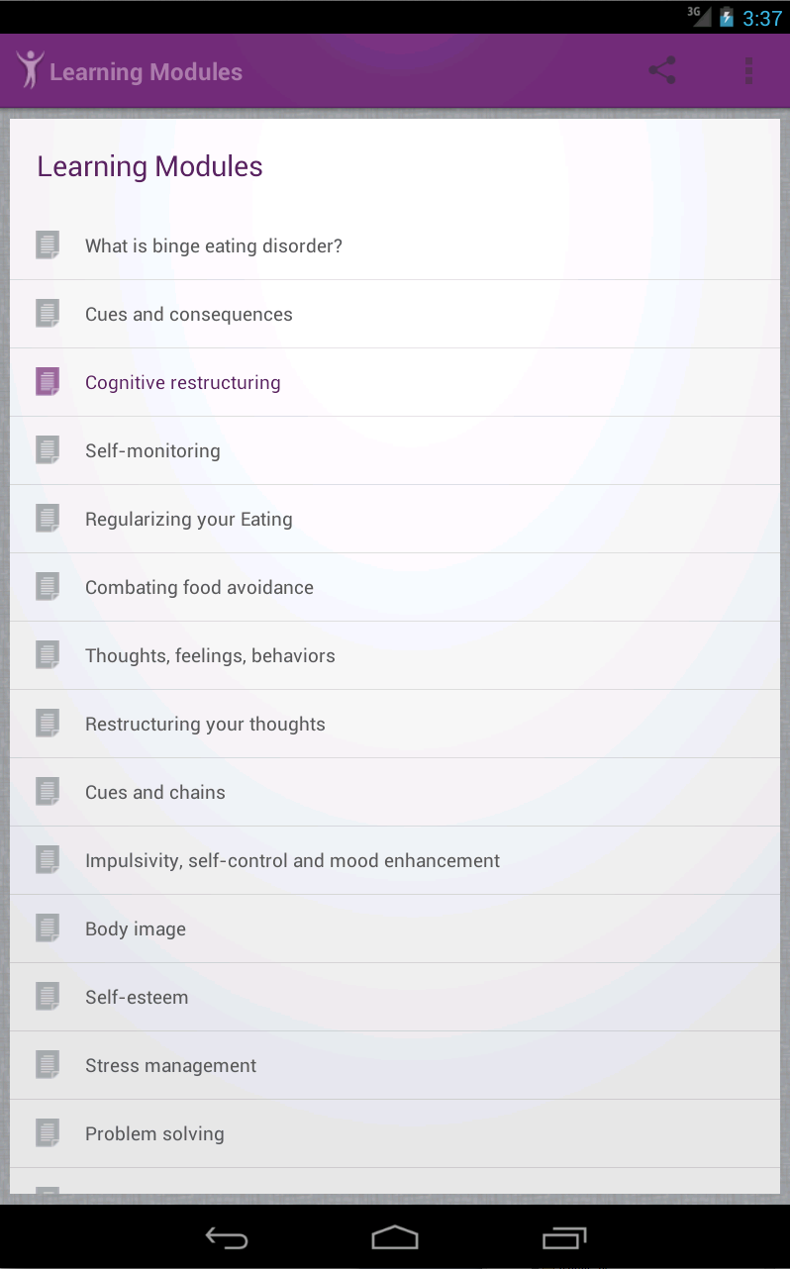
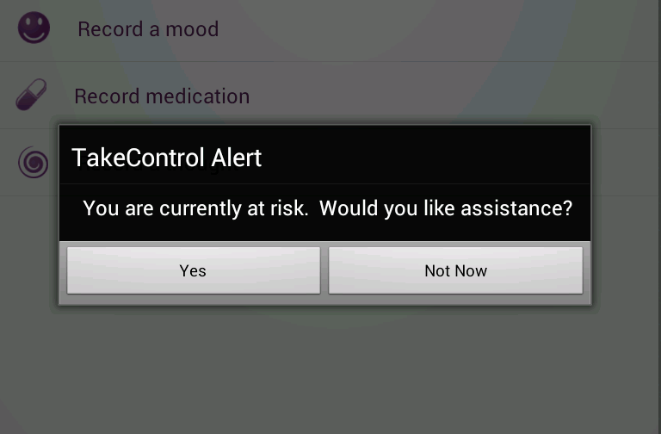
Activities
Usually, an Activity fills a screen…
…but it may be smaller

Slide 4
Creating an Activity
Every Activity must be a subclass of the Activity class (or one of its subclasses)
public class MainActivity extends Activity {
…
}

Slide 5
Creating an Activity
Every Activity in your application must be declared in your AndroidManifest.xml
<activity
android:name="com.example.project.MainActivity”
android:label="@string/example_label” >
</activity>
Notes:
Name = package path
Label = Title

Slide 6
Creating an Activity
A single application Activity will be declared as your main activity
It will be the first one shown when your application is opened from the launcher or called by another application
<activity
android:name="com.example.project.MainActivity”
android:label="@string/example_label” >
<intent-filter>
<action android:name=“android.intent.action.MAIN” />
<category android:name=“android.intent.category.LAUNCHER” />
</intent-filter>
</activity>

Slide 7
Creating an Activity
Override onCreate()
Called when an activity is created
public class MainActivity extends Activity {
@Override
public void onCreate(Bundle savedInstanceState) {
super.onCreate(savedInstanceState);
}
…
}

Slide 8
Creating an Activity
Use setContentView() to attach a layout
public class MainActivity extends Activity {
@Override
public void onCreate(Bundle savedInstanceState) {
super.onCreate(savedInstanceState);
setContentView(R.layout.main_layout);
}
…
}

Slide 9
Creating another Activity
public class OtherActivity extends Activity {
@Override
public void onCreate(Bundle savedInstanceState) {
super.onCreate(savedInstanceState);
setContentView(R.layout.other_layout);
}
…
}

Slide 10
Starting a new Activity
Use startActivity() to start a new activity
startActivity() takes an Intent as a parameter
public void onClick() {
Intent otherIntent = new Intent(this, OtherActivity.class);
startActivity(otherIntent);
}
Notes:
We’ll learn more about Intents tomorrow

Slide 11
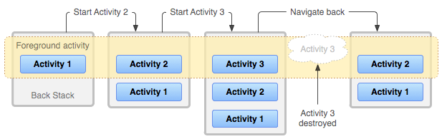
The Activity Stack
When an activity is started, it is pushed onto the Back Stack
When an activity ends and is destroyed, it is removed from the stack

Slide 12
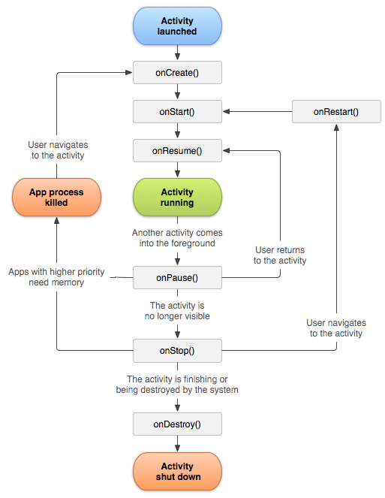
The Activity Lifecycle
The entire lifecycle of an activity happens between onCreate() and onDestroy()
An activity’s visible lifecycle happens between onStart() and onStop()
An activity’s foreground lifecycle happens between onResume() and onPause()

Slide 13
Activity Lifecycle
Override onCreate()
Called when an activity is created
public class MainActivity extends Activity {
@Override
public void onCreate(Bundle savedInstanceState) {
super.onCreate(savedInstanceState);
}
…
}

Slide 14
Activity Lifecycle
Override onCreate()
Called when an activity is created
public class MainActivity extends Activity {
…
@Override
public void onDestroy() {
super.onDestroy();
//Destroy other resources
}
}

Slide 15
Foreground Lifetime
@Override
public void onResume() {
//The activity is visible (resumed)
super.onResume();
}
@Override
public void onPause() { //Activity is about to lose focus
super.onPause();
}

Slide 16
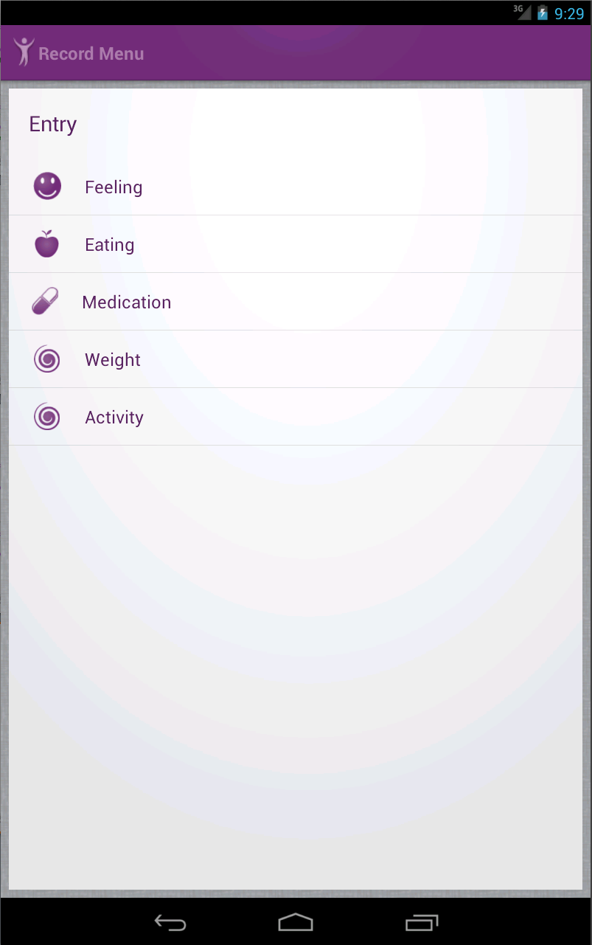
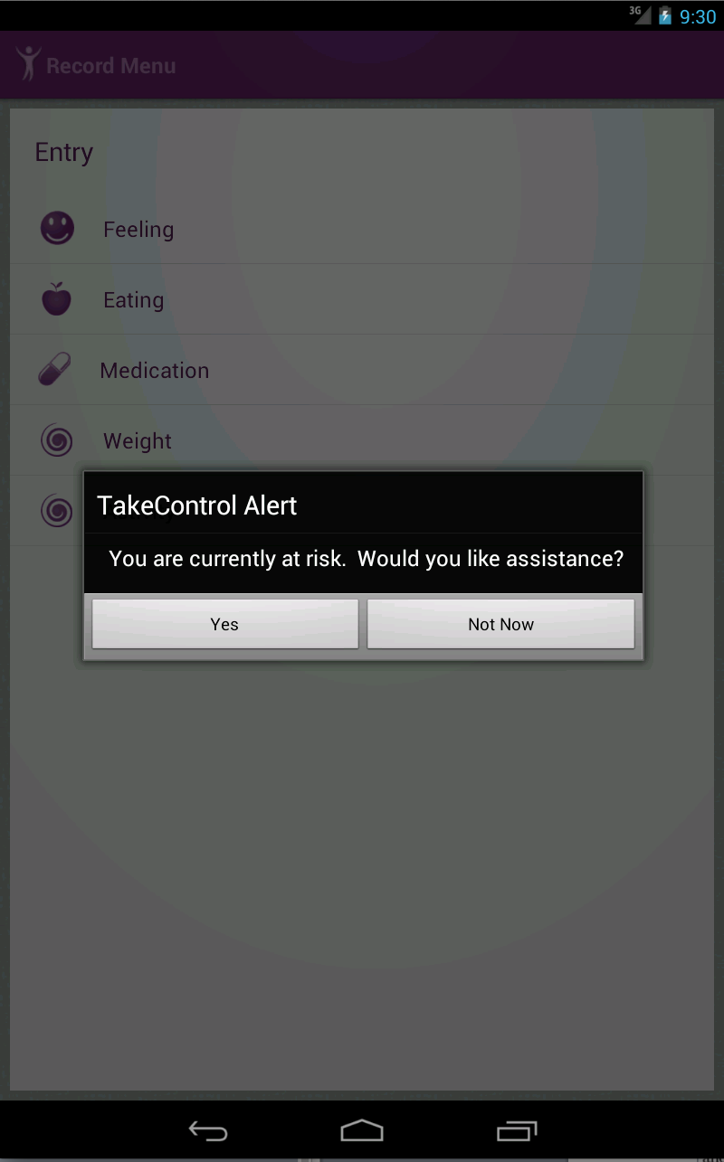
Foreground Lifetime
onPause()
onResume()

Slide 17
Visible Lifetime
@Override
public void onStart() {
//The activity is about to become visible
super.onStart();
//Initialize resources that manage your UI
}
@Override
public void onStop() { //Activity is no longer visible
super.onStop();
//Destroy (or pause) resources that manage your UI
}

Slide 18
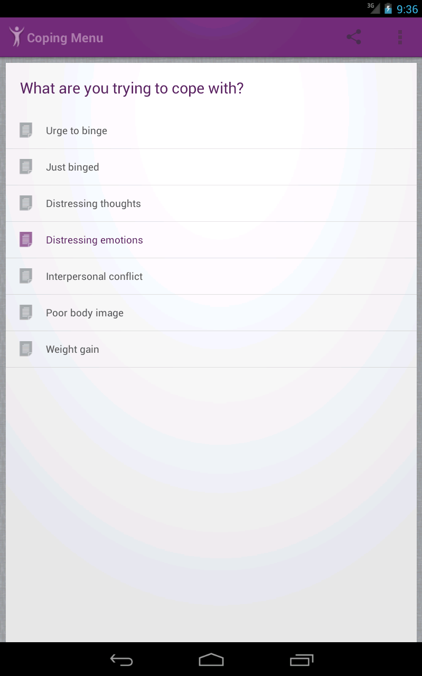
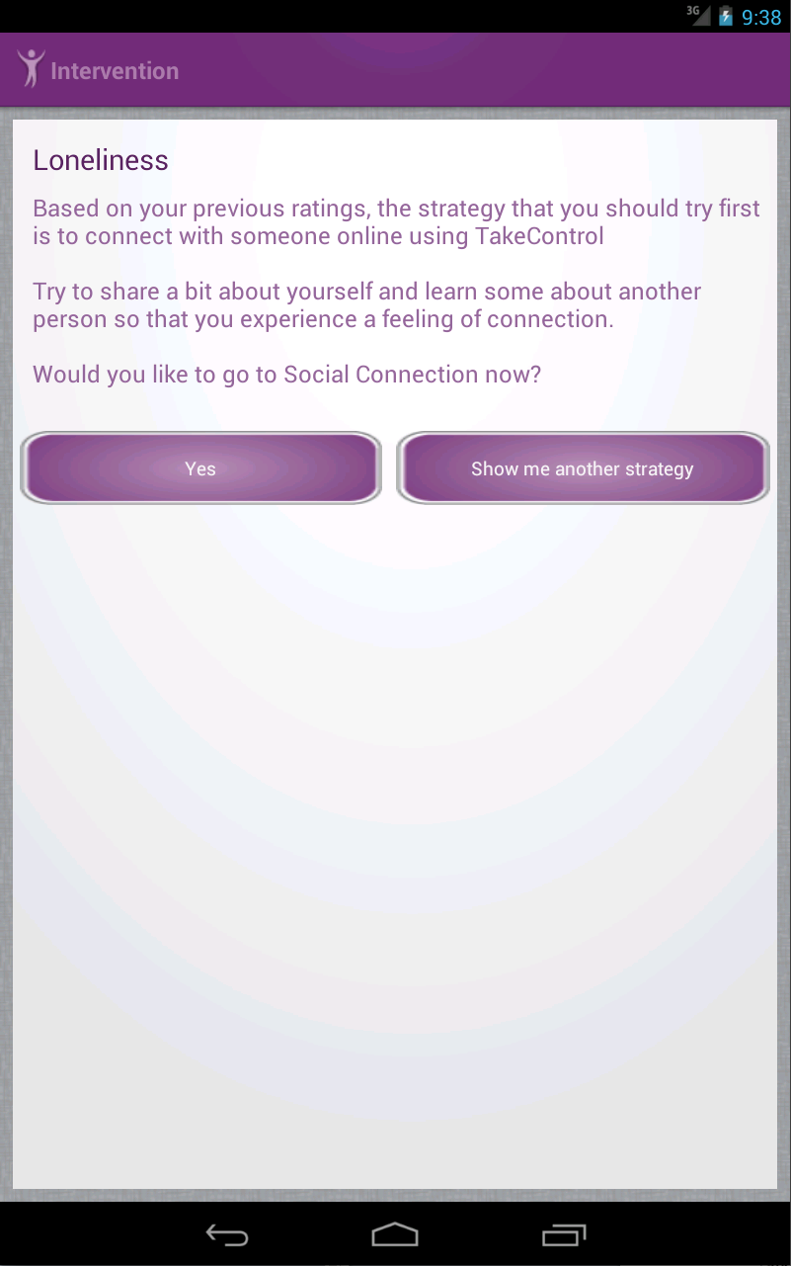
Visible Lifetime
onStop()
onStart()

Slide 19
Entire Lifetime
@Override
public void onCreate(Bundle savedInstanceState) {
//The activity is being created
super.onCreate(savedInstanceState);
//Initialize resources
}
@Override
public void onDestroy() { //Activity is about to be destroyed
super.onDestroy();
//Destroy other resources
}

Slide 20
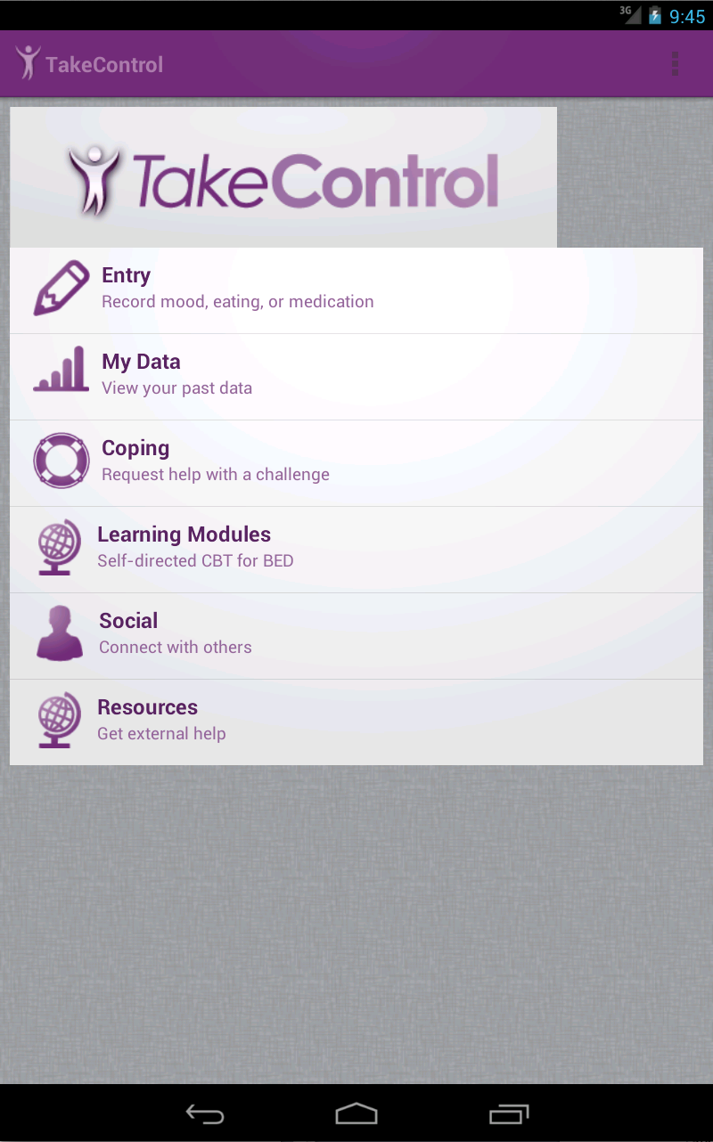
Entire Lifetime
onCreate()
onStop()
onDestroy()
onStart()

Slide 21
Getting a Result
public void onClick() {
Intent otherIntent = new Intent(this, OtherActivity.class);
startActivity(otherIntent);
}
public static final int REQUEST_CODE = 1;
public void onClick() {
Intent forResult = new Intent(this, OtherActivity.class);
startActivityForResult(forResult, REQUEST_CODE);
}
Notes:
We’ll learn more about Intents tomorrow

Slide 22
Getting a Result
public static final int REQUEST_CODE = 1;
public void onActivityResult(int requestCode, int resultCode,
Intent data) {
super.onActivityResult(requestCode, resultCode, data);
switch(requestCode){ case (REQUEST_CODE):
if (resultCode == Activity.RESULT_OK) {
//Do something with the result
}
break;
}
}
Notes:
We’ll learn more about Intents tomorrow

Slide 23
Getting a Result
public static final int REQUEST_CODE = 1;
public void onActivityResult(int requestCode, int resultCode,
Intent data) {
super.onActivityResult(requestCode, resultCode, data);
switch(requestCode){ case (REQUEST_CODE):
if (resultCode == Activity.RESULT_OK) {
//Do something with the result
}
break;
}
}
Let our parent class handle its activity result code
Notes:
We’ll learn more about Intents tomorrow

Slide 24
Getting a Result
public static final int REQUEST_CODE = 1;
public void onActivityResult(int requestCode, int resultCode,
Intent data) {
super.onActivityResult(requestCode, resultCode, data);
switch(requestCode){ case (REQUEST_CODE):
if (resultCode == Activity.RESULT_OK) {
//Do something with the result
}
break;
}
}
Check the request code
Notes:
We’ll learn more about Intents tomorrow

Slide 25
Getting a Result
public static final int REQUEST_CODE = 1;
public void onActivityResult(int requestCode, int resultCode,
Intent data) {
super.onActivityResult(requestCode, resultCode, data);
switch(requestCode){ case (REQUEST_CODE):
if (resultCode == Activity.RESULT_OK) {
//Do something with the result
}
break;
}
}
Make sure it’s a result for our activity
Notes:
We’ll learn more about Intents tomorrow

Slide 26
Getting a Result
public static final int REQUEST_CODE = 1;
public void onActivityResult(int requestCode, int resultCode,
Intent data) {
super.onActivityResult(requestCode, resultCode, data);
switch(requestCode){ case (REQUEST_CODE):
if (resultCode == Activity.RESULT_OK) {
//Do something with the result
}
break;
}
}
Make sure the activity finished successfully
Notes:
We’ll learn more about Intents tomorrow

Slide 27
Ending an Activity
onDestroy() is called when an activity ends
To end an activity, call its finish() method
Destroy an activity; remove it from the stack

Slide 28
Ending an Activity
onDestroy() can also be called when an activity is destroyed by the VM
If the VM needs memory, it can destroy activities to reclaim some
Activity is not removed from the stack
Will be recreated on demand

Slide 29
Saving Activity State
Override onCreate()
Called when an activity is created
public class MainActivity extends Activity {
@Override
public void onCreate(Bundle savedInstanceState) {
super.onCreate(savedInstanceState);
}
…
}

Slide 30
Saving Activity State
Override onCreate()
Called when an activity is created
public class MainActivity extends Activity {
@Override
public void onCreate(Bundle savedInstanceState) {
super.onCreate(savedInstanceState);
}
…
}

Slide 31
Bundle
A simple key-value store
put(key, value);
get(key);
In a Bundle, put/get by type
putString(key, value);
putInt(key, value);
getFloat(key);

Slide 32
Bundle
What can a Bundle hold?
boolean
int
char
float
byte
double
short
long
String
Also:
Classes implementing Parcelable
Classes implementing Serializable
Arrays and Lists of the above

Slide 33
Saving Activity State
@Override
public void onSaveInstanceState(Bundle outState){
super.onSaveInstanceState(outState);
//Save data in outState
}
Values stored in outState are passed to onCreate() when the activity is re-created

Slide 34
Saving Activity State
@Override
public void onSaveInstanceState(Bundle outState){
super.onSaveInstanceState(outState);
outState.putString(“foo”, “bar”);
}
@Override
public void onCreate(Bundle savedInstanceState) {
super.onCreate(savedInstanceState);
String foo = savedInstanceState.getString(“foo”);
}

Slide 35
Context
“Interface to global information about an application environment”
Uhhh….what?

Slide 36
Context
An abstract class provided by Android
You never have to implement it
All of your Activities and Services extend it
Without you having to specify so
Lots of things require a reference to it

Slide 37
Context
If you’re making a call to a function that requires it and you’re already in an Activity or Service, just pass “this”
If you’re not in an Activity or Service, you’ll need to pass a reference to your application context into the class

Slide 38
Context
public void onClick() {
Intent otherIntent = new Intent(this, OtherActivity.class);
startActivity(otherIntent);
}
The first parameter to this Intent is an application context
We can pass “this” because we’re calling from inside an activity

Slide 39
Logging
LogCat can be used to view logging info
Multiple levels of output:
ERROR, WARN, INFO, DEBUG, VERBOSE
Log.e(String tag, String msg)
Log.w(String tag, String msg)
Log.i(String tag, String msg)
Log.d(String tag, String msg)
Log.v(String tag, String msg)

Slide 40
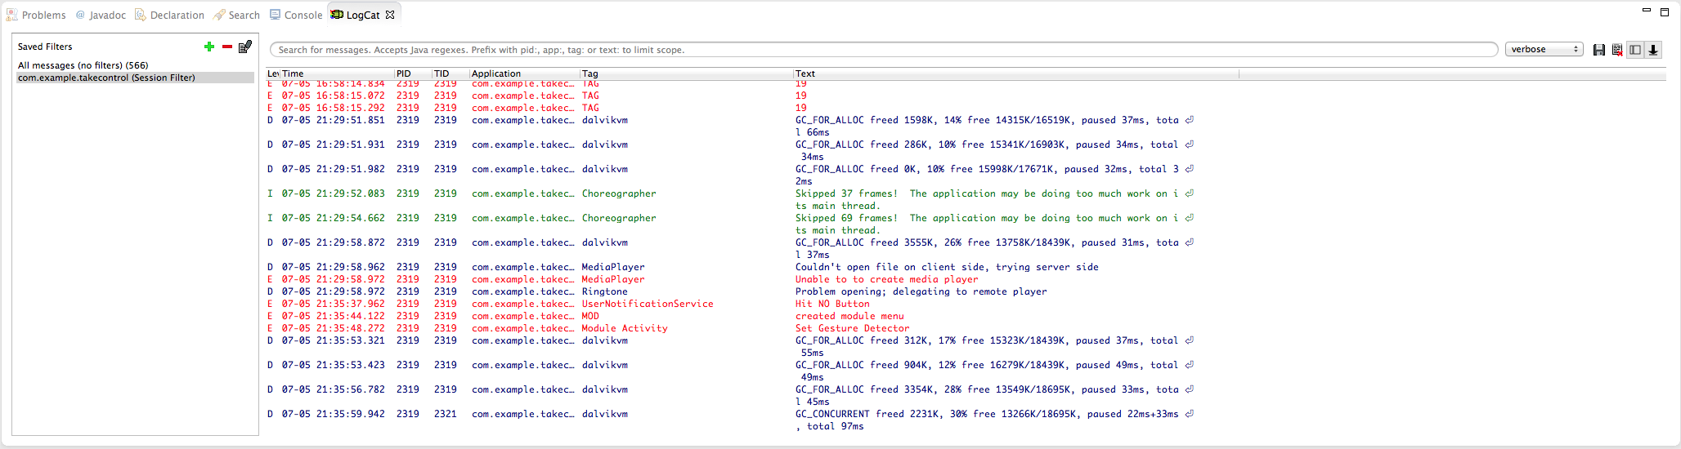
LogCat

Slide 41
Hello World Example

Slide 42
Review
Activities are a front-facing, single screen in your application
Applications are made up of multiple activities
Every activity you create must extend the Activity class (or a subclass)
You can start an activity using startActivity() and end an activity using finish()

Slide 43
Review
All activities are placed on the back stack
The VM will handle the lifecycle of your activities…
…but you can override the standard callbacks to add your own behavior
…but always call the superclass callbacks
Sometimes, this means that activities will be destroyed at the will of the VM
You can save the state of your activity using onSaveInstanceState()

Slide 44
Review
Context is a magical fantasy class that you never have to implement, but that everything seems to want
As long as you’re inside an Activity or Service, you are a Context
You can pass a reference to yourself (this)
The Log class can be used to view log output and is useful for debugging

Slide 45
Questions?

