Slide 1
What Have We Done So Far?
We invoked existing services using JSON parsers and HTTP libraries, such as Twitter and Foursquare
  Looked at OAuth along the way
We then integrated this into Android applications, and learned transitions to other screens via Activities and Intents
  Looked at Android permissions model
Then, we turned our attention towards making our own REST services
  Talked about CRUD and saving data

Slide 2
Android

Slide 3
Interfacing with your Emulator’s Host
Your host is visible to the emulator via IP address 10.0.2.2
Also, consider enabling Snapshots in AVD Manager for faster boot time!

Slide 4
More Tips when Threading
Use Background Services instead of threads to poll for data when needed (or when asked), and push that to a data store that your app uses instead
  That way, it can see old data, and refresh that data on-demand
  Improve user response time
Use ProGuard (proguard.sourceforge.net) to shrink your binary and perform some automated optimizations
  In Eclipse, add proguard.config=proguard.cfg to default.properties in your Eclipse project directory
  If you are using Google App Engine, turn off some optimizations so that variable names are consistent (Google App Engine uses reflection to inspect your classes)

Slide 5
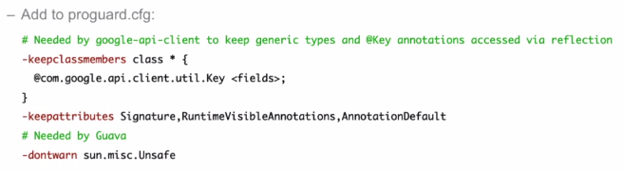
Configuring ProGuard

Slide 6
Performance Tips
Compress data that you send
  gzip your JSON both directions
  Support gzip with your HTTP requests and responses!
Only create objects and memory when you need to
Don’t request GPS updates more often than you need to
Make references static where able, declare constants final
Avoid float and enums
Instead of Services and Threads, use Receivers and Alarms
Avoid WakeLocks
  These keep your Android awake (for example, while your app is doing something intensive in the background)
  You can give them timeouts, or release them manually

Slide 7
Performance Tips
Implement onPause() and onResume() to save and restore app state in case your app is taken out for another.
private SharedPreferences mPrefs;
SharedPreferences mPrefs = getSharedPreferences();
x = mPrefs.getInt(“my_x", -1);
SharedPreferences.Editor ed = mPrefs.edit();
ed.putInt(“my_x", x);
ed.commit();

Slide 8
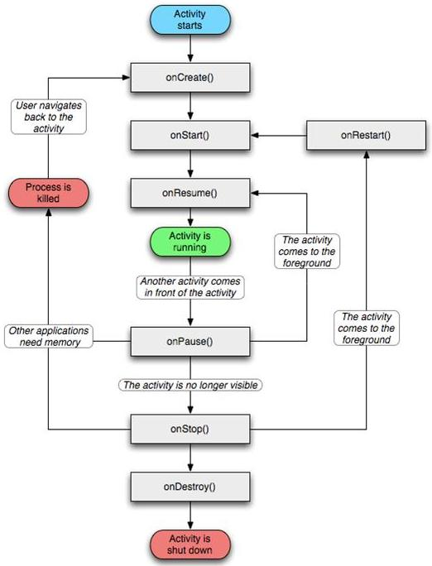
Android Activity Lifecycle

Slide 9
Separate Interface from Implementation
Use the /res directory to store images, strings, and activity layouts
The R global variable gives you access to these values
Like general programming, you should not have hardcoded values in your program
  This includes strings!
  Every Android platform will use these consistently

Slide 10
What are Intents, Really?
We used them previously to
  transition between Activities (starting new Activities)
  open a web page within our application (we did this to make an OAuth request)
We can broadcast Intents and listen for Intents to and from other applications’ activities, too!
Doing this will enable you to interface within your application and with other applications rather seamlessly, and transition back to your application when done.

Slide 11
Intents
Intent myIntent = new Intent(MainActivity.this, TwitterLister.class); // transition to another activity
startActivity(new Intent(Intent.ACTION_VIEW, Uri.parse(authURL)); // transition to web site
startActivity(new Intent(“com.something.SOMEACTION”, Uri.parse(“mydata://myhost/cars/blue”));
startActivityForResult() will allow you to return a result from the activitiy you just called, which you will receive via an event call to onActivityResult()

Slide 12
Intents
If an application has an intent filter registered for com.something.SOMEACTION, that activity will be started with that data!
If not, you can verify this and proceed without that functionality.
You saw Intent filters in your manifest.xml file:
  <activity …>
  <intent-filter>
  <action android:name=“com.something.SOMEACTION”/>
  <data android:scheme=“mydata” android:host=“myhost”/>
  </intent-filter>
  </activity>

Slide 13
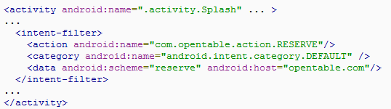
Example: Integrating with OpenTable
startActivity(new Intent(“com.opentable.action.RESERVE”, Uri.parse(“reserve://opentable.com/2947?partySize=3”)));

Slide 14
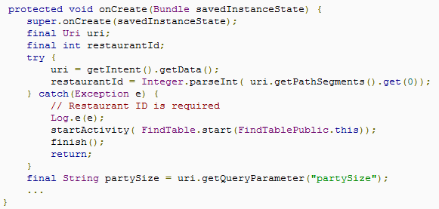
Example: Integrating with OpenTable
OpenTable might have an activity with that intent registered that would parse the data from the URI:
Notice that these URI’s are not actual URL’s, but data encoded in a URL

Slide 15
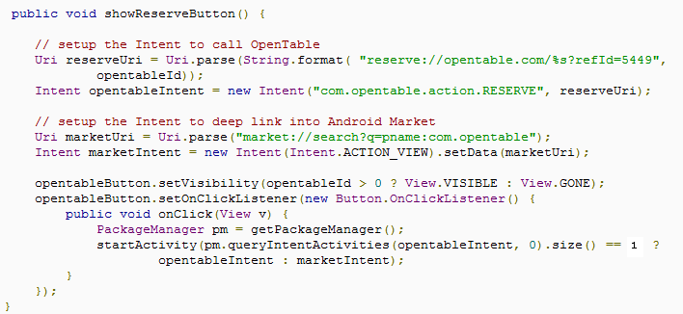
Pitfall: This Requires OpenTable
What if you don’t have OpenTable installed? You can check for this, and if no activity has an intent-filter registered for your desired intent, you can take some other (or no) action:

Slide 16
Handling Intents
You can use setResult() in your activity that handles the intent to return a status code, and an optional intent.
  This requires that the intent was passed using startActivityForResult previously
You can return an intent back to the caller that they can then invoke to go somewhere else!
Just as REST allows us to interface with web-based service interfaces using documented URI’s, Intents allow us to interface with other activities (even from other applications!).

Slide 17
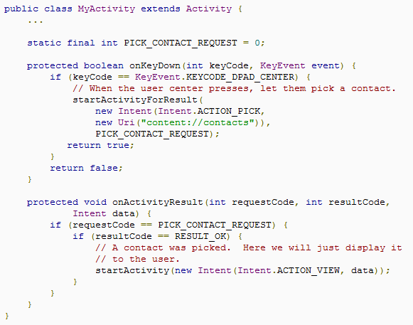
StartActivityForResult

Slide 18
Take a Picture with the Android Camera
You can take a picture using an Intent:
Intent intent = new Intent();
intent.setType(“image/*”);
intent.setAction(Intent.ACTION_GET_CONTENT);
intent.addCategory(
Intent.CATEGORY_OPENABLE);
startActivityForResult(intent, 1);

Slide 19
Take a Picture with the Android Camera
In onActivityResult(int, int, Intent), assuming Bitmap bitmap and ImageView imageView (in your layout XML), and android.permission.CAMERA permission:
if(requestCode == 1 && resultCode == Activity.RESULT_OK) {
if(bitmap != null) bitmap.recycle();
InputStream stream = getContentResolver().openInputStream(data.getData());
bitmap = BitmapFactory.decodeStream(stream);
stream.close();
imageView.setImageBitmap(bitmap);
super.onActivityResult(requestCode, resultCode, data);
}

Slide 20
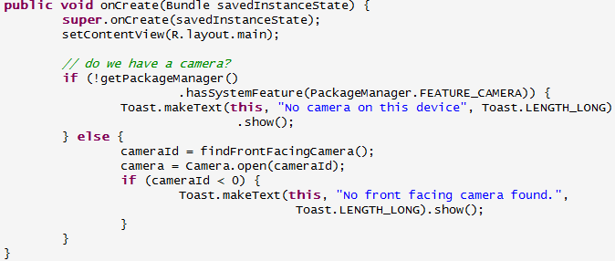

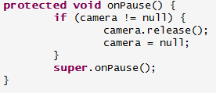
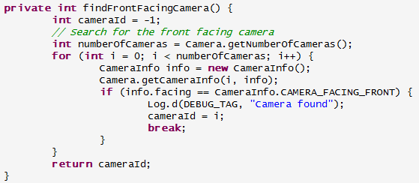
Taking a Picture using the Camera API

