Slide 1

Data Storage
Jeff Segall
July 11, 2013

Slide 2
Application Data
In the course of interacting our application, users will generate a lot of data
Preferences / Settings
Downloaded files
Explicit data entry
While our application is open, our variables hold all of this data

Slide 3
Application Data
Variables are normally visible to their containing class
We can pass values between components
Intent intent = new Intent(MainActivity.this,
OtherActivity.class);
intent.putStringExtra(“foo”, “bar”);
intent.putIntExtra(“test_int”, 3);
startActivity(intent);

Slide 4
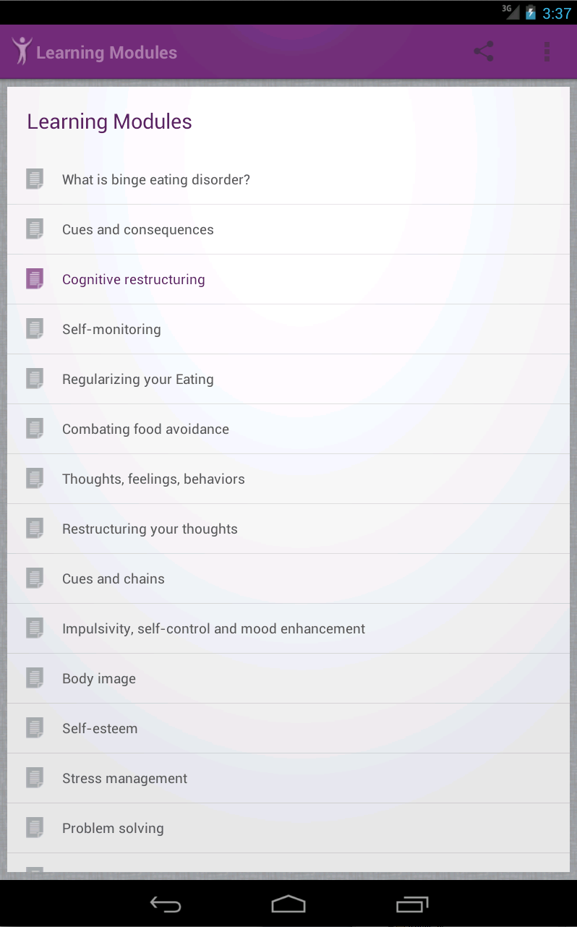
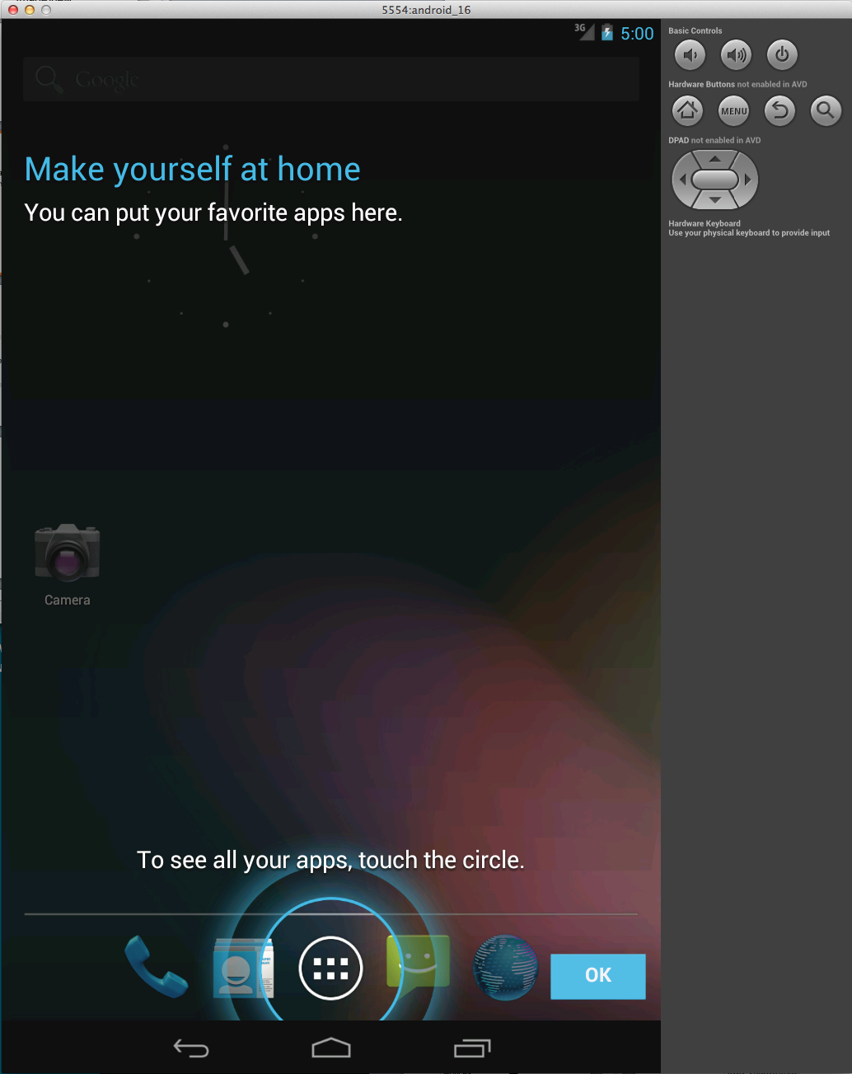

Slide 5
Persistent Data Storage
Sometimes (read: often) we want to store data even when our application is closed

Slide 6
Storage Options
Shared Preferences
Internal Storage
External Storage
Databases
Network

Slide 7
Storage Options
Shared Preferences
Internal Storage
External Storage
Databases
Network

Slide 8
Shared Preferences
General framework for storing key-value pairs of primitive types
boolean
int
float
long
String
Persists across user sessions

Slide 9
Shared Preferences
Use getPreferences() to get the default shared preferences file for an Activity
Values stored in this file are private to the calling Activity
SharedPreferences settings = getPreferences(MODE_PRIVATE);
String username = settings.getString(“username”, null);
long userid = settings.getLong(“id”, -1);

Slide 10
Shared Preferences
To edit the values in a preferences object, create an associated Editor with the edit() method
Editor is an inner class of SharedPreferences
Each editor is specific to its preferences object
SharedPreferences settings = getPreferences(MODE_PRIVATE);
SharedPreferences.Editor editor = settings.edit();

Slide 11
Shared Preferences
Use the Editor to put values into the preferences object
When done editing, use the commit() method to save changes
SharedPreferences settings = getPreferences(MODE_PRIVATE);
SharedPreferences.Editor editor = settings.edit();
editor.putString(“username”, “js572”);
editor.commit();

Slide 12
Shared Preferences
getPreferences() will obtain the preferences object for a given Activity
To get a global preferences object for our application, we can ask the PreferenceManager
SharedPreferences settings =
PreferenceManager.getDefaultSharedPreferences(this);

Slide 13
Shared Preferences
Convenient
Can only store primitive data

Slide 14
Storage Options
Shared Preferences
Internal Storage
External Storage
Databases
Network

Slide 15
Internal Storage
Each Android application is given a certain amount of internal storage space
Applications can store files in their internal space privately
Files cannot be accessed by other applications
Files are removed when the saving application is uninstalled

Slide 16
Internal Storage
From any Context, use openFileOutput() to open a file output stream
String filename = “test_file”;
String outputString = “hello, world!”;
FileOutputStream fos = openFileOutput(filename,
Context.MODE_PRIVATE);
fos.write(outputString.getBytes());
fos.close();

Slide 17
Internal Storage
FileOutputStream fos = openFileOutput(filename,
Context.MODE_PRIVATE);
MODE_PRIVATE tells openFileOutput to either create or overwrite a file with the given filename and restrict access
MODE_APPEND will add to the end of an already existing file

Slide 18
Internal Storage
Files can be read back in from internal storage using openFileInput()
FileInputStream fis = openFileInput(filename);
The process of reading in from a FileInputStream varies depending on the type of file saved.
http://developer.android.com/reference/java/io/FileInputStream.html

Slide 19
Internal Storage
Other useful functions
getFilesDir()
Returns the absolute path to your internal file storage directory
getDir()
Creates (or opens an exiting) directory
deleteFile()
Deletes a file saved on internal storage
fileList()
Returns a list of files saved by your application

Slide 20
Storage Options
Shared Preferences
Internal Storage
External Storage
Databases
Network

Slide 21
External Storage
Save to an SD card or other external storage device
Applications have private space on external storage
Private from other applications, but the user can remove the external storage and view files
Files are deleted on application uninstall

Slide 22
External Storage
Some devices may not have external storage, so check if it exists and is writeable
Use getExternalStorageState() and compare it to the MEDIA_MOUNTED state
String state = Environment.getExternalStorageState();
if (Environment.MEDIA_MOUNTED.equals(state)){
//We have read and write access to external storage
}

Slide 23
External Storage
Use getExternalStorageDirectory() to get the root of your application’s external storage
String root =
Environment.getExternalStorageDirectory().toString();

Slide 24
External Storage
String root =
Environment.getExternalStorageDirectory().toString();
File outFile = new File(root + “/my_file”);
try{
FileOutputStream out = new FileOutputStream(outFile);
out.write(“Hello, world!”);
out.close();
} catch (Exception e){
e.printStackTrace();
}

Slide 25
External Storage
Unlike internal storage, your application needs permission to write to an SD card
Permissions go in your Android Manifest
<uses-permission android:name=
“android.permission.WRITE_EXTERNAL_STORAGE” />

Slide 26
External Storage
String root =
Environment.getExternalStorageDirectory().toString();
File outFile = new File(root + “/my_file”);
try{
FileInputStream in= new FileInputStream(outFile);
//Once you have the stream, same as internal storage
} catch (Exception e){
e.printStackTrace();
}

Slide 27
Storage Options
Shared Preferences
Internal Storage
External Storage
Databases
Network

Slide 28
Databases
Android provides full support for SQLite databases
Databases created by an application are private to that application

Slide 29
Databases
Create a new class that extends SQLiteOpenHelper and override the onCreate() function
SQLiteOpenHelper assists in the creation and upgrading of databases

Slide 30
public class DictionaryOpenHelper extends SQLiteOpenHelper {
private static final int DATABASE_VERSION = 2;
private static final String DICTIONARY_TABLE_NAME = "dictionary”;
private static final String DICTIONARY_TABLE_CREATE =
"CREATE TABLE " + DICTIONARY_TABLE_NAME + " (" +
KEY_WORD + " TEXT, " + KEY_DEFINITION + " TEXT);";
DictionaryOpenHelper(Context context) {
super(context, DATABASE_NAME, null, DATABASE_VERSION);
}
@Override
public void onCreate(SQLiteDatabase db) {
db.execSQL(DICTIONARY_TABLE_CREATE);
}
}

Slide 31
Databases
DictionaryOpenHelper helper = new
DictionaryOpenHelper(this);
SQLiteDatabase db = helper.getWriteableDatabase();
With a reference to a SQLiteDatabase object, you can use rawQuery() or query() to query the database

Slide 32
Databases
The result of a query is a Cursor object
Cursor c = db.rawQuery(“SELECT * FROM “ + dbName);
while(c != null && c.moveToNext()){
c.getString(0);
//Or c.getInt(), c.getLong(), etc…
}

Slide 33
Learn SQL
http://www.w3schools.com/sql/sql_intro.asp

Slide 34
Persistence
You can persist to something other than a simple file
This allows you to form relationships (as with a SQL Database)
PersonID | FirstName | LastName
1 | Joe | Student
2 | Jane | Pupil
CourseID | ClassNum | ClassName
1 | CS480 | Web and Mobile
2 | CS281 | System Arch.
GradeId | PersonId | CourseID | Grade
1 | 1 | 1 | A
2 | 1 | 2 | A

Slide 35
Persistence
SELECT * FROM Grades JOIN Person on Grades.PersonID = Person.PersonID JOIN Course on Grades.CourseID = Course.CourseID
PersonID | FirstName | LastName
1 | Joe | Student
2 | Jane | Pupil
CourseID | ClassNum | ClassName
1 | CS480 | Web and Mobile
2 | CS281 | System Arch.
GradeId | PersonId | CourseID | Grade
1 | 1 | 1 | A
2 | 1 | 2 | A

Slide 36
Storage Options
Shared Preferences
Internal Storage
External Storage
Databases
Network

Slide 37
Network Storage
Applications can communicate with external servers to store and retrieve data
Check out the java.net.* and android.net.* packages for information about network access and communication

Slide 38
Review
Application users generate massive amounts of data
Data is stored within applications, but can be lose when applications are closed
To keep data around, we have to store it persistently

Slide 39
Review
Android offers a wealth of options for storing persistent data
SharedPreferences provide a key-value store that can store primative data
Each application has a private Internal Storage directory that can be used to store files
If External Storage devices exist, applications can also store files there

Slide 40
Review
Android offers a wealth of options for storing persistent data
Databases allow for the storing and querying of relational data
Network Storage is available for apps that prefer to store data on an external server

Slide 41
Questions?

