Slide 1

Android Platform/Development Overview
Jeff Segall
July 8, 2013

Slide 2

History of Android
Linux-based OS for touchscreen devices
Developed by Android, Inc.
Funded by Google
Bought by Google in 2005
First Android phone released in 2008
Open source (Apache)
Software can be freely modified and distributed

Slide 3

Competing with iOS
Released: 2007
Apps: 900,000
1Q13 Market Share: 17.3%
Released: 2008
Apps: 700,000
1Q13 Market Share: 75.0%

Slide 4
Java
Android development is done using the Java programming language
Includes most, but not all standard Java classes and some Android-specific classes
Compiled to Dalvik bytecode
Normally Java is compiled to JVM bytecode
Java applications compiled for JVM won’t run on Android

Slide 5
Java Resources
Java API Docs:
http://docs.oracle.com/javase/6/docs/api/
Android API Docs:
http://developer.android.com/reference/packages.html
http://developer.android.com/guide/components/index.html
Intro to Java for Android programmers:
http://mobile.tutsplus.com/tutorials/android/java-tutorial/

Slide 6
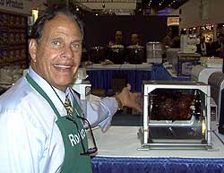
Android SDK
Software Development Kit
Includes libraries and API needed to build, test, and debug software for Android platforms
Full, local API documentation
ADB, the Android debugger
Licenses for Google Play
System Images
Emulator
“But wait, there’s more!”
- Ron Popeil

Slide 7
Emulator
Packaged with the SDK
Test applications without a physical device
Using the emulator requires an AVD file
System image for a given set of parameters
OS Version, memory, storage space, screen size

Slide 8
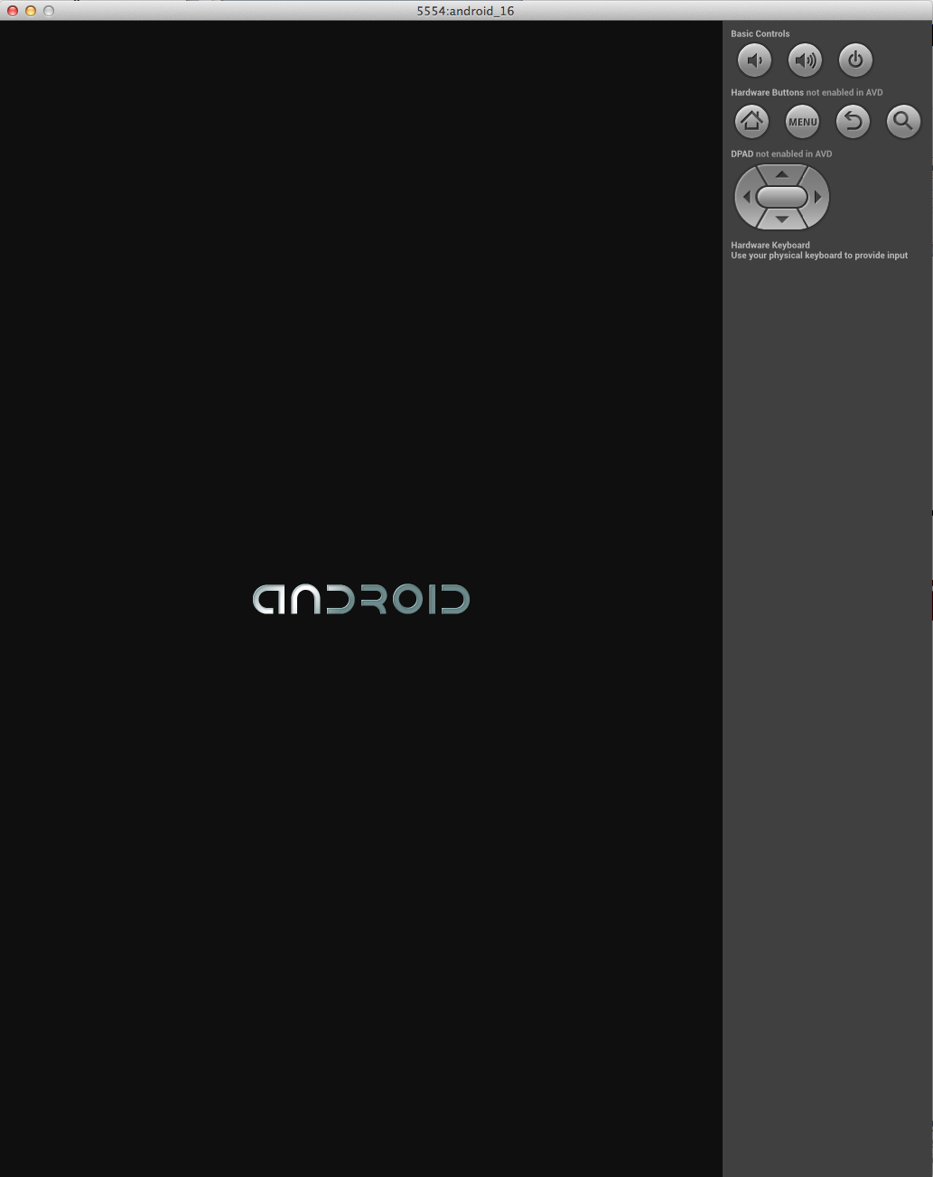
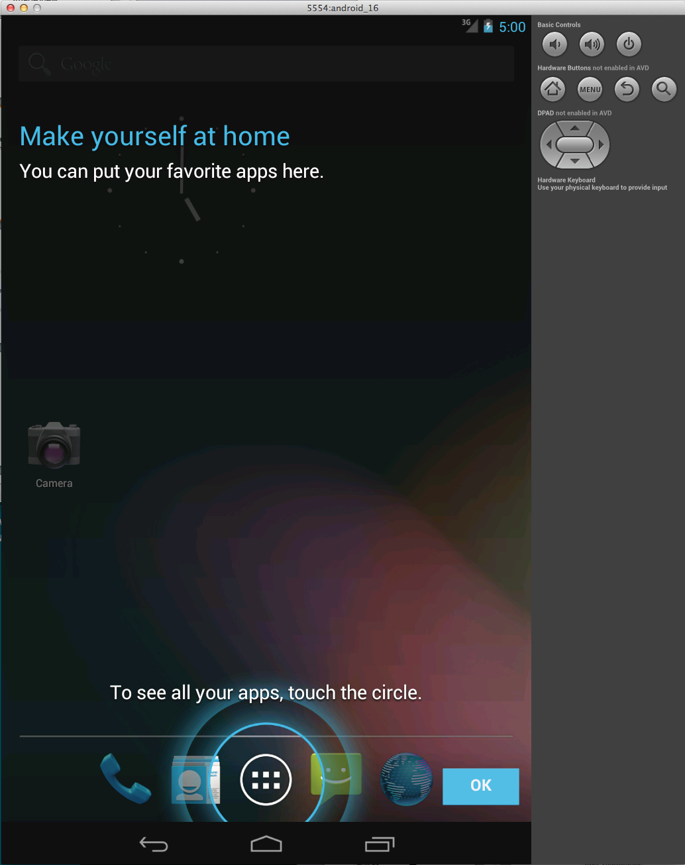

Slide 9

Eclipse IDE
For this project, we’ll be using Eclipse
Official Google ADT plugin

Slide 10
Android Applications
}
Activities
Services
Content Providers
Broadcast Receivers
Application Manifest
Static Resources
Android Package (.apk)

Slide 11
Android Applications
}
Activities
Services
Content Providers
Broadcast Receivers
Application Manifest
Static Resources
Android Package (.apk)

Slide 12
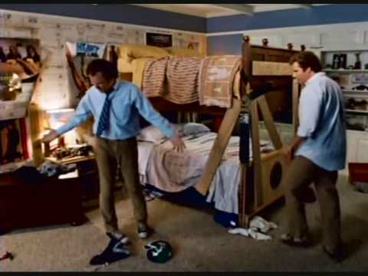
Activities
A single screen with a user interface
Examples
Screen that shows a photo gallery
Email application’s list of new emails
Foursquare’s “check in” screen
“It’s making my head spin; how many activities we can do”
- Will Ferrell, Step Brothers

Slide 13
Services
Background processes
Long running tasks
Short tasks that act on user input from activities
Examples
Music app that plays audio while other apps are running
Process that communicates with a server and pushes data to an app

Slide 14
Content Providers
Manages a set of application data
Between application and database
Between application and file system
Between application and web
Can keep data private or allow other applications to access and modify

Slide 15
Broadcast Receivers
Responds to a system-wide broadcast announcement
Sit idle until their event is received
No user interface
Examples
Waiting for a photo to be captured
Waiting on data to be downloaded
Performing actions when the screen goes off

Slide 16
Android Applications
}
Activities
Services
Content Providers
Broadcast Receivers
Application Manifest
Static Resources
Android Package (.apk)

Slide 17
Android Manifest
Details information about an application
Declares application components
Identifies permissions needed
Declares target and minimum API levels
Declares required hardware

Slide 18
Android Manifest
Declaring an activity:
<activity
android:name="com.example.project.ExampleActivity”
android:label="@string/example_label” >
</activity>
Or <service/> or <receiver/> or <provider/>
Starting a component that isn’t defined in the manifest will cause a runtime exception!

Slide 19
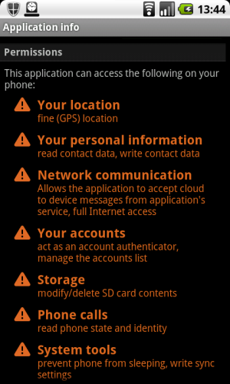
Permissions
Apps must request permissions to be able to perform some tasks
Access GPS
Read contact data
Access the internet
Access the camera
Make phone calls

Slide 20
Permissions
If you try to do something that requires a permission, Eclipse will warn you
Permissions can be added to the project’s manifest file, AndroidManifest.xml
Eclipse may even add them automatically if you ask nicely

Slide 21
Android Manifest
Declaring a permission:
<uses-permission
android:name=“android.permission.INTERNET” />
<uses-permission
android:name=“android.permission.VIBRATE” />

Slide 22
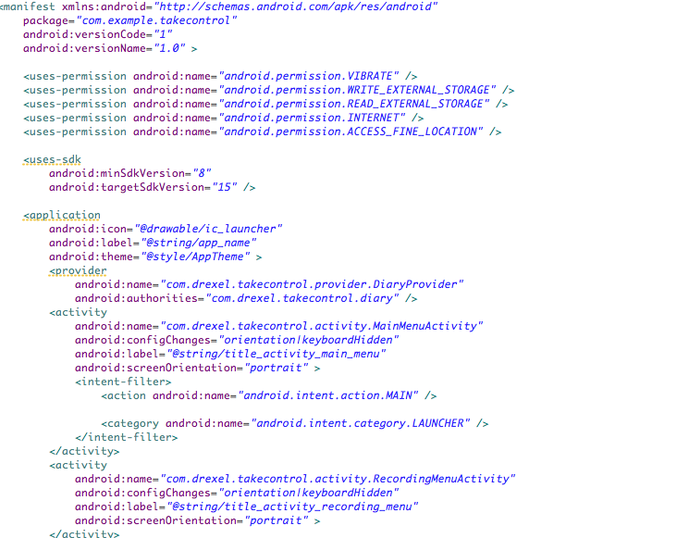

Slide 23
Android Applications
}
Activities
Services
Content Providers
Broadcast Receivers
Application Manifest
Static Resources
Android Package (.apk)

Slide 24
Resources
Static content used by an application
XML Files that define how things are drawn or presented…
Drawables
Layouts
… or contain definitions of project-wide constant values
Strings
Arrays
Colors

Slide 25
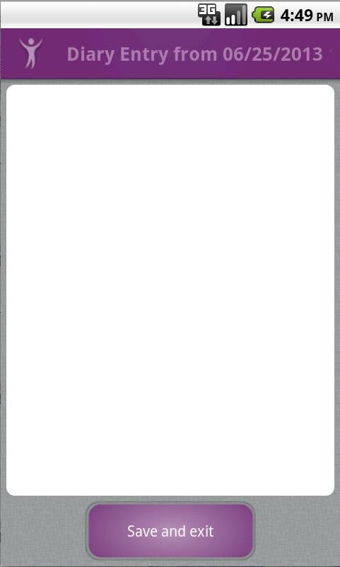
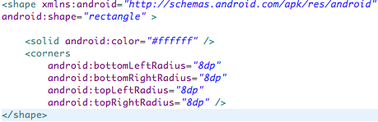
Drawables
/res/drawable
/drawable-xhdpi, /drawable-hdpi, /drawable-mdpi
Shapes or images that can be referenced by ID in the application

Slide 26
Layouts
/res/layout
XML files that define how objects are laid out on screen
More on layouts tomorrow…

Slide 27
Strings
/res/values/strings.xml
A list of String values that can be referenced by ID in the application
<string name=“hello_text”>Hello</string>
R.id.hello_text
@string/hello_text

Slide 28
Arrays
/res/values/arrays.xml
A list of arrays that can be referenced by ID in the application
<string-array name=“menu_icons”> <item>@drawable/ic_entry_food</item> <item>@drawable/ic_entry_mood</item> <item>@drawable/ic_entry_pill</item> </string-array>
R.array.menu_icons
@array/menu_icons

Slide 29
Colors
/res/values/colors.xml
A list of colors that can be referenced by ID in the application
<color name=“red_text”>#FF0000</color>
R.color.red_text
@color/red_text

Slide 30

Resources
Why?
“Ladies and gentlemen, this is Chewbacca. Chewbacca is a Wookie from the planet Kashyyyk. But Chewbacca lives on the planet Endor. Now think about it; that does not make sense! … Look at me. I’m a lawyer defending a major record company and I’m talkin’ about Chewbacca! Does that make sense? Ladies and gentlemen, I am not making any sense! None of this makes sense!”
- Trey Parker (as Johnnie Cochran), South Park

Slide 31
Resources
Why?
Keeps constants in one place
Change once and it changes everywhere
Applications can automatically use the correct resources for their situation
Screen size
Pixel density
Language

Slide 32

R
“Arrrrrrrrr!”
- Blackbeard (Probably)
R.java
An automatically generated file that contains references to all of your resources
Takes all of the definitions from /res, sorts them, and turns them into referenceable objects

Slide 33
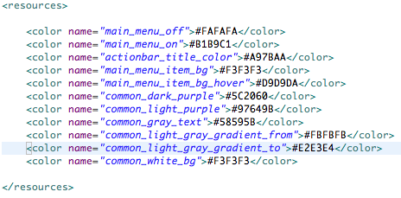
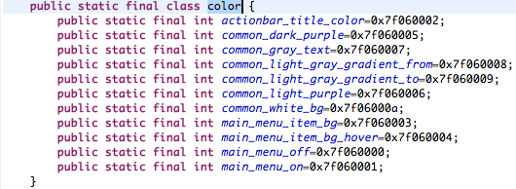

R
/res/values/colors.xml

Slide 34
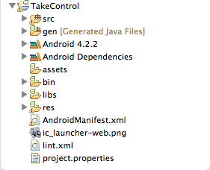
Structure of Android Programs

Slide 35
Structure of Android Programs
Hold all of the project source (.java) files
All classes you create should go in the /src directory
Auto-generated classes will go in the /gen directory

Slide 36
Structure of Android Programs
Android platform libraries
android.jar for the target platform
Other Android libraries
Google API

Slide 37
Structure of Android Programs
External files
Compiled into the final APK with filenames intact

Slide 38
Structure of Android Programs
Binary output
Most importantly, the project .apk

Slide 39
Structure of Android Programs
Other external libraries
Graphing API
Machine Learning API
Graphics API

Slide 40
Structure of Android Programs
Resource files
XML
Layouts
Drawables
Values

Slide 41
Structure of Android Programs
Manifest file
Contains all declarations
Permissions
Components
Target platforms
Themes
Application name
Icons

