Slide 1

Layouts and Designing Interfaces for Mobile
Jeff Segall
July 9, 2013

Slide 2
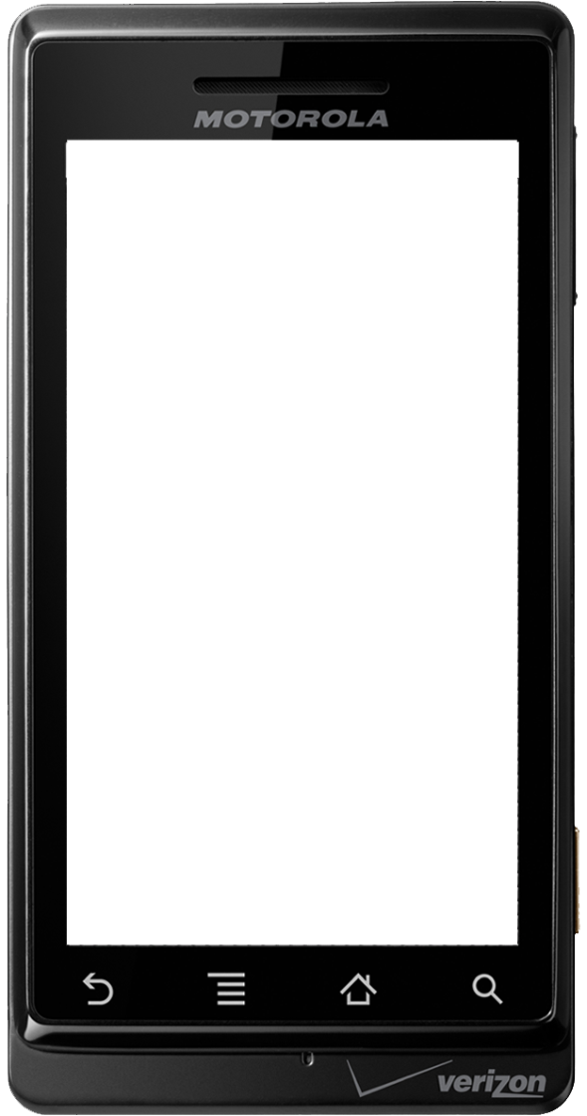

“Yes, well, this is all tremendously boring”
- The Joker, Batman:TAS

Slide 3
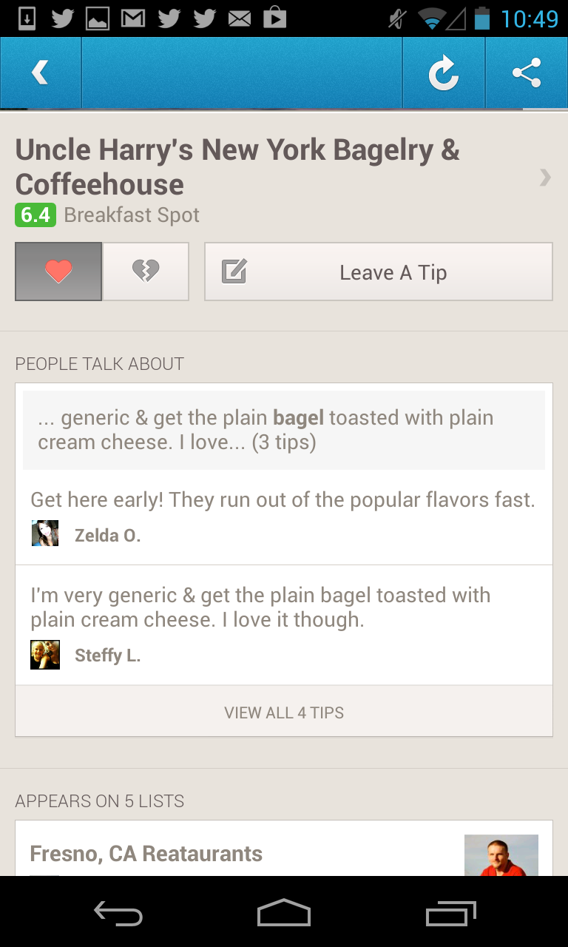

Slide 4
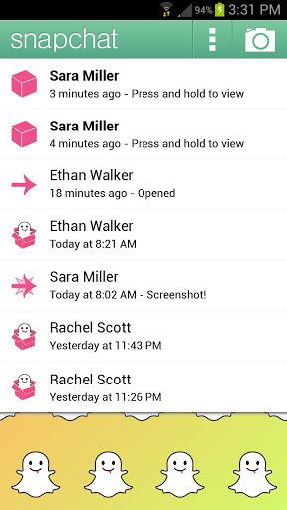

Slide 5
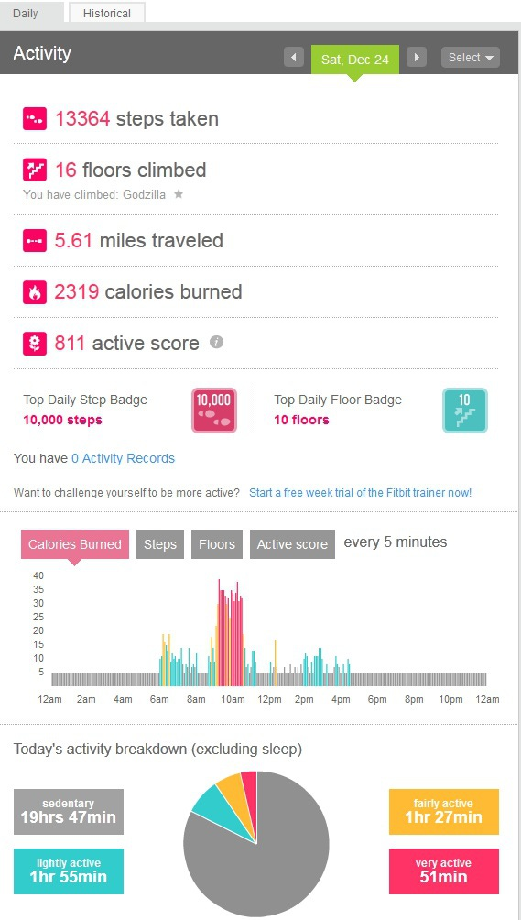

Slide 6
User Interface
How does the user view information?
How does the user interact with your app?
How does your app look to the user?

Slide 7
Building an Android UI
Hierarchical structure
Views organized in containers, organized in containers, organized in containers …
Static: XML + Java
Dynamic: Java + Java

Slide 8
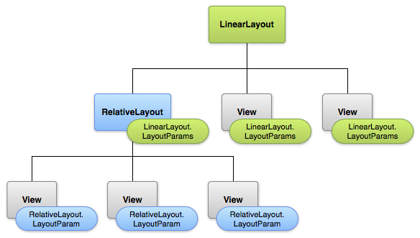
Building an Android UI
<?xml version="1.0" encoding="utf-8"?>
<LinearLayout xmlns:android="http://schemas.android.com/apk/res/android"
android:layout_width="fill_parent"
android:layout_height="fill_parent"
android:orientation="vertical" >
<TextView
android:id="@+id/text"
android:layout_width="wrap_content"
android:layout_height="wrap_content"
android:text="Hello, I am a TextView" />
<Button
android:id="@+id/button"
android:layout_width="wrap_content"
android:layout_height="wrap_content"
android:text="Hello, I am a Button" />
</LinearLayout>

Slide 9
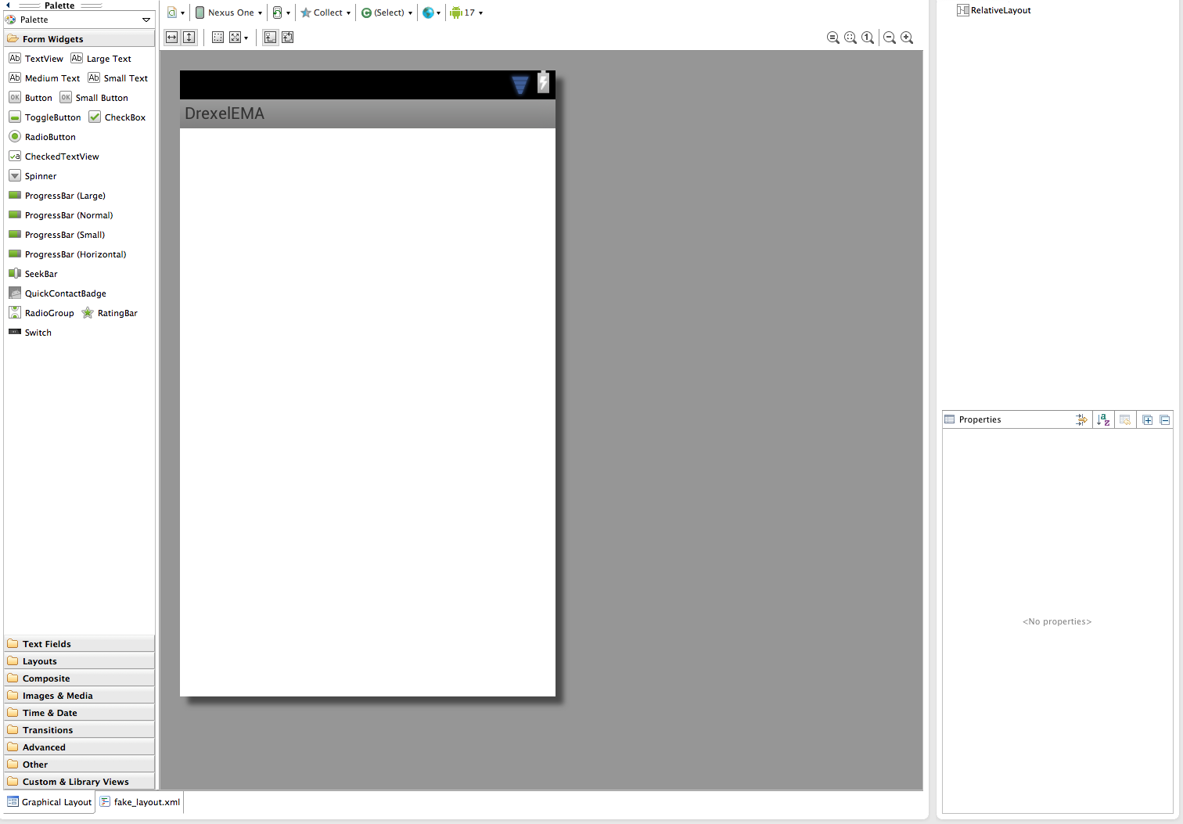
The Interface Builder

Slide 10
The Interface Builder
Palette
Holds all of the views that can be added to the layout
Loosely separated by type
Drag and drop

Slide 11
The Interface Builder
Outline
Shows a hierarchical list of views in the layout

Slide 12
The Interface Builder
Properties
Displays layout properties of the selected view
View customization without directly editing XML

Slide 13
The Interface Builder

Slide 14
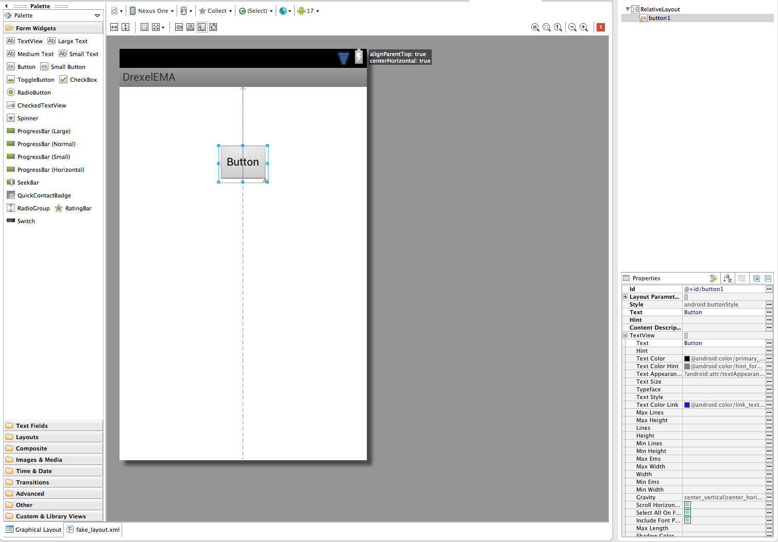
The Interface Builder

Slide 15
The Interface Builder

Slide 16
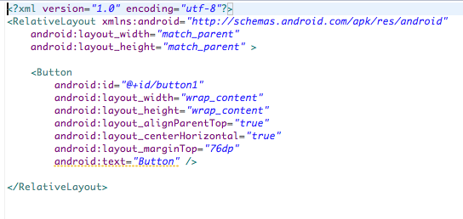
The Interface Builder

Slide 17
Loading a Layout
public class MainActivity extends Activity {
@Override
public void onCreate(Bundle savedInstanceState) {
super.onCreate(savedInstanceState);
setContentView(R.layout.main_layout);
}
…
}

Slide 18
Finding Statically-Defined Views
Given an XML layout, access View objects in your Java code
findViewById(R.id.button1);
Button okButton =
(Button)findViewById(R.id.button1);
okButton.setOnClickListener(this);

Slide 19
User Interface
How does the user view information?
How does the user interact with your app?
How does your app look to the user?

Slide 20
TextView
Display text to the user
TextView is a container and the text it holds can be set statically or dynamically
In XML
<TextView
android:id=“test_text”
android:text=“@string/hello_world” />
In Java
TextView v = (TextView)findViewById(R.id.test_text);
v.setText(“Hello, world!”);

Slide 21
ImageView
Display an image to the user
ImageView is a container and the image it holds can be set statically or dynamically
In XML:
<ImageView
android:id=“test_image”
android:src=“@drawable/image” />
In Java:
ImageView v = (ImageView)findViewById(R.id.test_image);
v.setImageBitmap(BitmapFactory.decodeFile(filepath));
OR
v.setImageResource(R.drawable.image);

Slide 22
Toast
Pop up a notification
Appears, waits, fades
Not a View
In Java:
Toast.makeText(context, “Hello, world!”,
Toast.LENGTH_LONG).show();

Slide 23
User Interface
How does the user view information?
How does the user interact with your app?
How does your app look to the user?

Slide 24
EditText
Retrieve text input from the user
In XML:
<EditText
android:id=“test_edit” />
In Java:
EditText edit =
(EditText)findViewById(R.id.test_edit);
String text = edit.getText();

Slide 25
Button
Perform an action on the user’s command
In XML:
<Button
android:id=“test_button”
android:text=“@string/submit” />
In Java:
Button button =
(Button)findViewById(R.id.test_button);
button.setOnClickListener(this);

Slide 26
ImageButton
Perform an action on the user’s command
In XML:
<Button
android:id=“test_button”
android:text=“@string/submit” />
In Java:
Button button =
(Button)findViewById(R.id.test_button);
button.setOnClickListener(this);

Slide 27
Handling Events
How do we know when a user has interacted with our UI?

Slide 28
Handling Button Clicks
Buttons have a View.OnClickListener
Button testButton =
(Button)findViewById(R.id.test_button);
button.setOnClickListener(new OnClickListener(){
@Override
public void onClick(View v){
//Do Something
}
});

Slide 29
Handling Button Clicks
What if we have a lot of things that can be clicked on?
public class MainActivity extends Activity implements OnClickListener {
public void onClick(View v){
switch(v.getId()){
case R.id.test_button:
//Do something
break;
}
}
testButton.setOnClickListener(this);
…

Slide 30
Checkboxes / Radio Buttons
Choose from a defined list of items
Multiple items visible at a time
Checkboxes
Select multiple options (or none)
Radio Buttons
Select a single option

Slide 31
User Interface
How does the user view information?
How does the user interact with your app?
How does your app look to the user?

Slide 32


Linear Layout
Child views organized in a single row
Vertical or horizontal

Slide 33

Relative Layout
Child views organized with respect to other views

Slide 34
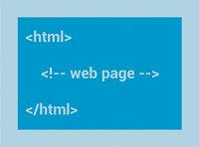
WebView
Displays a webpage or custom HTML
Handles page navigation

Slide 35
AdapterView
Class of views where children are held and defined by an associated Adapter
Views can refresh and resize when children are added or removed
Memory efficient!
Child views are recycled when not visible

Slide 36


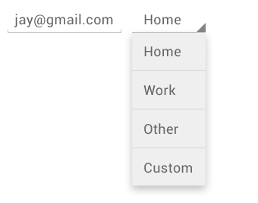
AdapterView
ListView
Children are organized in a vertical list
GridView
Children are organized in a grid
Spinner
Allows a user to select one item from a list, storing the others in a drop-down menu

Slide 37
Adapters
When you have a list or grid component, define the view in XML, but populate the view dynamically
Even if the list is static!

Slide 38
Adapters
Static lists are easy…
SimpleListAdapter(Context context,
List <? extends Map<String, ?>> data,
int resource,
String[] from,
int[] to);

Slide 39
Adapters
list_item.xml
School
Mascot
R.id.school_text
R.id.mascot_text

Slide 40
Adapters
SimpleListAdapter(Context context,
List <? extends Map<String, ?>> data,
int resource,
String[] from,
int[] to);
More on context in the next lecture
An abstract representation of an application’s global environment

Slide 41
Adapters
SimpleListAdapter(Context context,
List <? extends Map<String, ?>> data,
int resource,
String[] from,
int[] to);
The backing data
A list of what?

Slide 42
Adapters
Map is a key-value store
Map <String, String> values = new HashMap<String, String>();
values.put(“school”, “Drexel”);
values.put(“mascot”, “Dragons”);
Each entry in the List is a row in the list
List< Map<String, String> > data = new
ArrayList<Map<String,String>>();
data.add(values);

Slide 43
Adapters
SimpleListAdapter(Context context,
List <? extends Map<String, ?>> data,
int resource,
String[] from,
int[] to);
The layout resource that will hold the data
R.layout.list_item

Slide 44
Adapters
SimpleListAdapter(Context context,
List <? extends Map<String, ?>> data,
int resource,
String[] from,
int[] to);
The mapping to perform…

Slide 45
Adapters
The mapping to perform…
Map <String, String> values = new HashMap<String, String>();
values.put(“school”, “Drexel”);
values.put(“mascot”, “Dragons”);

Slide 46
Adapters
The mapping to perform…
Map <String, String> values = new HashMap<String, String>();
values.put(“school”, “Drexel”);
values.put(“mascot”, “Dragons”);
School
Mascot
R.id.school_text
R.id.mascot_text

Slide 47
Adapters
The mapping to perform…
Map <String, String> values = new HashMap<String, String>();
values.put(“school”, “Drexel”);
values.put(“mascot”, “Dragons”);
School
Mascot
R.id.school_text
R.id.mascot_text

Slide 48
Adapters
The mapping to perform…
String from[] = {“school”, “mascot”};
int to[] = {R.id.school_text, R.id.mascot_text};

Slide 49
Adapters
Map <String, String> values = new HashMap<String, String>();
values.put(“school”, “Drexel”);
values.put(“mascot”, “Dragons”);
List< Map<String, String> > data = new
ArrayList<Map<String,String>>();
data.add(values);
String from[] = {“school”, “mascot”};
int to[] = {R.id.school_text, R.id.mascot_text};
SimpleAdapter adapter = new SimpleAdapter(this, data,
R.layout.list_item, from, to);

Slide 50
Adapters
ListView mascotList = (ListView) findViewById(R.id.mascot_list);
mascotList.setAdapter(adapter);
Drexel
Dragons

Slide 51
Adapters
For more complex layouts, it may be necessary to create your own adapter
Custom adapters extend the BaseAdapter class
Override getView() function and manually set your fields

Slide 52
Width / Height
Component width and height can defined in absolute terms
More often, it’s better to use relative terms
match_parent
Stretch to fill the space of this component’s parent
Formerly “fill_parent”, renamed in API Level 8
wrap_content
Size the component to fit its children

Slide 53
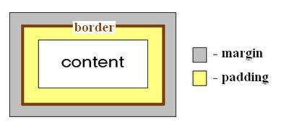
Padding / Margins
Widgets can be given extra space using padding and margins
Padding adds spacing within the widget
Margins add spacing outside the widget

Slide 54
Accessibility
How is designing an application for a mobile platform different than designing an application for a desktop or laptop?

Slide 55
Accessibility
How is designing an application for a mobile platform different than designing an application for a desktop or laptop?
Screen size
Less precise selection
Processing power
Memory
Storage

Slide 58
<Button
android:id=“tip_button”
android:layout_width=wrap_content
android:layout_height=wrap_content
android:text=“@string/tip_text” />

Slide 59
<Button
android:id=“tip_button”
android:layout_width=wrap_content
android:layout_height=wrap_content
android:text=“@string/tip_text” />

Slide 60
<LinearLayout
android:layout_width=fill_parent
android:layout_height=wrap_content
android:orientation=horizontal>
<Button
android:id=“tip_button”
android:layout_width=wrap_content
android:layout_height=wrap_content
android:text=“@string/tip_text” />
</LinearLayout>

Slide 61
<LinearLayout
android:layout_width=fill_parent
android:layout_height=wrap_content
android:orientation=horizontal>
<Button
android:id=“tip_button”
android:layout_width=wrap_content
android:layout_height=wrap_content
android:text=“@string/tip_text” />
</LinearLayout>

Slide 62
<LinearLayout
android:layout_width=fill_parent
android:layout_height=wrap_content
android:orientation=horizontal>
<Button
android:id=“tip_button”
android:layout_width=wrap_content
android:layout_height=wrap_content
android:text=“@string/tip_text” />
</LinearLayout>
<ListView
android:id=“talk_list”
android:layout_width=match_parent
android:layout_height=wrap_content />

Slide 63
<LinearLayout
android:layout_width=fill_parent
android:layout_height=wrap_content
android:orientation=horizontal>
<Button
android:id=“tip_button”
android:layout_width=wrap_content
android:layout_height=wrap_content
android:text=“@string/tip_text” />
</LinearLayout>
<ListView
android:id=“talk_list”
android:layout_width=match_parent
android:layout_height=wrap_content />

Slide 64
<LinearLayout
android:layout_width=fill_parent
android:layout_height=fill_parent
android:orientation=vertical>
<LinearLayout
android:layout_width=fill_parent
android:layout_height=wrap_content
android:orientation=horizontal>
<Button
android:id=“tip_button”
android:layout_width=wrap_content
android:layout_height=wrap_content
android:text=“@string/tip_text” />
</LinearLayout>
<ListView
android:id=“talk_list”
android:layout_width=match_parent
android:layout_height=wrap_content />
</LinearLayout>

Slide 65
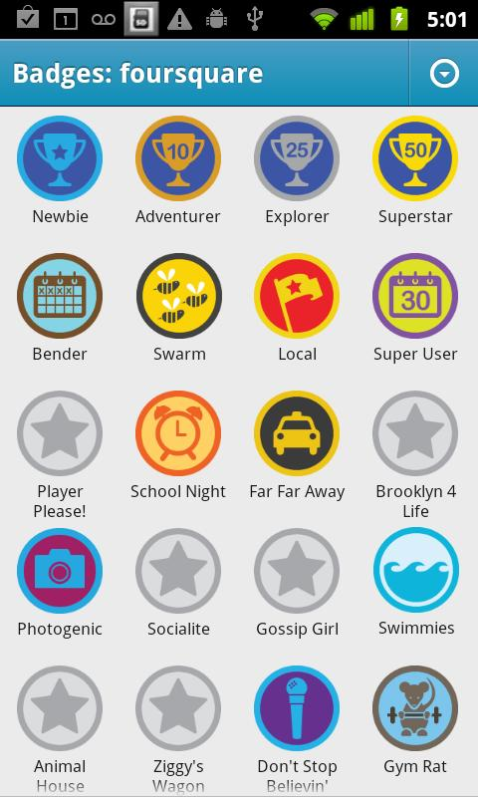

Slide 67
<ImageView
android:id=“cab_image”
android:src=R.drawable.cab_badge
android:maxWidth=64dp />

Slide 68
<ImageView
android:id=“cab_image”
android:src=R.drawable.cab_badge
android:maxWidth=64dp />

Slide 69
<ImageView
android:id=“cab_image”
android:src=R.drawable.cab_badge
android:maxWidth=64dp />
<TextView
android:id=“cab_text”
android:text=“@string/cab_text” />

Slide 70
<ImageView
android:id=“cab_image”
android:src=R.drawable.cab_badge
android:maxWidth=64dp />
<TextView
android:id=“cab_text”
android:text=“@string/cab_text” />

Slide 71
<LinearLayout
android:layout_width=wrap_content
android:layout_height=wrap_content
android:orientation=vertical>
<ImageView
android:id=“cab_image”
android:src=R.drawable.cab_badge
android:maxWidth=64dp />
<TextView
android:id=“cab_text”
android:text=“@string/cab_text” />
</LinearLayout>

Slide 72
<LinearLayout
android:layout_width=wrap_content
android:layout_height=wrap_content
android:orientation=vertical>
<ImageView
android:id=“cab_image”
android:src=R.drawable.cab_badge
android:maxWidth=64dp />
<TextView
android:id=“cab_text”
android:text=“@string/cab_text” />
</LinearLayout>

Slide 73
<LinearLayout
android:layout_width=wrap_content
android:layout_height=wrap_content
android:orientation=vertical>
<ImageView
android:id=“cab_image”
android:src=R.drawable.cab_badge
android:maxWidth=64dp />
<TextView
android:id=“cab_text”
android:text=“@string/cab_text” />
</LinearLayout>
<GridView
android:id=“badge_grid_layout”
android:layout_width=fill_parent
android:layout_height=fill_parent />

Slide 74
What Else?
There are lots of pre-built Android view components
So many that I couldn’t possibly go over how to use them all or even everything that you can do with the ones I did mention
See: http://developer.android.com/guide/topics/ui/overview.html for a more extensive list and usage guides

Slide 75
Review
User interfaces make your app presentable to a user
Android UI are hierarchical
Made up of Views inside Views inside Views
Built statically in XML or dynamically in Java
Interface builder provides a drag and drop solution to creating Android UI

Slide 76
Review
In an Activity:
Use setContentView() to load a layout file
Use findViewById() to get a reference to a view in your XML layout
Remember to cast the object to the correct type
When designing layouts for mobile:
Remember, screen sizes are small and fingers are huge (compared to a pointer)

Slide 77
Questions?

