Slide 1
Service Integration and Composition
William M. Mongan

Slide 2
Composition
Before REST became a popular vehicle for implementing web services, services were defined by “Web Service Description Language” or WSDL.

Slide 3
Introduction
Service Oriented Computing (SOC) is a movement towards an implementation-independent architecture for distributed computing.
Rather than an object-based design and functionality, Service Oriented Architecture (SOA) raises the level of abstraction towards higher level business logic.

Slide 4
A Typical Scenario
A small company is currently using separate in-house proprietary systems to process orders, charge credit cards, check inventory and ship products.
  Data is exchanged from one department to the other via hand-written e-mails, though the inventory and shipping departments were recently integrated and sharing messages using a proprietary format over TCP.

Slide 5
Why SOA
In this example, departments only expose the highest level of business logic that each needs to share.
For example, the shipping department need only know that the credit card transaction was approved and the shipping address provided by the customer.

Slide 6
Bottom Up vs. Top Down Design
Although SOA allows for a bottom-up design amicable to the integration of legacy systems, the real benefit is realized from a top-down, implementation-independent approach.

Slide 7
Bottom Up vs. Top Down Design
By using XML schemas to define abstract data types and an XML document to define business-logic operations in terms of these abstract types, a complete interface is derived for a system that naturally hides implementation details and business secrets.

Slide 8
The Design Hides the Implementation
Services only provide their public interfaces to one another.
Information is filtered from messages as they travel from service to service, or hidden completely via selective XML encryption.

Slide 9
So What?
Imagine services as a pipeline, or assembly line, through which business logic is realized.
If a service (i.e. the shipping department) was outsourced to a third party, only the service contract and the surrounding clients that invoke it need to be changed.

Slide 10
So What?
As we’ve discussed, the new shipping company does not want to disclose private information such as its sub-contractors and charges.
Only the invocation requirements, message format, and data parameters are exposed by the contract.

Slide 11
Advantages to SOA
Services are discoverable and dynamically bound;
Services are self-contained and modular;
Services stress interoperability;
Services are loosely coupled;
Services have a network-addressable interface;
Services have coarse-grained interfaces;
Services are location transparent;
Services are composable;
Service-oriented architecture supports self-healing.

Slide 12
Service Invocation
Method calls are based either on legacy Remote Procedure Calls (RPC) or on XML documents.
When using XML documents to call service functionality, an XML document is formed and addressed to the service being hosted.
  The content of the document is a structure that matches the structure and contains all the data parameters mandated by the service’s contract.

Slide 13
Service Invocation
The service receives that message, executes the method that implements the service, and returns the result in another document as prescribed by the service contract.
The underlying transport is often transparent to the programmer, as the communications implementation is often automatically generated, leaving a code stub that the programmer must implement and call as a normal object method.

Slide 14
Service Composition
Because services are a primitive unit in SOA, they can be composed just as objects are in the OO paradigm to create new applications according to business processes.
Unlike objects, services are also registered with a name service that can be searched.
In this way, services can be dynamically found, bound, and consumed at runtime.
  An interesting and open problem is to dynamically bind to services based on a semantic query.

Slide 15
Service Flexibility
This flexibility facilitates a heterogeneous and asynchronous service environment.
Of course, one requirement is that the decision must be made and agreed upon by the service and caller.

Slide 16
How to Reach that Agreement
An XML schema document (XSD) is created to reflect the data types that will be used throughout the system.
Through XSD, implementation-independent complex data types can be represented via this structured document.
The service contract that specifies the XSD is called a WSDL.

Slide 17
XSD and Web Services
For example, Suppose we create an XSD that includes a type representing a sales order, and that type contains the item number, buyer’s name, address and credit card number.
We could then create a corresponding message type in our WSDL that conforms to this schema.

Slide 18
XSD and Web Services
In other words, we would produce an XML message identical in structure to the XSD (hence it is called a schema), but includes the appropriate data as well.
This XML message would be used as part of the service invocation to make a purchase.

Slide 19
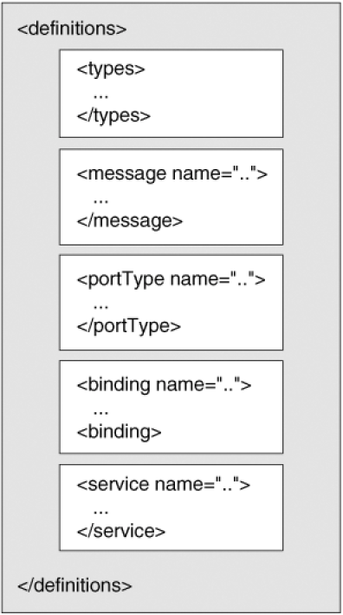
Web Service Description Language (WSDL) XML Description
The WSDL separates “what” a service does.
It expresses this separately from “how” and “where” the service does it.

Slide 20
WSDL Describes The…
Data types that a service uses (usually imported from the XSD schema),
Messages that are either sent or received by the service,
Operations the service supports and messages that are passed as parameters and sent as return values,
Protocol(s) over which those messages are sent (SOAP over HTTP, etc.), and
Physical location at which the service is accessible.

Slide 21
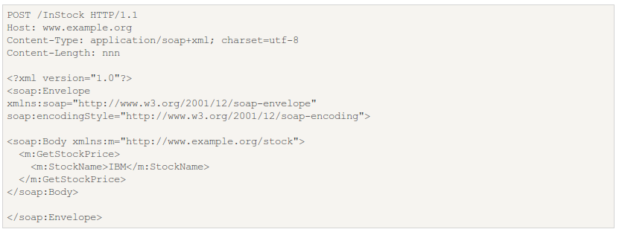
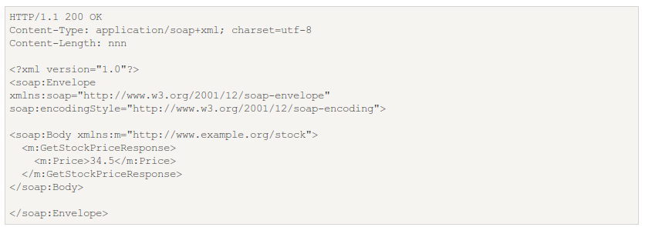
Example SOAP Request and Response

Slide 22
From WSDL to Client and Server
Once the WSDL file is formed, a server and/or client implementation may be created.
When we consider the usefulness of web services, we see that it is often the case that the client and server are implemented by two different parties.

Slide 23
From WSDL to Client and Server
Because WSDL forms a service contract between client and server, client code can be generated that conforms to the WSDL and calls the appropriate web service.
The <service> section also shows the physical location with which to interact and communicate.

Slide 24
Implementing a Client
It is possible to obtain the WSDL of a deployed web service from the application server on which it resides.
So it becomes trivial to write a client to interact with service providers such as eBay, Google, Amazon, and so on.
All of this holds true for server implementation as well.

Slide 25
Implementing the Server
Apache Axis, .NET, and others provide tools to generate code stubs that conform to a given WSDL definition.
The developer must simply provide the implementation of that stub, which is essentially the private algorithms used to execute the advertised functionality.

Slide 26
Composing Services with BPEL4WS
With the Business Process Execution Language, one can:
  Allow for interaction with the applications being composed,
  Wait for some time,
  Copy data from one place to another,
  Indicate error conditions,
  Terminate the entire composition instance,
  Or do nothing.

Slide 27
Semantics for Automatic Discovery and Binding: DAML-S
Composition of web services requires compatibility between those web services, both from a syntatic as well as a semantic point of view.
  Syntactic compatibility is enforced by WSDL.
Ideally, services would be loosely coupled to the point that they become interchangeable.

Slide 28
Semantics for Automatic Discovery and Binding: DAML-S
If a service or provider goes down, introduces a bug, or does not meet a desired non-functional requirement such as speed or security, another service can be invoked seamlessly in its place.
Moreover, entire applications can be defined simply by defining the business-level functionality, and services to achieve that goal could be automatically discovered and incorporated into the composed business process.

Slide 29
Semantics for Automatic Discovery and Binding: DAML-S (aka OWL-S)
This, however, is non-trivial and is an area of open research among the services community and the Semantic Web folks.
The DARPA Agent Markup Language (DAML-S) provides a language and ontology for adding semantic meaning to web service descriptions to facilitate automated discovery and, ultimately, automated composition.

Slide 30
Introduction to Service Semantics
OWL-S sits on top of WSDL and describes:
  What the service does (“ServiceProfile”)
  How to access the service (“ServiceGrounding”)
  How the eservice works (“ServiceModel”)
Matchmaker and schedulers (possibly agent systems) identify suitable services from this information.

Slide 31
Case Study: REportal
REportal is a service-based reverse engineering portal.
Users may upload code to REportal and perform RE analysis, without needing to install, configure and run individual tools.

Slide 32
Brief History
REportal 1.0 was based on Java Servlets, but the presentation layer was tightly coupled to the tools.
The tools quickly became obsolete, and others simply didn’t work, hindering the functionality.
Browser wars were a big problem during this time as well.

Slide 33
REportal 2.0
REportal 2.0 is based on web services. This was chosen because the architecture decouples the interface from the tools.
Relationships between tools are based on data via message passing in XML.
This makes it easy to
  Maintain existing tools.
  Add new (legacy) tools by simply turning them into a service.
  Take advantage of SOA security, automatic binding, distributed computing, and other features.

Slide 34
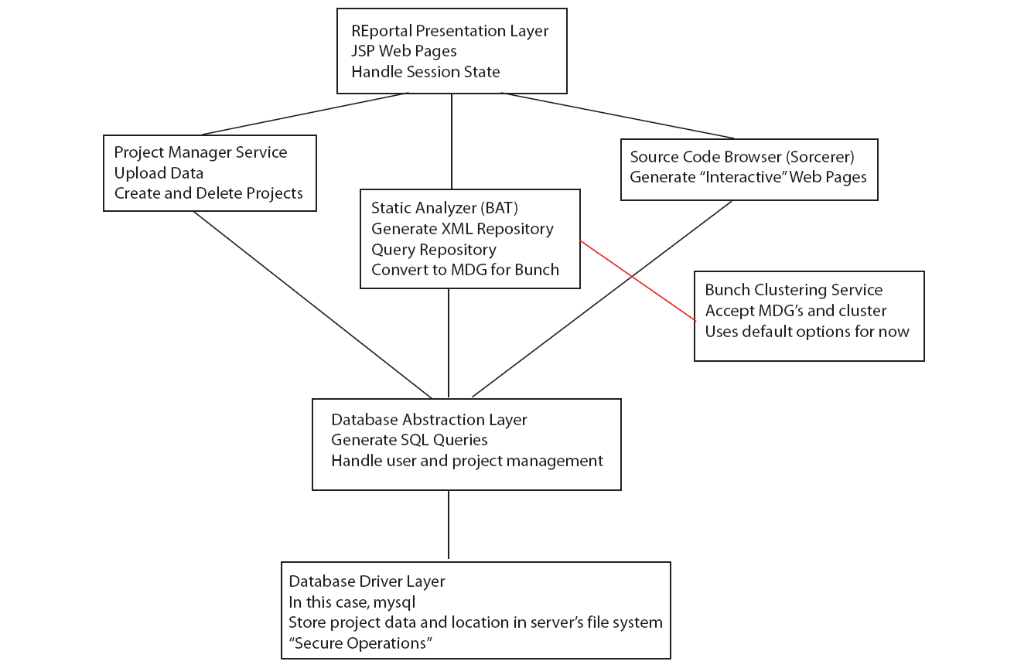

Slide 35
The Tools (Services)
REportal Application Layer
Bunch Wrapper
Static Analyzer
Source Code Browser
Text Search
Aspect Instrumentation
Project Manager
Database Layer

Slide 36
The Tools
REportal Application Layer
  This is the presentation layer, where JSP pages reside. The JSP pages invoke services to render functionality.
Bunch Wrapper
  This is used by several services, whenever graphical data or an MDG is produced. Bunch Wrapper clusters the graph and returns a new graph.

Slide 37
The Tools
Static Analyzer
  This is based on the BAT Static Analyzer for Java 1.5.
  Given Java class file(s), BAT creates an XML repository with source code relationships that exist between the entities.
    This needs to be improved to a database model for scalability.
    REportal queries the repository via XQuery and XSLT.

Slide 38
The Tools
Source Code Browser
  This is based on the Sorcerer source code browser tool. It provides a cross-referenced source index.
  Currently, REportal downloads a zip file of web pages to the user.
    Ultimately, using Ajax, we will display this content on the fly, rendering a seamless user interface!
Text Search
  Grep

Slide 39
The Tools
Aspect Instrumentation
  Using aspects, it is possible to instrument code to trace function calls.
  Doing this, we yield an MDG graph that can be viewed or clustered to show runtime slices.
Project Manager and Database Layer
  Using a database, tracks user logins and projects, including their location on the file system.
  They don’t have to reside on the same machine, but the database provides absolute file paths on the Project Manager service’s file system.

Slide 40
Microsoft Exchange
https://exchangeweb.drexel.edu/EWS/Services.wsdl
contains a web services definition that, when imported into a project, automatically creates data structures and methods that invoke the services (the idea is not unlike REST, but REST exposes these services and structures via more generic descriptors like URL's).
Access this via http://exchangeweb.drexel.edu/EWS/Exchange.asmx

Slide 41
Microsoft Exchange
You can add that URL as a web reference in a project like Visual Studio, or import it at the console using a tool like Apache Axis.

Slide 42
Microsoft Exchange
public void SendMessage(
string subject,
string body,
string toEmailAddress)
{
// Set the version, credentials, and the Client Access server on ExchangeServiceBinding.
ExchangeServiceBinding esb = new ExchangeServiceBinding();
esb.Credentials = new NetworkCredential("user2", "password", "domain");
esb.Url = "https://www.example.com/ews/exchange.asmx";
// Create a CreateItem request object
CreateItemType request = new CreateItemType();
// Setup the request:
// Indicate that we only want to send the message. No copy will be saved.
request.MessageDisposition = MessageDispositionType.SendOnly;
request.MessageDispositionSpecified = true;

Slide 43
Microsoft Exchange
// Create a message object and set its properties
MessageType message = new MessageType();
message.Subject = subject;
message.Body = new BodyType();
message.Body.BodyType1 = BodyTypeType.Text;
message.Body.Value = body;
message.ToRecipients = new EmailAddressType[1];
message.ToRecipients[0] = new EmailAddressType();
message.ToRecipients[0].EmailAddress = toEmailAddress;
message.ToRecipients[0].RoutingType = "SMTP";
//There are some more properties in MessageType object
//you can set all according to your requirement
// Construct the array of items to send
request.Items = new NonEmptyArrayOfAllItemsType();
request.Items.Items = new ItemType[1];
request.Items.Items[0] = message;
// Call the CreateItem EWS method.
CreateItemResponseType response = esb.CreateItem(request);
this.ThrowOnError("SendMessage", response.ResponseMessages.Items[0]);
}

Slide 44
References
Mongan, W., Shevertalov, M., Mancoridis, S., “Re-engineering a Reverse Engineering Portal to a Distributed SOA.” IEEE Proceedings of the 16th International Conference on Program Comprehension (ICPC), 2008.
Mongan, W. “A Service-Based Web Portal for Integrated Reverse Engineering and Program Comprehension.”
http://www.codeproject.com/Articles/28704/Programming-With-Exchange-Server-2007-EWS-Part-1
http://www.w3schools.com/webservices/ws_soap_example.asp

