Slide 1
AQademiC
(advanced question answer document enhanced machine intelligence computation)
Dave Zack Martin Moreno

Slide 2
Project/Presentation outline
Objective: Develop a model that can answer questions, that has been enhanced by additional context.
Version control/directory structures
Project planning
Data Collection/Preparation (several steps)
Exploratory Data Analysis
Model Development
Conclusions

Slide 3
Objective
Create a model that takes in context and provides an answer to questions
Use Stanford Question Answering Dataset (SQuAD) dataset to provide additional context to:
A custom (that one that we will attempt to create) and
A pre-trained RoBERTa question-answering model

Slide 4
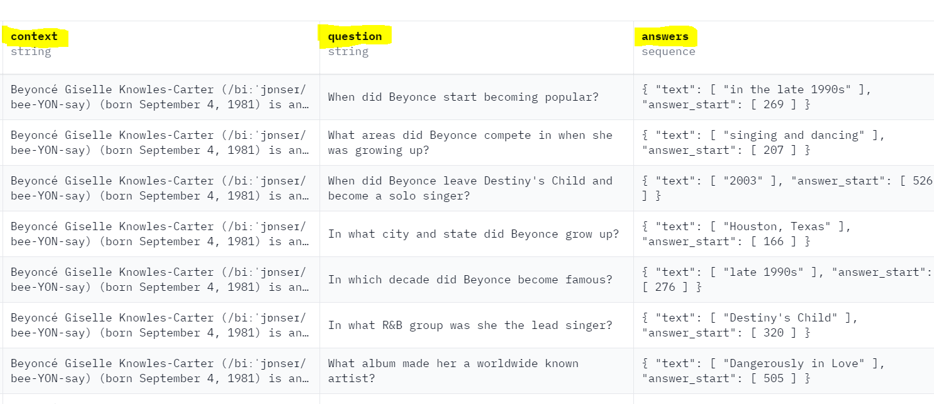
Context Question Answer

Slide 5
Project Planning
We went over every task in the project guideline and developed a plan:
Limited time to complete ambitious project
We agreed and started on a complete project set up before any tasks

Slide 6
Version control/Directory set up
Setting up a GitHub
Setting up folder structures for project
Split up every task into a separate scripts
Outputting a new Dataset after every task (data cleaning, augmentation, etc.) allowed us to quickly experiment over different data structures
Creates a structured data pipeline that can be used for unseen data in a similar format

Slide 7
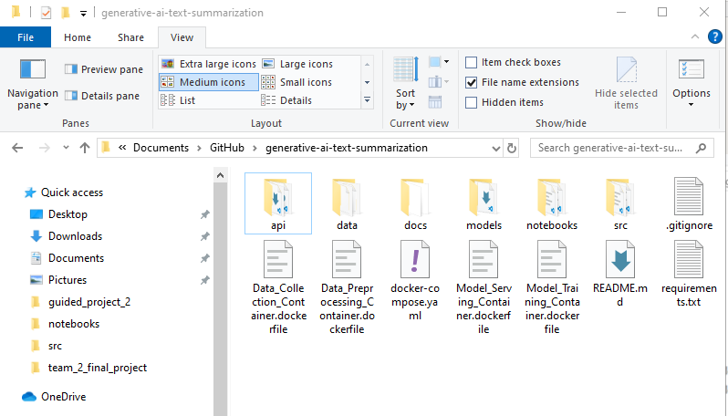
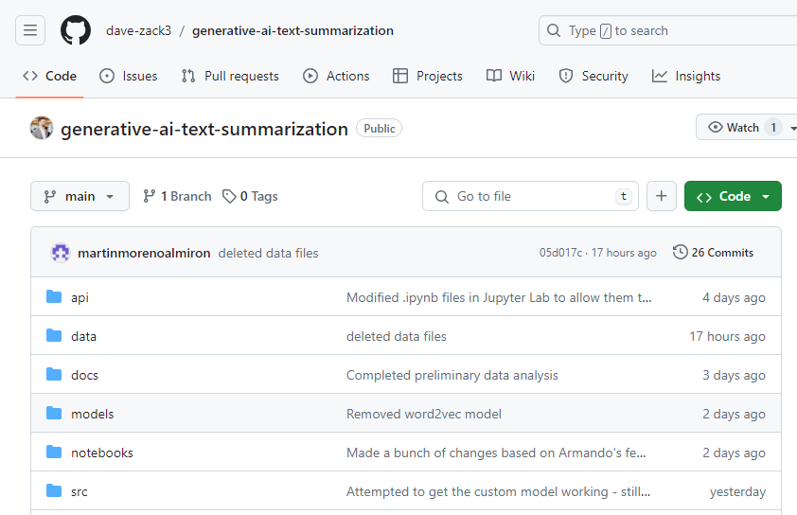
Directory
Github

Slide 8
Data Collection/preparation
Publicly available dataset, we expected it to be relatively clean
Downloaded as a JSON, converted to python data structures
Checked for duplicate entries
Data Transformation: Lemmatization, stemming, and “stopword” removal
Feature engineering: Part of Speech (PoS) tagging and Name Entity Recognition (NER)
Data augmentation: Synonym replacement and random word insertion

Slide 9
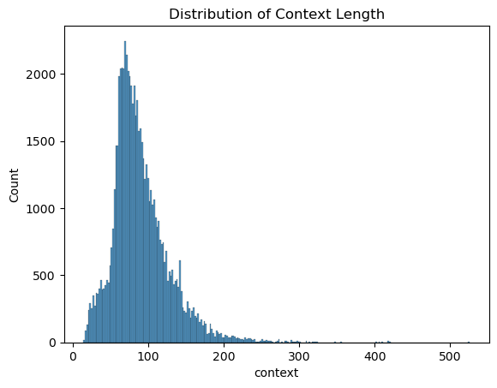
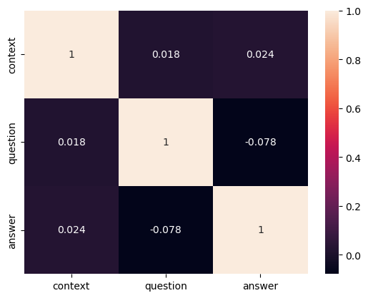
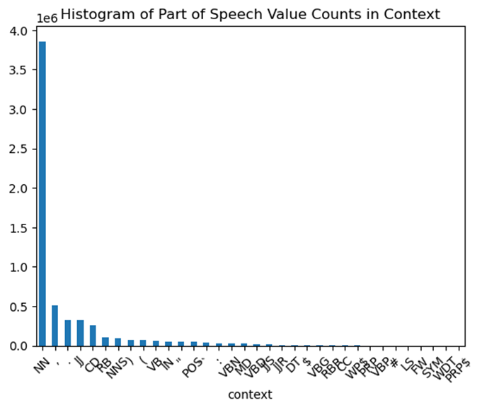
Exploratory Data Analysis (EDA)
Distribution of lengths of context entries
Correlation between lengths of context, question, and answer
The tag distribution

Slide 10
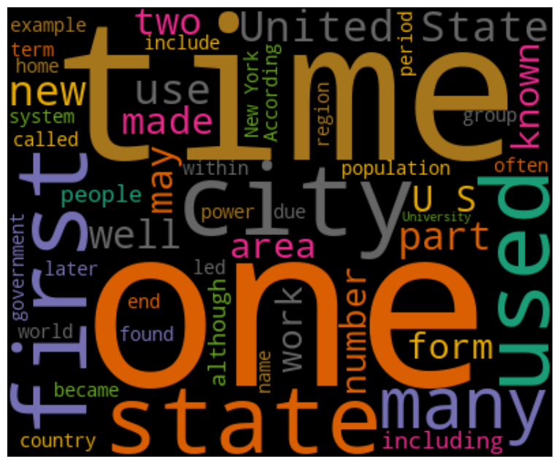
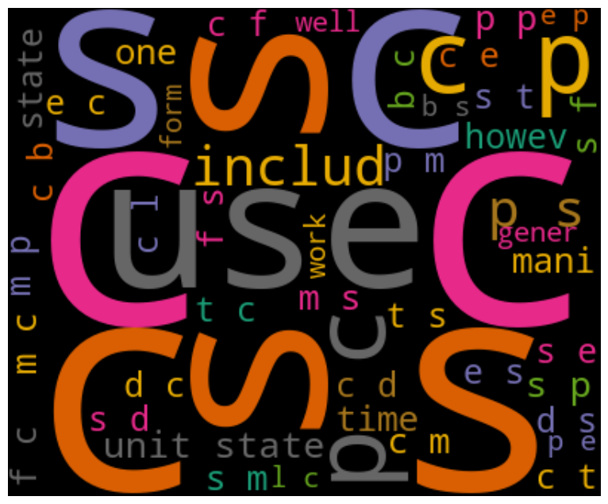
EDA (cont.)
Unprocessed Context Data
Processed Context Data

Slide 11
Model Development
Split the data into Train, Validation and Test sets
Attempted two models:
Custom transformer architecture
Fine-tuned RoBERTa model
Difficulties:
Transformer - Getting the output of the model to align with the tokenized answers
RoBERTa - Structuring data in a way that can be used to fine-tune the model
Given more time, could explore a “Start and Stop” output method in our custom architecture

Slide 12
Conclusions/Next steps
Working models
Hyper parameter optimization
Documentation
Take-aways:
Organization and project structuring are crucial in the beginning
Built a comprehensive data processing pipeline that could feed into models

