Slide 1

Grocery Store Ant Farm:
Technology Location Based Services
David Johnston
ThoughtWorks Away Day 2014

Slide 2
Outline
Technologies for location based services
IBeacons (w demo)
Applications in Grocery Stores and other places

Slide 3
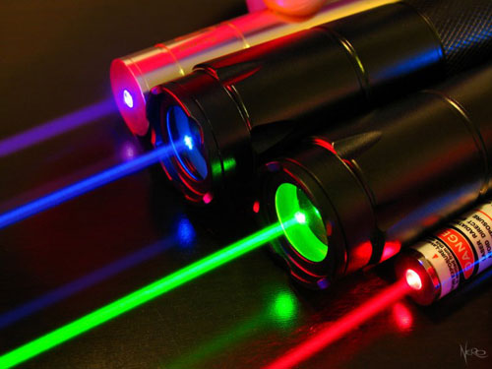
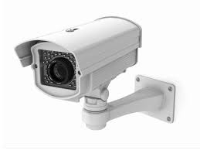
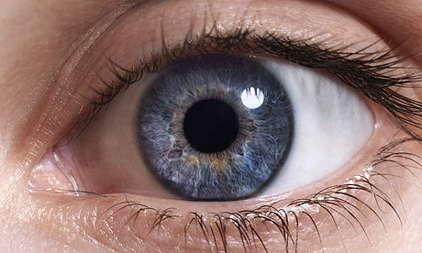
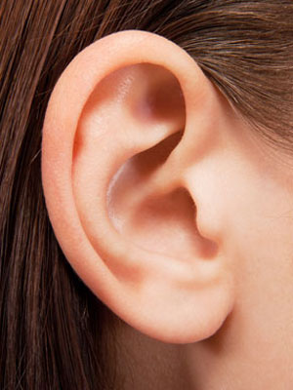
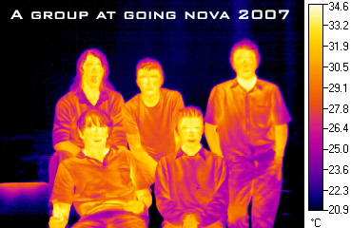

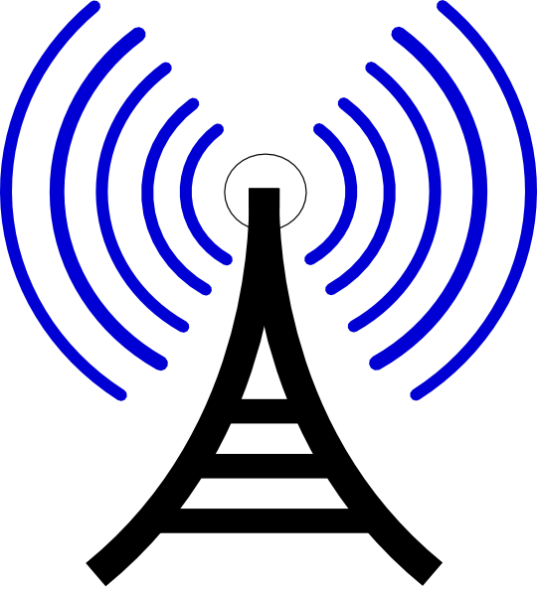

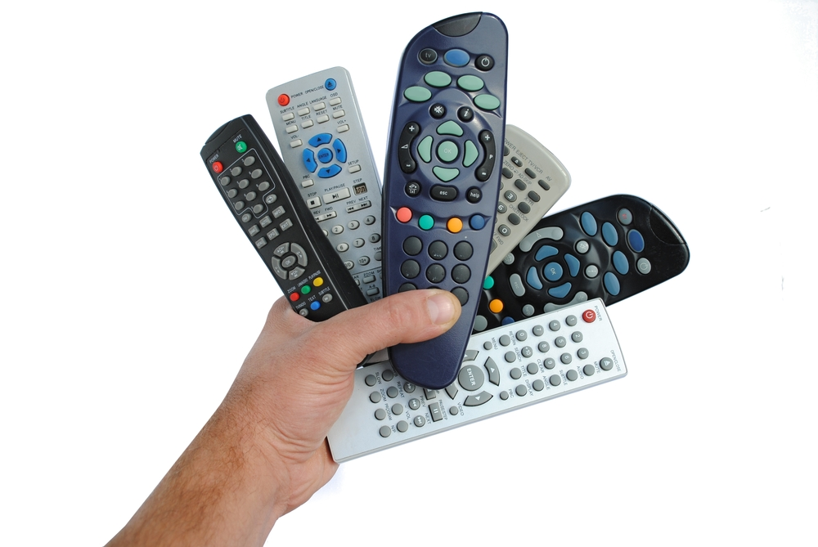
How do we sense people and things?

Slide 4
Our Fiducial Problem:
As a Grocery Store Owner, I want to ...
Map the location of people
Track their paths through the store
Identify them with their purchase data
So that I can …
Develop Apps to help them … somehow

Slide 5
Cool Problem
Different areas of store have different products
People move at a slow pace
All technologies can be considered
Retailers have loads of purchase data
We have a lot of retail clients
Movement is constrained by store structure

Slide 6


Cost Matters
High-value target
Focus on:
Imaging cameras
Infra-red (IR) cameras
Infra-red, non-imaging detectors
Radio-based devices:
GPS
Wi-fi
Blue-tooth iBeacons
Low-value target

Slide 7
Optical Cameras
  Pros:
  Often exist already, quite cheap
  Lots of software, experience
  High position accuracy
  Can sometimes identify high-resolution things
  Cons:
  Obstruction
  Data analysis, not simple
  Confusion, maintaining identity hard

Slide 8
IR non-imaging
  Pros:
  Very cheap
  Simple data analysis
  Obscuration, sometimes desired
  Cons:
  Locational accuracy poor
  Obscuration, sometimes undesired

Slide 9
Radio: iBeacons, wi-fi, GPS
  Pros:
  Low obscuration
  Low-medium position accuracy
  Can maintain identity well
  Cons:
  Needs hardware on the moving objects, phones etc
  Data analysis, not trivial
  Low obscuration

Slide 10
Works best in combination
Use iBeacons for primary location
Infra-red non-imaging and/or optical camera to aid with accuracy and aisle determination

Slide 11
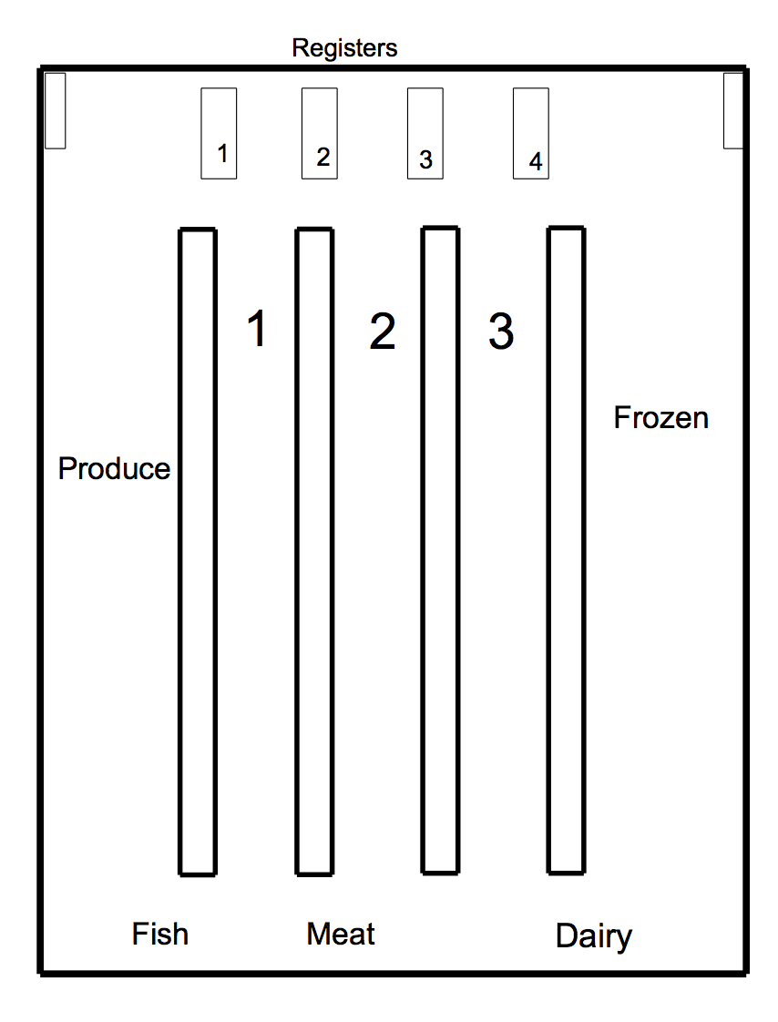
Grocery Store

Slide 12
Grocery Store
Add an iBeacon

Slide 13
Grocery Store
Add an iBeacon
Add Infra-red

Slide 14
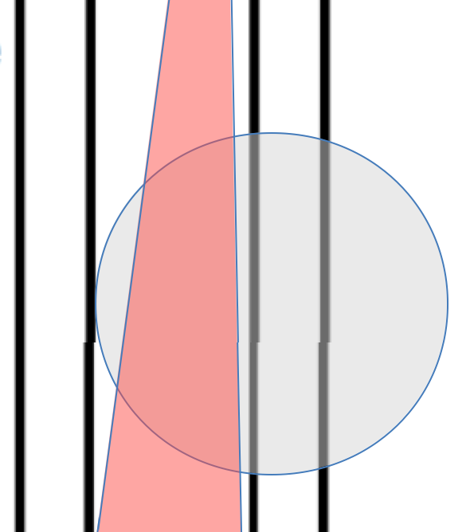
(Zoomed)
Overlap region
Customer in aisle 1
Not aisle 2

Slide 15
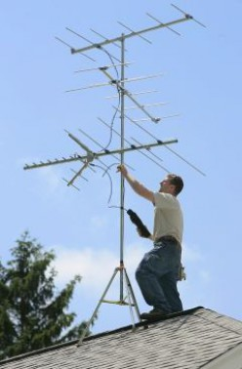
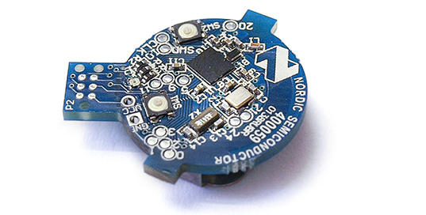

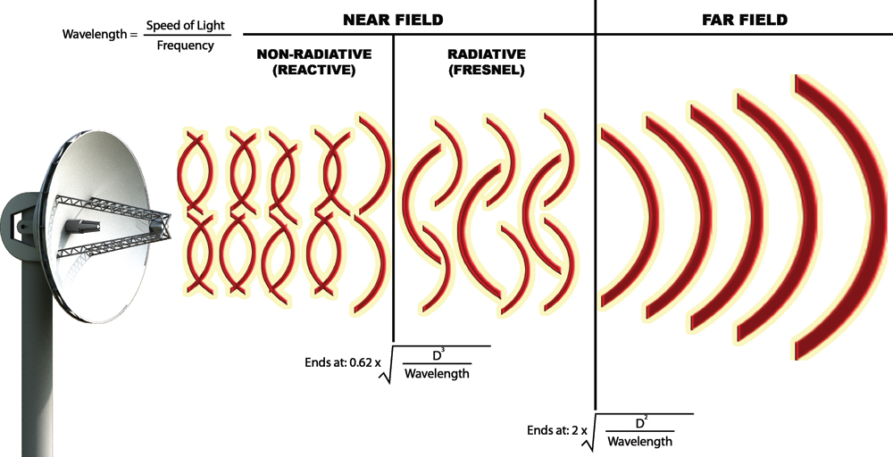


iBeacons
1-3 GHz
Not your fathers radio antennae!
2.4 GHz ISM band

Slide 16


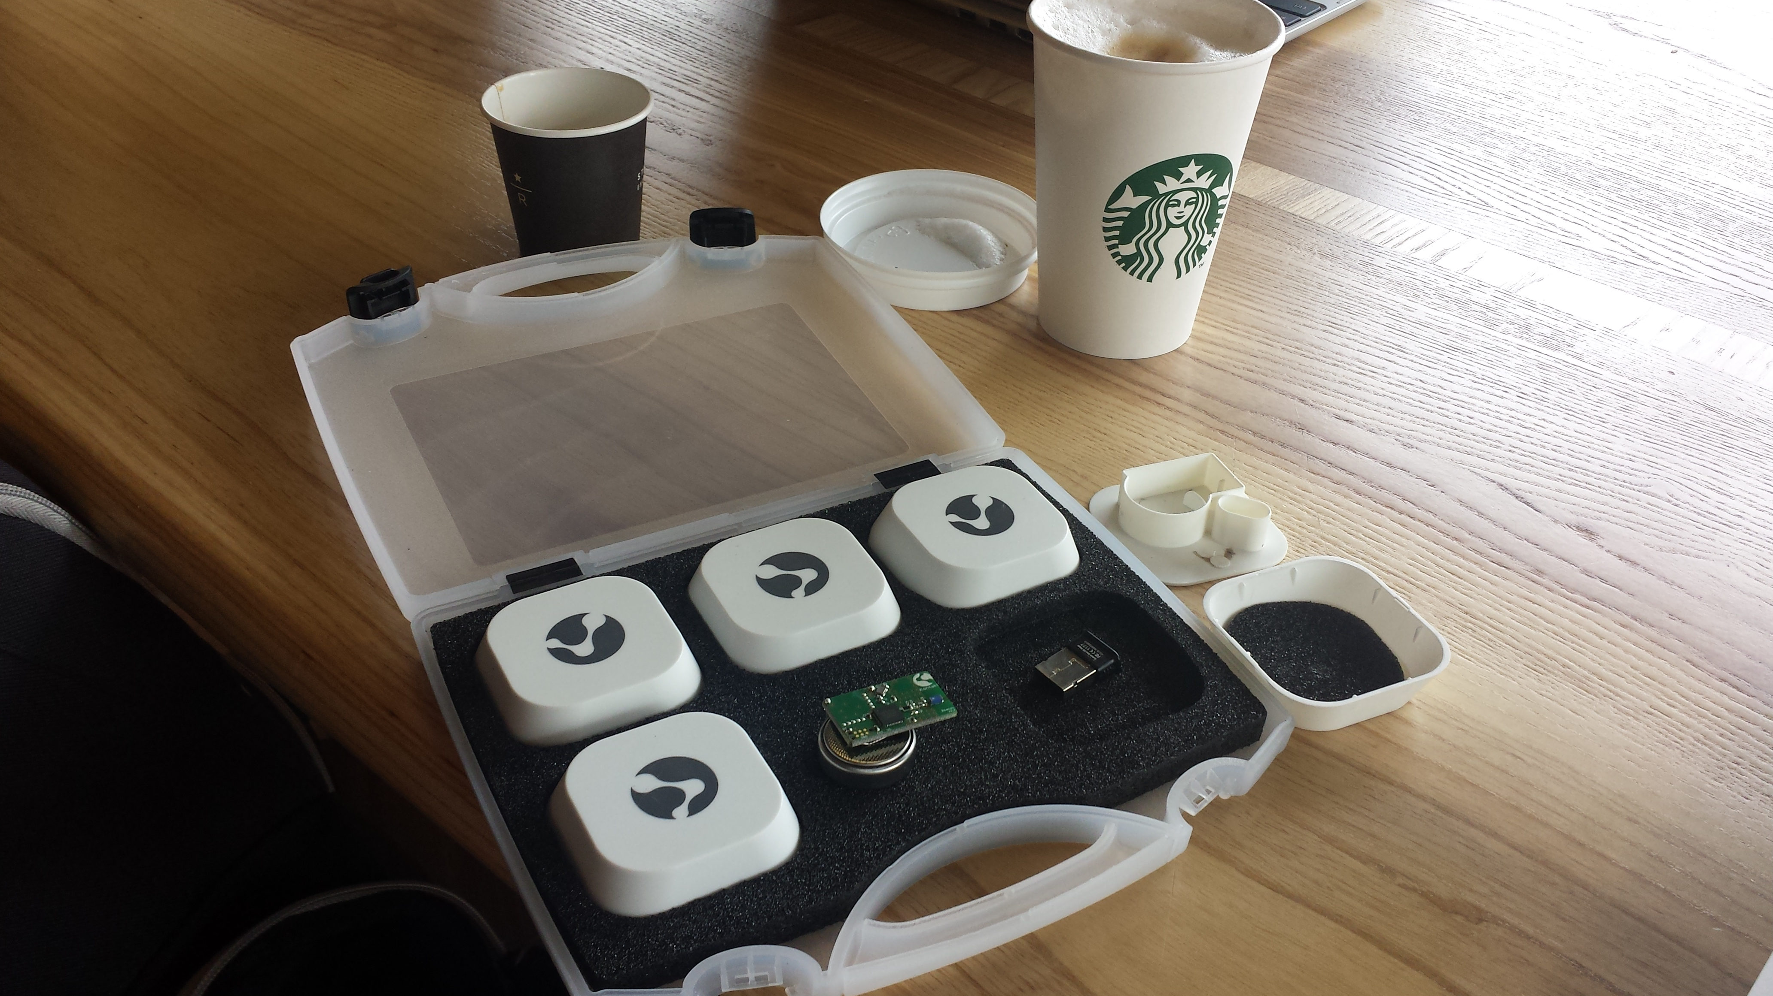
Make your own iBeacon detection experiment
1) Buy your iBeacons, about $25/each
2) Download or write some detection software
3) Make measurements and calibrations

Slide 17
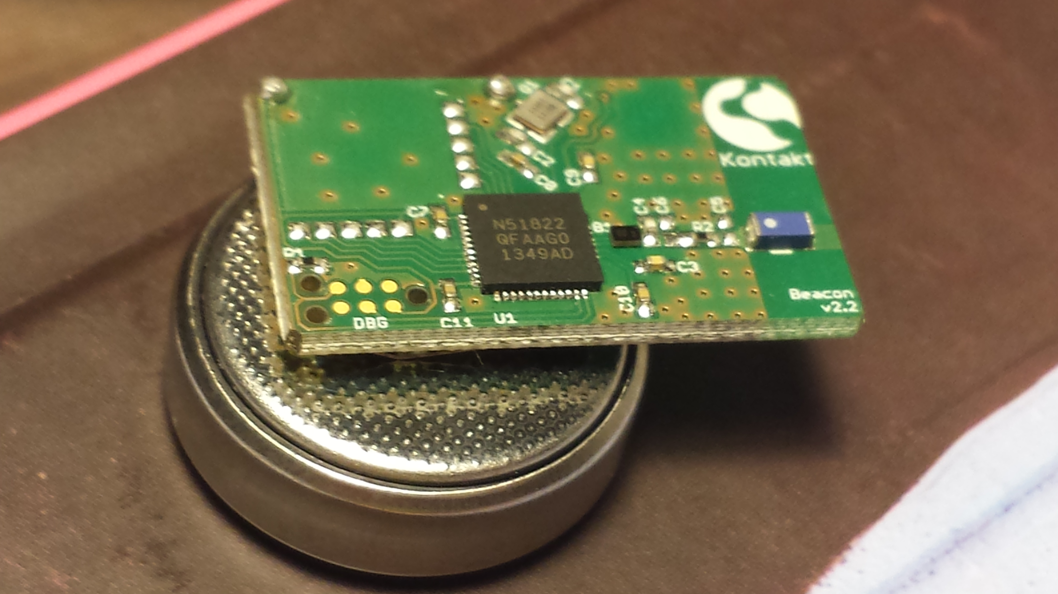
Mostly Battery (lasts 2 years)

Slide 18
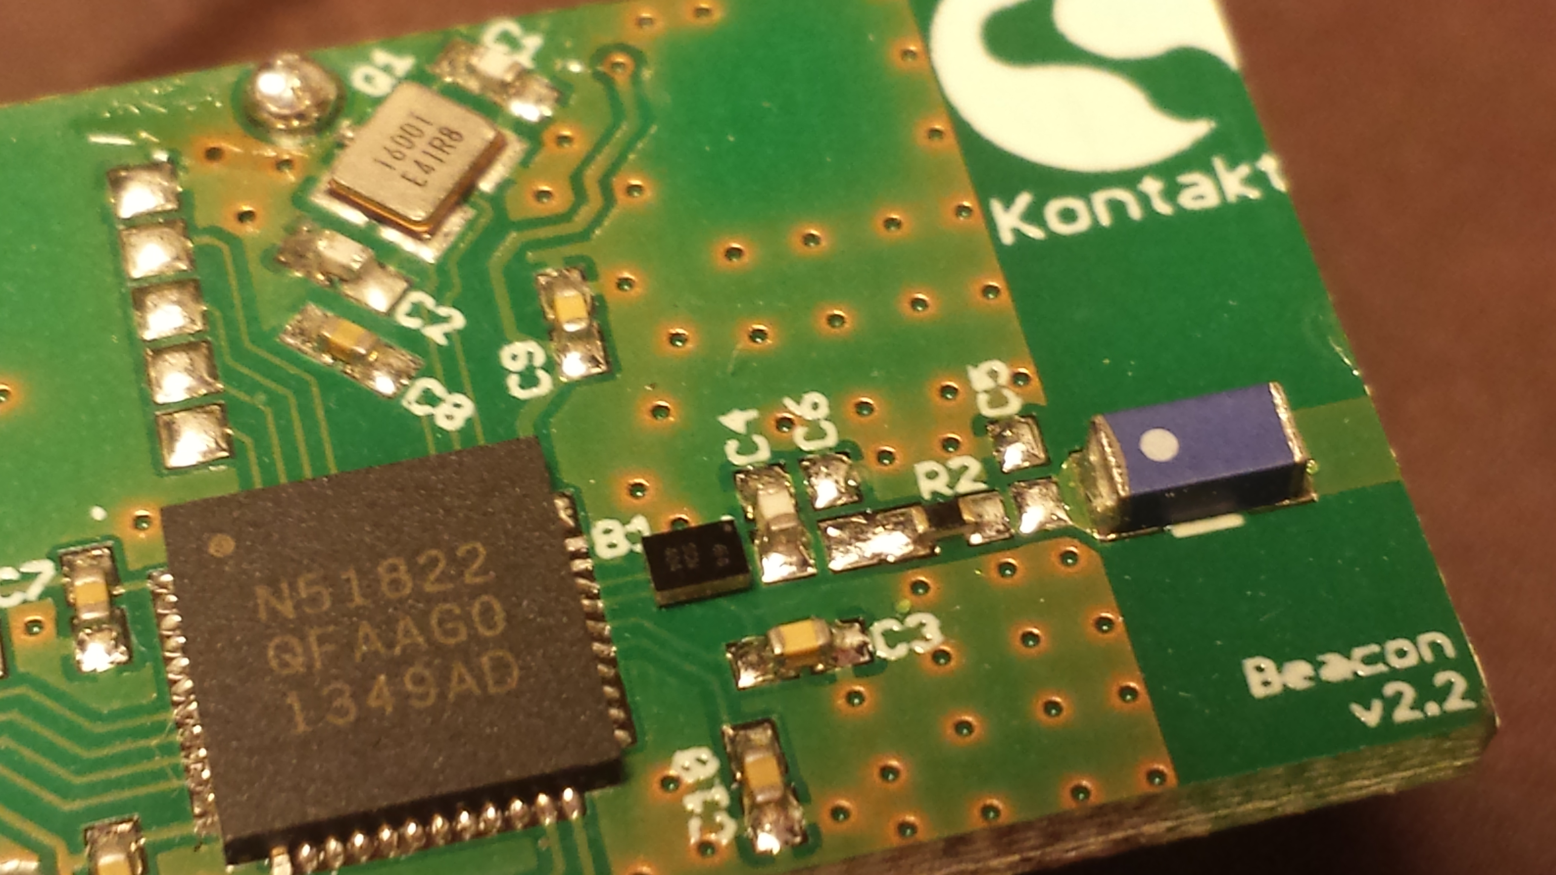
Blue-tooth Antennae

Slide 19
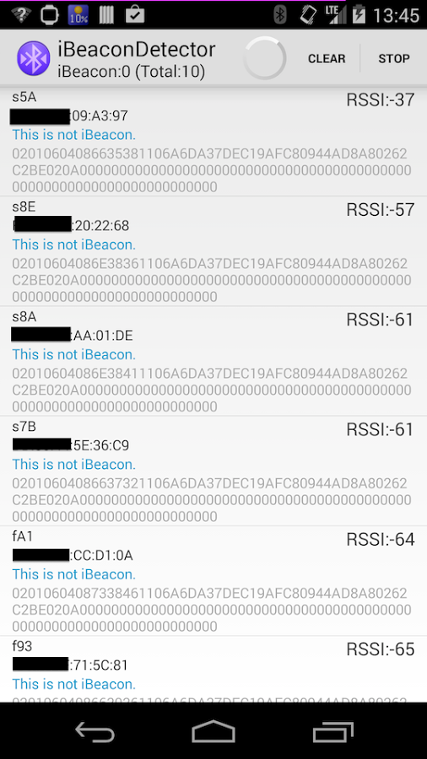
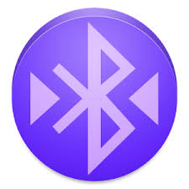
Existing software
iBeacons Detector – Open source Android App
Works quite well
Allows logging to csv files
Logging required a button push
For MAC OSX
BeaconScanner by Radius Networks
C# code, open source
https://github.com/mlwelles/BeaconScanner
My fork adds automated logging to csv file
https://github.com/dave31415/BeaconScanner

Slide 20
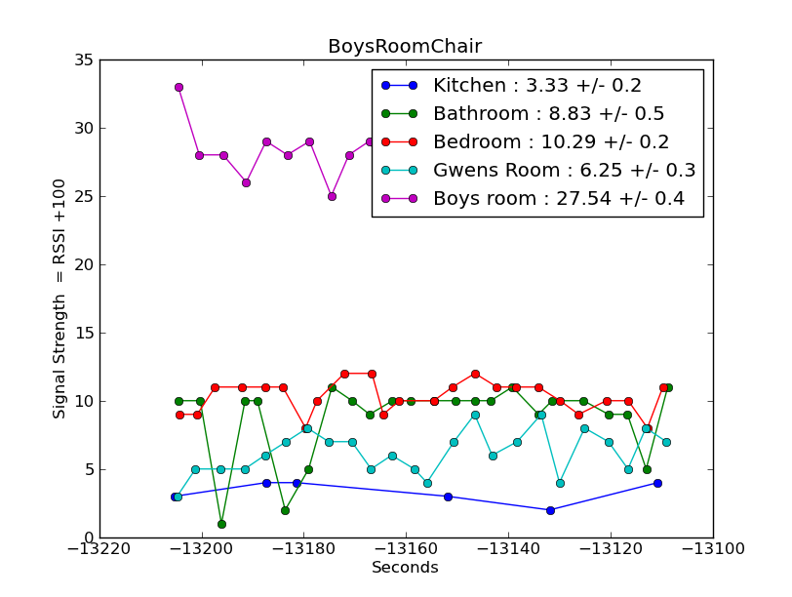
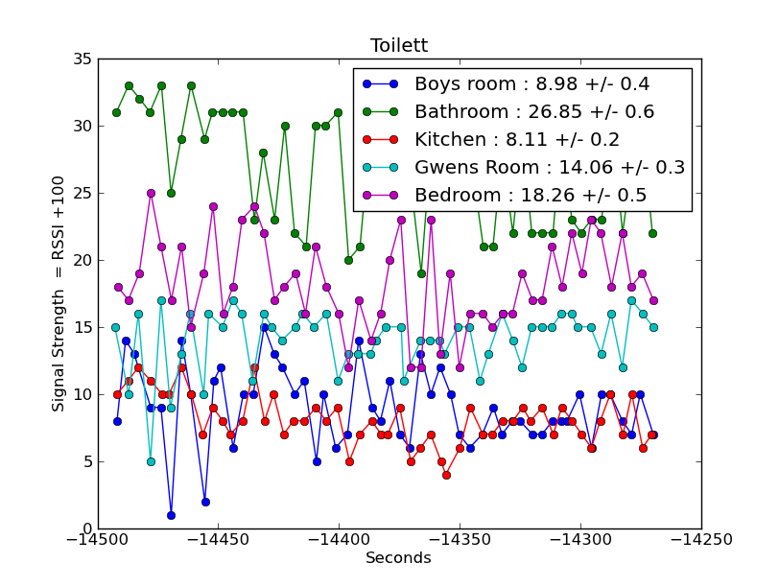
Mapping my house

Slide 21
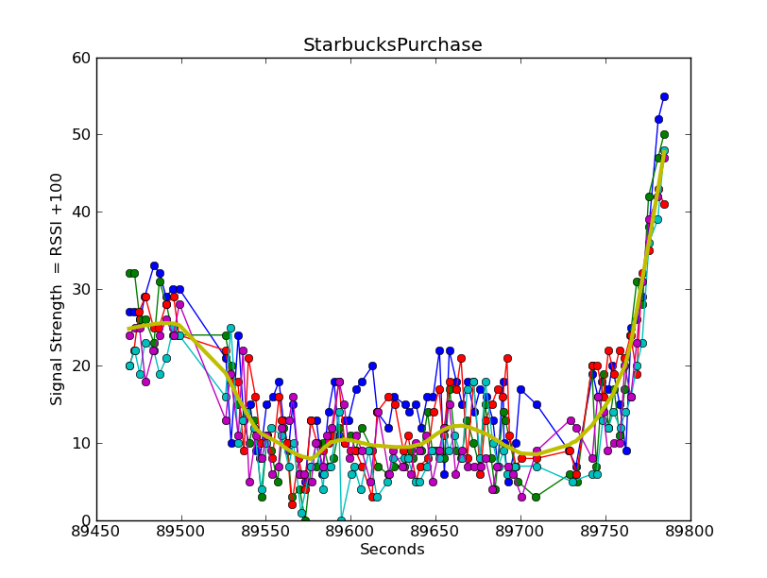

Slide 22
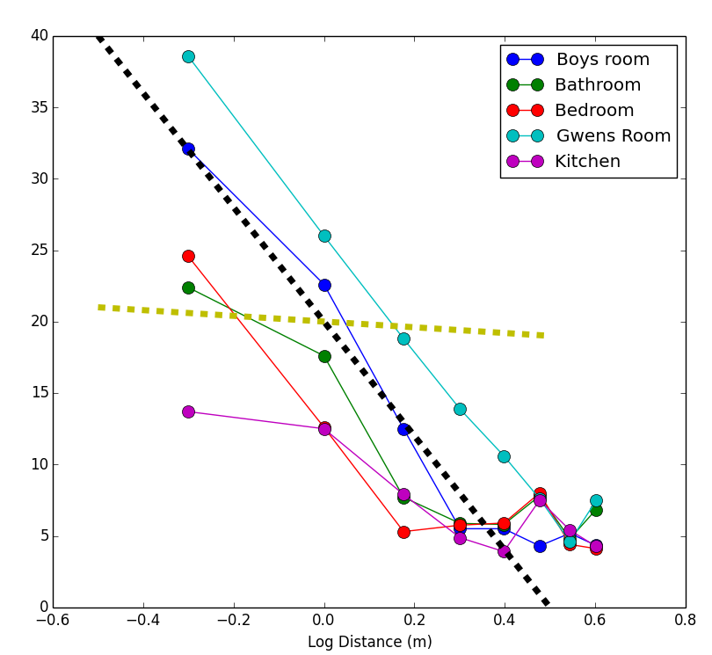
Power Law Decays
Falls off WAY faster
than inverse square law
(Gold Line)
Power ~ (1/d)^20
RSSI = -77 - 20 log(d)
Noise Floor RSSI ~ -100
At about 15 m
Reflections when indoors

Slide 23
Other stuff I am writing
https://github.com/dave31415/beacons
Making REST calls to iBeacons
Scripts to send BeaconScanner logs to server – REST
Web App for visualizing data
Python, Flask, D3
(DEMO)

Slide 24
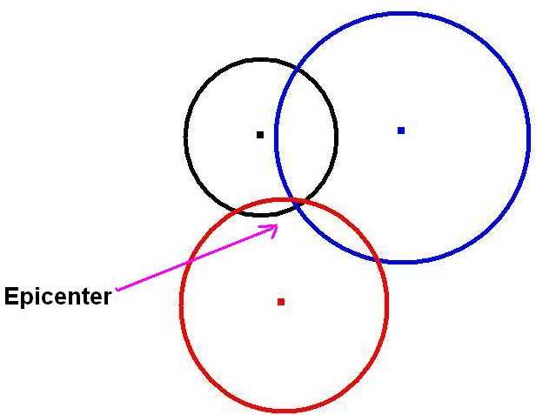
Triangulation

Slide 25

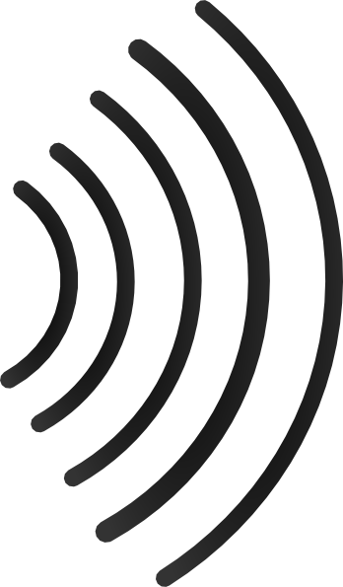
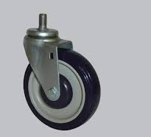
Measuring Grocery Cart Velocity
Light Sensors in the wheels?
Beamed radio?

Slide 26
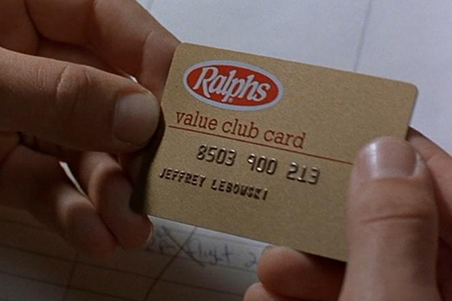
Connecting with purchase data

